Slide 1
IPEDS: Comparing Your Library Apples and Oranges by Brian Sherman – LSU Shreveport
Library Dean
Integrated Postsecondary Education Data System

Slide 2
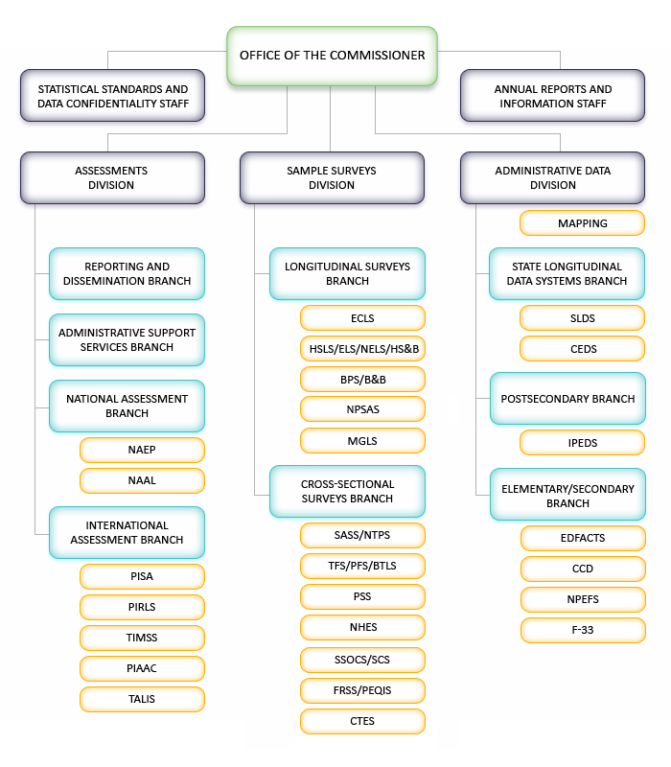
The Who and the Why?
The National Center for Education Statistics (NCES) is the primary federal entity for collecting and analyzing data related to education in the U.S. and other nations. NCES is located within the U.S. Department of Education and the Institute of Education Sciences.

Slide 3
Collection Data
Where do I get such wonderful numbers?

Slide 4

Best Practices
Be Consistent
Utilize what you already report
Think Ahead
Titles!
Titles!
TITLES!

Slide 5
The Counting House
Best Sources for Collection Information
PUBLICATION FINDER
(OR NOT)
------------
Books
eBooks
Journals
eJournals
Public A-Z List
------------
eJournals
Databases
Holdings Management
------------
Journals
eJournals
Databases
Workflows-
Use a COUNT titles Report
------------
Books
eBooks
Journals
eJournals
Databases

Slide 6
Usage Statistics and Circulation
What did we say about Titles?
Where do we get them?
Not everything is created equally
Think Ahead

Slide 7
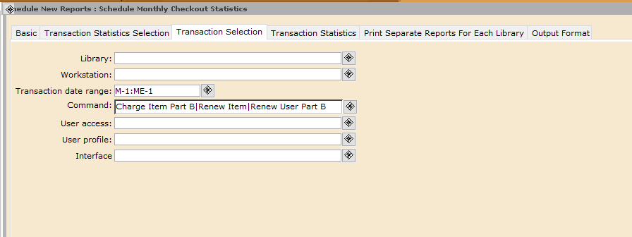
Using Workflows for Tracking Checkouts
Transaction Statistics under Administration tab in Workflows (Use Charge Item B)

Slide 8

Digital / Electronic Circulation

Slide 9
Those Apples and Oranges:
Collecting your online usage statistics
Publishers that host their own content
---------------
Do you have ebooks housed on different vendor platforms?
Ex. Elsevier; T&F
Publishers that use a third-party platform to host content
---------------
Do you purchase from publishers that house on or another hosting platform?
Ex. JSTOR, Project Muse
Aggregators that license
---------------
Do you purchase from vendors that license content from others?
Ex. EBSCO ebooks and ProQuest eBook Central
Who you gonna call?
---------------
Are there vendors that do not provide online statistical Information?

Slide 10
Counter 4 and 5
Counter 4
Counter 5
Number of Successful Title Requests by Month and Title (BR1)
Number of Successful Section Requests by Month and Title (BR2)
Total Searches, Result Clicks, and Record Views by Month and Platform (PR1)
Common metric types: downloads, session views, transaction logs, etc.).
Book Requests
  Total Item Requests and Unique Title Requests (TR_B1)
    Suggestion: Use UTR – Compare to print book
  Common metric types: Investigations and Requests
  An “Investigation” is intended to measure users’ expression of interest in an item or title; “Requests” are about accessing the actual content item.

Slide 11
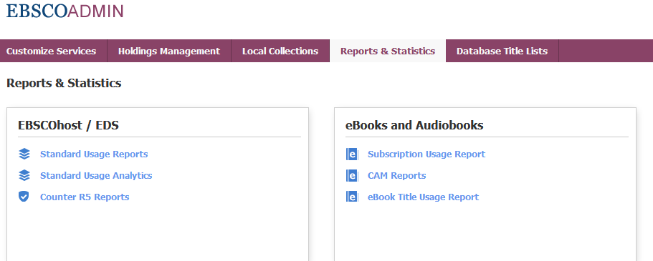
Where do I get these reports?
Counter 5 reports offer two useful reports:
Book Requests and Book Usage by Access Types eBook Title Usage Report

Slide 12
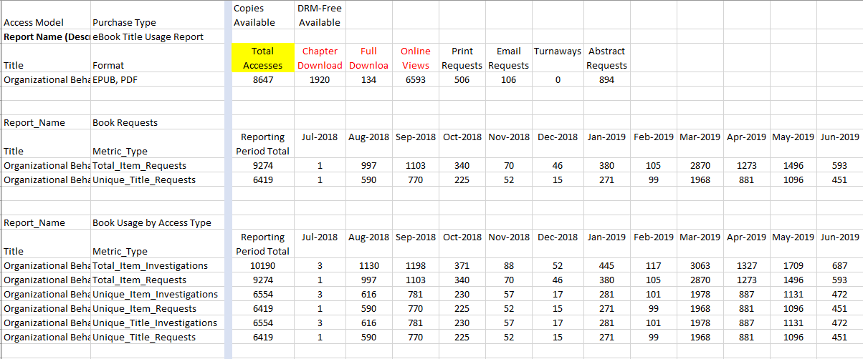
Comparison of eBook Usage Reports for an Example Title

Slide 13
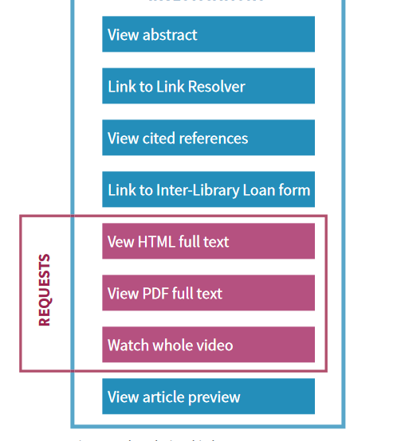
Making Sense Of It All

Slide 14
Expenses

Slide 15
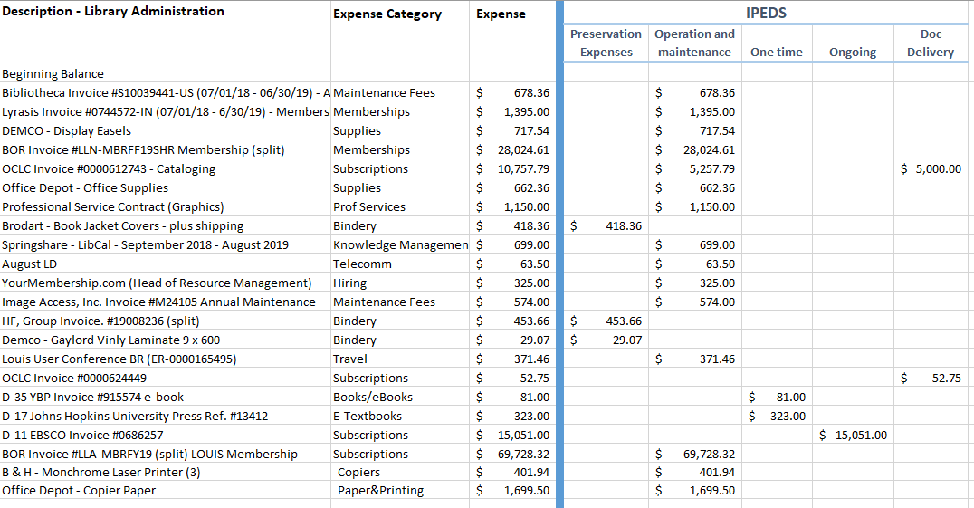
Tips and Tricks:
Track in Excel

Slide 16
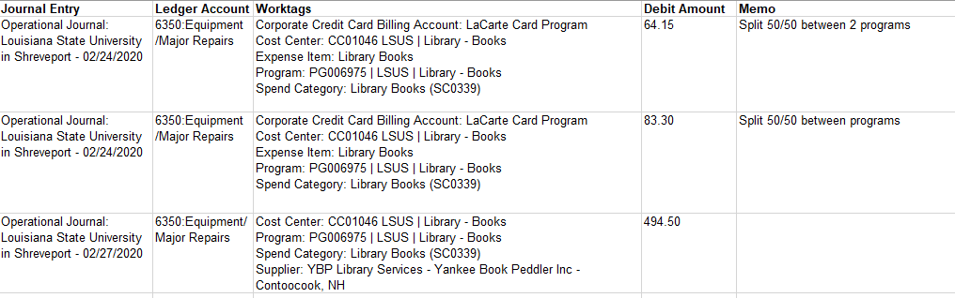
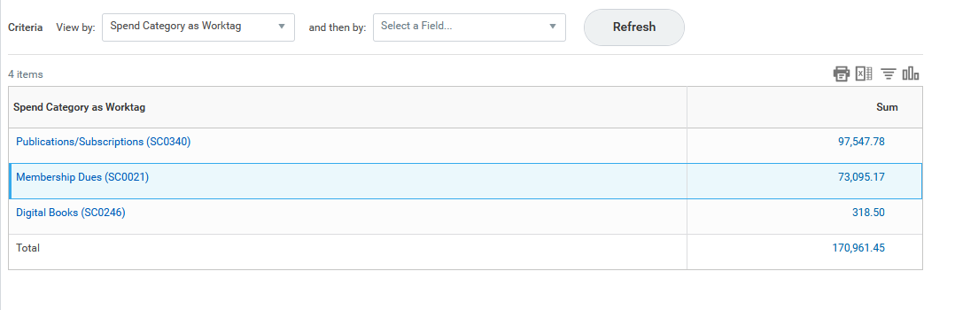
Internal Accounting Systems
Example: Workday

Slide 17
Changes for the 2021 IPEDS
(2019-2020 fiscal year)
Itemizing staff by FTE count
Inclusion of Digital / Electronic Serials Usage in the Circulation Report

Slide 18
Helpful Links
Friendly Counter 5 Guide for Librarians
IPEDS AL Survey

