Slide 1
Consortia Manager Overview
Presenter: Lisa Stigall

Slide 2
What Is It?
Consortia Manager is a tool built specifically for consortia to help them with their daily management tasks. It is a system for streamlining and optimizing the workflow process of consortium's electronic subscriptions.

Slide 3
What It Is Not
Consortia Manager is not an Electronic Resource Management (ERM) for individual libraries.
It was designed for consortia to manage vendor and member invoicing.

Slide 4
Member Benefits
Provides access to subscriptions and opt-in invoice details.
Gives access to download license agreements and VPATS.
Allows members to update IP addresses (vendors are automatically updated).
Provides a reporting tool to generate reports of subscriptions, publishers, etc.
Includes a catalog of all available LOUIS opt-in agreements with vendor contact information.
Automatically logs each interaction by user or LOUIS. Logs are available to the user.
Includes log of latest emails sent to site from Consortia Manager.

Slide 5
LOUIS Staff Benefits
Consolidates the management of the core and opt-in agreements with the vendors.
Provides an automated workflow of the renewal process.
Allows LOUIS to contact groups of users based on agreements, sites.
Limits the need to distribute information manually and individually to members.
Allows LOUIS staff to coordinate renewals with one platform instead of individual email accounts and spreadsheets.

Slide 6
User Accounts
One account is designated as the primary account. This is the fallback recipient of system emails
3 Types of Users – View Only, User, Administrator
View Only - Can view anything. Can put items in the shopping basket. Cannot order/renew/cancel subscriptions.
User - Can view anything. Can order/renew/cancel subscriptions.
Administrator - Same as user but can also create/de-activate other users and control their user-rights.
Each user can decide which types of emails they want to receive.
Invoices emails - All invoices if sent via email and other related invoice matters
IP changes emails - Emails related to IP changes
Licenses emails - Emails related to licensing for instance notifications about changed licenses
Ordering emails – new offers, renewals, reminders for renewals and order confirmations
Receive updates emails - Updates on new features, tips and tricks, and general information re. the system
Subscriptions emails - General information from the consortia for instance emails re. subscriptions that are about to start, general inquiries etc.
Usage stats emails – LOUIS does not have this module

Slide 7
Renewal Process
LOUIS uses the software throughout the renewal process. Each step must be completed before we can move to the next step in the renewal.
These are the basic steps we follow.
Request pricing – sends an email to the vendor
Pricing Calculation – we enter the vendor pricing
Publish Agreement – sends the renewal email to you
Place Order – sends the order to the vendor
Publisher Invoice – we upload the invoice
Member Invoice – we create an invoice and send the email with the invoice attached to the user accounts that have elected to receive invoices. Invoice and email is generated from within Consortia Manager.

Slide 8
Renewal Process – Email to Members
Once LOUIS receives the quote and enters the individual pricing, an email is generated.
Only members of the opt-in receive a notification email.
You will receive this email if your user account is set to receive Ordering emails.
Everyone at your organization that receives this email will be listed at the bottom.
Dear {{MEMBER_CONTACT}}, There are subscriptions that require your attention: {{CM_URL}}
The steps to renew or reject a subscription are found in the following LOUIS Task Portal article.
https://task.louislibraries.org/hc/en-us/articles/360015266033-Consortia-Manager-Processing-Renewals
By agreeing to the published price, you are also agreeing to the terms and conditions of the license agreement and the VPAT report. These can be viewed and downloaded from Consortia Manager. They can be located by choosing Subscriptions and then your Product. The product information page has a License Information section and links to the documents.
Best regards, {{CONTACT_NAME}} {{CONTACT_TITLE}} {{CONTACT_EMAIL}} {{CONTACT_ORGANISATION}} {{CONTACT_ADDRESS}} {{CONTACT_TELEPHONE}}

Slide 9
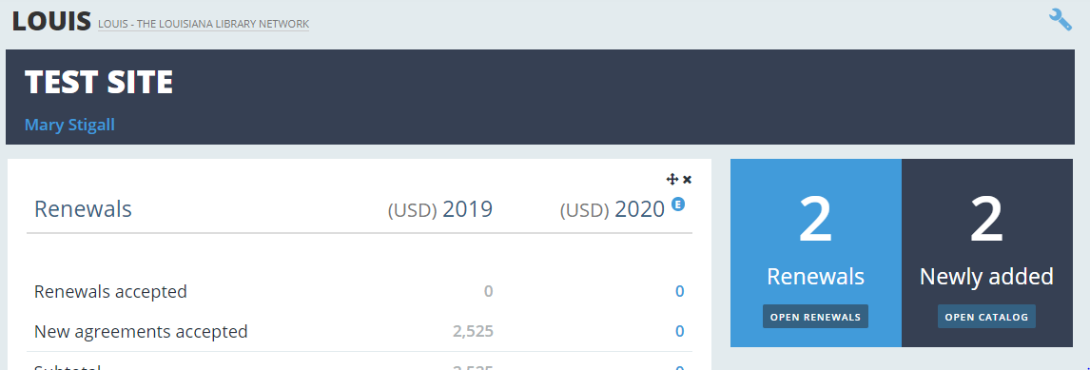
Renewal Process – the Steps
Step 1. Click the Open Renewals button

Slide 10
Renewal continued
Step 2. Click the Order options button. Alternatively, you can choose the ADD ALL TO BASKET button.

Slide 11
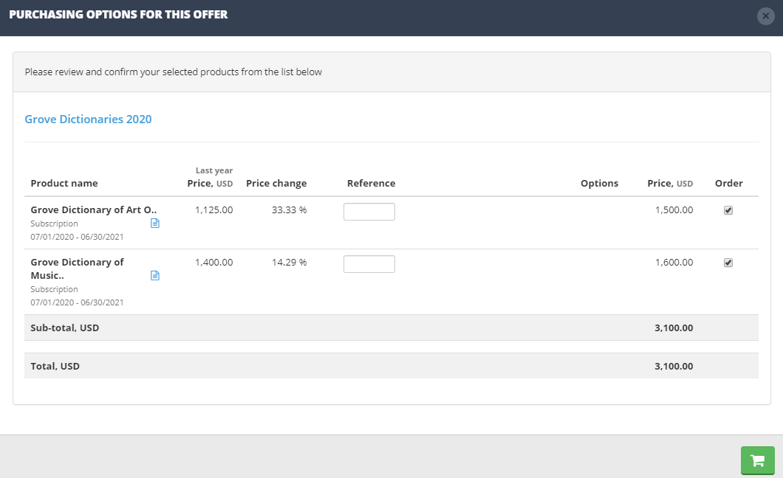
Renewal continued
Step 3. Mark (by checking the box) what you want to renew and click the shopping cart icon.

Slide 12
Renewal continued
Step 4. View the Shopping Basket by clicking on either the icon or the words View basket.

Slide 13
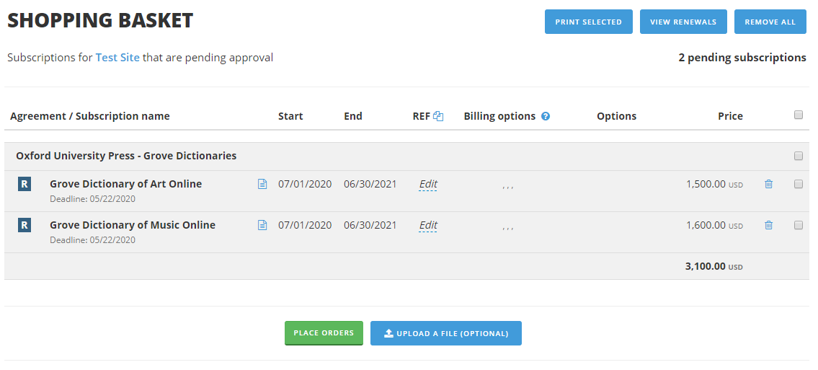
Renewal continued
Step 5. Place the order by selecting the products (by checking the boxes) and clicking the PLACE ORDERS button.

Slide 14
Licenses and VPAT’s
Licenses or Terms of Agreement and VPATs are available.
Click on Subscriptions and then on an Agreement.
Scroll down to the License Information section

Slide 15
Subscriptions
The link to Subscriptions is in the menu at the top of the page. This is your library’s current subscriptions with LOUIS.

Slide 16
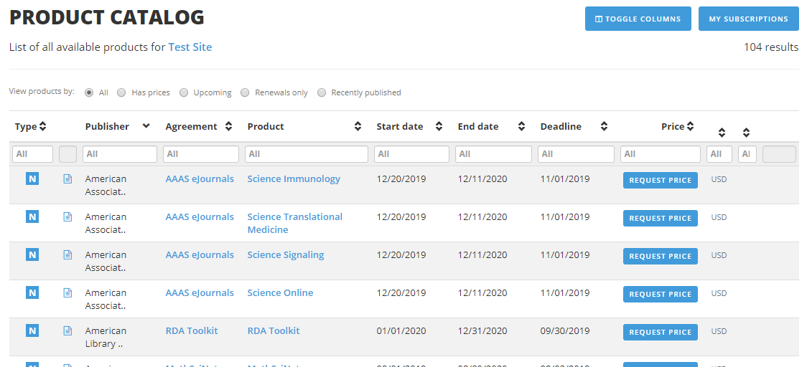
Catalog
The link to the LOUIS catalog of products is in the menu at the top of the page. Click the Request Price button if you would like a quote for a product.

Slide 17
Reports
Reports are located under the More menu button.
Multiple report types are available, and reports can be saved.
Can choose which fields to include.
Reporting filters are included.
Can include output Agreement Type so that you know what is Core and what is an Opt-in
There are three reports that were created for you.
Agreements 2019, 2020 with Type
Product and Vendor List
Products by Category

Slide 18
Task Portal Articles
Consortia Manager - Processing Renewals
Consortia Manager Member Overview
Consortia Manager - Dashboard Overview
Consortia Manager - Adding User Accounts
Consortia Manager - Verifying Your Institution's Contacts

Slide 19
Questions?
Questions?
Complete training feedback at:
https://louis.libwizard.com/f/Consortia_Manager_Feedback

