Slide 1
Basics and Current Practices
HOOTSUITE
Brandy Burbante
Ellender Memorial Library
Notes:
Short background
-previous outreach coordinator
- mention social media team

Slide 2
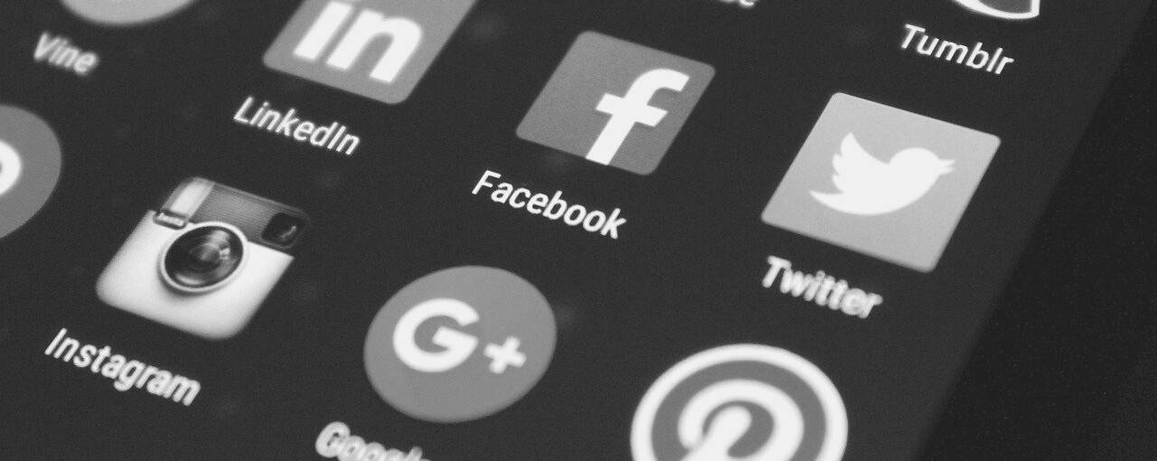
what is
HOOTSUITE
a social media management tool to schedule & monitor posts for multiple accounts from one dashboard; can be accessed via web browser or mobile app
Notes:
previous librarians managing our accounts were already using Hootsuite
learned more about it while researching social media management
the dashboard is easy to use
I'll show our dashboard later in the presentation

Slide 3
free
paid
SCHEDULE UP TO 30 POSTS
SCHEDULE UNLIMITED POSTS
UP TO 3 PROFILES
10+ PROFILES
Facebook
Instagram
Twitter
Analytics
Reports
Assignments
Notes:
other features not listed but these are ones I find most helpful
there is a link shortener available, also some things we don't like about links is that the preview for the link isn't always visible when scheduling
there are other ways we've found to track statistics

Slide 4
SCHEDULING
INSTAGRAM
great for planning ahead & checking team posts
can only post one image per post
EDITING
TWITTER
can edit scheduled posts in each platform individually
& edit image sizing, effects, text, etc...
can't schedule multiple tweets for a thread
Notes:
some things we enjoy and some that have annoyed us a bit
mentioned workarounds for the negatives

Slide 5
strengthens
COLLABORATION
Social Media Team can ...
see scheduled posts & previous posts
save time by sharing publishing responsibilities & post similar content across all platforms
evaluate content quickly by looking over streams
track dates & times of posts
Notes:
being able to see the scheduled posts helps with
-not posting the same content around the same time, ex. I want to post a graphic to promote our hours. I check Hootsuite and see we already have a scheduled post about our hours
-can help with catching typos or other edits that need to be made to the content

Slide 6
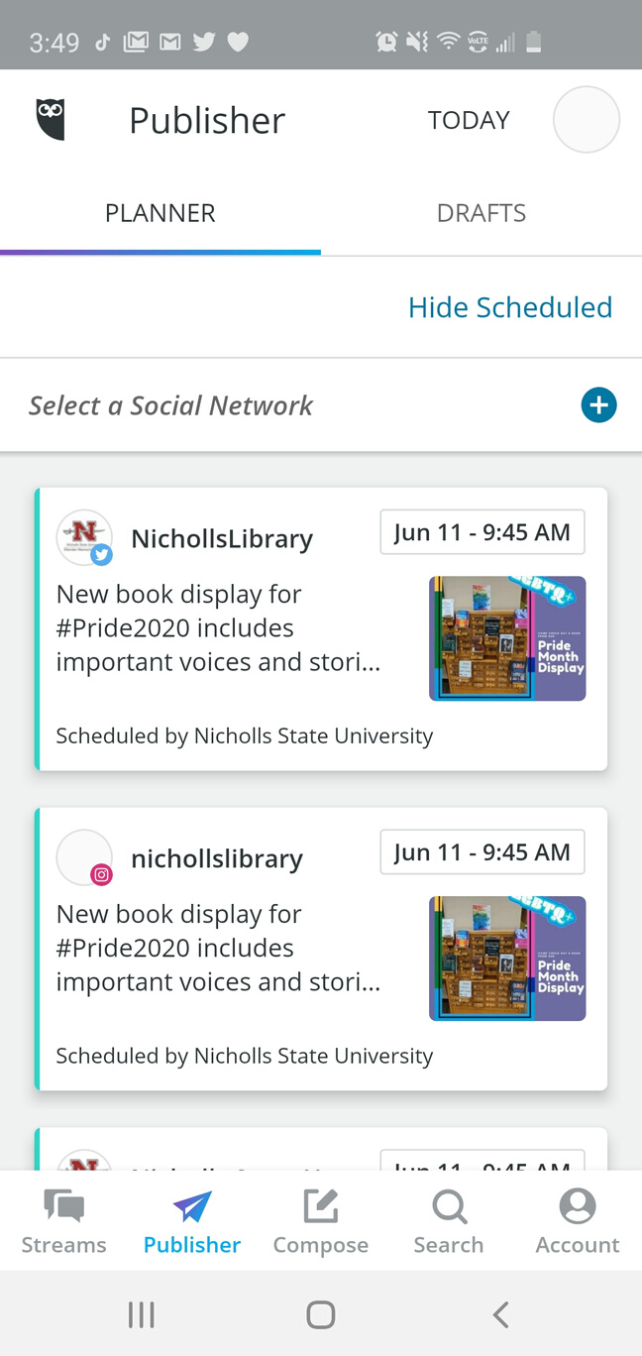
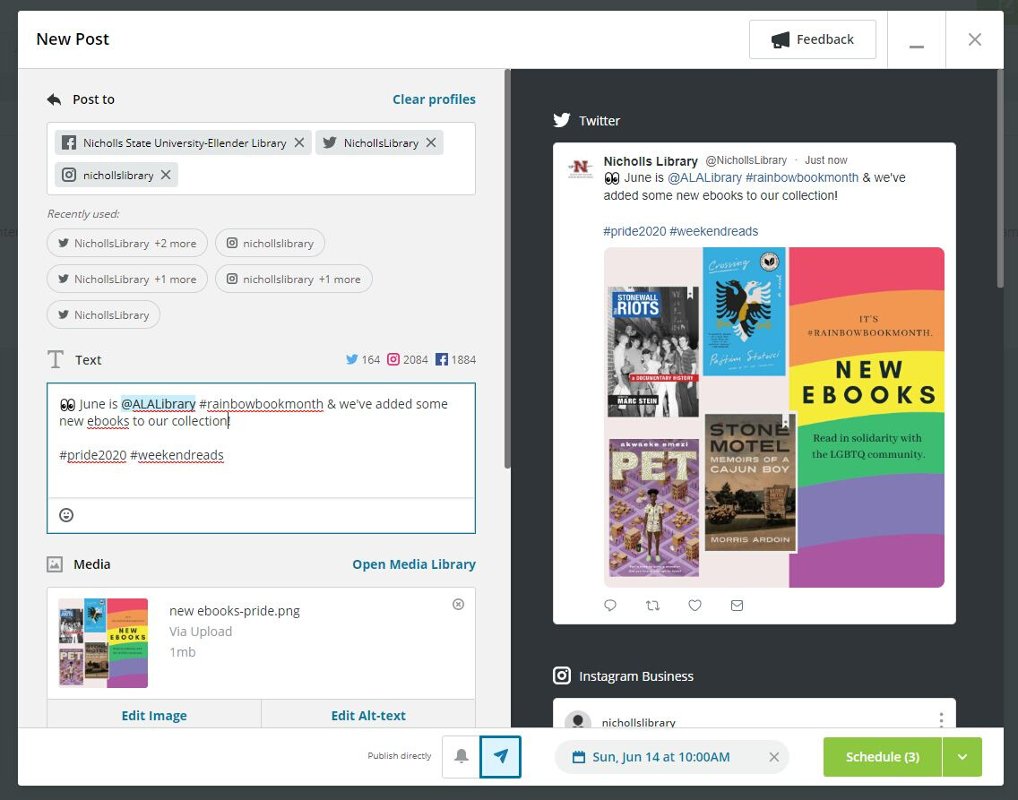
CREATING A NEW POST
Notes:
screenshots of the web browser and mobile app
I'll demo how to schedule a post
I don't use the app as often since I find it easier to create the content on a desktop---I also have more typos when I post things from my phone

Slide 7
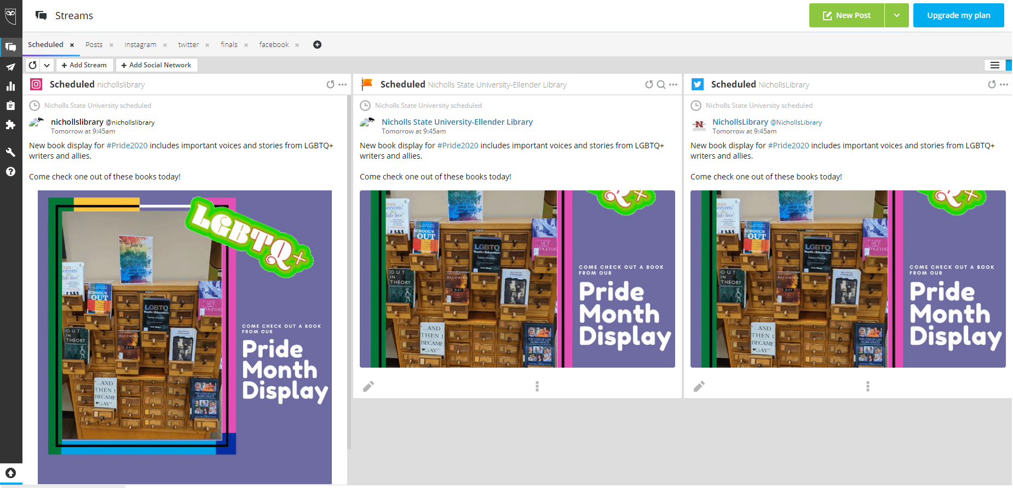
MOST USED
Streams
Publisher
Notes:
screenshot of the dashboard
I mostly use the streams section
also use the publisher section for a calendar view of the content
there are other features that I don't use often but are useful, such as tracking streams for mentions and hashtags
can also interact with the posts but I usually do that within the actual platfrom instead of on Hootsuite

Slide 8
HOOTSUITE
demo
@NichollsLibrary
LET'S GET SOCIAL
Brandy Burbante
Ellender Memorial Library
brandy.burbante@nicholls.edu
Notes:
Text for post during demo. Schedule for June 30 at 8am. after schedule, go to edit each one to take out platform name. Tag @Nichollsstate @NichollsEngage
#DYK June 30 is World Social Media Day? If you're looking for a new account to follow check out our Facebook, Instagram, Twitter, YouTube, and TikTok!
#socialmediaday

