Slide 1
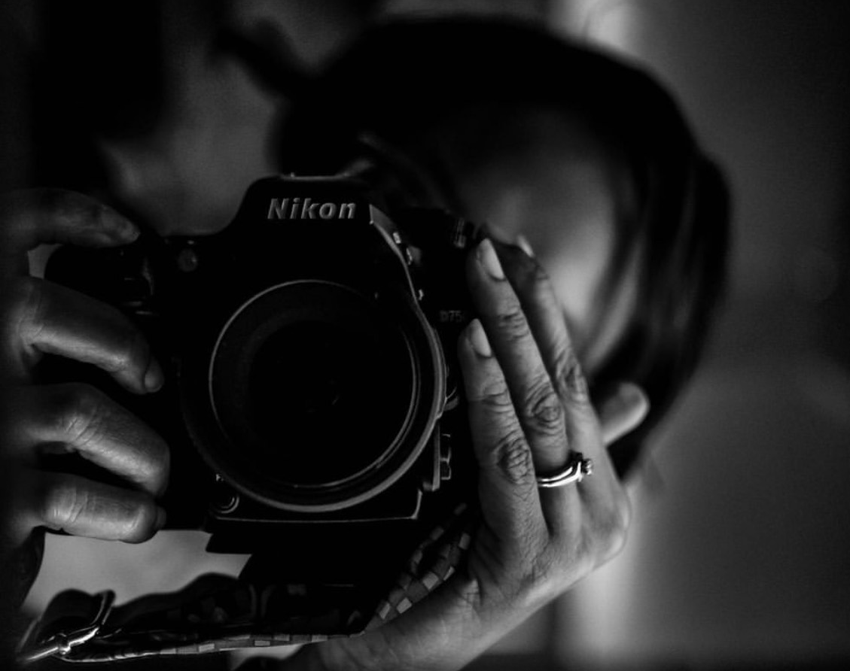
Photography: DSLR & Cell Phone
Dani Vaughn-Tucker
Director of Library Services
Social Media Coordinator
Central Louisiana Technical Community College

Slide 2
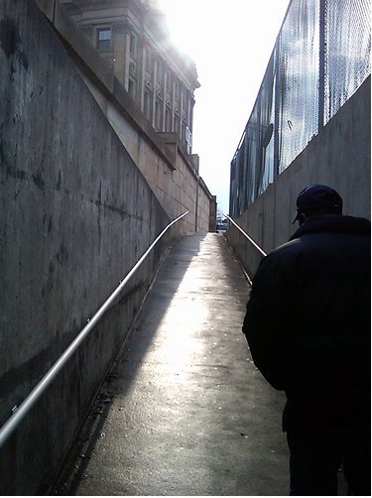
How'd this start?
My husband told me to
Photos were noticed by the Cape Girardeau, MO Visitor's Bureau
Church photographer
Became the Darton State College/Albany State University Library photographer
Library events
Staff photos
Chancellor Sawtelle had an idea
Take photos at college events
Social Media Coordinator

Slide 3
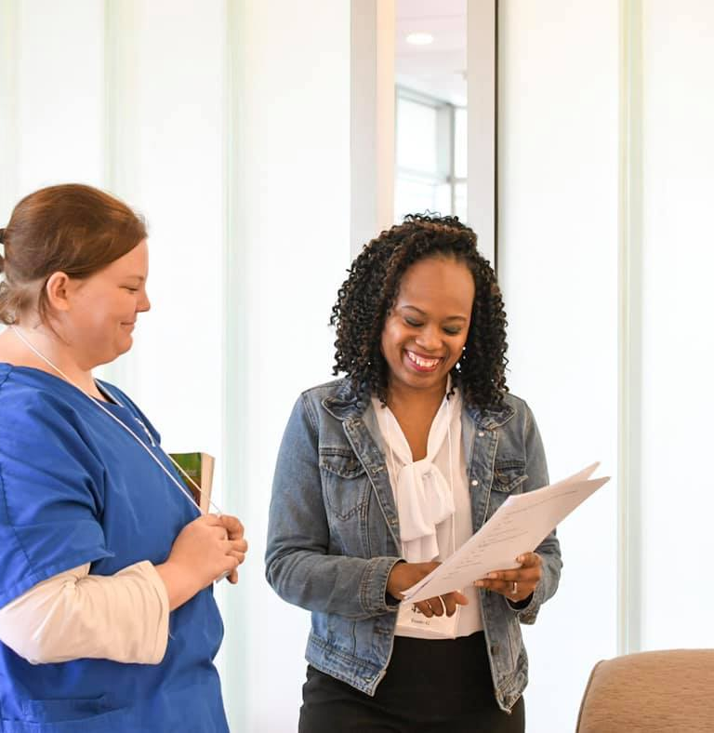
Why take pictures?
Documents an event – you can capture anything you feel is worth remembering
Connects you with others – it's an easy way to interact with people
Moves you out of your comfort zone – you can connect while remaining on the periphery
Part of your personal or institutional legacy - #throwbackthursday

Slide 4
What kind of gear do you need?

Slide 5
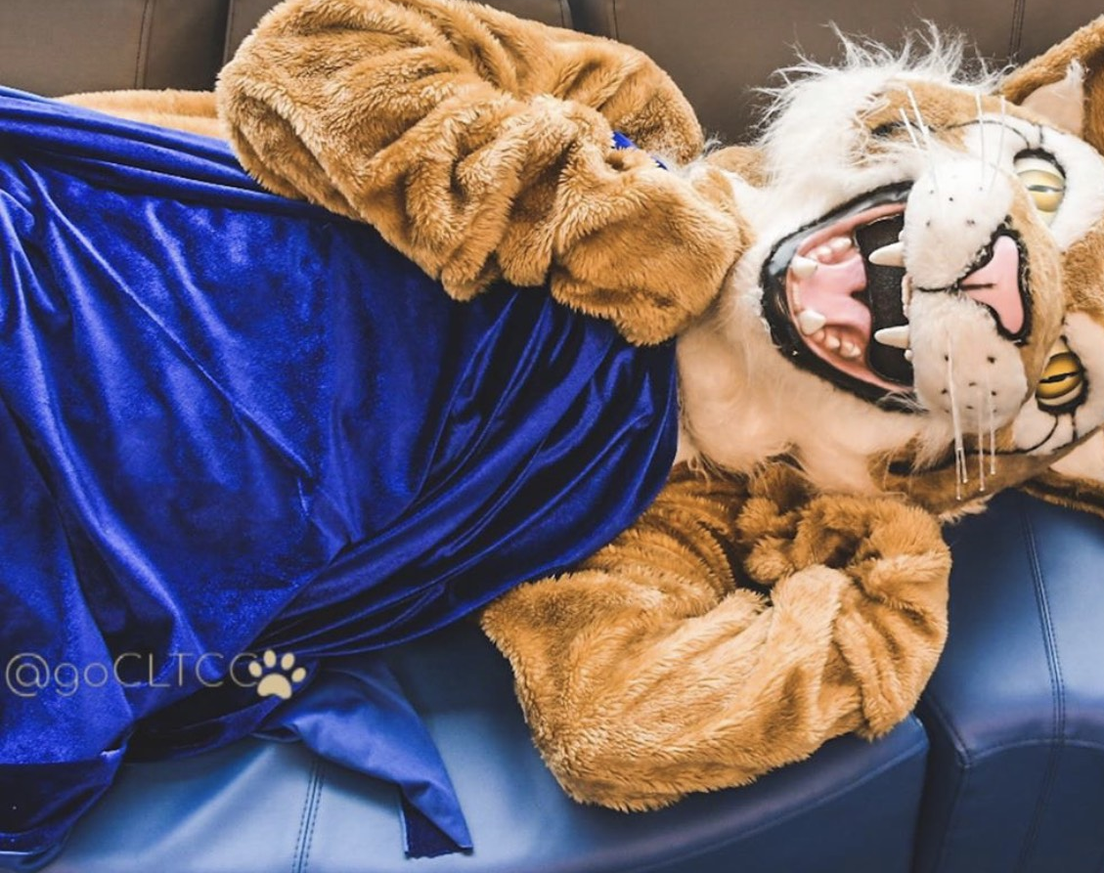
Tools
Uploading, Editing, & Sharing

Slide 6
If you're using a DSLR...
SnapBridge – Transfers pictures with a Bluetooth/Wi-Fi enabled Nikon camera. Android and iOS versions.
Canon Camera Connect – Transfers pictures with a Bluetooth/Wi-Fi enabled Canon camera. Android and iOS versions

Slide 7
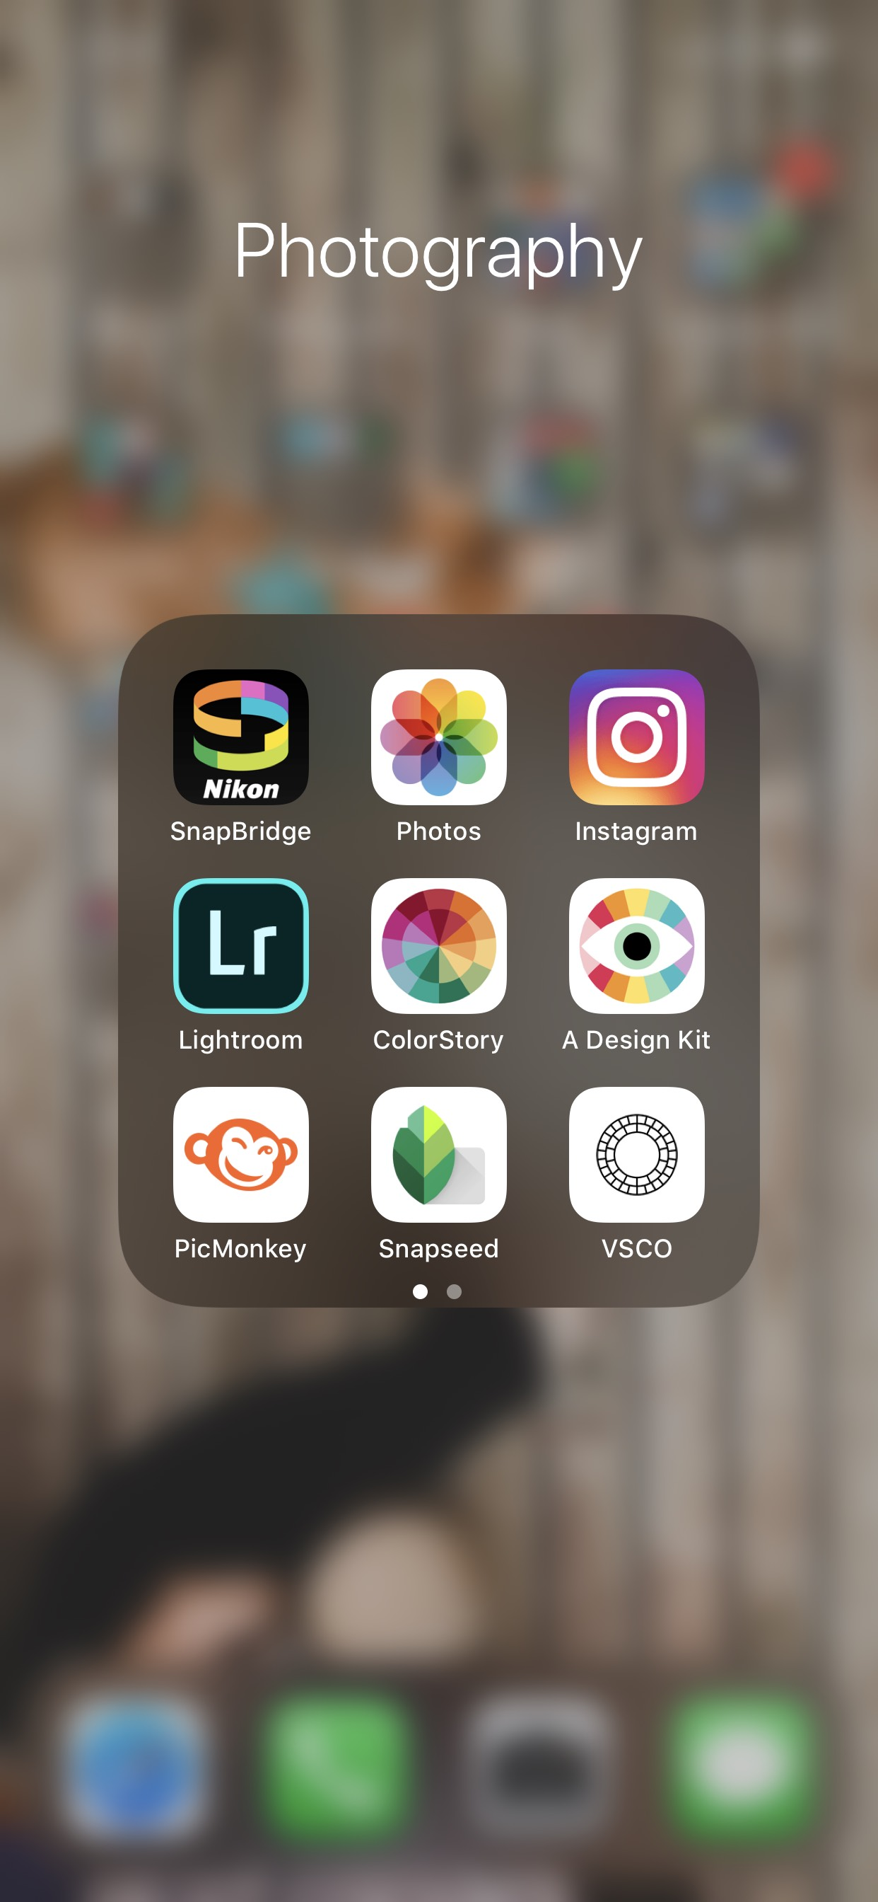
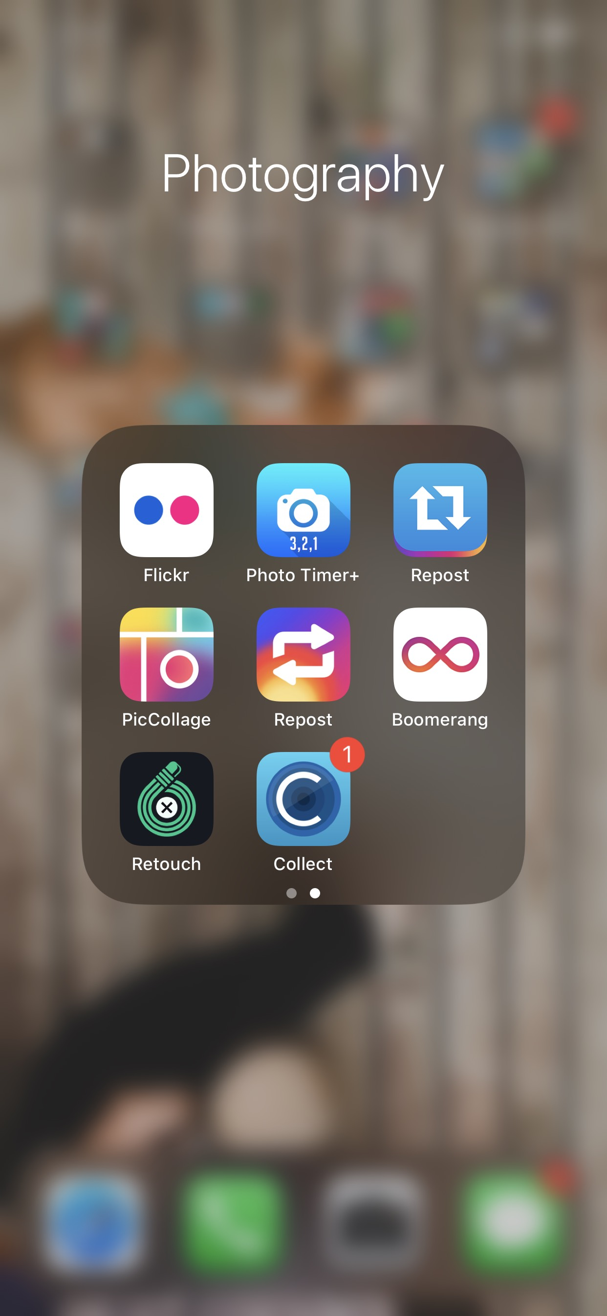
Editing tools
Desktop
Lightroom
$120/year
PicMonkey
Free
Basic - $72/year
Mobile
Lightroom
Free
PicMonkey
Free
Snapseed
Free
Photo Timer +
Free

Slide 8
Unedited Photo
Flat color
Kind of crooked
No Branding

Slide 9
Edited Photo
Image pops
Horizon is straightened
Logo/watermark added

Slide 10
Comparison

Slide 11
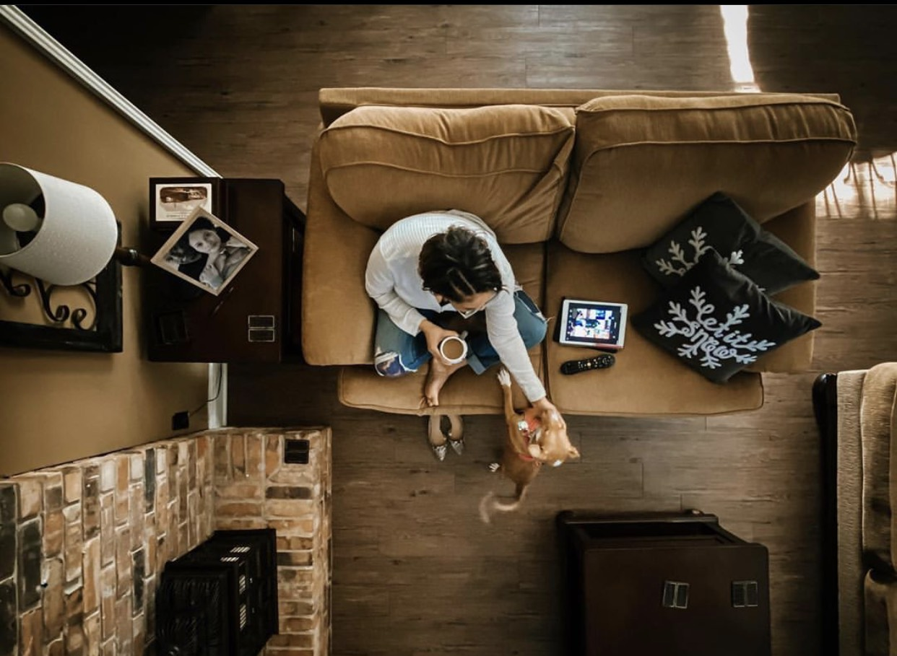
Cardboard and Painter's Tape

Slide 12
Sharing
Facebook – 940x788 pixels
Instagram – 1080x1080 pixels
Twitter – 1024x512 pixels

Slide 13
Tips
Make things interesting

Slide 14
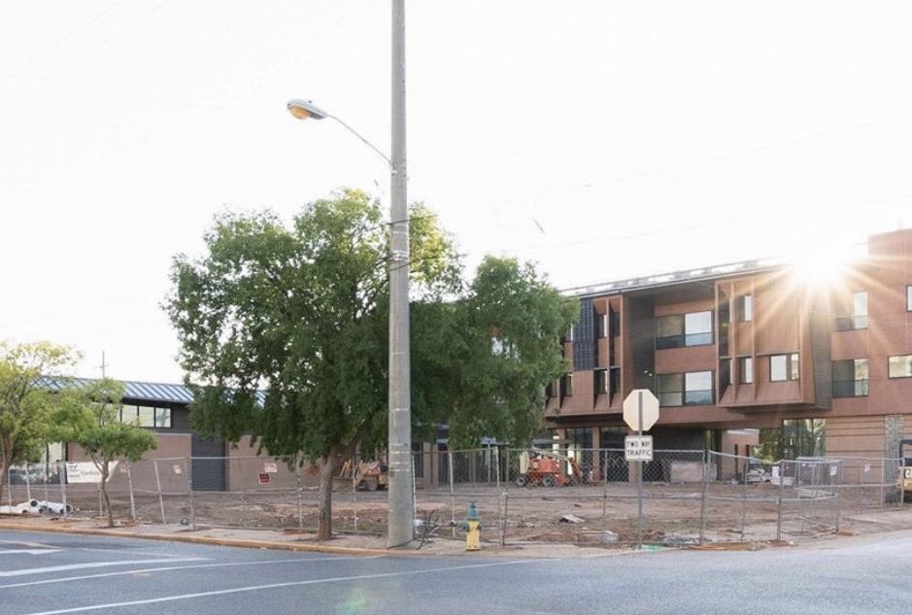
Find the light
*if you touch the box on your camera, you can adjust your exposure

Slide 15
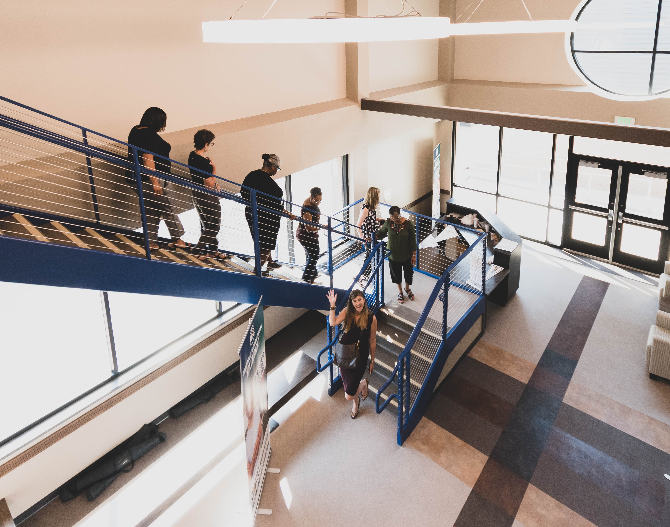
Preserve memories *perfection isn't necessary, just get the shot
Taken with cell phone, unedited

Slide 16
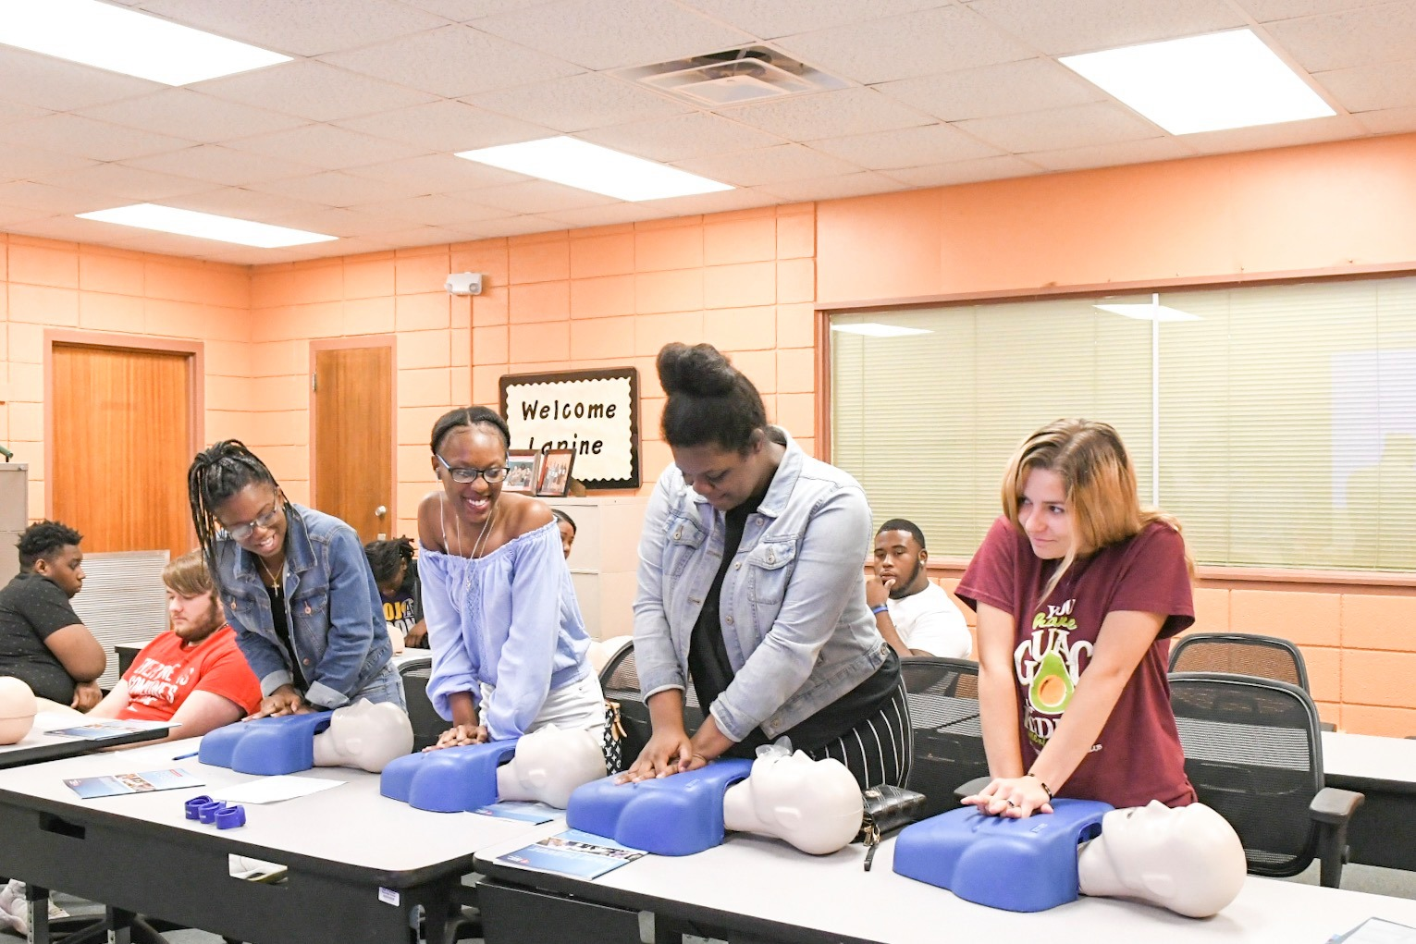
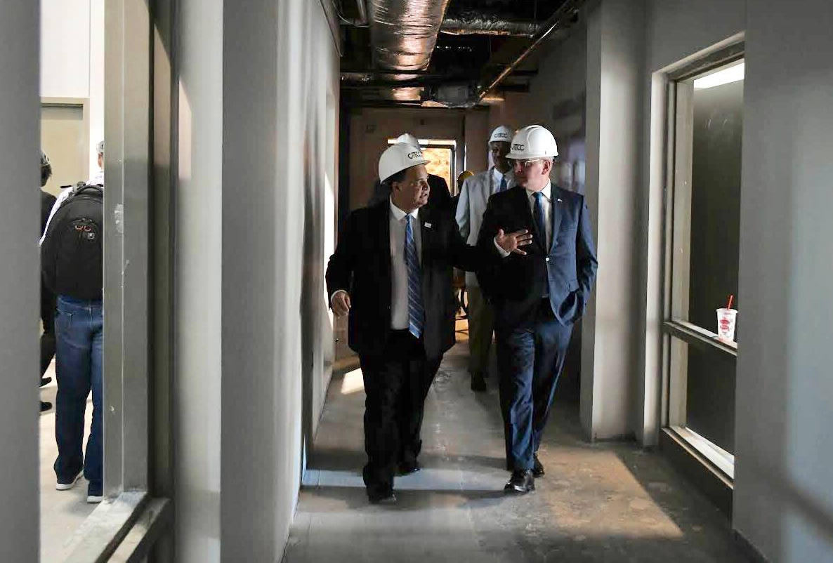
Show movement
*either through actual movement or expression
Taken with DSLR and edited on cell phone, using Lightroom app

Slide 17
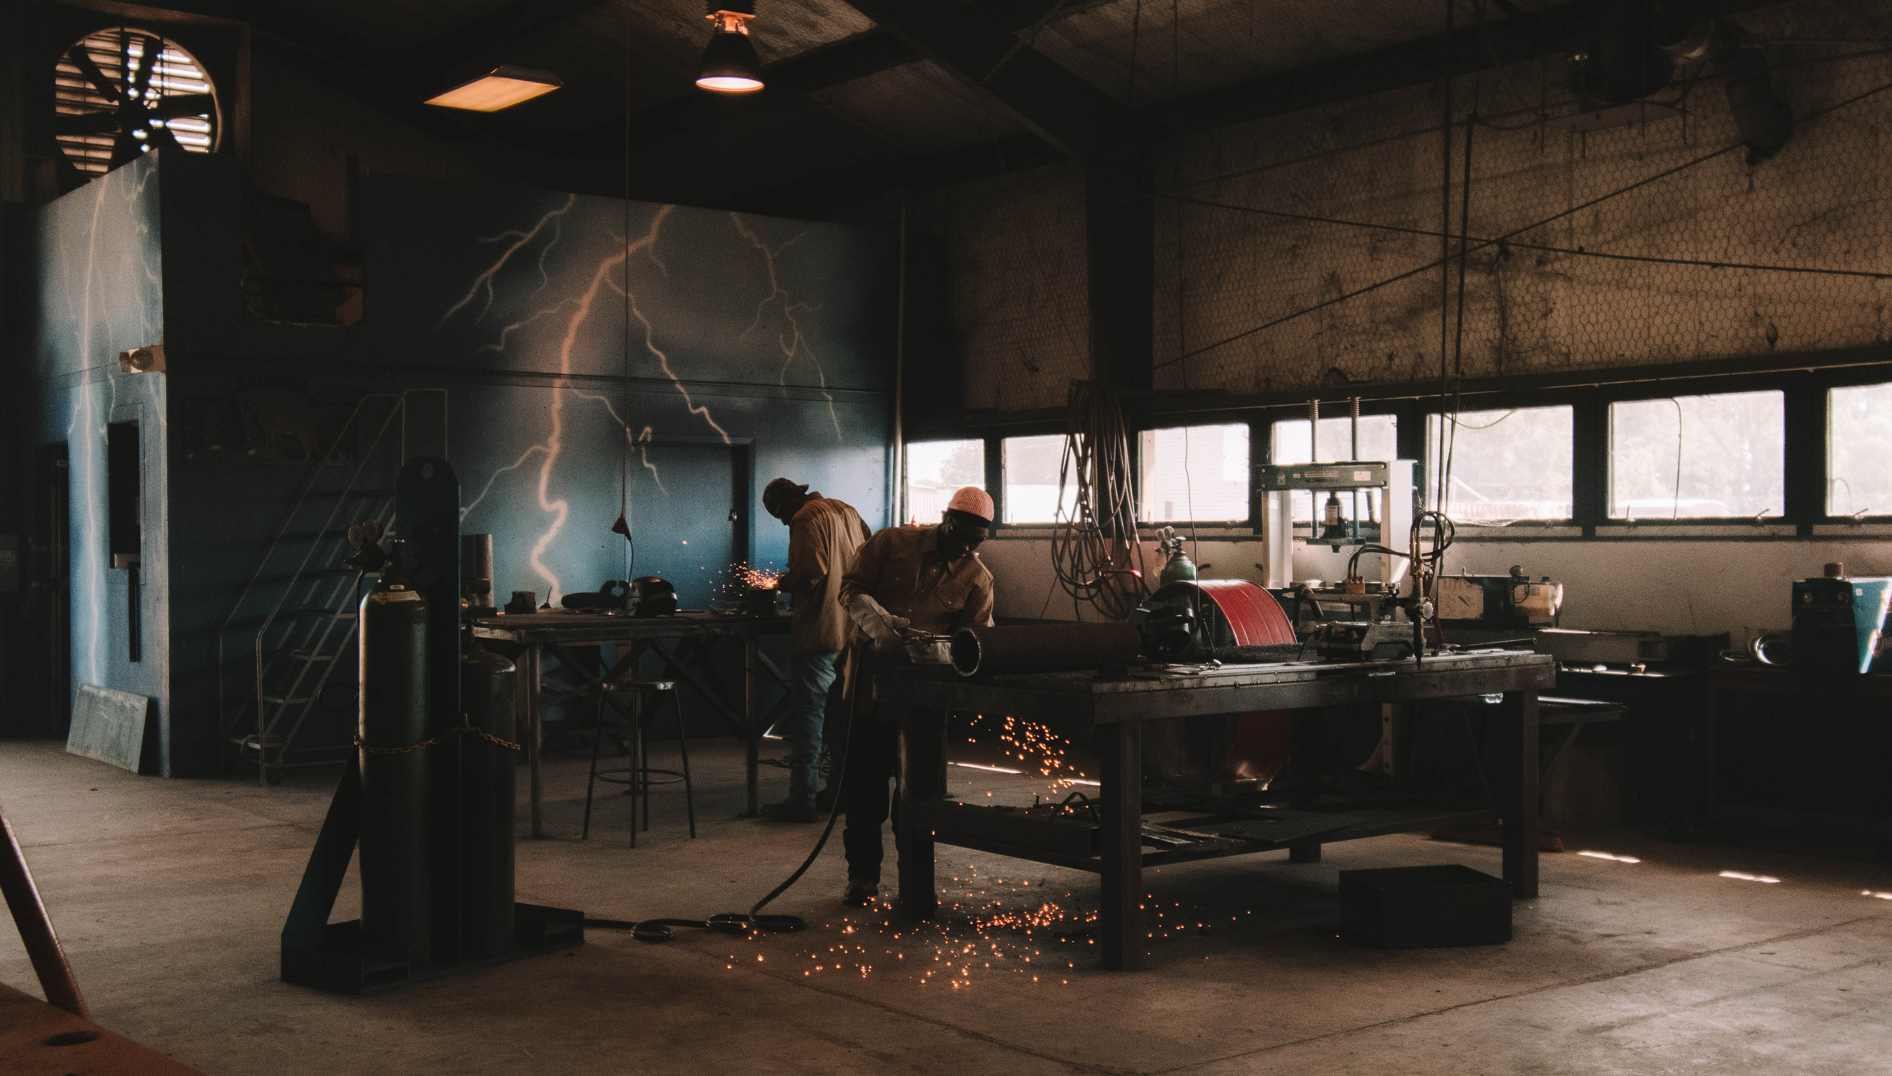
Frame the image *tell people where you want them to look
Taken with DSLR edited on desktop using Lightroom

Slide 18
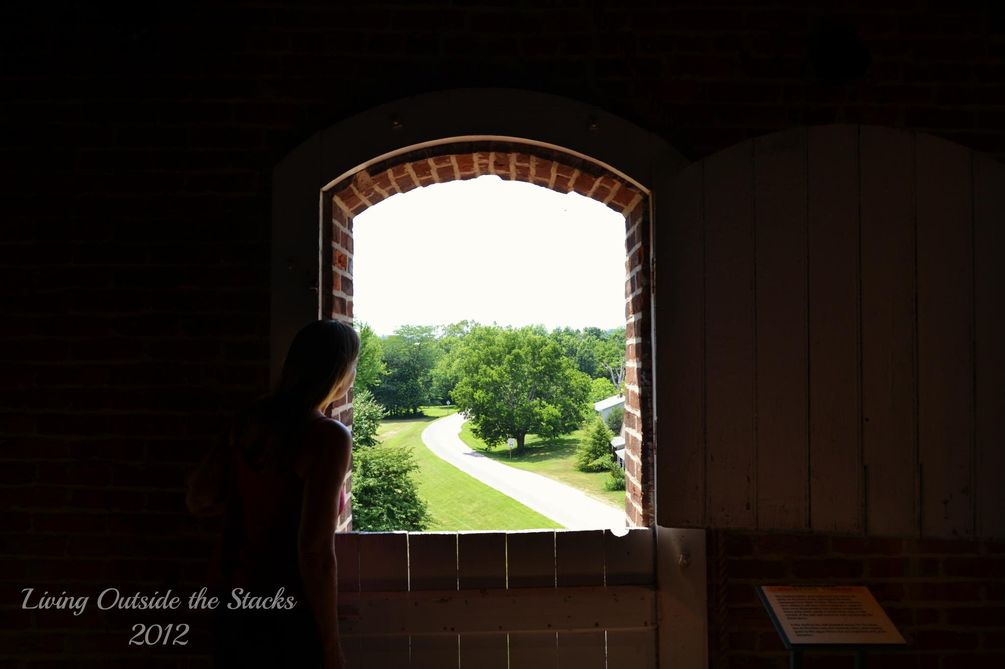
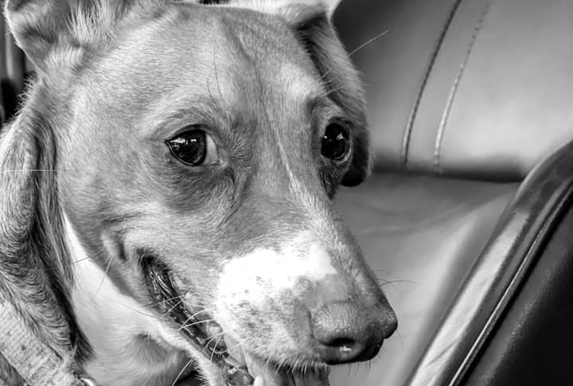
Connect with the audience
*either through light or eye contact

Slide 19
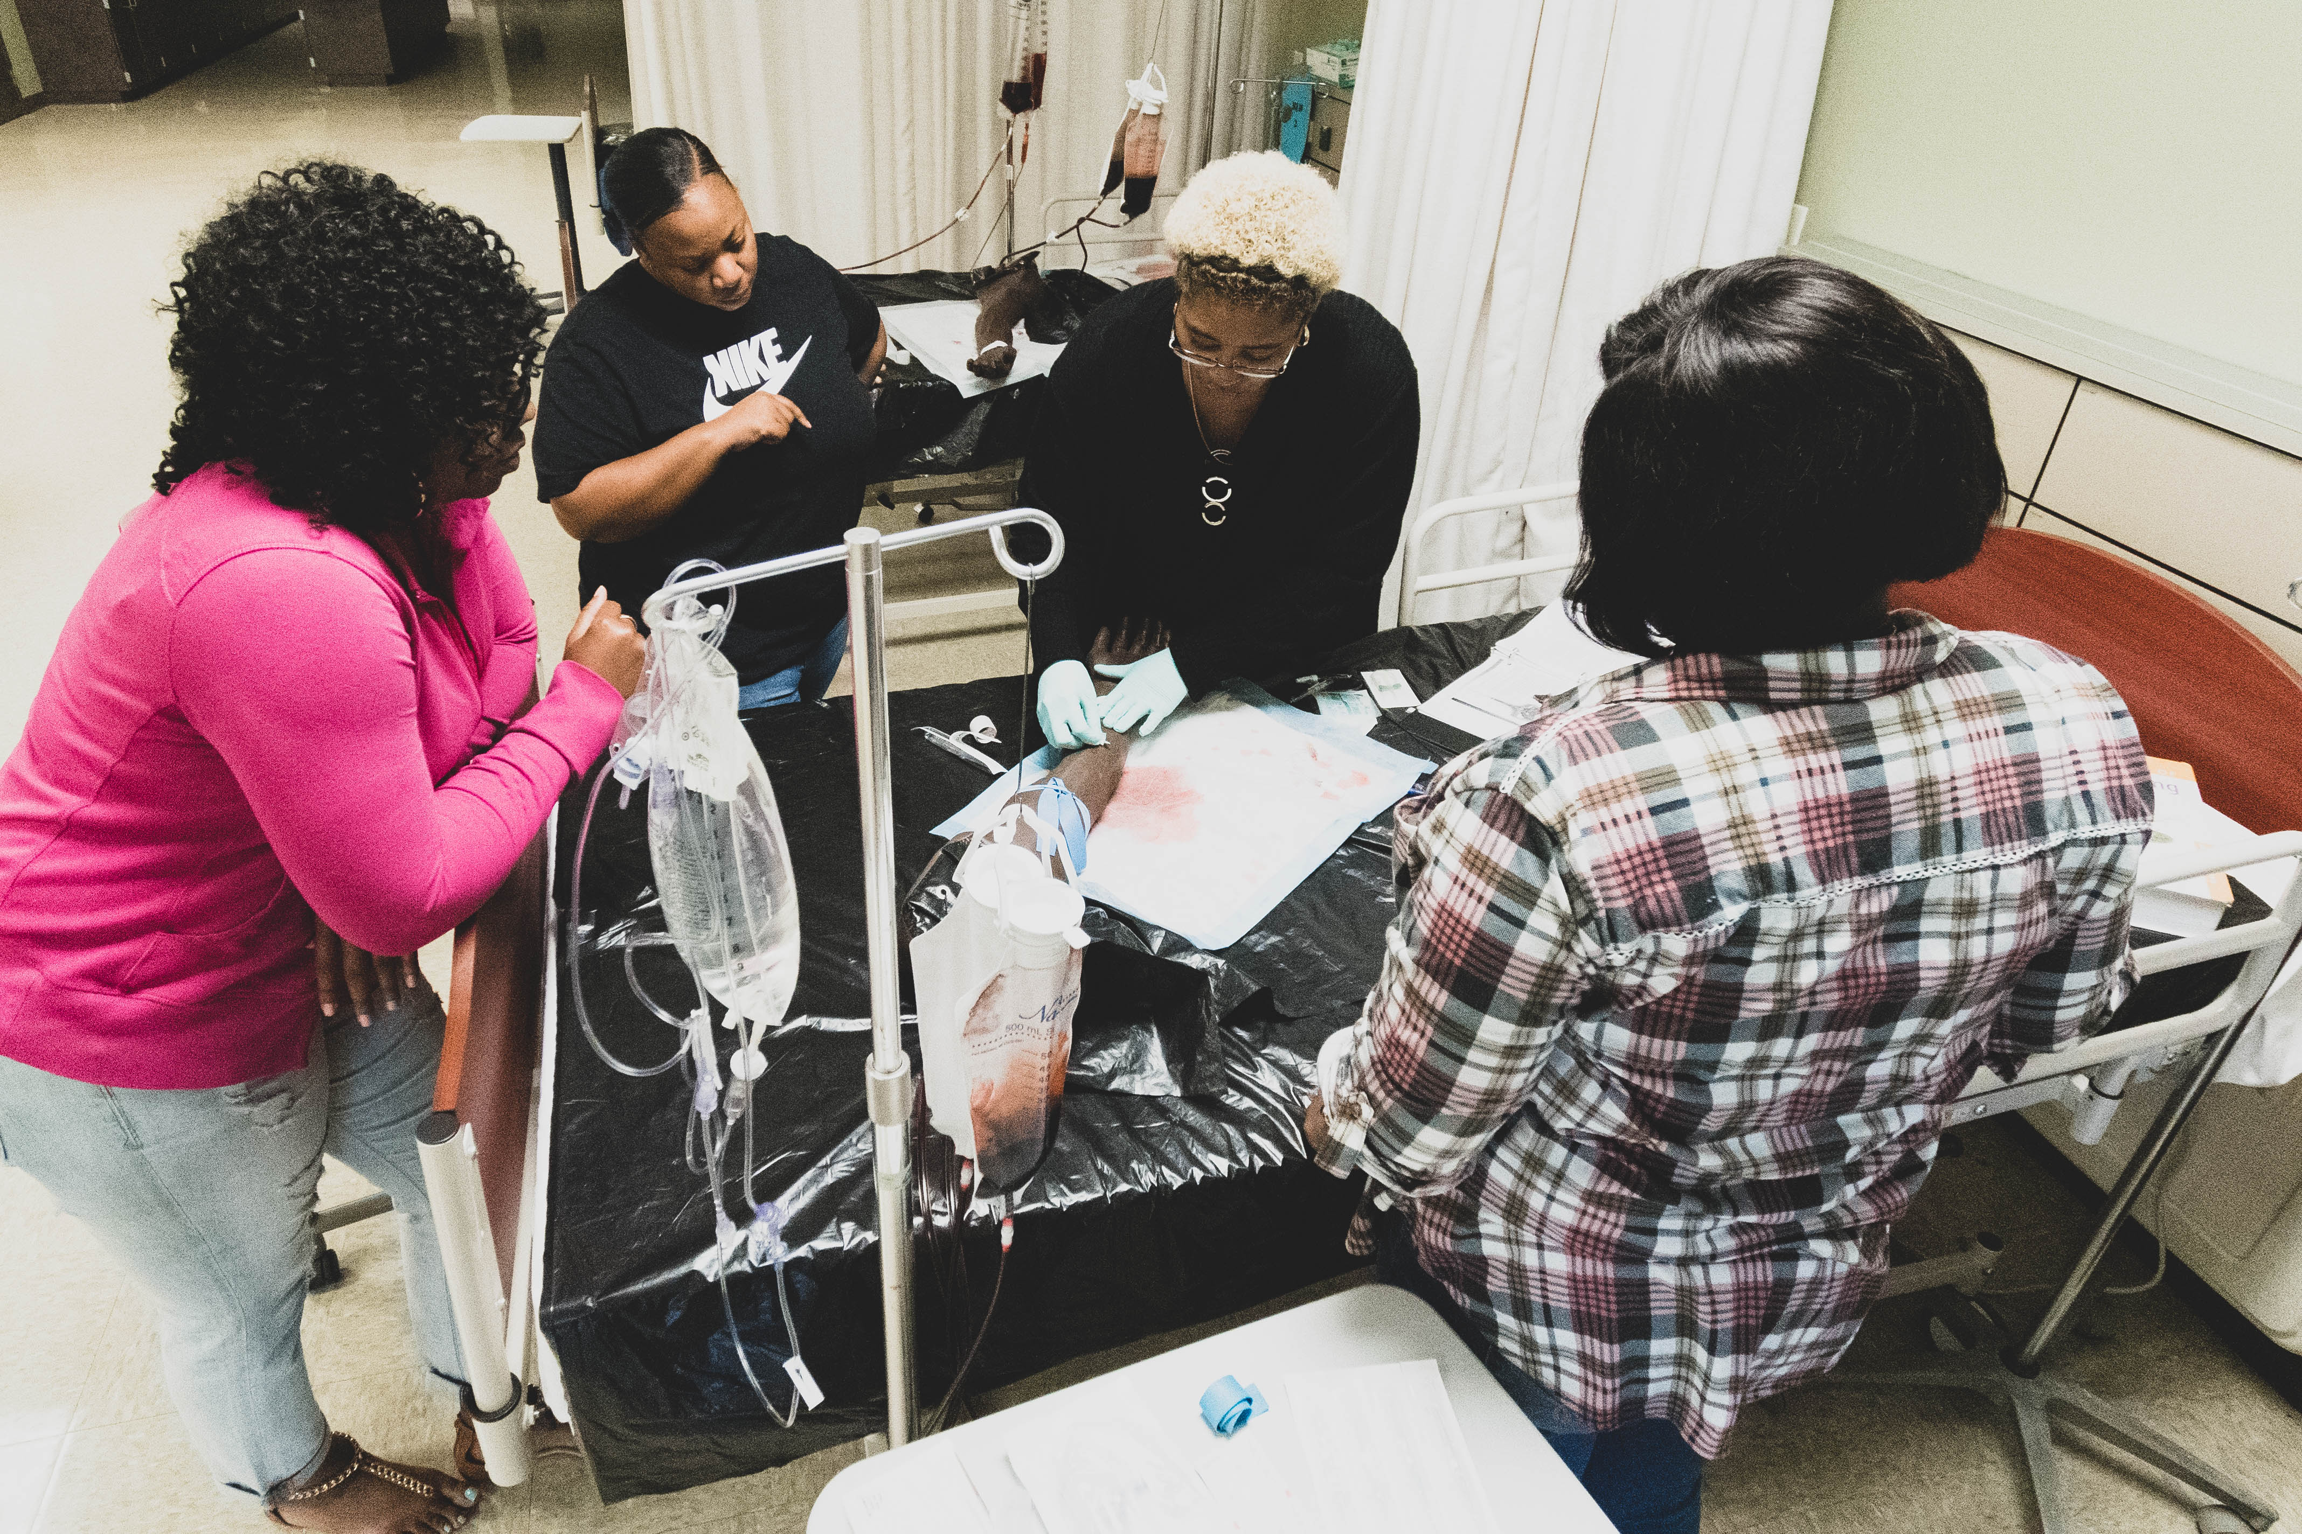
Use unusual angles *shoot from above or below
Taken with DSLR, edited on cell phone

Slide 20
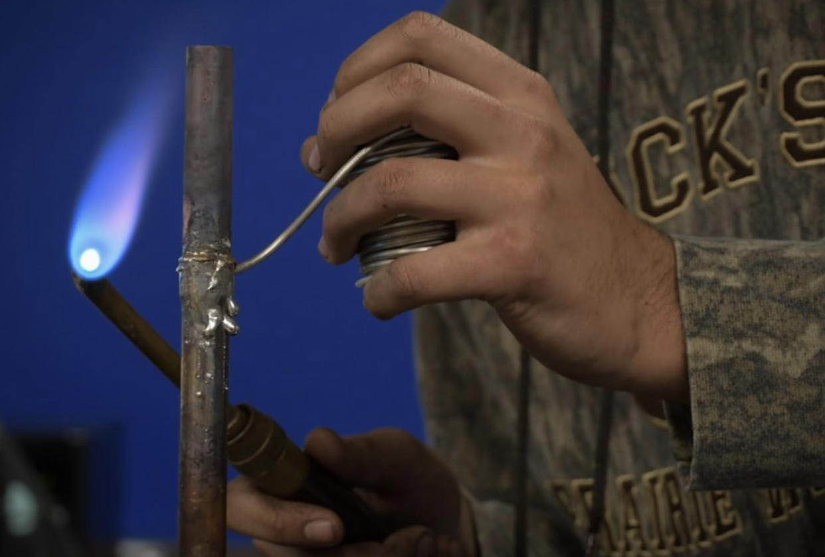
Focus on the details
*Get in as close as possible

Slide 21
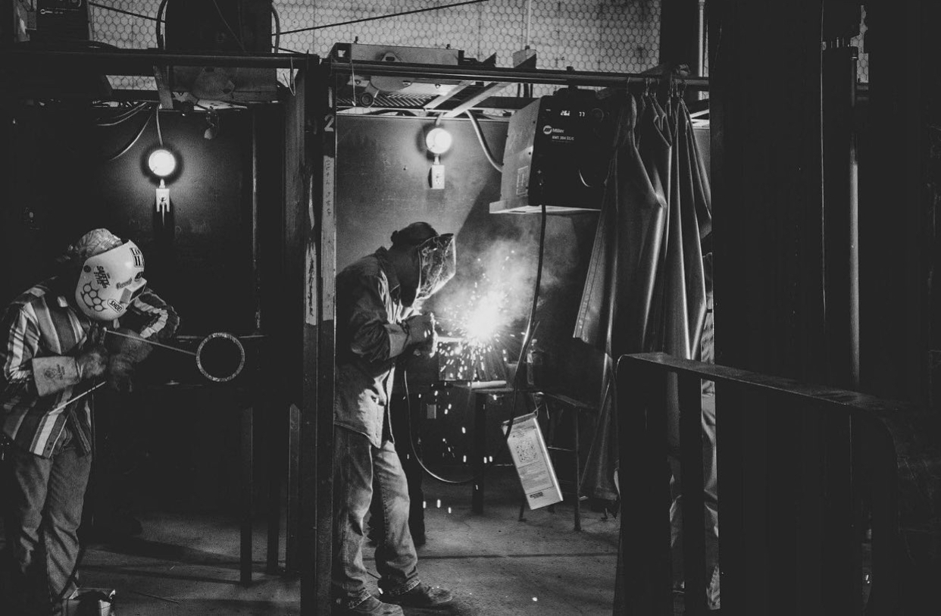
Keep the "bad" images *memory making

Slide 22
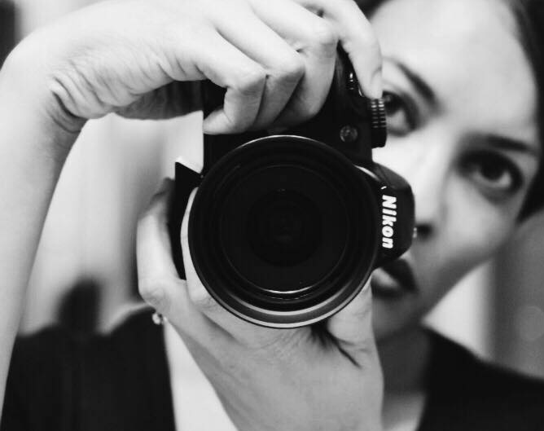
Tutorials
Clickin Moms
Digital Photography School
iPhone Photography School

Slide 23
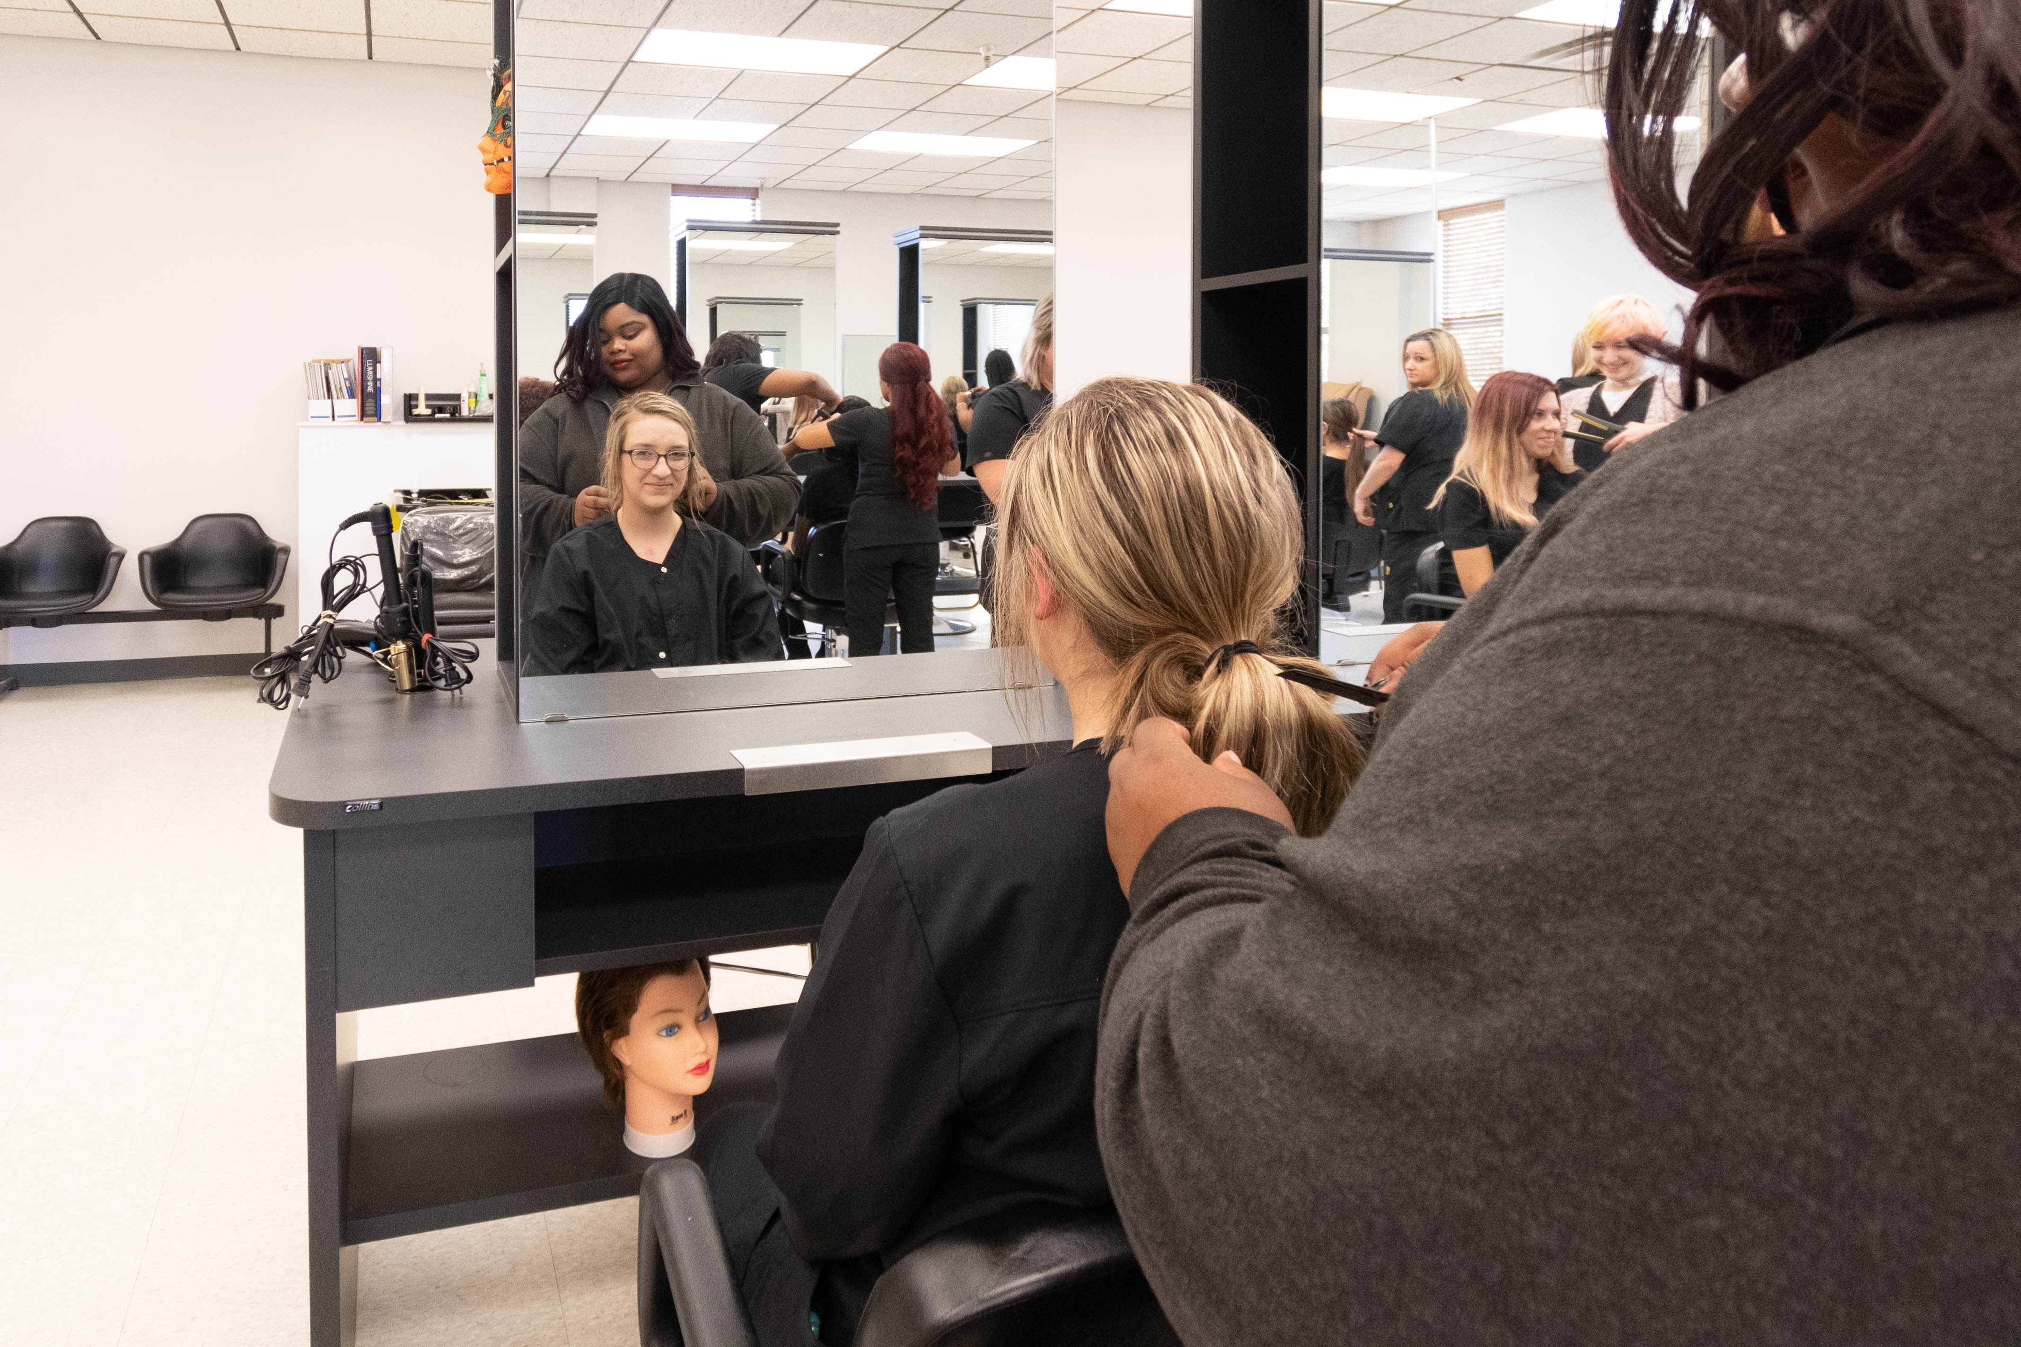
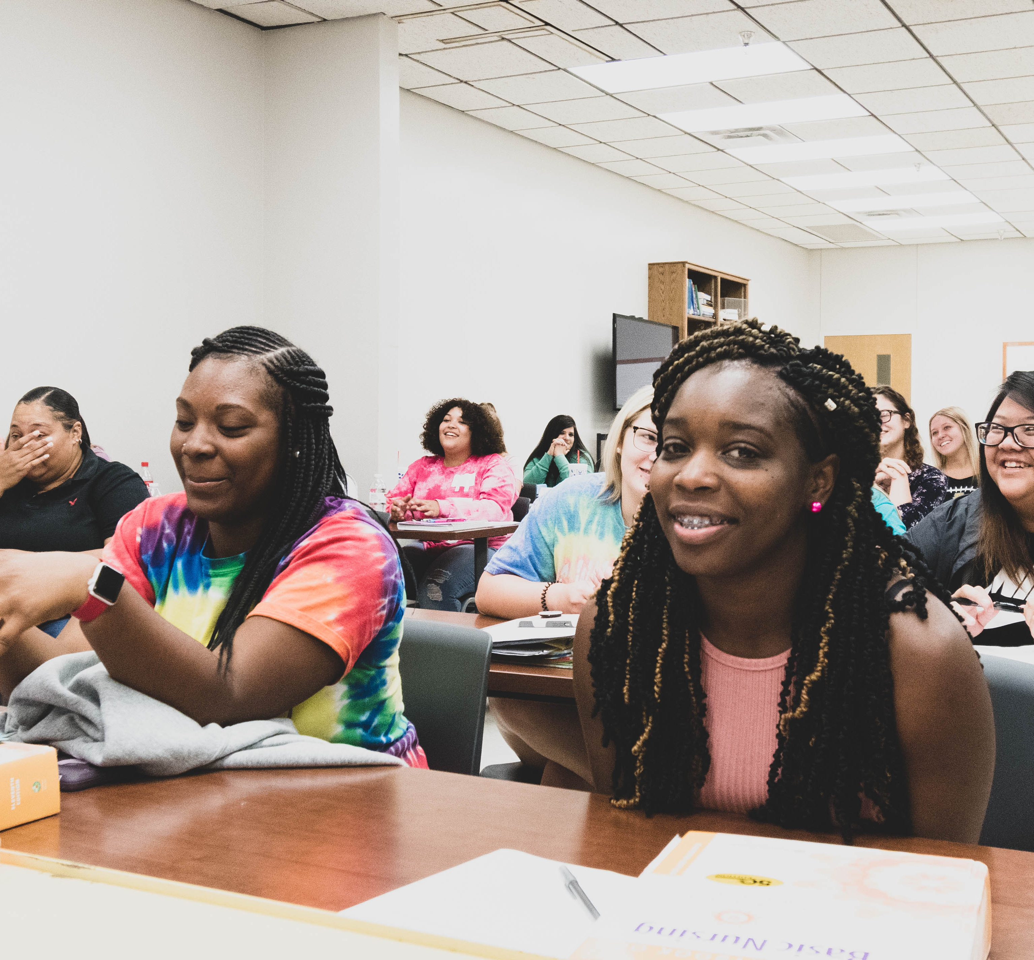
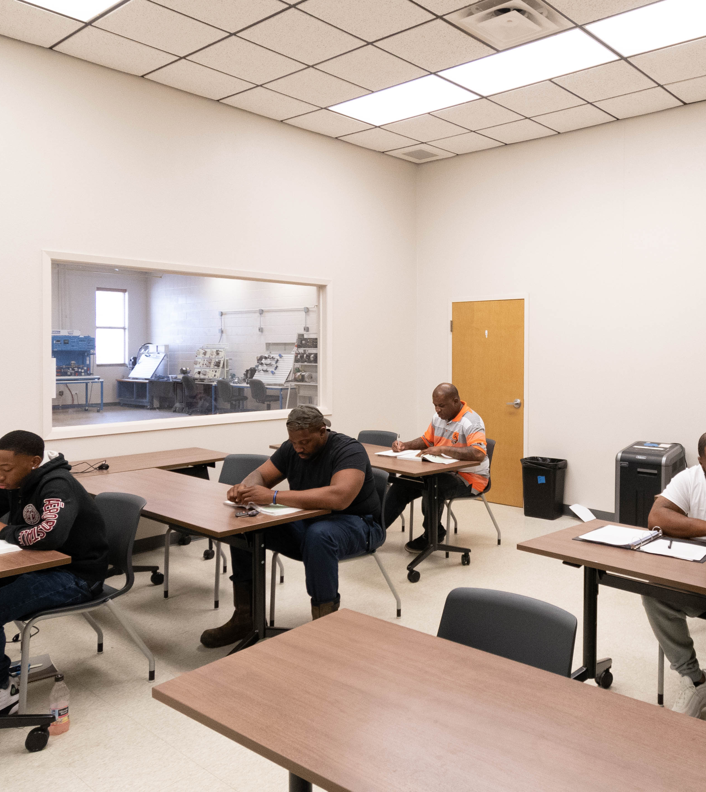
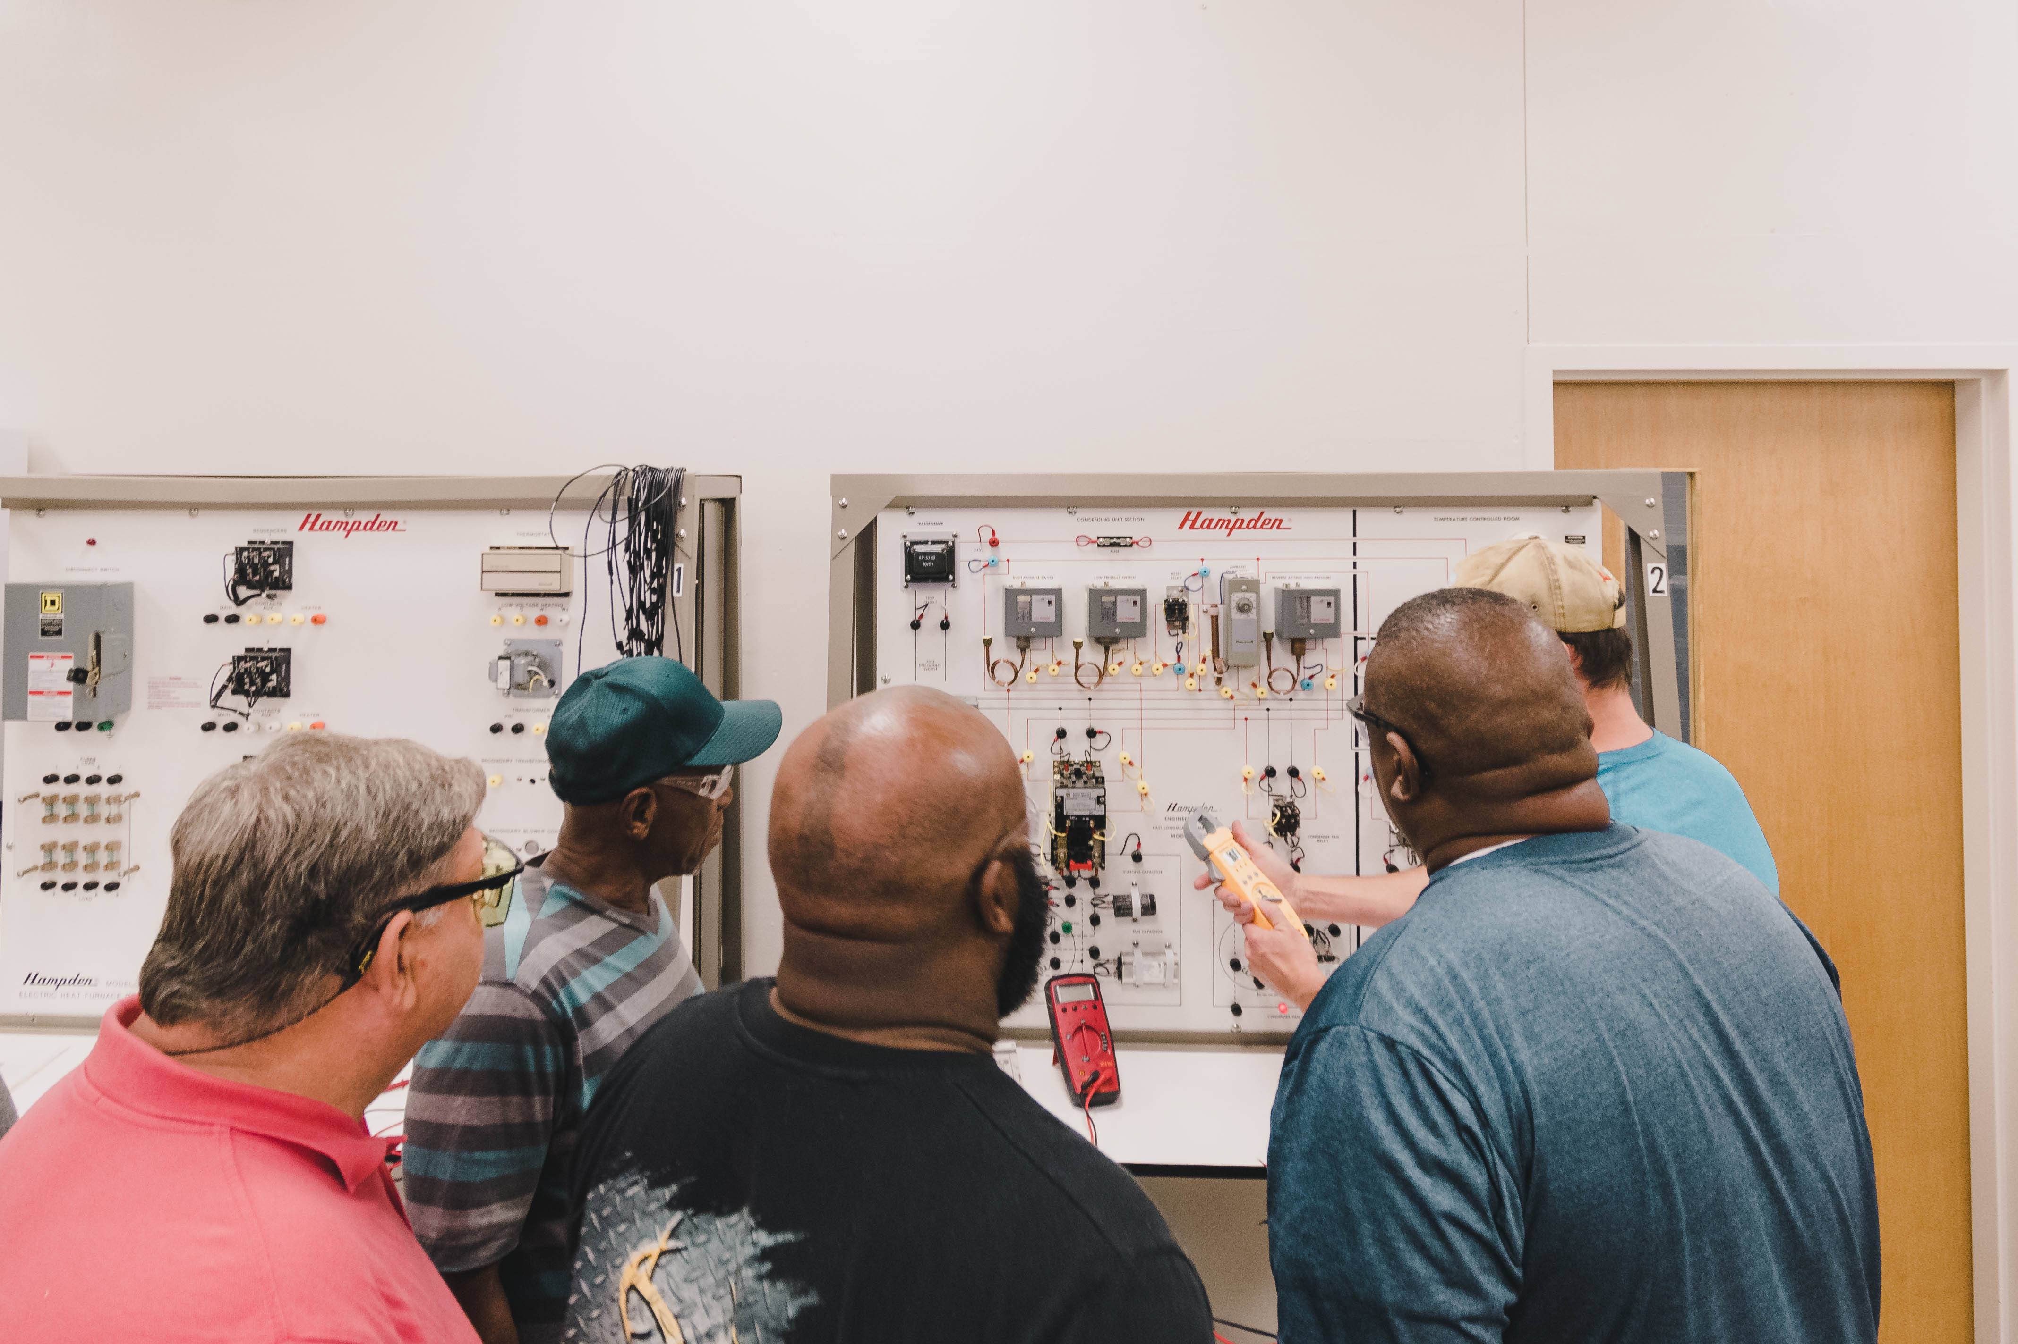
Questions?
Dani Vaughn-Tucker
dvaughntucker@cltcc.edu

Slide 24
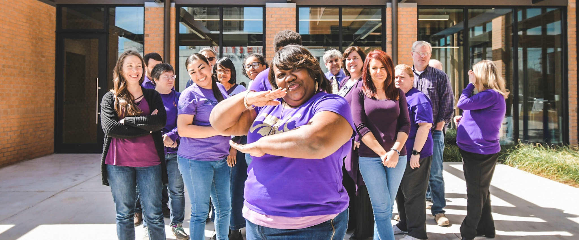
Happy Snapping!
#goCLTCC

