Slide 1
Authority Load Errors: Manual Intervention May Be Required
Learning with LOUIS
June 25, 2020
Natalie Palermo, LSU Law Library

Slide 2
Disclaimers
I am not an expert on authority control in general or as it is implemented in Symphony
I can only offer limited information in the time allotted
I am sharing how I handle errors
You may choose to handle them differently
My only recommendation is that you do not ignore them

Slide 3
Topics Covered
Manual intervention may be required
When?
Why?
Examples
Heading has been deleted
Name
Subject
Heading changed from 1XX to 1XX
Additional info

Slide 4
Manual intervention may be required: When?
Heading has been deleted
Name
Subject
Heading changed from 1XX to 1XX
110 to 111
110 to 130
110 to 151

Slide 5
Manual intervention may be required: Why?
Heading has been deleted
Load report only removes the associated headings from the thesaurus
Headings are no longer authoritative
Authority record is not removed but retained for reference
Headings in bibliographic records are still linked to the wrong authority record
Manual intervention is required to delete the authority record and correct headings in bibliographic records
Heading changed from 1XX to 1XX
Load report does not change MARC tags in bibliographic records
Manual intervention is required to correct headings in bibliographic records

Slide 6
Examples
Heading has been deleted: Name
Heading has been deleted: Subject
Heading has been changed from 110 to 111

Slide 7
Heading has been deleted: Name
Authority IDs beginning with the letter N are name headings
Data from load report log:
20200615111049 authority load: Authority ID N2011037907
20200615111049 authority load: heading has been deleted.
20200615111049 authority load: Manual intervention may be required.
Load report does not delete the authority record
Authority record is replaced with a record marked for deletion
Status is changed to d for deleted
Note may be added in a 6XX field to explain the reason for deletion
I start by searching the authority file by the authority ID above
If authority ID is NOID, this indicates the authority record had been deleted from the system prior to the authority load. NOID can refer to a name or subject heading.

Slide 8
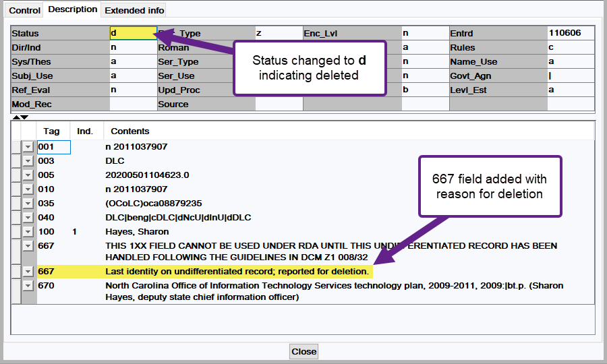
Authority Record: Deleted Name Heading

Slide 9
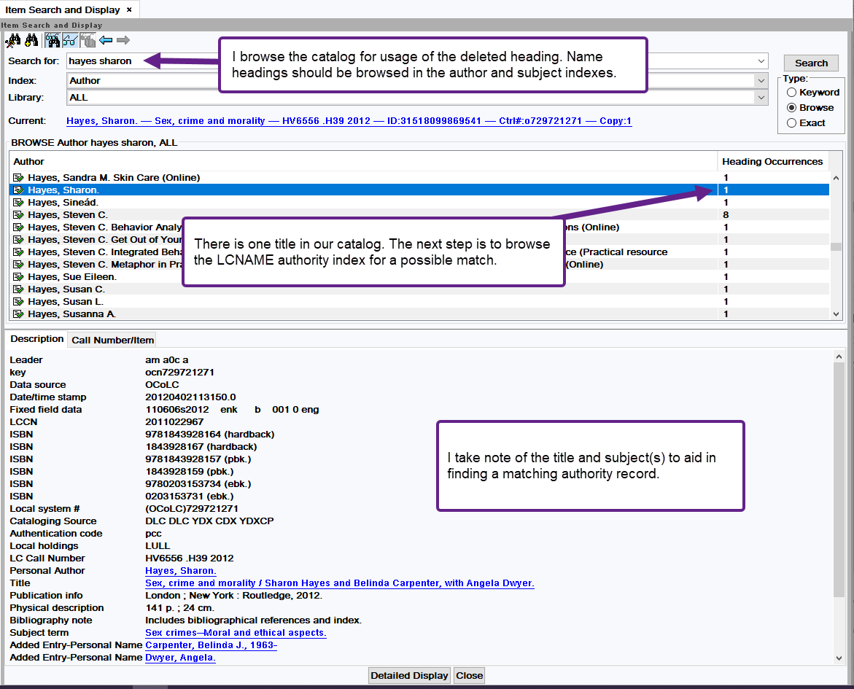
Browsing Catalog for Usage of Heading

Slide 10
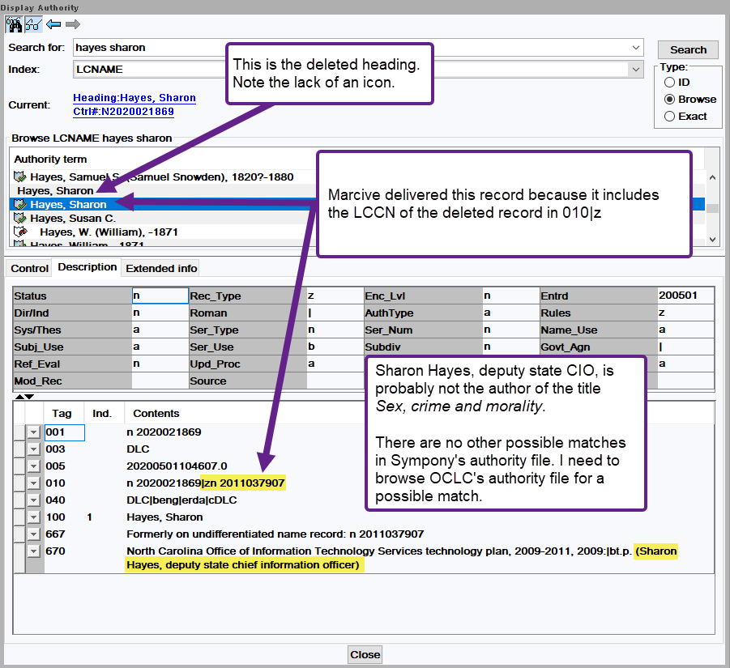
Browsing LCNAME Authority Index

Slide 11
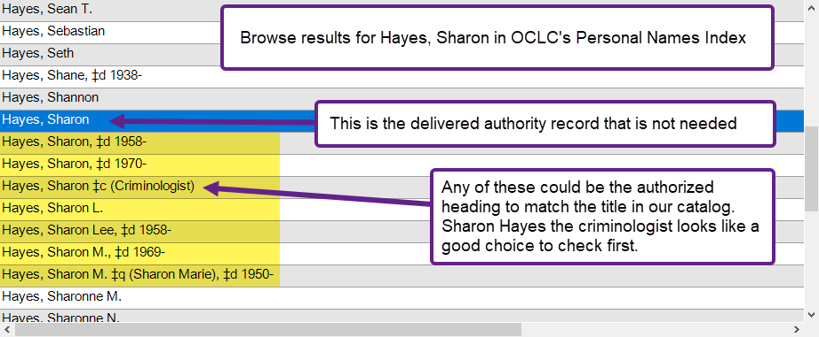
Browsing OCLC Personal Names Index

Slide 12
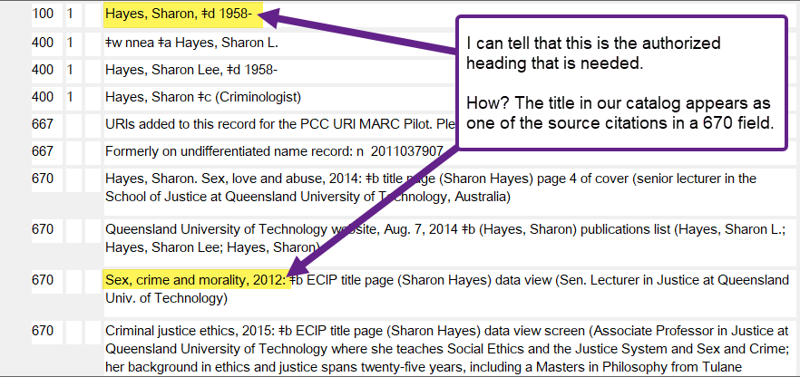
Authority Record in OCLC

Slide 13
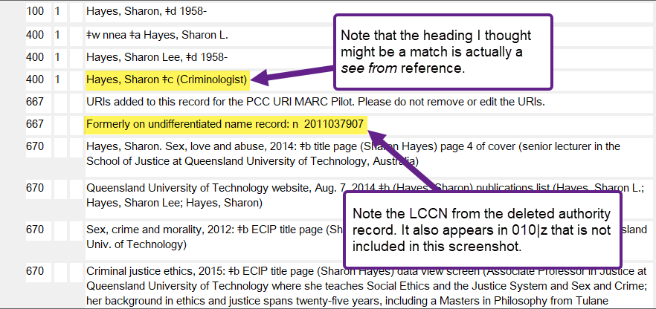
Authority Record in OCLC (2)
I’ll import this authority record from OCLC into our Symphony authority file.

Slide 14
Browsing LCNAME Authority Index

Slide 15
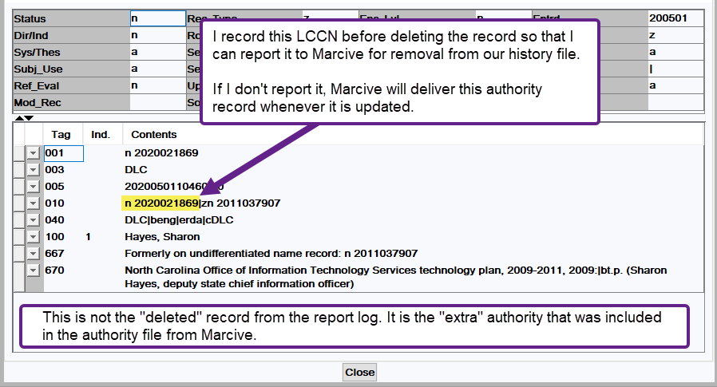
Report Deleted Authority Record to Marcive

Slide 16
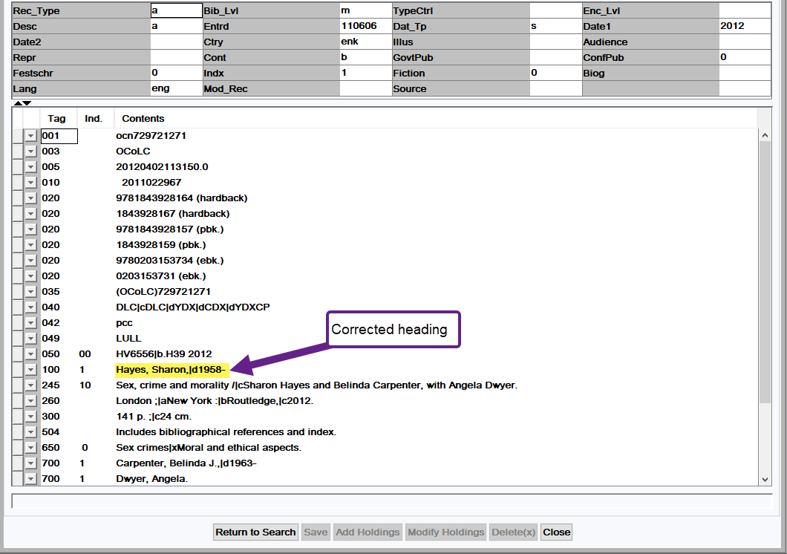
Corrected Bibliographic Record

Slide 17
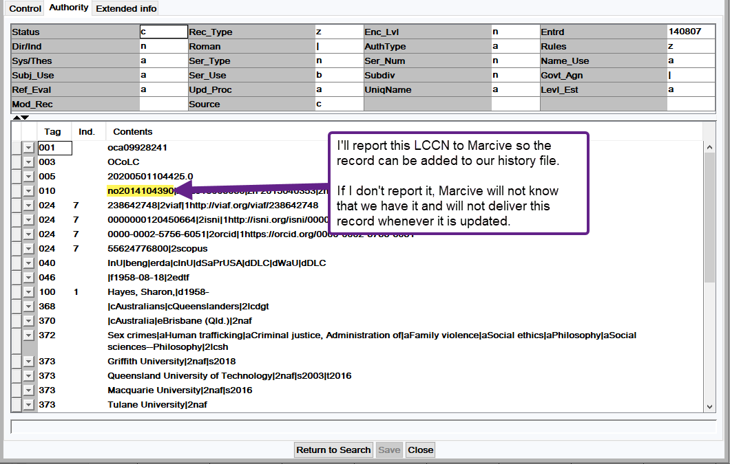
Report Added Authority Record to Marcive

Slide 18
Heading has been deleted: Subject
Authority IDs beginning with the letters SH are subject headings
Data from load report log:
20191024123031 authority load: Authority ID SH86002228
20191024123031 authority load: heading has been deleted.
20191024123031 authority load: Manual intervention may be required.
Load report does not delete the authority record
Authority record is replaced with a record marked for deletion
Status is changed to d for deleted
Note may be added in a 6XX field to explain the reason for deletion
I start by searching the authority file by the authority ID above
If authority ID is NOID, this indicates the authority record had been deleted from the system prior to the authority load. NOID can refer to a name or subject heading.

Slide 19
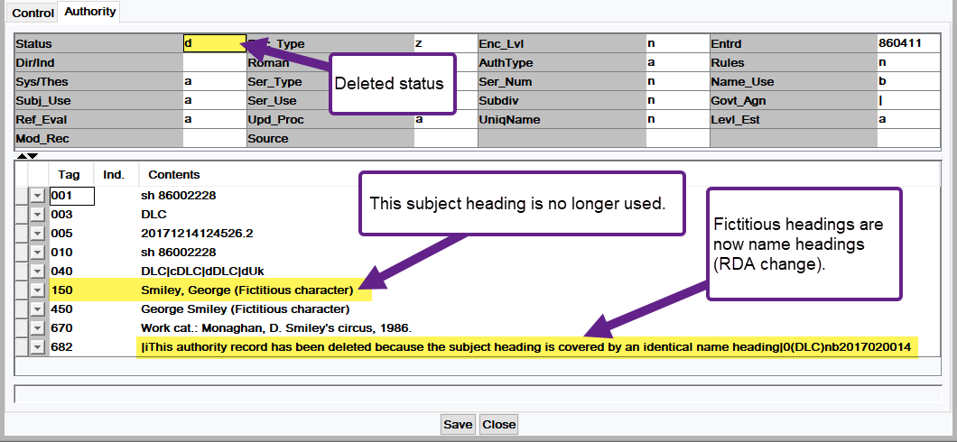
Authority Record: Deleted Subject Heading

Slide 20
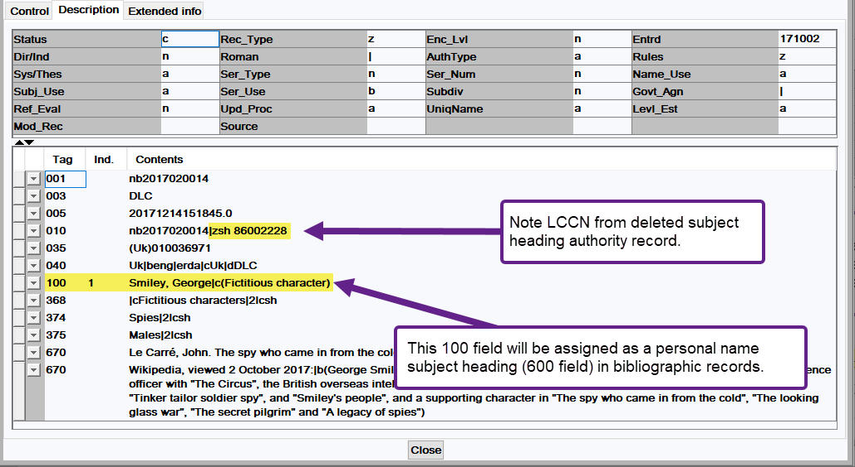
Authority Record: Identical Name Heading

Slide 21
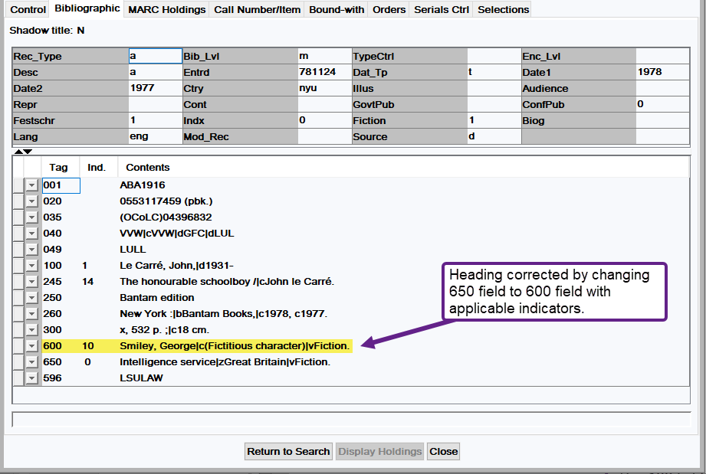
Corrected Bibliographic Record

Slide 22
Heading changed from 110 to 111
Data from load report log:
20200303111515 authority load: Authority ID NO99078400
20200303111515 authority load: heading changed from 110 to 111.
20200303111515 authority load: Manual intervention may be required.
20200303111515 authority load: See headings below.
20200303111515 authority load: 110: United States.|bMarine Mammal Commission.|bWorkshop
20200303111515 authority load: 111: Marine Mammal Commission Workshop
Corporate name heading changed to a meeting name heading

Slide 23
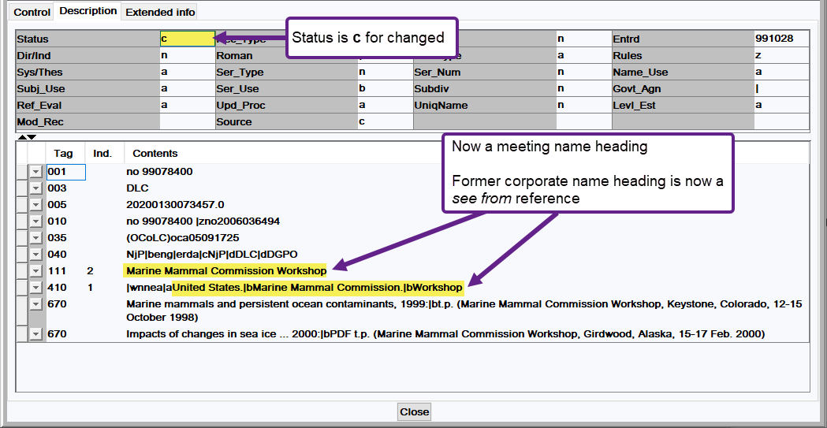
Changed Authority Record

Slide 24
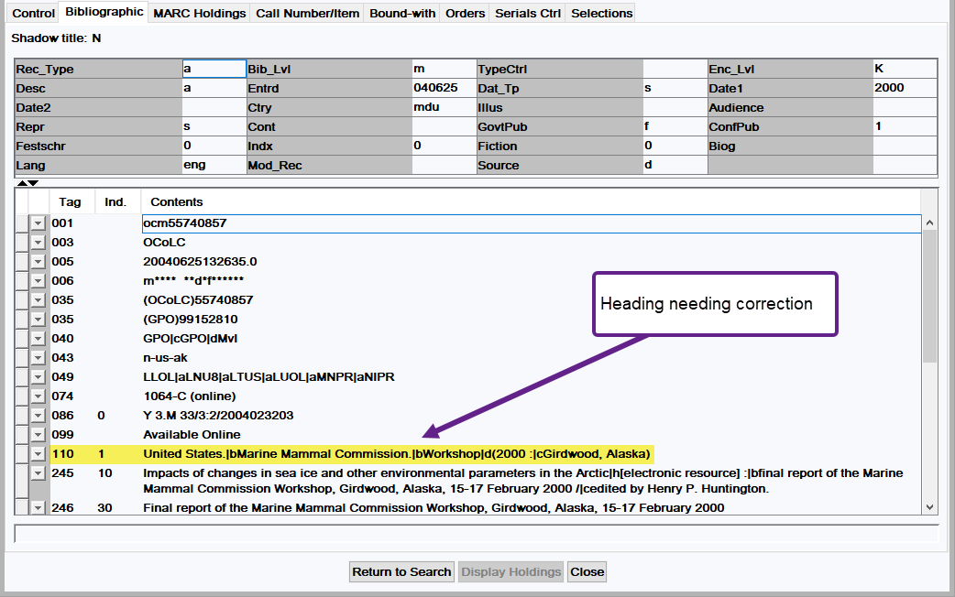
Bibliographic Record Before Correction

Slide 25
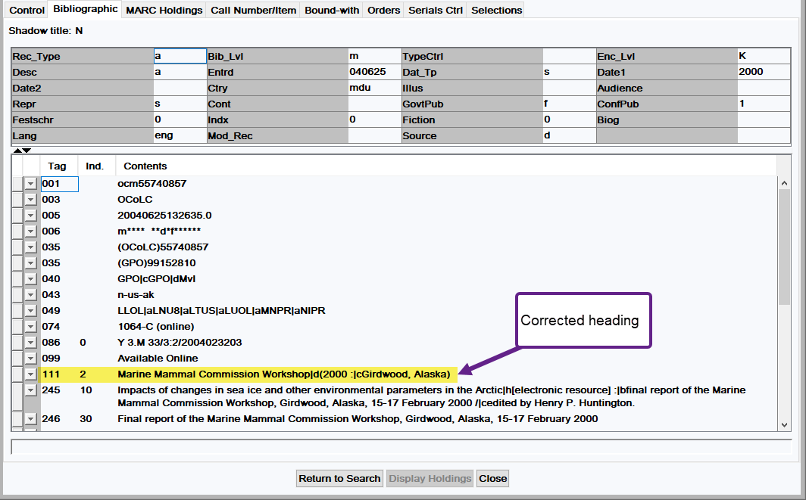
Bibliographic Record After Correction

Slide 26
Additional Info
I can provide detailed instructions to LOUIS for:
Deleted name and subject headings
Changed name headings
Reporting additions and deletions to Marcive

