Slide 1
I have received the Marcive Authorities file, now what do I do Iodo?”
LwL – Learning with LOUIS: Authority Loads
June 25, 2020
Zehra ‘ZeeZee’ Zamin

Slide 2
How to get Authority records
1. Use SmartPort to get records from:
OCLC
LC
Another LOUIS site
2. Authority service from a vendor
e.g. SirsiDynix, Marcive

Slide 3
SIRSIDYNIX: FULL & LITE options

Slide 4
MARCIVE: Authority options

Slide 5
MARCIVE: Authority options – contd:

Slide 6
Authority options
Cost – based on number of bibliographic records
SirsiDynix –
Extract and Reload records
Run Rebuild Heading and Rebuild Text reports
Resolve ‘Unauthorized Heading’ in Workflows
Marcive
Extract and Reload records yourself or LOUIS helps
Schedule Rebuild Heading and Rebuild Text reports
Full level authority for Update & Overnight Services
Free authority records for GovDocs

Slide 7
Authority options
SirsiDynix:
Bossier Parish Community College Lite
Nicholls Lite
Northwestern Lite
Southern Univ. New Orleans Lite
Univ. of Holy Cross Lite
Univ. of Louisiana at Lafayette Full
Marcive:
Franciscan Missionaries of Our Lady
La. Tech
LSU
LSU Law
McNeese
Southeastern
Southern Baton Rouge
Southern Law
Univ. of New Orleans

Slide 8
What does Marcive send
Email with download instructions:
A data file produced for you by Marcive is available for pickup over the Internet at
ftp://ftp.marcive.com/output/ftp/suboftpx
For detailed instructions see http://home.marcive.com/ftp-options/
Description: Authority Notification
Directory: /output/ftp/sitenameftpx
File name: sitenameALL.306
File size: 1210395 bytes
Record count: 168
Alternatively, you may download your file via http by following this link:
http://web.marcive.com/httpdownload/?l=ftp&s=suboftpx

Slide 9
Now what do I do?
Get the Authority file
Use the Marcive email
Add it to the server (Production or Test)
Use Utilities wizard
Load it into the catalog
Use the Report – ‘Authority Load’

Slide 10
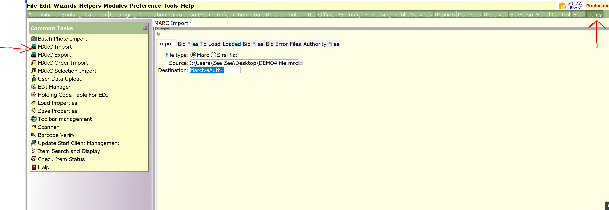
Utilities – MARC Import wizard

Slide 11
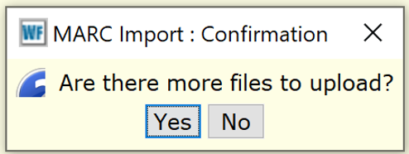
Utilities – MARC Import wizard
Click the gadget for Source - browse to the saved the Marcive file
Destination –enter a file name that is meaningful. This is the name you will see it in the Load Authorities Records report
Click: Import
The system will ask if you have more files to load, say: NO
The system will provide a doc showing the import has taken place. Note the number of records imported.

Slide 12
Utilities – Import Log
Notes:
Confirm that the same number of records have loaded

Slide 13
Reports – Load Authority Records

Slide 14
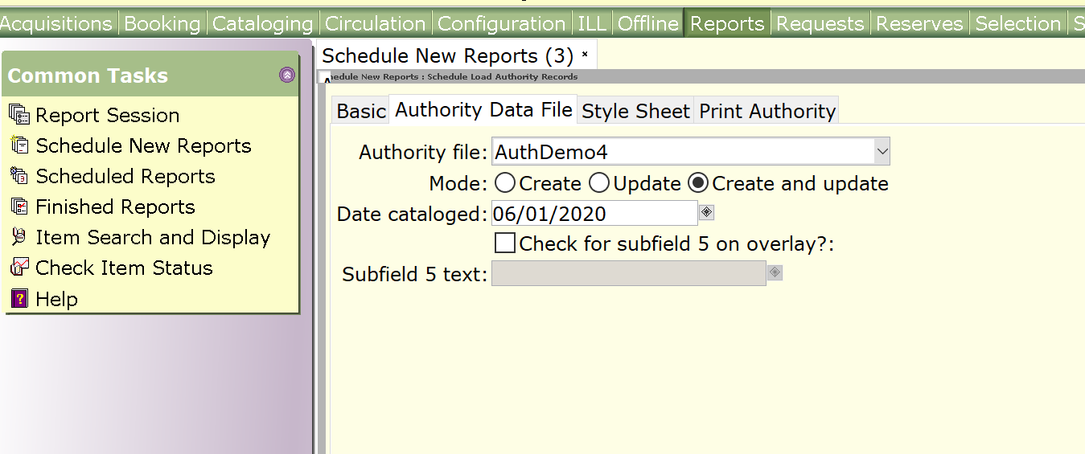
Authority Load Report
Click: Run Now
Notes:
Subfield 5: If you want to retain some local notes, for example: series tracing or classification practices
Enter your OCLC code in subfield 5 field.
If an incoming rec matches the oclc symbol in subfield 5 ofan existing authority record, this field will not be deleted, instead will be merged with the incoming record.

Slide 15
Authority Load Report – subfield 5
Notes:
644 shows how you analyzed the Series: f= full & p=partial
645 shows if you traced the Series: t = traced etc

Slide 16
Authority Load Report – subfield 5
Notes:
646 Series classification practice (The code specifies whether the volumes in the series are classified as a collection, with the main series, or separately)
s – Volumes are classified separately c – Volumes are classified as a collection m – Volumes are classified with main or other series
644 shows how you analyzed the Series: f= full & p=partial
645 shows if you traced the Series: t = traced etc

Slide 17
Authority Load Report - finished
Notes:
644 shows how you analyzed the Series: f= full & p=partial
645 shows if you traced the Series: t = traced etc

Slide 18
Authority Load Report Results

Slide 19
Authority Load Report Results

Slide 20
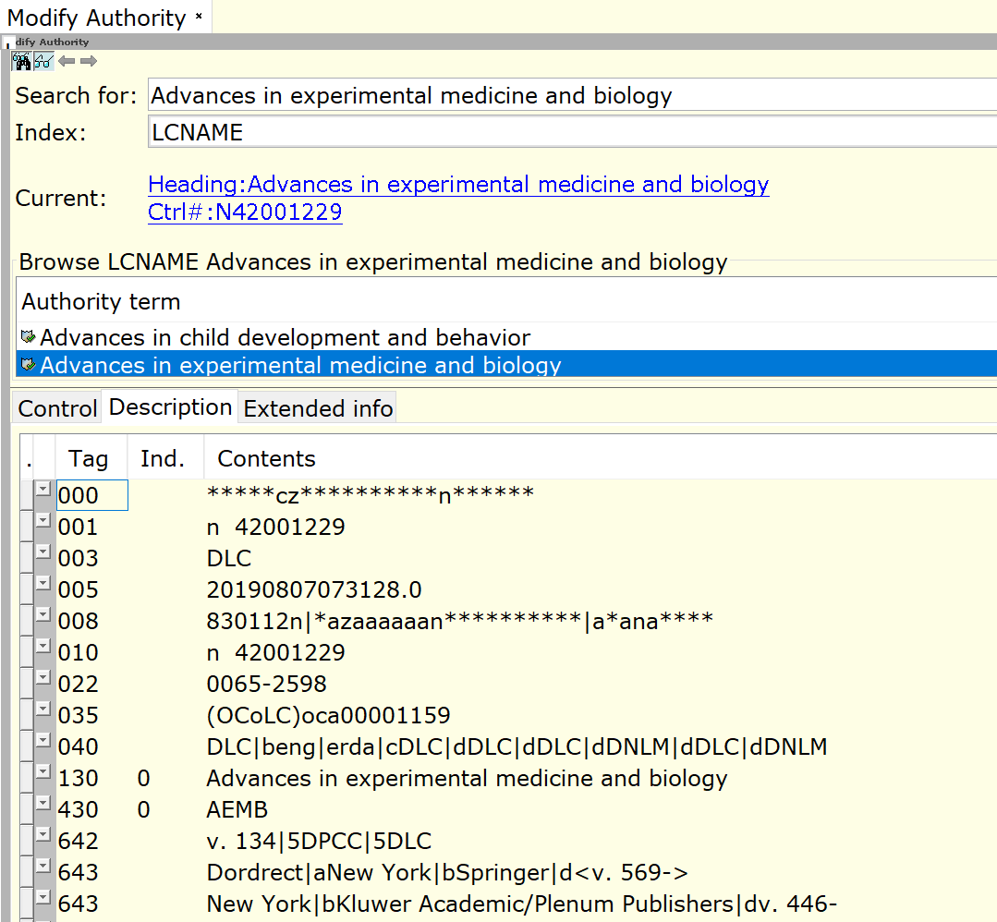
Name Authority record in catalog

Slide 21
Subject Authority record in catalog

Slide 22
After the file is loaded
Ideal scenario - perfect records, all matched and overlaid.
Or
the Load Report Log indicates actions you need to take.
Lists records loaded - which you can ignore
Lists deleted authority records that need to be removed
Lists records requiring manual intervention

Slide 23
‘EntryID not found’
At times after an Authority file load, get the following error message :
Error: **Entry ID not found in format
Entry number: 034; format GEOGRAPH
May list different Entry IDs, for example:
086; format TITLE [Gov Docs number]
370; format Personal [Associated Place]
374; format Personal [Occupation]
386; format Personal [Gender]
Notes:
When this happens, then the report log is missing the listing of ‘Manual intervention required’ records.

Slide 24
contd: Entry ID not found
The reason - Entry IDs (e.g. 034) incoming record has a value which is not defined in in the Geographic Authority format policy.
Use Configuration toolbar to add the entry id 034 for the authority entries, then define the 034 in the Geograph format policy, and finally add it to the synonym list.
After a Halt/Run of the workstation server is performed, you will be able to re-load the records without error.
OR
Put in a Task Ticket and LOUIS will be glad to help.
Notes:
System Admins have access to Config Toolbar and will probably do this for you.

Slide 25
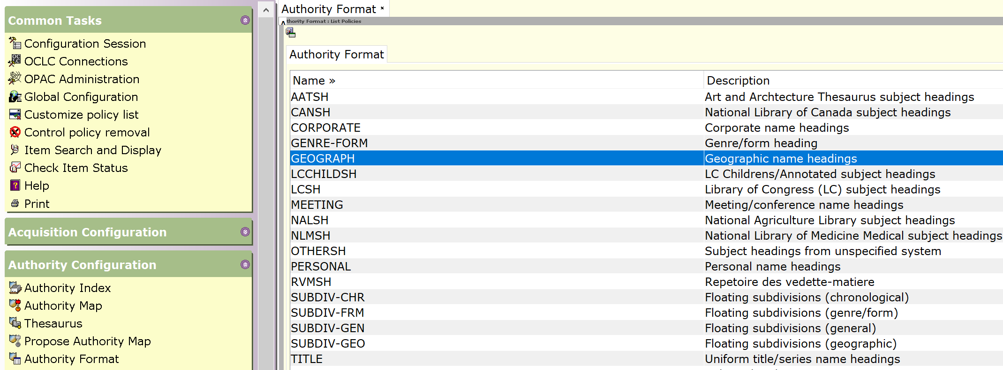
Add Entry ID to an Auth Format
Check the Entry ID policy list, within a format, to see if the entry you want to add is available.
If not, create a new Entry ID policy.
Select Format Geograph, Modify, click: Entries tab,
Notes:
Will show how to add 034 tag to Geograph Format. It is often called just ‘Geographic’ but is actually: Coded Cartographic Mathematical Data

Slide 26
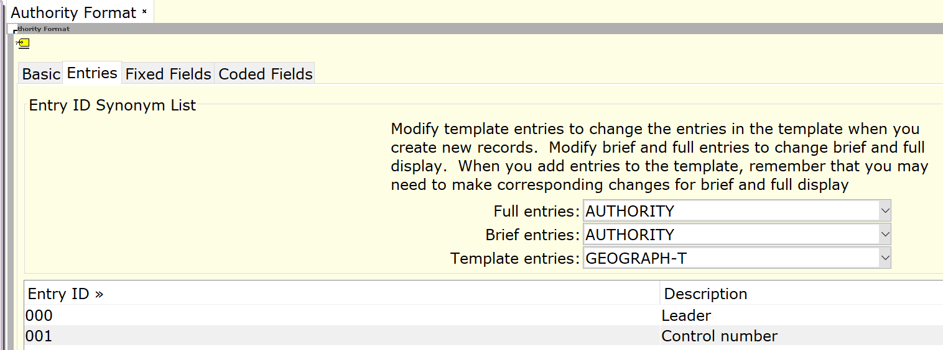
contd: Add Entry ID to an Auth Format
Click the Entries tab

Slide 27
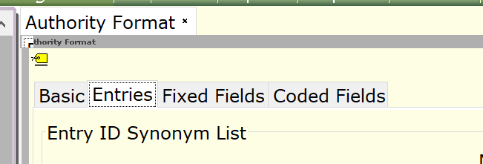
contd: Add Entry ID to an Auth Format
Scroll to see if Entry ID 034 is available.
If not, click Entry Helper (yellow label tag on top left)

Slide 28
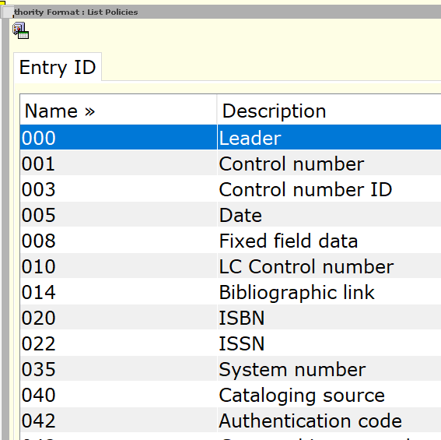
contd: Add Entry ID to an Auth Format
Check to see if 034 is there, else needs to be created
Click Create

Slide 29
contd: Add Entry ID to an Auth Format
Enter Name (can enter the tag value e.g. 034) and Enter Description
Retain the rest of the default values.
If you are creating an Entry ID for a single tag,
the Purpose should be Authority

Slide 30
contd: Add Entry ID to an Auth Format

Slide 31
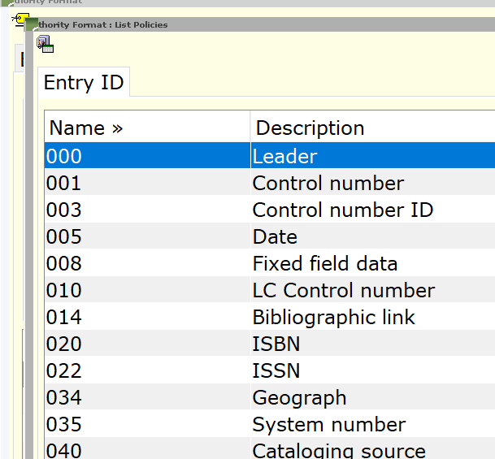
contd: Add Entry ID to an Auth Format
Return to the Entries Helper list.
Scroll to confirm the new Entry is there.

Slide 32
contd: Add Entry ID to an Auth Format
Now create the policies that define how the tag should be indexed and displayed.
Geograph Format – Modify – Entries tab - Create
In the Entry ID field, choose the new entry you created.
Fill in the values you need.
Information on making these selections is in
WF Help topic, "Defining Format Variations."

Slide 33
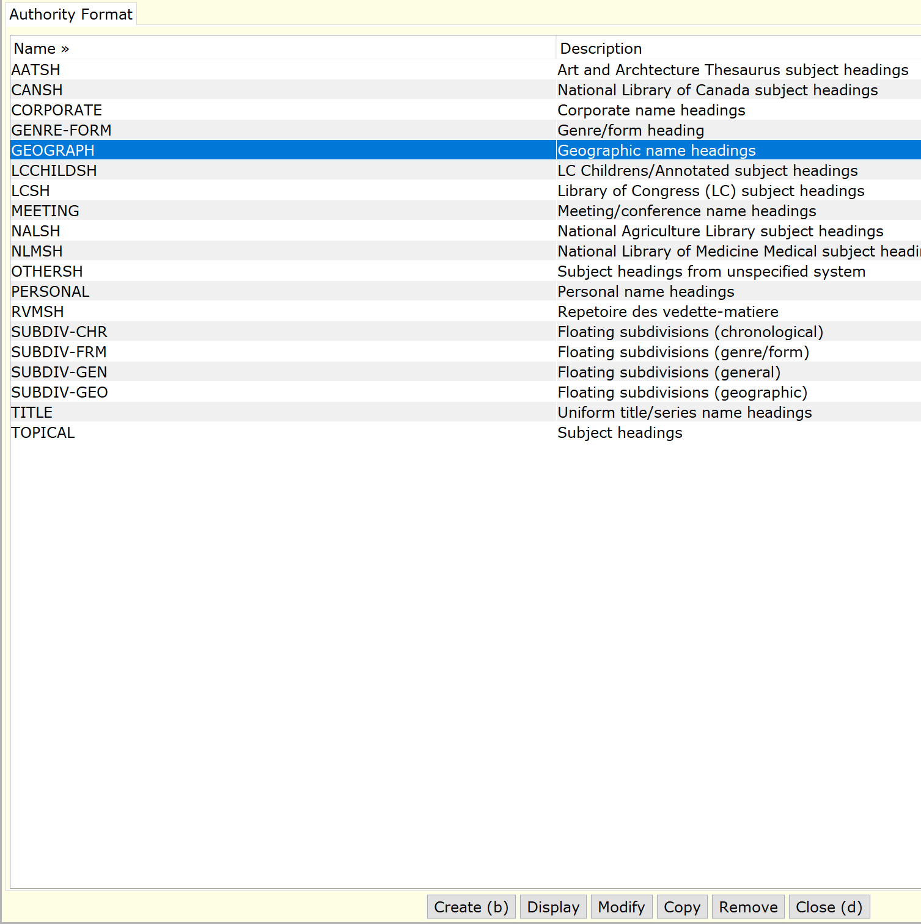
contd: Add Entry ID to an Auth Format
Select format and click Modify

Slide 34
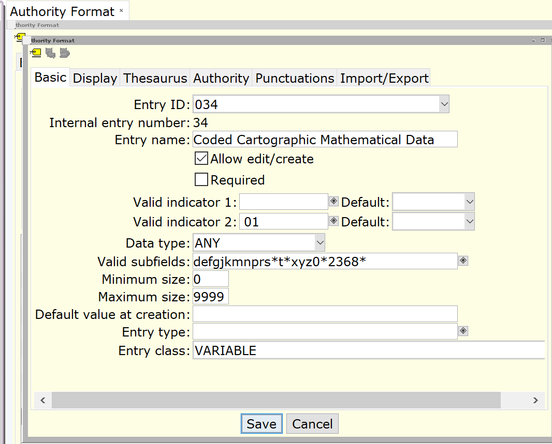
contd: Add Entry ID to an Auth Format
In the Entry ID field, choose the new entry you created.

Slide 35
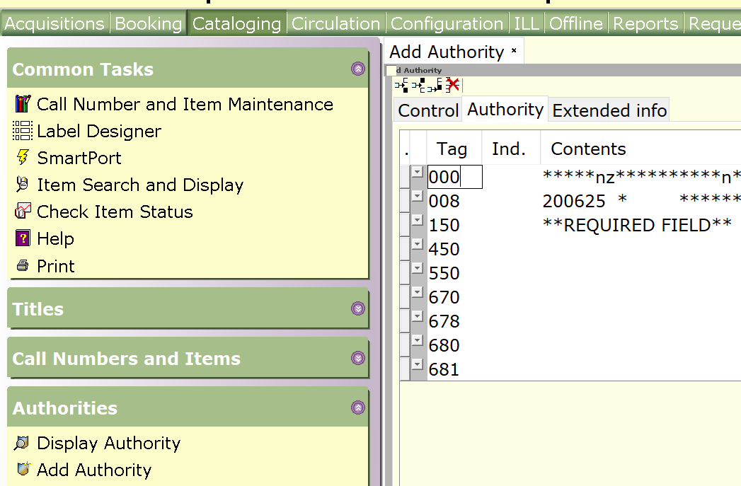
contd: Add Entry ID to an Auth Format
Optional –
Add this tag to the Template list.
It displays in the Add Authority wizard.

Slide 36
contd: Add Entry ID to an Auth Format
Format:
Geograph – Entries tab – Entries (yellow tag) – Find Geograph-T - Use Gadget to add 034 - Save

Slide 37
contd: Add Entry ID to an Auth Format

Slide 38
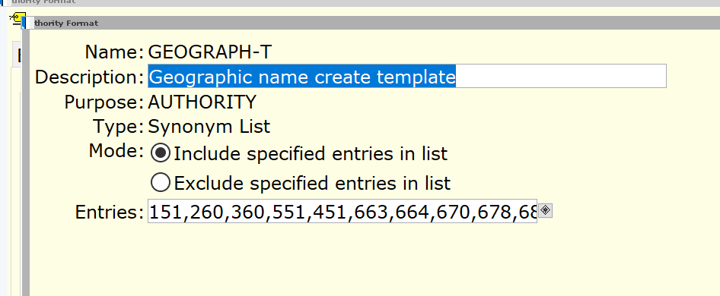
contd: Add Entry ID to an Auth Format
Click Entries gadget

Slide 39
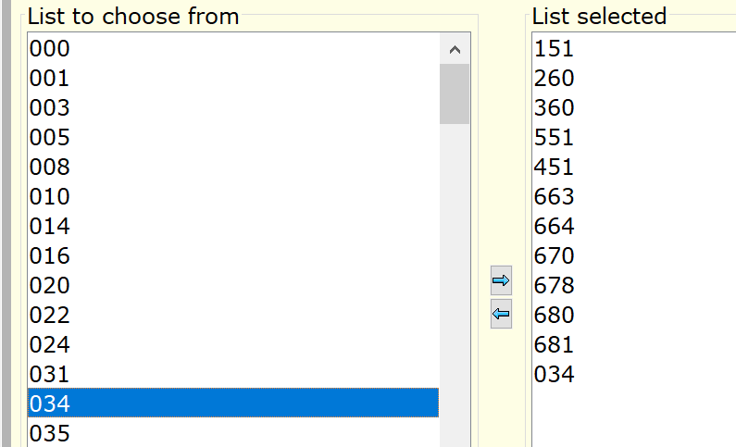
contd: Add Entry ID to an Auth Format
Select 034 and move it to ‘List selected’

Slide 40
contd: Add Entry ID to an Auth Format
Need a Halt/Run of the system
for the Entry to display in the Format policy, before you can start using it in your authority records.
Reload the Authority file, and there should be no errors this time.

