Slide 1
BRIDGING THE DIGITAL LITERACY DIVIDE IN LOUISIANA

Slide 2
Agenda
Is Digital Literacy a problem for Louisiana?
How can we address it?
What is Northstar?
What is a successful outcome?
How can you get involved?

Slide 3
What is Digital Literacy
“the ability to use information and communication technologies to find, evaluate, create, and communicate information, requiring both cognitive and technical skills.”
American Library Association’s (ALA)
Digital Literacy Task Force
Notes:
Digital literacy is defined by the American Library Association’s (ALA)
Digital Literacy Task Force as “the ability to use information and
communication technologies to find, evaluate, create, and communicate
information, requiring both cognitive and technical skills.”

Slide 4
Digital Inclusion: A Three-Legged Stool
Internet Access
Training
Devices
Notes:
National Digital Inclusion Alliance (NDIA)
holistic definition of digital inclusion as the “activities necessary to ensure that all individuals and communities, including the most disadvantaged, have access to and use of Information and Communication Technologies (ICTs).”
identified five key elements for inclusivity:
1) affordable, robust broadband internet service;
2) internet-enabled devices that meet the needs of the user;
3) access to digital literacy training;
4) quality technical support; and
5) applications and online content designed to enable and encourage self-sufficiency, participation and collaboration.

Slide 5
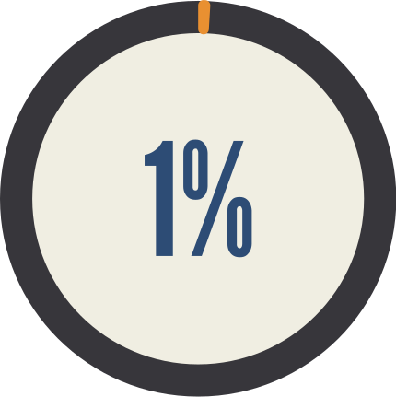
Digital Literacy in the U.S.
"Only 2 percent of students scored at the highest levels implied by digital native status, and only another 19 percent of the 42,000 students assessed in 14 countries and educational systems could work independently with computers as information-gathering and management
tools."
2%
https://www.washingtonpost.com/education/2019/11/16/todays-kids-may-be-digital-natives-new-study-shows-they-arent-close-being-computer-literate/
Notes:
Results were recently released from the International Computer and Information Literacy 2018 study,
computer-based international assessment of eighth-grade students’ capacities to use information communications technologies
ICILS is sponsored by the International Association for the Evaluation of Educational Achievement (IEA) and is conducted in the United States by the National Center for Education Statistics (NCES).
About 10 percent of 8th-grade students in the United States did not reach the lowest proficiency level (level 1)
In the United States, students with 2 or more computers at home on average scored higher in CIL than students with fewer computers.

Slide 6
Digital Literacy in the U.S.
"A majority of U.S. adults can answer fewer than half the questions correctly on a digital knowledge quiz..."
50%
https://www.pewresearch.org/internet/2019/10/09/americans-and-digital-knowledge/
Notes:
From Pew research
new Pew Research Center survey finds that Americans’ understanding of technology-related issues varies greatly depending on the topic, term or concept. While a majority of U.S. adults can correctly answer questions about phishing scams or website cookies, other items are more challenging. For example, just 28% of adults can identify an example of two-factor authentication – one of the most important ways experts say people can protect their personal information on sensitive accounts. Additionally, about one-quarter of Americans (24%) know that private browsing only hides browser history from other users of that computer, while roughly half (49%) say they are unsure what private browsing does.
This survey consisted of 10 questions designed to test Americans’ knowledge of a range of digital topics, such as cybersecurity or the business side of social media companies. The median number of correct answers was four. Only 20% of adults answered seven or more questions correctly, and just 2% got all 10 questions correct.
As was true in a previous Center survey, Americans’ knowledge of digital topics varies substantially by educational attainment as well as by age. Adults with a bachelor’s or advanced degree and those under the age of 50 tend to score higher on these questions. These are some of the key findings from a Pew Research Center survey of 4,272 adults living in the United States conducted June 3-17, 2019.

Slide 7
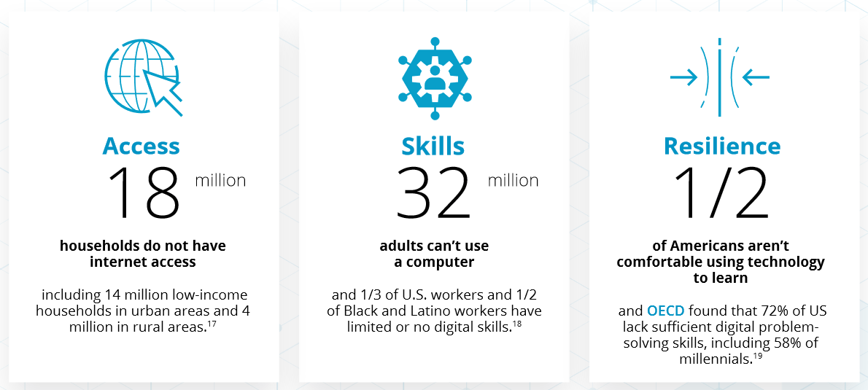
Digital Equity Imperative
https://digitalus.org/wp-content/uploads/2020/06/DigitalUS-Report-pages-20200602.pdf
Notes:
From a report called Building a
Digitally Resilient
Workforce:
Creating On-Ramps
to Opportunity
DIGITAL US COALITION
"In our increasingly tech-infused world, digital inequity compounds existing disparities...“
“Digital resilience signifies having the awareness, skills, agility, and confidence to be empowered users of new technologies and adapt to changing digital skill demands. Digital resilience improves capacity to problem-solve and upskill, navigate digital transformations, and be active participants in society and the economy. Digital US Coalition “:
8/10 U.S. executives are highly
concerned about the digital
skills gap.8
2/3 workers who struggle to use
computers are using them
on the job anyway
Even middle-skill workers
show significant gaps in
“digital readiness”.10

Slide 8
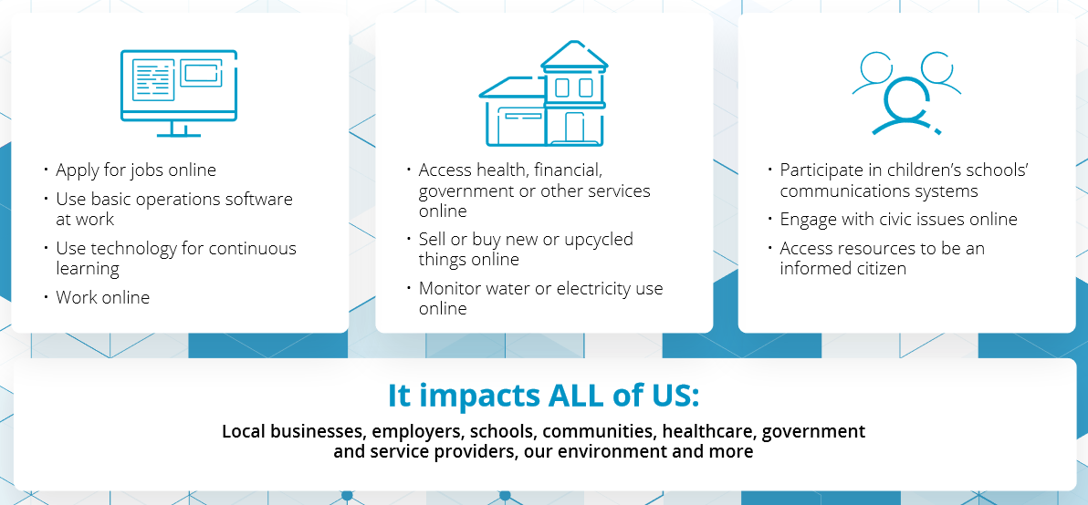
Digital Equity Imperative - Impacts
https://digitalus.org/wp-content/uploads/2020/06/DigitalUS-Report-pages-20200602.pdf
Notes:
"In our increasingly tech-infused world, digital inequity compounds existing disparities..."

Slide 9
Notes:
UN Secretary-General António Guterres’
“Digital technology is central to almost every aspect of the response to the pandemic, from vaccine research to online learning models, e-commerce and tools that are enabling hundreds of millions of people to work and study from home.”
Globally and locally the COVID-19 Pandemic is forcing higher education to adjust and overcome a variety of critical challenges. Due to the extremely contagious nature of the COVID-19 virus, remote learning has been brought to the forefront of the entire academic enterprise as a rapid deployable, scalable, and extensible model for both academic and business continuity planning. For Louisianans, COVID-19 did not create systemic access issues, yet it exposed gaps in digital equity and inclusion.

Slide 10
Notes:
“Added to this stark reality of increased risk of illness is an economic outlook in which people of color are losing employment at a greater rate and thus may be less able to afford college tuition or attend college in lieu of working to support their families. This combination of negative forces puts students of color at greater risk of not being able to attend college in the fall, due to illness and personal finances.”
“And in many homes, families still rely solely on shared computers and mobile internet with limited data plans. These technological barriers are making learning extremely difficult if not almost impossible for the most vulnerable students.
COVID-19’s impact on students from low-income families and underrepresented minorities will continue to resound at universities for a decade or more because of its effects on K-12 students. As The New York Times reported this week, rural and lower-income communities received much less live teaching this spring because of a lack of school and home resources. Taken with other factors, according to McKinsey & Co., an average student lost as much as seven months of learning this spring, with greater losses among African American (10 months) and Latinx students (nine months). This giant step backward for students added to the already existing “homework gap,” as FCC commissioner Jessica Rosenworce labeled the divide between students from connected homes and those struggling to meet the technological bar required to learn in the 21st century.”

Slide 11
Louisiana
"Students have limited access to internet, limited access to technology, and are often very limited in basic digital literacy. In addition, Adult Education students face basic need deficiencies, resulting in increased stress and a lower prioritization of free basic educational services. In this, food bank distribution, Chromebook distribution, and access to other support services support student engagement and success."
Notes:
One Louisiana campus explained the impact of transitioning to remote learning during the initial COVID-19 stay at home order...

Slide 12
Louisiana
NDIA ranked four Louisiana locations in the top 100, with Bossier City, Louisiana ranked as the third worst-connected city in the nation when considering the lack of broadband of any type in 45% of households and fifth worst due to lack of cable, DSL or fiber broadband in 57% of homes.
https://www.digitalinclusion.org/data-research/
Notes:
2018

Slide 14
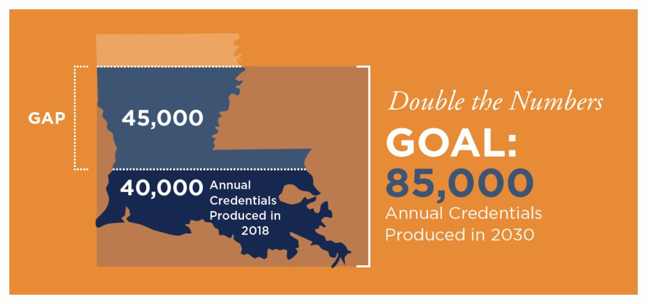
Board of Regents Master Plan
By 2020 65% of jobs nationally, and 56% of jobs in Louisiana, will require education beyond a high school diploma.
Add a little bit of body text
https://cew.georgetown.edu/wp-content/uploads/2014/11/Recovery2020.SR_.Web_.pdf
Notes:
Tying in this program to the overarching goals of higher education in Louisiana via the Master Plan
Reaching an educational attainment level of 60% will require Louisiana to more than double the number of annual credential recipients, from approximately 40,000 in 2018 to 85,000 by 2030.
Master Plan posits that "continuing to offer postsecondary opportunities ‘the way we always have’ or relying on demographic changes to ‘fix’ the problem will not be sufficient."
Pandemic necessitates that we ensure the all those ready to purse a credential or degree must be digitally ready to do so

Slide 15
Board of Regents Master Plan
Notes:
Our audience is diverse in this endeavor, it reflects the citizenry of louisiana
A look at minorities in Louisiana reveals that African American and Hispanic populations make up 32% and 5%, respectively, of Louisiana’s total population, and both have grown as a share of total population since the 2010 census. Only 19% of Louisiana’s African American citizens hold an associate’s degree or above, a number almost doubled by the white population, at 34%. Currently African American students represent 29% of students enrolled in postsecondary education and only 24% of postsecondary completers.

Slide 16
Board of Regents Master Plan
Removing Barriers
"...more than 8,000 students leave college after their first year with some credit but no degree."
Notes:
A recent report by the Education Trust gave Louisiana a failing grade in achieving equity, identifying a 10-point gap between the African American population and postsecondary attainment based on 2016 data. Hispanic students, a much smaller segment of both Louisiana’s and higher education student populations, comprise 5.2% of postsecondary enrollment and 4% of completers, percentages consistent with representation in the general population.
more than 8,000 students leave college after their first year with some credit but no degree. Louisiana can retain and graduate this talent pool by identifying and overcoming the barriers that lead students to drop out of college and often not return.
The need for remediation discourages many students, reduces access, drives up costs, and can be a barrier for adult students wanting to enroll in or return to college.

Slide 17
How can we address the Digital Literacy learning gap in Louisiana?
Give students the tools for success
Notes:
I've presented an overview of the situation and how the problem impacts the nation and Louisiana citizens. now I want to shift into how the Boar of Regents through LOUIS is positioning campuses to address this.

Slide 18
Northstar Partnership
LOUIS is pleased to announce a partnership with Literacy Minnesota to bring their Northstar digital literacy testing center capacity to Louisiana along with a professional development series on testing center administration and delivery of digital literacy educational programming.
Notes:
As part of the Governor’s CARES Act for the Governor’s Emergency Education Relief Fund (GEER) program, LOUIS: The Louisiana Library Network (LOUIS) has been tapped to implement a digital literacy program under the direction of the Commissioner of Higher Education, Dr. Kim Hunter Reed and LOUIS Executive Director, Dr. Teri Gallaway. This program was developed through the Board of Regents (BoR) Digital Inclusion Strategic Action Team, which identified improving digital literacy as one strategy the Louisiana higher education community could embrace to address the negative impact of the digital divide during the COVID-19 pandemic.
This partnership allows campuses to participate in a training program on digital literacy and to also have access to the NorthStar digital literacy testing center

Slide 19
What is Northstar?
Mission: To help individuals around the world master the digital skills needed to work, learn, and participate fully in daily life.
Notes:
"About Northstar
Northstar Digital Literacy defines basic skills needed to perform tasks on computers and online. Online, self-guided modules assess the ability of individuals to perform tasks based on these skills. Included are basic computer digital literacy standards and modules in three main areas:
Essential Computer Skills - Computer Basics, Internet Basics, Email, Windows OS, Mac OS X
Essential Software Skills – Word, Excel, PowerPoint
Using Technology to Accomplish Tasks - Social Media, Information Literacy.
Northstar was developed in response to the needs of job seekers who may lack the digital literacy skills needed to seek, obtain, and retain employment, as well as to perform other tasks in daily life. Northstar allows end users to freely take the assessments from anywhere via our homepage, but individuals can instead go to an approved testing location and obtain the Northstar Digital Literacy Certificate when they pass assessments. Certificates provide an important credential for employment, as even entry-level jobs increasingly require basic computer skills. Certificates also certify end user ability to complete computer skills needed in higher education, and demonstrate their ability to use social media and online information thoughtfully. If individuals do not pass, personalized assessment results provide a roadmap to relevant instruction, allowing them to retake the assessment once they have mastered the necessary skills.
Northstar is used by over 1020 Adult Basic Education programs, colleges, nonprofits, workforce centers, government agencies, and businesses. There is no cost to complete the assessments on the Northstar homepage."

Slide 20
How does Northstar Work?
3 Essential Parts
Digital Literacy Lessons
Student Skills Assessments
Certification

Slide 21
Digital Literacy Lessons
Essential Computer Skills
Basic Computer
Internet basics
Using Email
Windows 10
Mac OS
Essential Software
Microsoft Word
Excel
PowerPoint
Using Technology in Daily Life
Career Search Skills

Slide 22
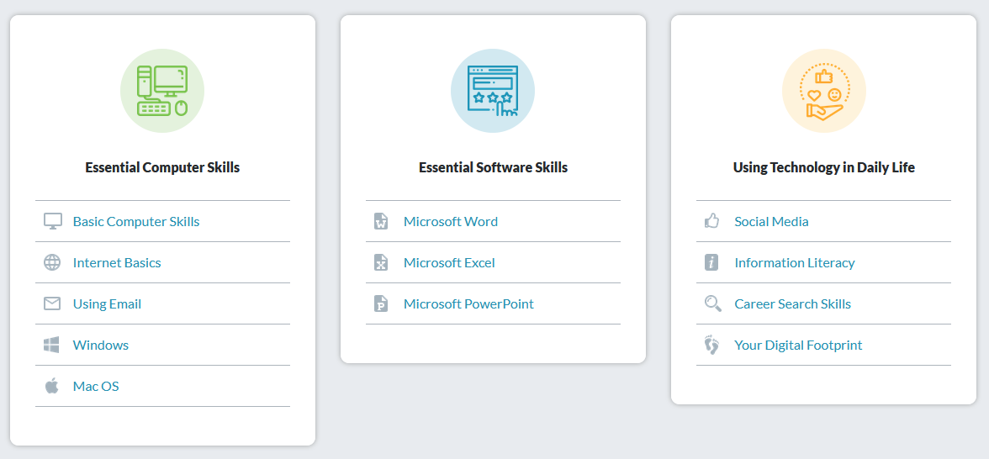
Student Skills Assessments

Slide 23
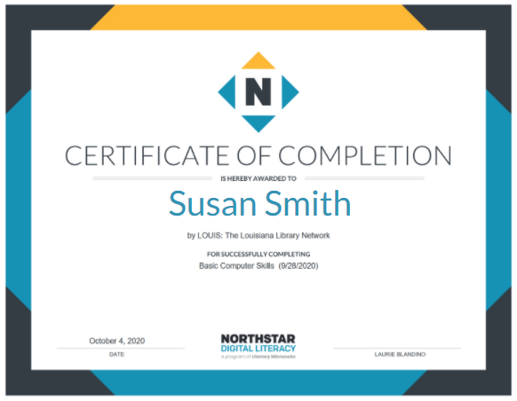
Certifications

Slide 24
How can you get involved?
Provide Testing Center Contacts
Schedule Introductory Training
Strategy Sessions for Campuses/Systems
Notes:
Contact LOUIS to organize implementation or access training materials:
LCTCS and WorkReadyU
Southern starts next week

