Slide 1
Interlibrary Loan in Turbulent Times: Keeping Academic Research Flowing during a Pandemic Regina Foster, Library Specialist Supervisor, Louisiana Tech Jacob Fontenot, Head, Interlibrary Loan, LSU Baton Rouge Jackie Hawkins, Interlibrary Loan, Northwestern State April Rome, Library Specialist, Nicholls State Angela Mason, Director for Public Services, Southern University Law Center Jessica Perry, ILL Coordinator, Loyola University New Orleans
October 7th 1:00pm-2:00pm
Notes:
This panel will discuss how interlibrary loan librarians and staff across the state kept academic research going during the pandemic. Our panelists will talk about the personal and technical challenges we faced, how we communicated changes to ILL services to our patrons., and special projects we did. We want to start a conversation. So after our presentations, we’d like ILL folks in the audience to ask questions and share your stories!

Slide 2
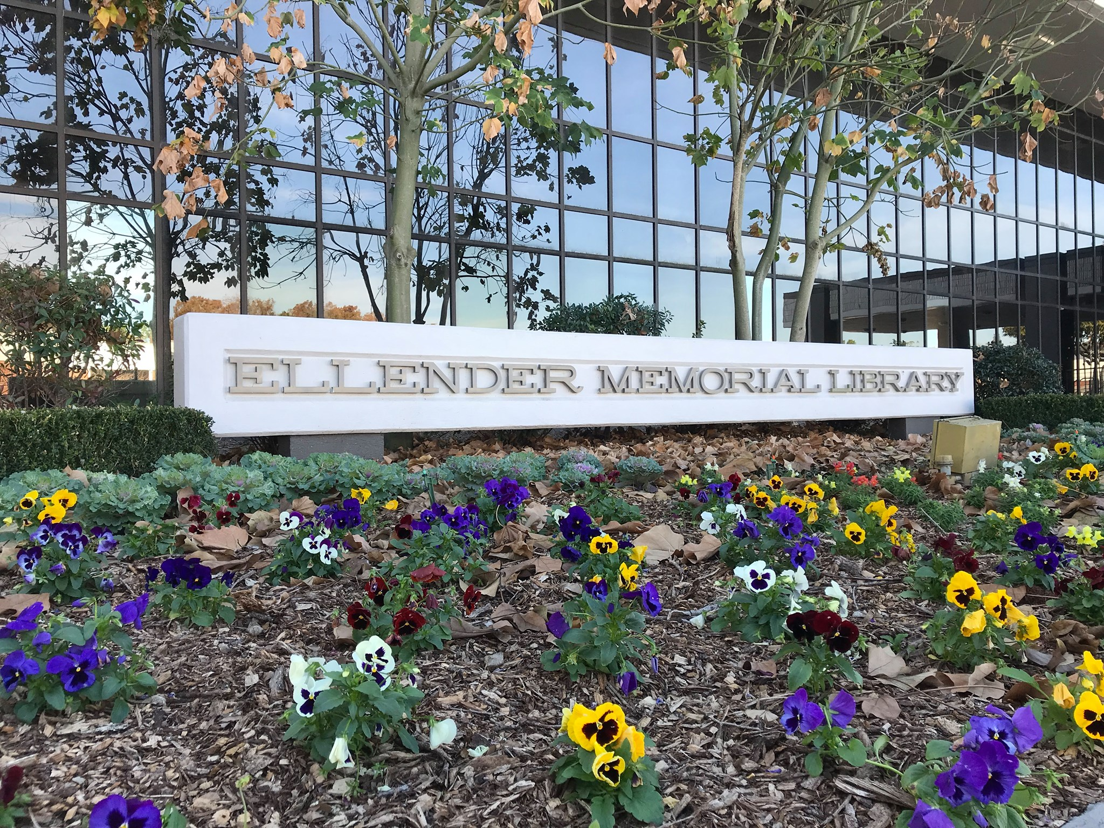
April B. Rome Library Specialist 3
Nicholls State University

Slide 3
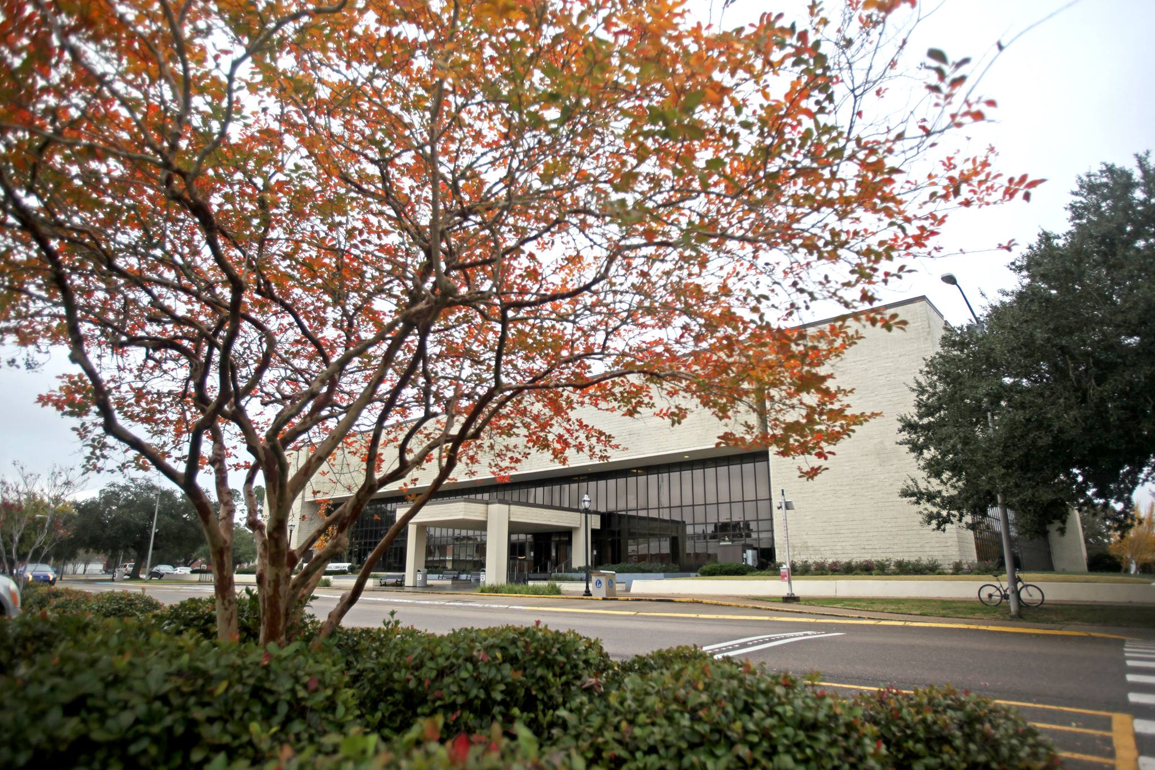
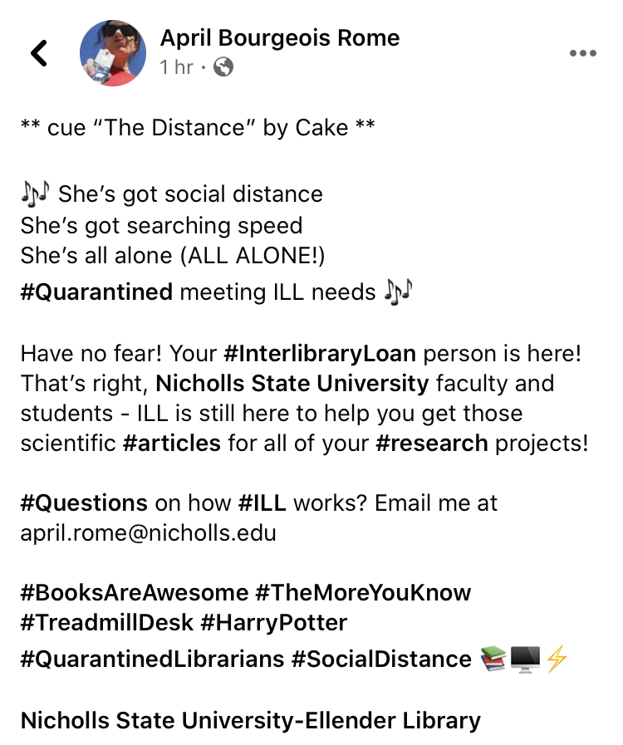
Next up: Regina Foster from Louisiana Tech

Slide 4
Communicating Services Regina Foster Library Specialist Supervisor Prescott Memorial Library
October 7, 2020

Slide 5
Borrowing
Considered placing a web alert on the library’s web page that we would not request books through ILL
Instead, I sent cancellation or may not be able to borrow messages for the individual request

Slide 6
Borrowing cont.
Examples:
Tech library owns this volume of the journal. It cannot be checked out. It cannot be requested through Interlibrary Loan. You can view the journal in the library. It is being held at the circulation desk. The library hours are M-TH 10am-5pm and Friday 10am-1pm. Masks are mandatory. Only the main floor is open at this time.
We cannot provide ILL book loan services at present. Many partner libraries have closed or ceased mailing books at this time. Individual chapters should be available in IEEE XPlore located under Databases on the library's webpage.
We cannot provide ILL book loan services at present. Many partner libraries have closed or ceased mailing books at this time. One chapter can be requested if you know which one you need.

Slide 7
Receiving Mail
All incoming ILL books were quarantined for3-6 days

Slide 8
Lending
Set a deflection for loans in the OCLC Policies Directory
Changed days to respond for loans from 4 to 20
Books not loaned from March 21-August 31
Jeffrey updated a couple Google spreadsheets that we were not lending physical items
Processed article requests and provided electronic copies if available
Updated the OCLC list that we could accept returns in July
Next up: Jacob Fontenot from LSU

Slide 9
Borrowing Print… in a Pandemic? Jacob Fontenot Head, Interlibrary Loan LSU Library
October 7, 2020

Slide 10
Bridging the Gap
On March 17th, 2020 LSU Library closed to staff and patrons. Borrowing print was not possible. Borrowing was reduced to articles and book chapters only.
We borrowed over 7,300 physical items in FY 2019.
Whole books are still in demand.
We needed to bridge the gap until we could borrow print again….

Slide 11
Alternatives to Print - Ebooks?
Option #1 Internet Archive’s “National Emergency Library”
Allows checkout. No success.
Option #2 “EBOK” the OCLC group of ebook lenders.
17 libraries. Mostly VIVA (Virginia.) Only select publishers.
Brill, Oxford, Taylor & Francis, Wiley
https://vivalib.org/c.php?g=836990&p=6137355
Notes:
Recommend making a custom holdings group in your ILL system with EBOK libraries.

Slide 12
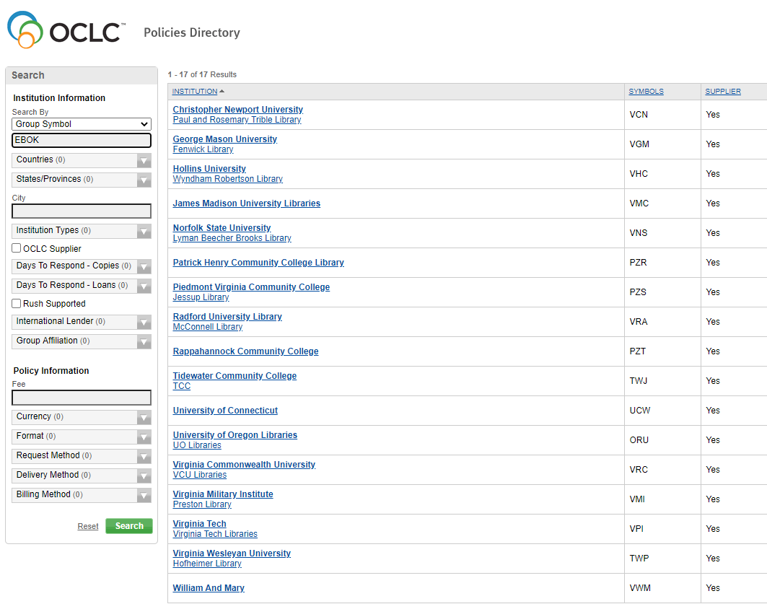
https://illpolicies.oclc.org/

Slide 13
Options for Patrons: Email Template
1) Hold (request after library reopens)
2) Scan (selected chapters)
3) Cancel

Slide 14
Reopening!
Reopened for patron pickup on June 10th!
Sent pickup notice for every book on the ILL Holds shelf. If overdue, we extended the due date to July 1st and circulated it.
* Included new library pickup hours and Covid safety instructions in the notice.
Patron Returns
In July we had ~700 books checked out to patrons. About 600 were overdue. Did not want to receive all them back first week of Fall. Sent overdue notice asking patrons to return the books. Had a deluge of returns in late July and early August.
Next: Angela Mason at Southern University Law Center
Notes:
Edited lots of templates: Due Soon, Overdue – to tell patrons to drop off but NOT at desk, or mail it back. Also mentioned quarantining books. Pickup Notifications – to explain new pickup procedures
We had about 650 items checked out to customer. Emailed all patrons with overdue books before. Many were due before or just after the pandemic closure. We created an ILLiad email template to notic

Slide 15
Remoting In Angela Mason Assistant Director for Public Services Oliver B. Spellman Law Library Southern University Law Center
October 7, 2020

Slide 16
Working Through the Process
Initial Support from IT
Small department
Very busy transitioning everyone
Figuring Out Our Best Option
RDP
VPN
Whitelisting IP address
MAC Compatibility Issue

Slide 17
The Result
One Librarian – Access from Home
One Librarian – Periodically Working from the Office

Slide 18
What I Learned & What I Would Do Differently
Following-up with IT more earlier on.
Communicating with other libraries
Next: Jackie Hawkins from NSU

Slide 19
How NSU ILL kept services going during the closure Jackie M Hawkins, Library Specialist
October 7, 2020

Slide 20
Statistics 2019 vs. 2020

Slide 21
NSU ILL kept services going during the closure
Worked from home
Once or twice a week scanning
Email sent to patrons letting them know they can still pick up book
Days to Respond in OCLC was changed
Did not mail books, requests or returns. 7-day quarantine.
No overdue charge

Slide 22
Changes?
Set up email system
Example: Send emails to only patrons that have books to pick up
Or send emails to only active ILL users to notify them of any changes.

Slide 23
ILL in the Pandemic - Updating ILLiad pages Jessica Perry - Loyola University New Orleans
October 7

Slide 24
LLM Stats
Borrowing: 1959 articles, 656 loans requested 2018-2019
Lending: 381 articles, 842 loans requested 2018-2019
Pandemic Lending: 133 article and 321 loan requests 2019 3/1 to 7/31 vs 212/231 in 2020.
Pandemic Borrowing: 700 article 209 loan requests 2019 3/1 to 7/31 vs 147/47 in 2020.

Slide 25
Upgrading ILLiad pages
Can easily do from home
Match new library and university website
Mobile-friendly
Less cluttered/granular, more intuitive for students
To change color/font, you need some basic CSS knowledge

Slide 26
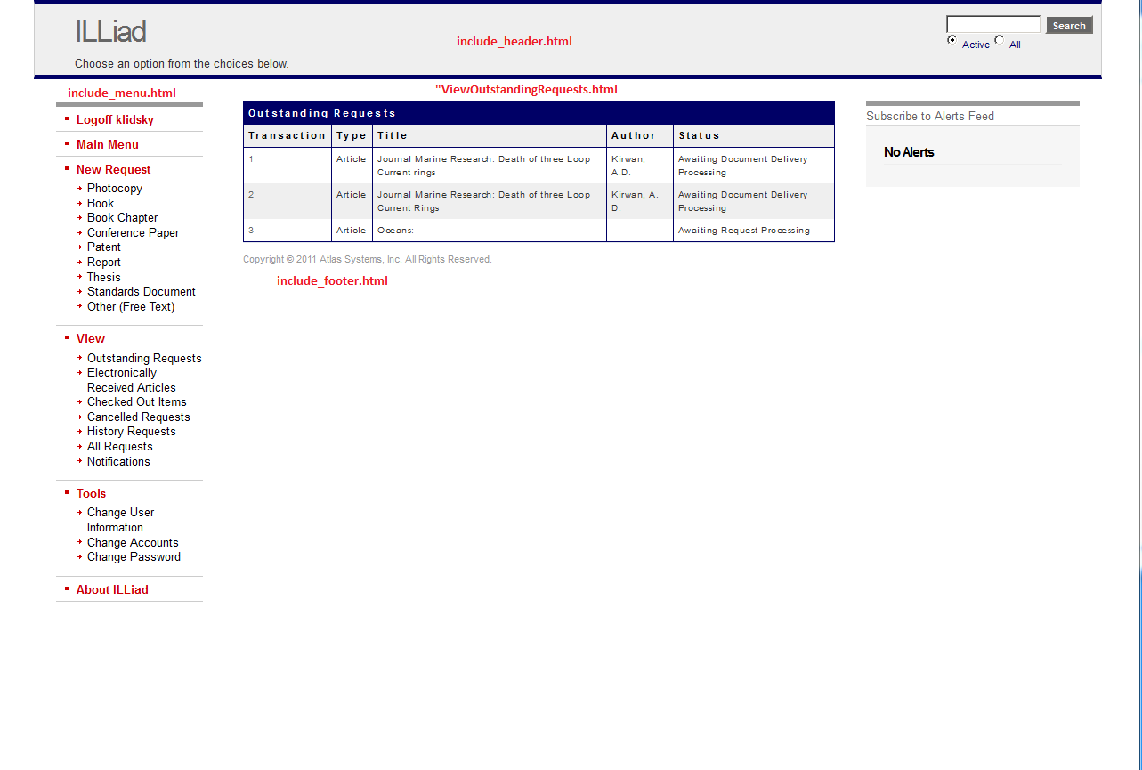

Slide 27
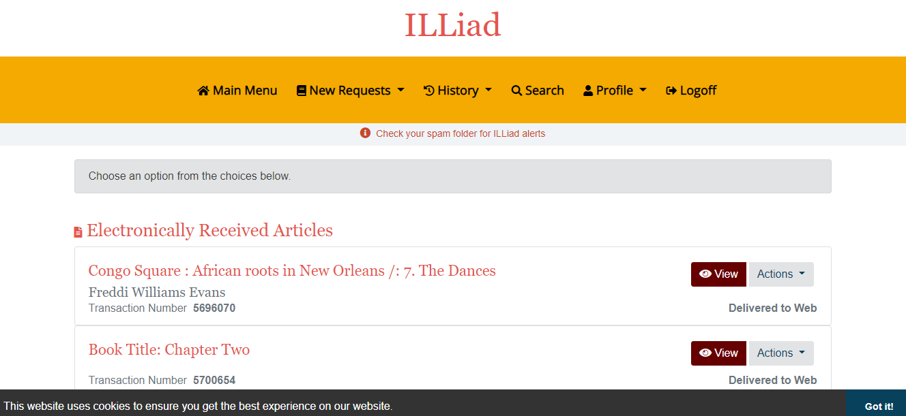

Slide 28
Recommendations
Thorough testing on testweb, including user registration and updating profile. Use HTML/CSS comments
Double check hidden fields
Helpful documentation: https://task.louislibraries.org/hc/en-us/articles/360049032113-ILLiad-Upgrade-to-v-9-1-Summer-2020 https://support.atlas-sys.com/hc/en-us/articles/360037397593-ILLiad-9-1-New-Fully-Accessible-and-Responsive-Web-Pages-
Or email me! perry@loyno.edu
Notes:
The default look is fine, but if you want to match your university colors you may want to ask your web department for guidance
We still had an old setting that made the default delivery of articles print instead of electronic. The departments were also not accurate. I manually deleted all text/SMS notification options since we don’t offer that service.
I still wanted to use Accept Non English, so I had to add it back in

