Slide 1
Changing on a Dime: Reworking an Information Literacy Workshop Series in the COVID-19 crisis
Peter Klubek and Johannah White
Baton Rouge Community College
LOUIS Users Conference, Oct 7 2020

Slide 2
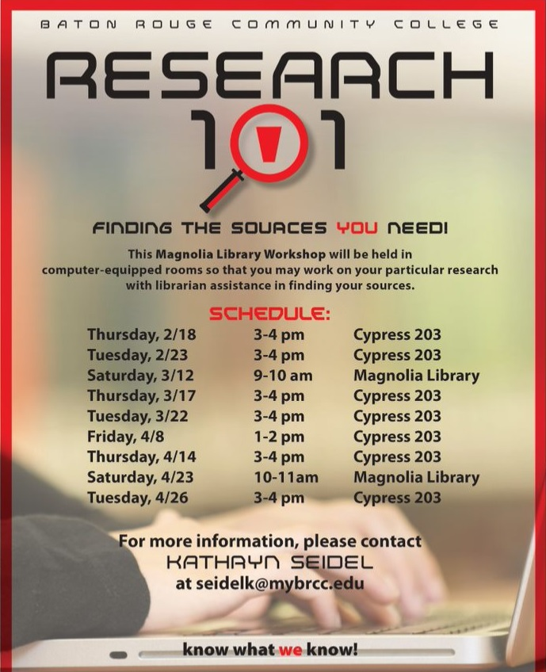
Research 101
History
- The Research 101 series
of workshops began
in the 2000’s.
- Intended as a route to help
students learn how to use the library
databases etc.

Slide 3
Research 101
History
-The earliest research 101
workshops were very
popular.

Slide 4
Research 101
History
-Student Participation
was welcomed and
encouraged.
-A partnership with
library club developed
and SLEUTH formed.

Slide 5
Research 101
History
-SLEUTH Libguide

Slide 6
Research 101
History
-SLEUTH Libguide

Slide 7
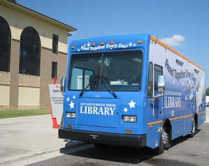
Research 101
History
-SLEUTH Libguide

Slide 8
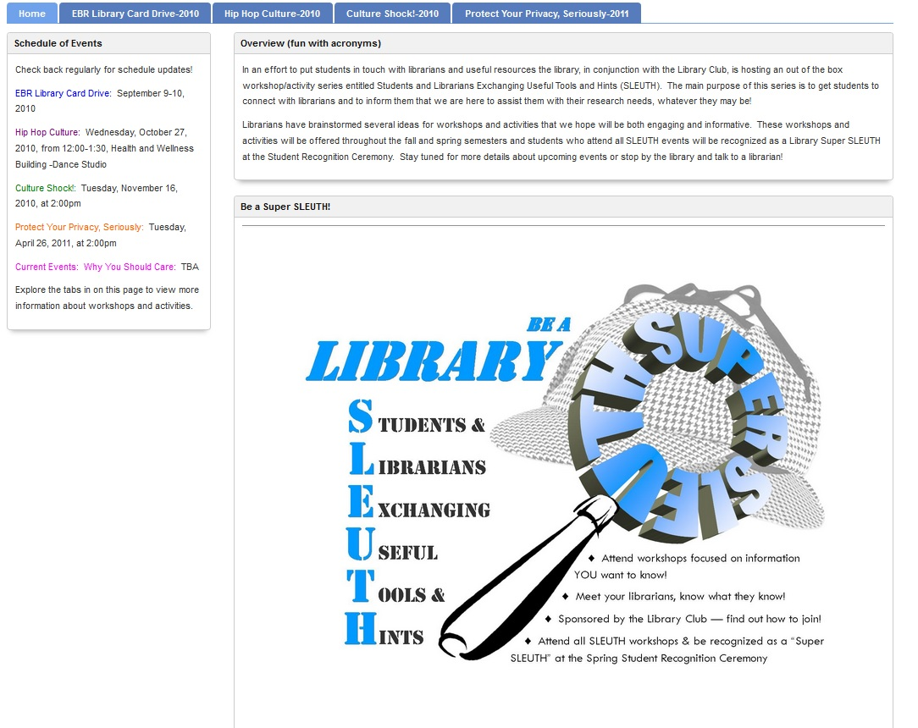
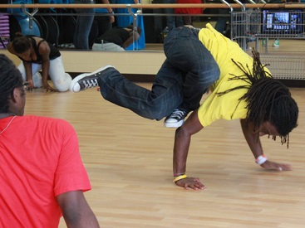
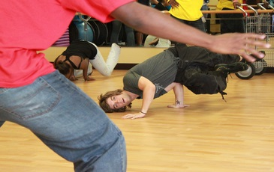
Research 101
History
-SLEUTH Libguide

Slide 9
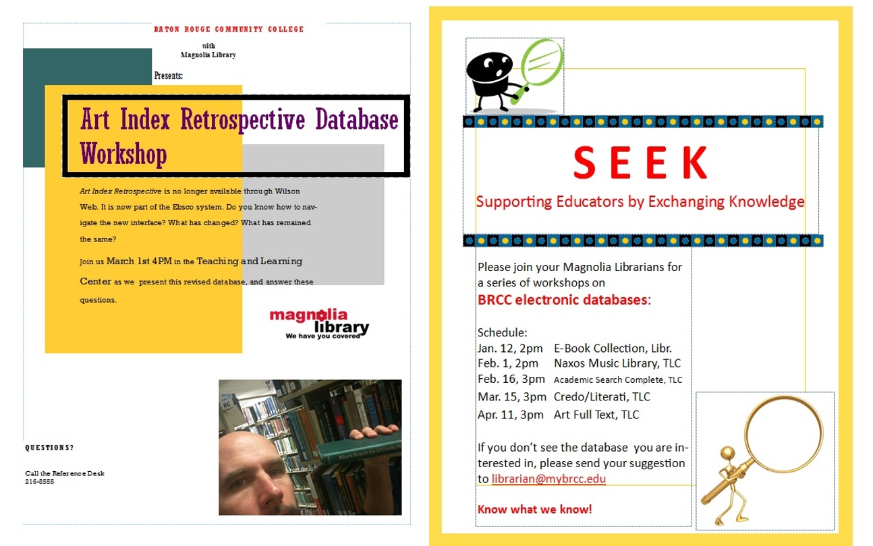
Research 101
History
-With the continued
success of Research 101,
faculty sessions and sessions
targeting specific databases
were developed.

Slide 10
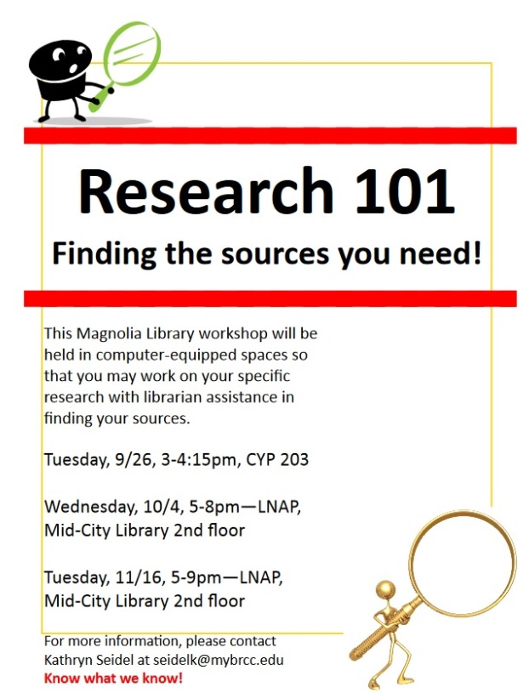
Research 101
History
-Research 101 became
linked with LNAP
(Long Night Against
Procrastination).

Slide 11
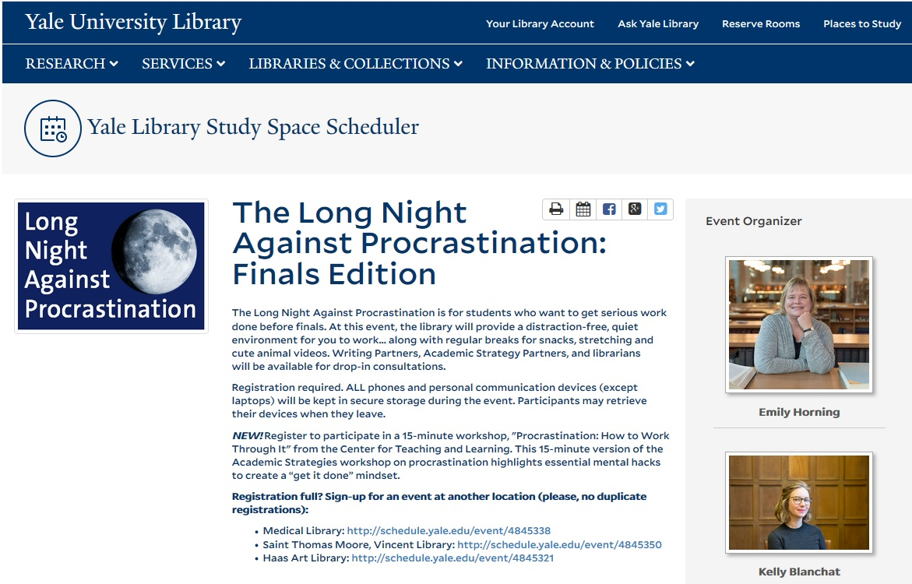
Research 101
What is LNAP

Slide 12
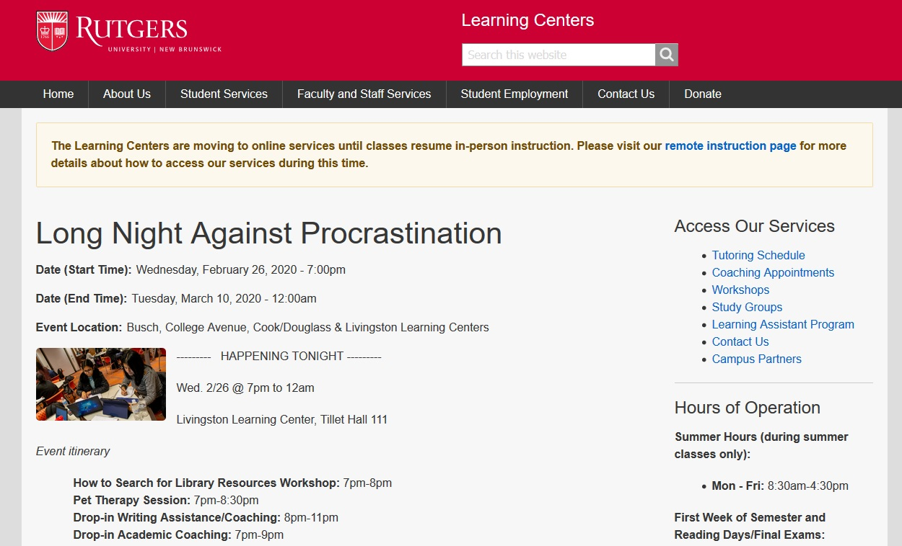
Research 101
What is LNAP?

Slide 13
Research 101
What is LNAP?

Slide 14
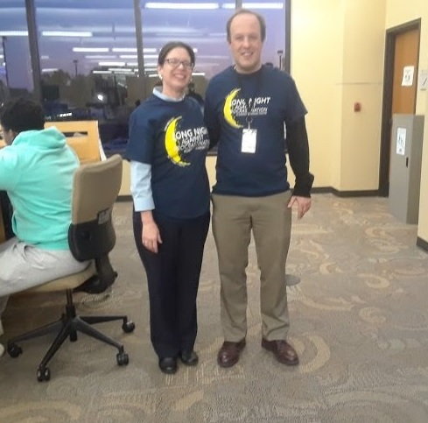
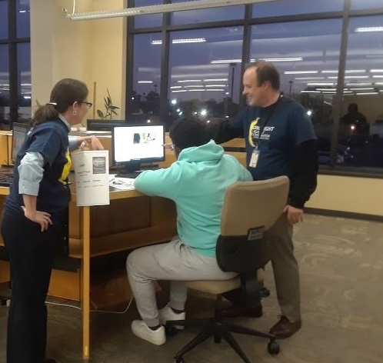
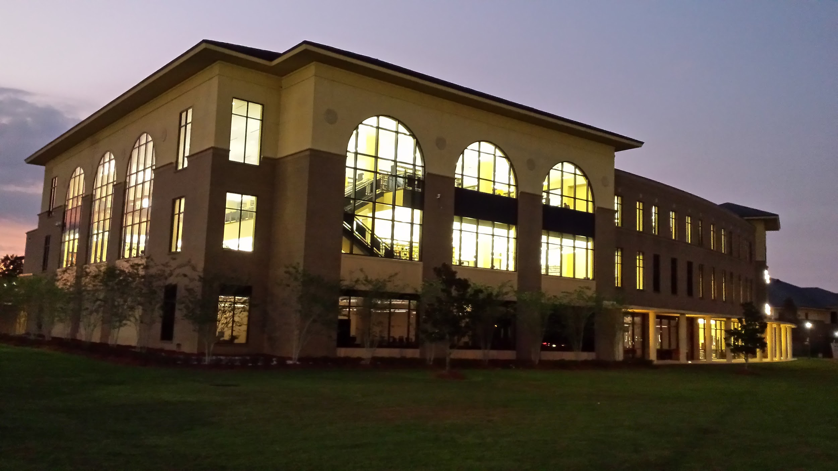
Research 101
LNAP 2019
-The library offered Research
101 as part of LNAP 2019
only.
-Session was held in the
library at the Reference
Open Lab.

Slide 15
Research 101
Spring 2020 ‘Long Night Against Procrastination’
Observations

Slide 16
Research 101: The Next Iteration
More librarians! Meet your liaison
Breakout Rooms--cycle through
Rewards or Kudos to Instructors on Behalf of Students
Assessment-- 3 Questions; Poll Everywhere
#1 Why did you attend this session?
#2 Did you get the help you needed?
#3 Would you tell a friend about your experience?

Slide 17
Thank You!
Questions or comments?
Feel free to reach us at:
peter.klubekatlouisiana.edu and
whitej2atmybrcc.edu

