Slide 1
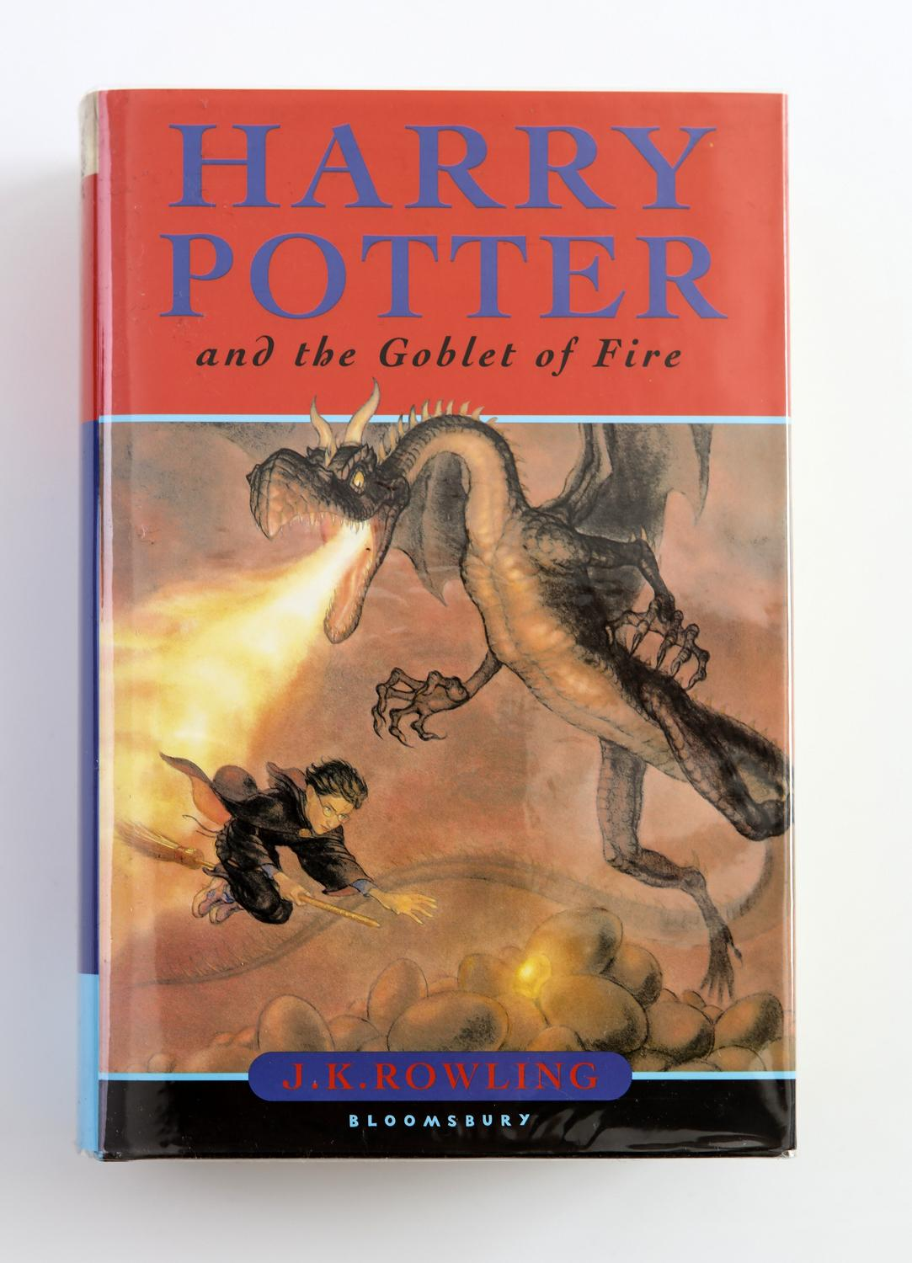
A Study of Virtue-Based Typology Within the Field of Librarianship Using a Universal Personality System
SURVEY RESPONSES:
Randa Lopez Morgan - Events and Programming Librarian
Winnie Schwaid-Lindner - Digital Preservation Librarian
ugh
Image source: abebooks.com
Notes:
(r)
Welcome! This is Harry Potter and the Goblet of Survey Responses: a study of virtue-based typology within the field of etc etc etc
We are Randa Lopez Morgan and Winnie Schwaid-LindNer. I am the Events and Programming Librarian and she is the Digital Preservation Librarian.
We are both HP lovers and we both happen to be Slytherins.
What is Harry Potter?
Harry Potter is a 7 book young adult fantasy series that came out 23 years ago about a boy who goes to a magical boarding school and whose greatest strength is repeatedly being almost killed.
99% of the series doesn’t matter to us, but we do care about the magical boarding school bit.
Hogwarts is a school that teaches students how to do magic. When students enter their first year at Hogwarts, they are sorted into one of four houses, these houses.
In reality, these houses were created as a reference to how the English educational system has traditionally grouped their students in terms of “houses”, but this sorting concept has taken on a life of its own as far as Hogwarts houses are concerned.

Slide 2
Presentation Outline
Contextual information about the Harry Potter Universe
Why this topic of study?
Research Methodology
Survey Conclusions
Unintended Conclusions
Unintended Consequences
Other Lessons Learned
Questions
Image source: Mike Hinson / BuzzFeed https://www.buzzfeed.com/lorynbrantz/15-of-the-best-harry-potter-comics-ever-made
Notes:
R
Today our goal is to cover
Contextual information: things you need to know to follow along
Why this topic: why we chose this topic, and why we think it’s relevant
Research methodology: how we went about this survey
Conclusions: what we found in relation to what we expected to find
Unintended conclusions: what we found about data we didn’t realize we were collecting at the time
Unintended consequences: things we didn’t realize about the survey until we closed it
Other lessons learned: what we know now that we didn’t before

Slide 3
Context - The Hogwarts Houses
Gryffindor
You might belong in Gryffindor, Where dwell the brave at heart, Their daring, nerve, and chivalry Set Gryffindors apart;
Hufflepuff
You might belong in Hufflepuff, Where they are just and loyal, Those patient Hufflepuffs are true And unafraid of toil;
Ravenclaw
Or yet in wise old Ravenclaw, if you've a ready mind, Where those of wit and learning, Will always find their kind
Slytherin
Or perhaps in Slytherin You'll make your real friends, Those cunning folks use any means To achieve their ends.
Rowling, J. K., (1998). Harry Potter and the sorcerer's stone. New York :Arthur A. Levine Books.
Notes:
R
These are the Hogwarts Houses as defined by the Sorting Hat in HP Book 1. It's very one dimension and there's not a lot there honestly. However, in the past 23 years, Millennials have really ran with the houses. Asking, "What is your Hogwarts House?" Is a common way of meeting new people and learning a lot about them in a very short amount of time. We have all globally developed a universal understanding of what each house is and how they are represented.

Slide 4
Image Source: https://i.pinimg.com/originals/90/ff/05/90ff05258cd0c3e667eb21c4bb11b692.jpg
Notes:
R
The way the fandom has interpreted the traits belonging to each house is very different than the canonical definition by Rowling and it's only grown overtime.
One of the comments we got is that the houses as defined by JKR are just, “good, evil, smart, other” and we have really ran past that as fans.
Just Googling Hogwarts House traits gets us 1,280,000 results.
Hogwarts house memes: 14,100,000 results
The houses hold different significance to each and every person who either reads the books or sees the movies and there’s a lot of subjectivity in what people interpret the houses to be / indicate.
We will talk about this more later but there is a distinction between canon and houses as independent entities, where the fandom now dominates the narrative of what houses indicate .
The best example of this is that in Slytherins in the books are evil, also known as the house where terrible people go, but the traits that are assigned to Slytherin, “cunning” and ambition, are not inherently negative traits. This means that in real life, identifying a Slytherin has absolutely nothing to do with being good or evil. The same is true of Gryffindor, the rivals to Slytherin, who are treated as the place where all the good guys go.

Slide 5
Inspiration
“The Sorting Hat of Medicine: Why Hufflepuffs Wear Stethoscopes and Slytherins Carry Scalpels”
251 respondents
Clear delineations between different specialties and the different houses
Expected to see equivalent results with regards as to article and clear definitions
Image source: tiktok user xo90210
Notes:
R
This past summer I read an article titled, "The Sorting Hat of Medicine: Why Hufflepuffs Wear Stethoscopes and Slytherins Carry Scalpels.”
This was a web survey of 251 students in the medical field about the houses they belonged in. They found some pretty interesting correlations. Slytherins – more surgical specialties than Hufflepuffs
General Surgery- More Gryffindors than Hufflepuffs
Orthopedic Surgery- more Slytherins
Pediatrics- Few Gryffindors more Hufflepuffs
OGYN- more Ravenclaws, few Gryffindors
Family Medicine- no Slytherins
We expected that, similar to The Sorting Hat of Medicine, we would see a clear stratification within subfields of librarianship. However, these categories are more clearly defined whereas, librarianship is more subjective.

Slide 6
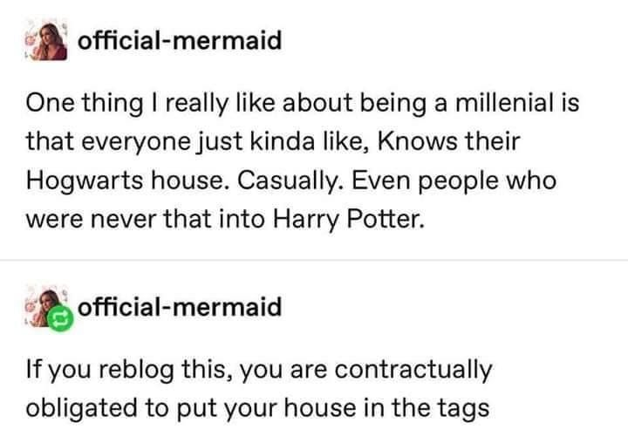
Motivations
Human urge for classification in general
Self-classification
Millennials in libraries and archives
It’s fun and we’re fun
Image source: official-mermaid.tumblr.com
Notes:
W
Looking into our motivations for why we wanted to do this survey for our field, there are some interesting aspects to classification in general. It's clear, from all of the personality quizzes and different personality identification systems out there that we, as humans, have a very strong urge to classify ourselves in many different ways.
This, naturally, includes the humans in *our field* specifically. The urge to classify is really interesting in and of itself, and it's interesting to consider what the resulting classification means, as well.
The reason we supported the idea of doing this classification through hogwarts houses, is primarily that these houses are a rudimentary self-classification tool which enables the person themselves to choose where they want to be. This is clearly aligned with the sorting system in the HP series (as you can be given the opportunity to choose which house you’re in), as well as beneficial in a practical sense of self-identification: choosing which house you’re in is essentially choosing which house’s primary values are most important to you.
In addition, we felt it was important to consider our audience.
There are a million jokes about how millennials, which we both are, and which make up the largest share of the library/archive workforce at this time, place a particularly high value in categorization in general (like buzzfeed quizzes) but more specifically, that we have a particular affinity for Hogwarts houses, to the point that it’s become an identifier and joke about the entire generation. You’ll see some of these jokes throughout this presentation, but please know that there are many, many more. As two millennials out of the millions that the jokes are about, we wanted to use a tool that's relevant to our generation within the field, but more importantly one that doesn't require taking a proprietary test, or have complex answers that require additional deciphering, like the Meyers Briggs system which has 16 possible outcomes.
Lastly, there’s also the undeniable aspect we’re doing this because we find it entertaining. There is an entire field of scientific research around identifying personality traits and this is NOT that, this is two people who thought this sounded like fun, and are delighted to be presenting on it.

Slide 7
Research Methodology
Started with questions from Sorting Hat of Medicine but modified it to fit our field.
Qualtrics
IRB Approval Process
Number of respondents
Resubmitting
When/Where Survey Ran
Number of respondents
Resubmitting
Coded in Excel
Python (a different type of coding)
Image source: twitter.com/jacuhbo
Notes:
R
I originally started this project on my own. I wanted a short and easy survey that people could fill out quickly so more people would be likely to complete it.
I debated a lot about the questions and what I was expecting from each answer. I wanted people to be able to just report what area of librarianship they worked in and their job title. I thought (stupidly) that there would be common areas. There were but we also had a lot of nontraditional answers as well that were kind of confusing. I also wanted anyone working in libraries (not just librarians) to be able to participate.
Decided to use Qualtrics (which has lots of creepy features, by the way) since it was the easiest way.
Ran it through IRB approval process but ended up resubmitted it twice. Once to add Winnie, the second time to increase the number of respondents. We started with 250 and then increased to 1000.
Survey ran starting July 22nd 2020 and we hit our 1000 on august 10th 2020
Posted it to the ALA Thinktank FB group and ALA Connect.
Shared it on the LSU Libraries Listserv.
Spread to various listservs and across the country. Was surprised at not only how fast it spread but also WHERE it spread. Friends on the USAIN Listserve were emailing me to tell me they saw the survey.
W
From there, we decided to code the results of our 3 main qualitative questions in excel. This was partially done because of ease of use, as we both already have excel and our data already fit nicely into a spreadsheet, but also because it was a way to ensure that our coded results stayed connected with the survey submission they were derived from, as well as being easily separated so the coded version could be used with with no connection to those results.
The responses were coded on a question-basis (aka going down one column in the spreadsheet). For two questions the coding was done by one of us instead of both, which gave us more internal consistency than could’ve been done with 2 people working on the same thing, while we ended up working together to code one of the questions to reduce bias.
One of these questions asked "Do you see any parallels between the qualities of your Hogwarts House and how you approach your work?", and this one required the most coding, which Randa kindly did. This included a wordlist of 166 keywords to maintain consistency between different survey responses, and these were all added into one excel field per response, and the keywords were separated with a percent sign for easy parsing later.
At this point, I wrote a python script to separate coded keywords and to keep track of how many keywords were listed for each house, regardless of how many responses there were, because one response may indicate more than one keyword.
Lastly, I went back to excel to make the graphs you'll see in this presentation.

Slide 8
Survey Conclusions: Disclaimers
Neither of us have a stats or data analysis background
(identifying as more than one house is valid though, people aren’t generally just one version of anything)
People often identify as more than one house, but that’s not represented here
That affects results
Image source: tiktok user nae_nae_boy_
Notes:
W
Before we delve into what we found, there are a few disclaimers that we need to acknowledge here
1. we’re doing this because it’s interesting and fun, but neither of us have a stats background or significant experience with data analysis, so you should probably take everything you see here with a grain of salt - it’s possible that if we were to show any of this to an actual statistician, they’d have a VERY different take on the numbers.
Second disclaimer is that a lot of people identify as more than one house, and commented as much. Because the survey was only structured to accept one house, it means that they had to pick the house they identified most closely with. This meant that our coding probably reflects a greater spread of traits per single house than may exist... or maybe that’s actually how it would look even if we did allot for combined houses, there’s really no way to know.

Slide 9
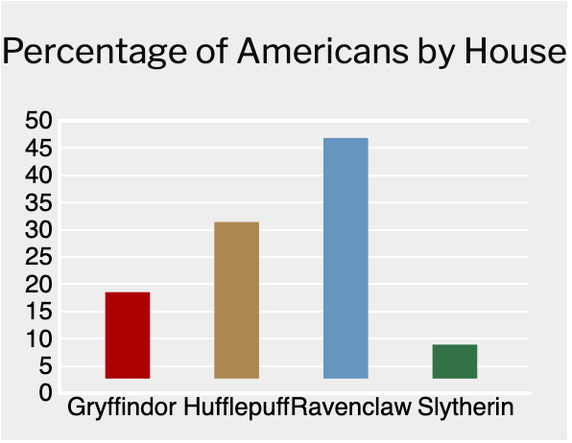
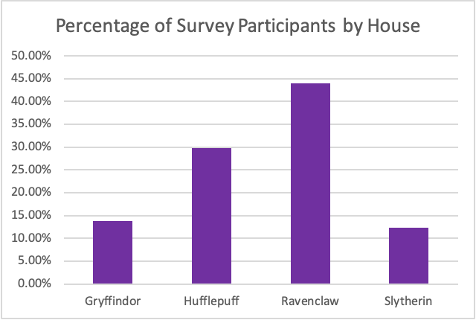
Survey Conclusions: Disclaimers
Time Magazine / Cambridge Results
Our Results
Appears, upon first glance, to align with study identifying national trends...
Except that’s actually not true
Image source: Time Magazine
Notes:
W
Another disclaimer is in our results compared to other results.
Time magazine and University of Cambridge collaborated to see what the spread of houses would look like for America as a whole, and superficially we were surprised that our results looked so similar to theirs. However the more we started to dig into it, the more apparent it became how superficial that alignment actually was.
Our study (on the right) differs from theirs (on the left) in at least one significant way: ours is based off self sorting, where people choose where they should be, while theirs is based off the results from a quiz that all participants take which indicates which house you’re in, and then adds that data to form these combined results.
This means that they needed to create questions and form a quiz that would indicate which house you would be in, and in forming their test questions and results (they never published an article of the results so we have no real point of reference here), they seemed to have based this quiz off a canonical and simplistic interpretation of slytherin traits, in that they basically used the definition of slytherin as “evil” when building their quiz. We both identify pretty strongly as slytherins and neither of us were sorted into slytherin in their quiz. So, in a way, our results are very incomparable to theirs, since we don’t have enough information to know what parts of our processes hold any kind of parallels, and all we know from our sample size of the 2 of us was that it was wrong.
What this also indicates though, of course, is that we are people and people are unpredictable and have our own biases, and when you’re doing something like this, there are going to be huge variations in how each person interprets any given question or situation at hand, regardless of whether it’s our survey or their quiz.

Slide 10
Survey Conclusions: Disclaimers
Very unequal distribution across houses
Means we can only really compare ratios, not numbers
Notes:
W
Looking deeper into our own results: Because of the huge variation in how many respondents there were from each house (which is inherently interesting by itself) we run into a problem where it’s really not a 1:1:1:1 comparison from house to house, especially when we get to gryffs and slyths who had the fewest respondents
We have to wonder if them having the fewest respondents is because we didn’t reach them, or is it because they just aren’t highly represented in the field? OR are there fewer people who identify as slytherins because they’re basing slytherins off the negative qualities in the books, the same ones that time magazine based theirs off? The world may never know, but all we do know is that we had one comment in the survey that said “who would self sort into slytherin????”.
So, although we originally thought that your area of expertise would indicate what house you were in, needing to breakdown by house in order to try to normalize the numbers we were seeing means that we can only really compare the general ratios between the houses. So by percent of the house in a category instead of percent of the category belonging to each house is where most of the actually interesting stuff started to appear

Slide 11
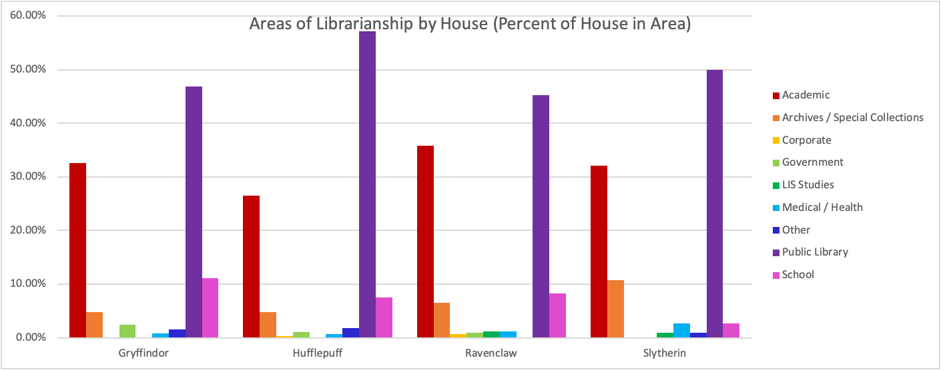
Notes:
W
So this is a pretty good example of that.
On the top you see the different areas but according to how many people said that’s the area they were in – so you can see that, farthest to the left, there were slightly over 40 gryffindors who work in academic libraries.
On the bottom, you can see this being normalized by percent, essentially to get the ratios of who is where, to try to get as close to comparing 1:1:1:1 as possible. So looking back to the same section as we did above, the gryffindors in academic libraries, you can tell that 33% of all gryffindors work in academic libraries.
Although it would be easy to say that public librarians (the purple category) are more likely to be ravenclaws by looking at the top graph, that’s not really taking into account that our respondents were most likely to be a ravenclaw in the first place. So when you compare within the house, you start to notice things like how it’s actually hufflepuffs that have the highest percentage of public librarians, which isn’t surprising, but slytherins having the second highest percentage, which I think is.
The last disclaimer is that at some point you reach a “chicken or the egg” scenario:
Looking at the graphs at the rightmost hot pink bar in both graphs, we can tell that Slytherins don’t like being school librarians – is this because Slytherins don’t like working in schools, or maybe because Slytherins interested in being school librarians don’t associate themselves with the negative reputation that the books give Slytherins? Gryffindors have the highest percentage of their house working in schools, which could indicate that that’s true since gryffindors are repeatedly touted as The Good Guys in the books, oooor it could indicate that the personality traits gryffindors emphasize means they find themselves well suited to school librarianship.
Because of the huge variation in respondents for each house, it’s actually more interesting when slytherins and gryffindors show an equal or higher count for a category, like how Gryffindors have the same number of respondents working in government as puffs do, even though far fewer gryffindors responded, or how slytherins are also more likely to work in archives or special collections than any of the other houses are.

Slide 12
What did we actually see?
Nothing lifechanging
There are some fun tidbits though
Notes:
W
Ok ok, enough with the disclaimers, what do we actually see? This is a larger version of the bottom graph from the previous slide
Mostly… there are no real life changing correlations/causations we could find?
There were a couple of small, fun things, like how ravenclaws didn’t have any jobs that we (or they) identified as “other” (like working for an independent non-profit or for a synagogue, or doing childhood community engagement), and that ravenclaws have the most diverse spread of categories (again, this could just be because we had the most ravenclaw respondents)
We also can tell that Hufflepuffs aren’t a huge fan of academia while ravenclaws love it (shocker), only ravenclaws and slytherins work in LIS studies (like professors or consultants studying the field), while only puffs and claws work in corporate environments, and no slytherins work in government (which also makes sense)
Out of the 4 houses, gryffindors and slytherins were the most different from *each other* between areas of their fields, while hufflepuffs had the greatest difference between the two most popular categories of work within their own house: public librarianship and academic librarianship, and ravenclaws were most evenly distributed.

Slide 13
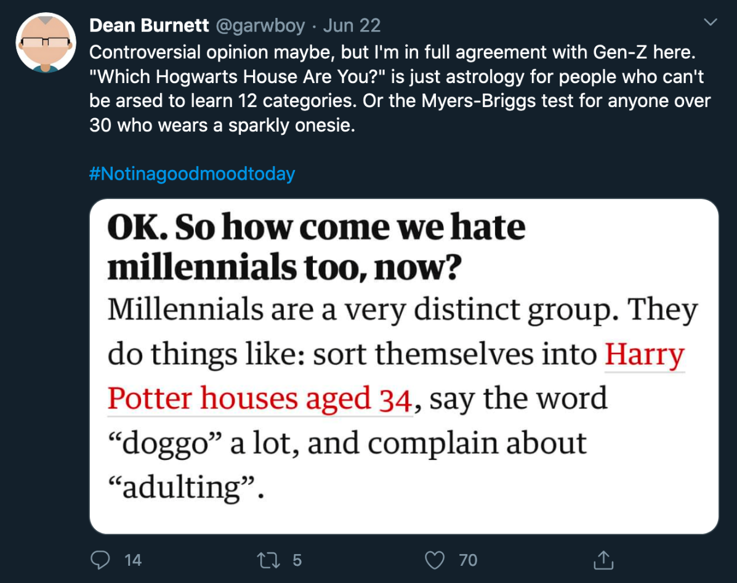
Unintended Conclusions
MLIS Degrees
Time it took to fill out the survey
Time of day the survey was filled
Keywords from coding
“Do you have any comments?”
Types of comments?
Image source: twitter.com/garwboy
Notes:
W
But the unintended conclusions we found were actually far more interesting.
One of our questions asked whether people have MLIS degrees so we were able to compare ratios there, but Qualtrics also provides information about the survey itself, such as the time it took to complete it and the time of day it was completed, which ended up being some of our more entertaining results.
We also did coding to determine keywords from each qualitative response, including responses to our last question on the survey: "do you have any comments?" and I’ll show you the results of those.

Slide 14
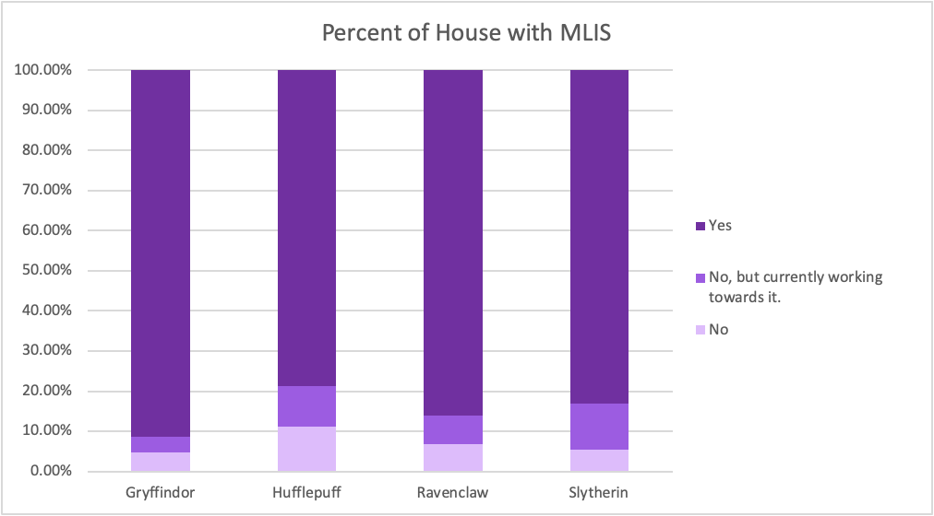
Unintended Conclusions: MLIS
Gryffindor is the house with the highest percentage of people with an MLIS, while Hufflepuff is the lowest
Notes:
W
Starting with MLIS results, we can see that gryffindors have the highest percentage of people with an MLIS but the lowest percent of current students, and puffs the lowest percent of people with an MLIS, while slytherins have the highest percent currently working towards it. The questionable Time Magazine and Cambridge study said that “Slytherin is for the young”, as it was most prevalent among younger people, so part of me wonders if that’s something that’s indicated by the highest percent of people currently working towards an MLIS, but who really knows.

Slide 15
Unintended Conclusions: Duration
Hufflepuffs take the longest to answer a survey
Gryffindors the shortest
Slytherins don’t appear to have a clear peak in the trend
Notes:
W
This chart is how long people in each house took to answer the survey (courtesy of qualtrics), with the x axis (the horizontal axis for those of us who haven’t taken math or thought of graphs in a very long time) being number of seconds it took to answer, and y axis (the vertical) being number of people who answered in that amount of seconds.
You can’t see it because it’s an outlier, but we actually had one Hufflepuff who left their survey open for several days before finishing it. But even so, hufflepuffs took the longest to finish, and gryffindors the shortest. Also one interesting bit is that how slytherin is the only house that doesn't have a clear peak in their results, indicating that there was a more even distribution over time of slytherin respondents.

Slide 16
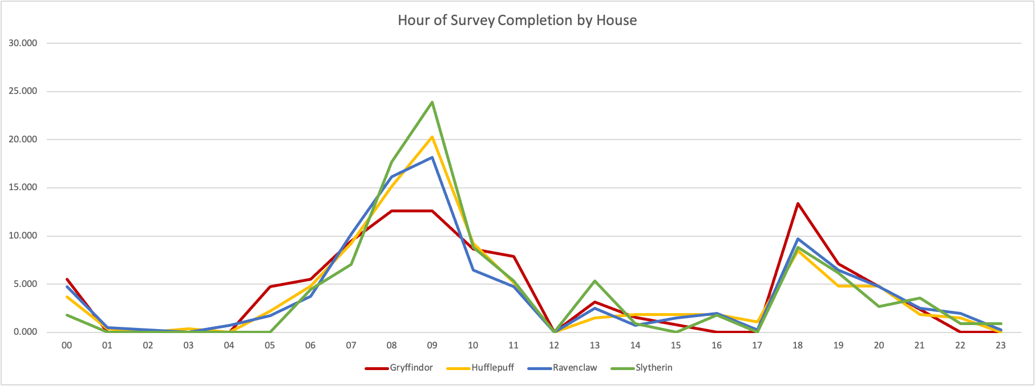
Unintended Conclusions: Time of Day
Slytherins are most likely to complete the survey first thing in the morning
Gryffindors like to do surveys at 6pm
Ravenclaws wake up the earliest
Hufflepuffs are most consistent, especially in the afternoons
Notes:
W
Looking into another qualtrics field, the time of day people responded, here's a graph where the y axis is percentage of house’s answers along that point in time and the x axis is the hour of the day, so 01 is 1am and 13 is 1pm.
Also I'm pretty sure that these results are from local time of the respondent? This data is from qualtrics and I couldn’t actually tell, but:
Slytherins are most likely to complete the survey towards 9am, presumably at the beginning of the day, while gryffindors do it at the end, or maybe after work?
Ravenclaws wake up the earliest (or at least a few of them did), and hufflepuffs are the most consistent in the afternoons, which you can see by the yellow line remaining pretty steady, starting at 13 and extending til 17.

Slide 17
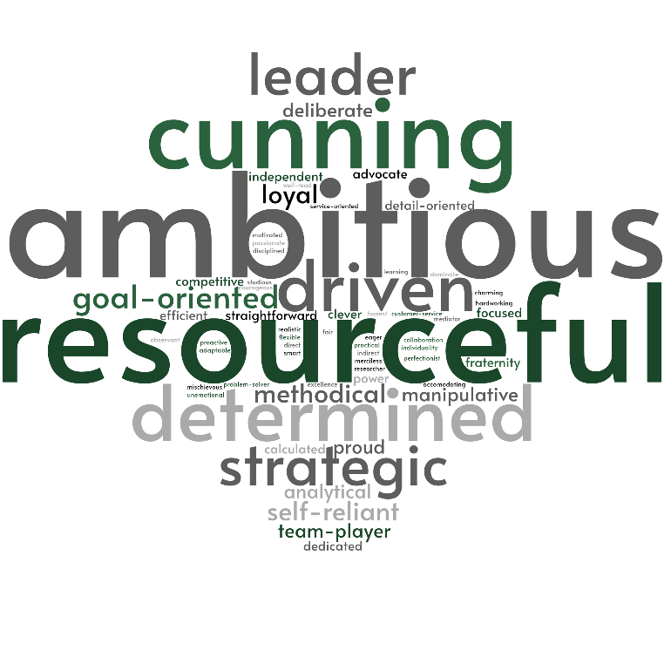
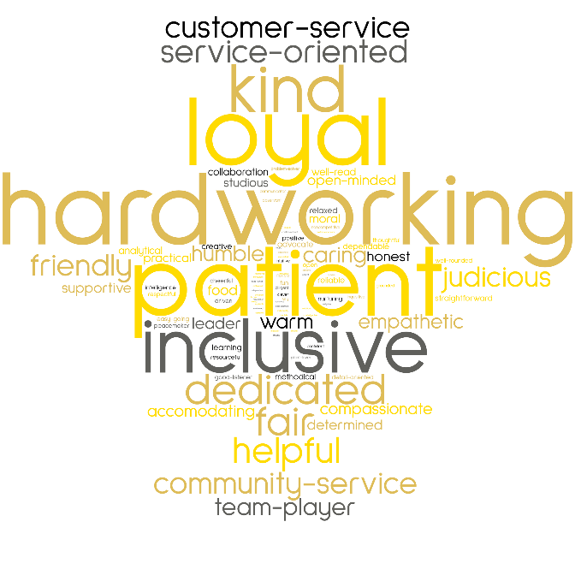
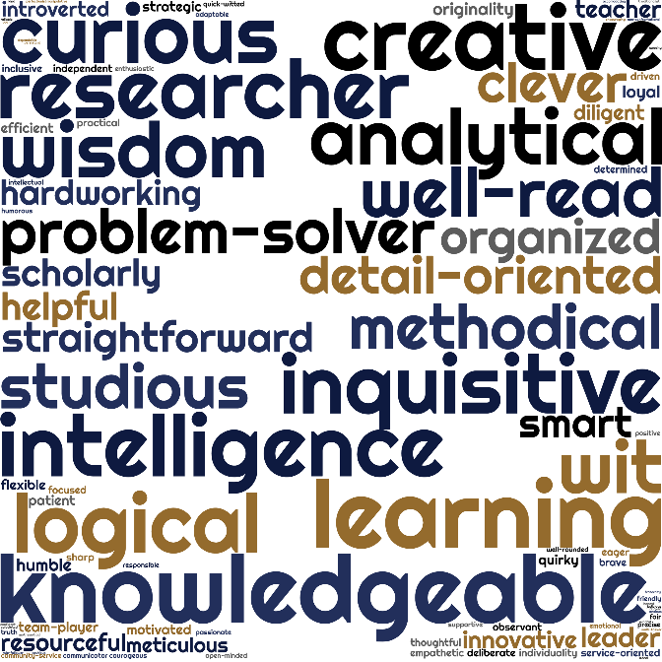
Unintended Conclusions: Keywords
Gryffindor
Slytherin
Hufflepuff
Ravenclaw
Notes:
R
These are word clouds made out of the coded traits we identified and we will go into these specifically in just a minute. One of the questions asked in the survey was, "Do you see any parallels between the qualities of your Hogwarts House and how you approach your work?"
Over 700 people responded to this field. Some would just list characteristics while others would write longwinded responses and why they thought the things they did. People would often list multiple traits. To help with consistency in the vocabulary, I created a word list using the words that they would use. I ended up with 166 character defining words.
There is inherent biases to this process however. Because I was the only one doing this coding, I would read a response and tag it with the words I felt was proper. For instance, Humble in this context is defined as someone who works without recognition. I used judicious in place of justice or just. I also tried to use neutral language so not to give any one house, "negative" traits. Also, pregnancy brain would have me asking my partner, "What does it mean to not leave anyone behind?" Or "Yes, I am very eager to do a good job and will do whatever it takes - which often translate to doing others' work to pick up the slack." Is it this tag? Or this tag?
Keywords only really brought unintended conclusions, because in general you see what you’d expect to see: a high prevalence of the traits used to define each house by the sorting hat, so Gryffindor's are brave, Slytherins are ambitious, etc.
However, you can probably immediately see some differences that we can delve into

Slide 18
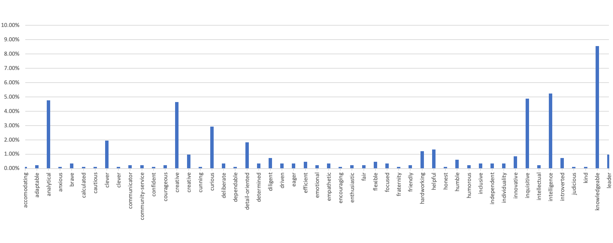
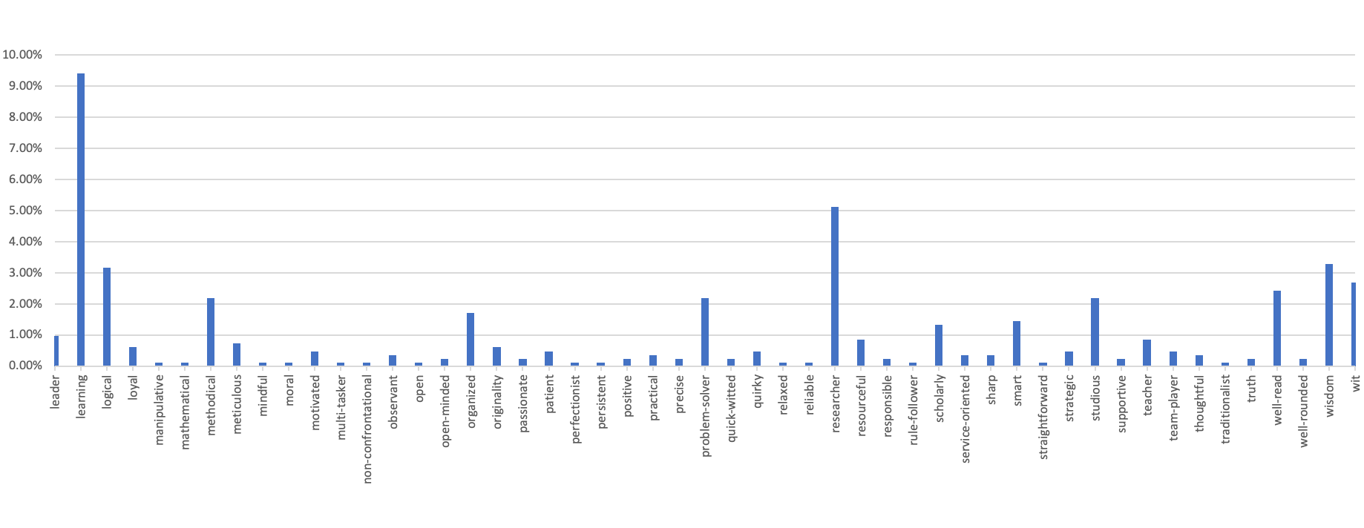
Unintended Conclusions: Keywords
Largest number of separate traits
Notes:
W
Starting with ravenclaws!
There were actually so many traits ravenclaws used to describe themselves or conveyed in their response that they wouldn’t even fit on a single bar graph, so I've broken it out into two just for the sake of visualization, and they do have the same scale, so they're comparable.
The percentages that are along the Y axis are that trait divided by the total number of times that any traits were listed for all ravenclaws, so we're looking at what was most popular within a house.
As you can see, there are a lot of traits but they’re pretty evenly distributed, which seems to be a bit of a ravenclaw theme – there are the expected peaks for traits like “knowledgeable” and “learning”, but a lot of traits with just a few respondents attributed to them as well.
One thing I found pretty funny is that a lot of these traits that ravenclaws used to describe themselves are solidly complimentary: intelligent, knowledgeable, wise, etc. so I’ll let you draw your own conclusions from that
Also, this is the word cloud that randa had the most trouble with because the number of words made it really difficult to get everything visually represented, which really does fit right in with the graphs.

Slide 19
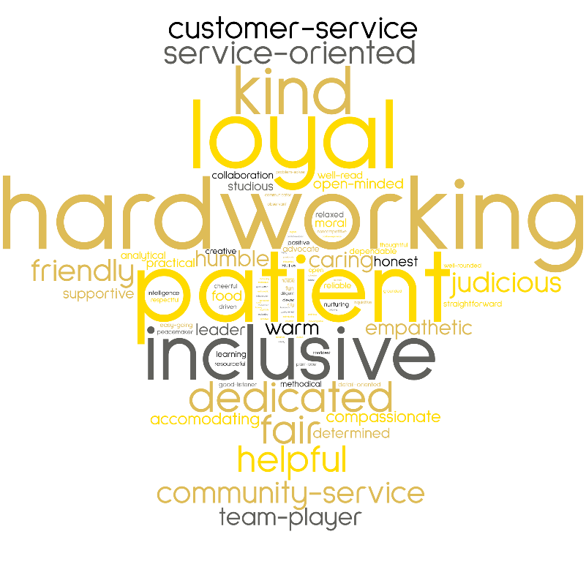
Unintended Conclusions: Keywords
Traits are mostly as expected
But food
Notes:
W
Looking at hufflepuffs, both the bar graph and word cloud look pretty much as expected, not too much breadth but with a lot of responses for quintisential hufflepuff traits like “hardworking”, “loyal”, and “patient” which are highlighted in light purple, but interestingly, "hardworking" is in direct contrast to “laziness” as seen in giant letters from the wordcloud from the beginning of this presentation. We've been wondering if there's a difference in how others see puffs vs how puffs see themselves, or if it's a case of working from different definitions, like the hufflepuff equivalent of 'slytherins are evil'
Some other notes are that puffs were also more likely to just list their characteristics without providing justification for those traits.
And if you look at that one keyword that’s highlighted in pink, that shows how Hufflepuffs were also the only house to mention food in their responses.

Slide 20
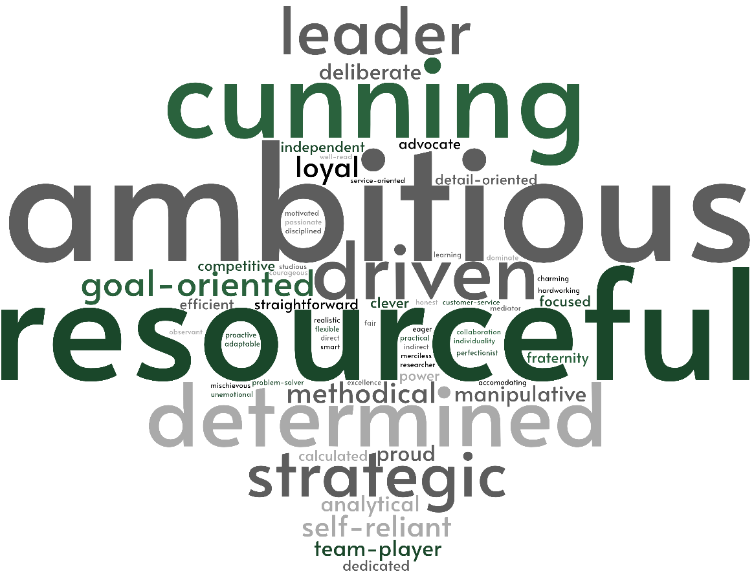
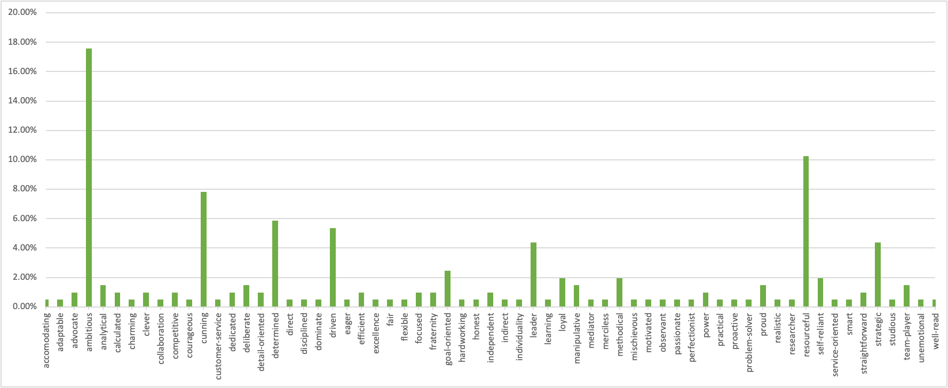
Unintended Conclusions: Keywords
Highest percentage of a single trait
Fewest number of traits
Notes:
W
Slytherins have the highest percentage of people indicating a single trait at 17.6% (which is ambition) while resourcefulness comes in second place at about 10%. Although you'll have to take my word for it, this 10% is the same percentage of the *highest* hufflepuffian trait, so slytherins have a higher concentration of traits. Slytherins also have the fewest number of individual traits out of all the houses and the fewest respondents (like an inverse of ravenclaw), so it’s possible that Slytherins have a very strong sense of identity, orrrr that we’re not creative, or that we don’t tend to write a lot, or even just that there aren’t a ton of us.
Slytherins were also more likely to list traits that seemed more matter of fact or "honest" like being manipulative or ruthless.
Randa ended up having to create alternative words for some of these in order to try to maintain a neutral tone since many of these have negative cultural associations, and no other house needed alternative words. We wanted to be able to compare these traits with the equivalent from another house, such as slytherins saying “ruthless” which we broadened to “driven”, while other houses are likely to use less negatively associated words to express the same thing and are more likely to just say either “driven” itself or perhaps “motivated” which is more neutral/positive leaning. So we changed the slytherins to fit the other houses instead of fitting the other houses to slytherin.

Slide 21
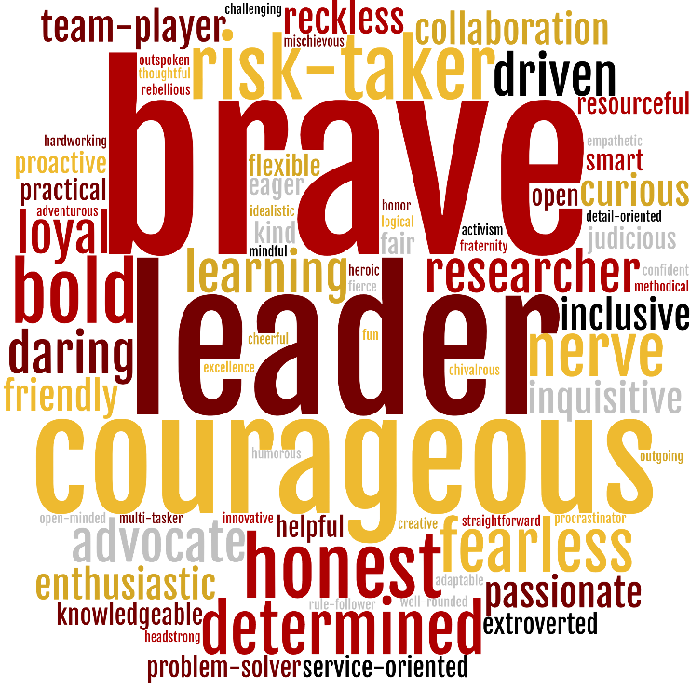
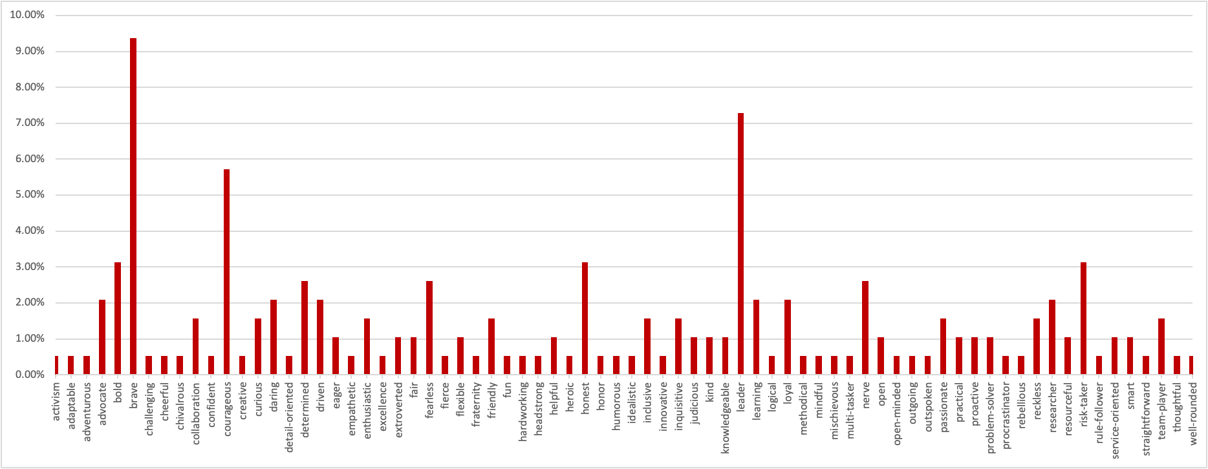
Unintended Conclusions: Keywords
Have leader as the second most prevalent trait
(Leader does not mean manager)
Notes:
W
Lastly, we get to Gryffindor. Gryffindors are another where the traits are basically as expected, but we did find it interesting that Gryffindors seemed to strongly identify with the trait of leadership (highlighted in light purple here), but we didn’t see any indication that gryffindors were actually *in* leadership positions more than any other house. However, they are more likely to work in government, so perhaps leader is more of highlighting the importance of leadership? Who knows?

Slide 22
Detail-oriented
Flexible
Leader
Loyal
Methodical
Practical
Problem-solver
Service-oriented
Team-player
Notes:
W
This is a combination of all of the previous bar graphs stacked on top of each other, and is therefore broken into two stacked graphs just like the ravenclaw graphs from a few slides ago. As you can hopefully see, most of the traits that are in a house’s description are dominated by that one house, so “brave” is dominated by gryffindors, but it’s interesting to see traits that are clearly shared by more than one house.
There are some pairings, both predictable and not:
Houses known for being more extroverted (Gryffindor and slytherin) are more likely to identify as leaders, while ravenclaws and slytherins, houses known for being more calculating or analytical, are more likely to identify as being “detail oriented”.
One interesting thing about this spread is that in traits that have responses from each house, ravenclaws are usually the odd one out. For example, hufflepuffs are the most loyal which makes sense as loyalty is a trademark Hufflepuff trait, while Gryffindor and slytherin are pretty equal to each other, but ravenclaws don’t identify with being loyal *at all*, and the same goes for “team player”. This could be because ravenclaws had their traits distributed so thinly across so many different traits and have so few popular traits in the first place, or it could be because they don’t identify with those things, we have no way to tell for sure.
BUT more interesting than all of that I think, is all of the fields highlighted in light purple and listed to the side. These are fields that have substantial representation from each of the houses. Some houses are more represented than others and I’m certainly not trying to claim they’re all equal, but they all have pretty clearly visible representation from each house. This, reading between the lines, makes me think that perhaps these are traits that we feel are applicable to librarianship as a whole. As librarians, we may all see that we are detail oriented, flexible, leaders, loyal, methodical, practical, problem solvers, service oriented, and team-players.

Slide 23
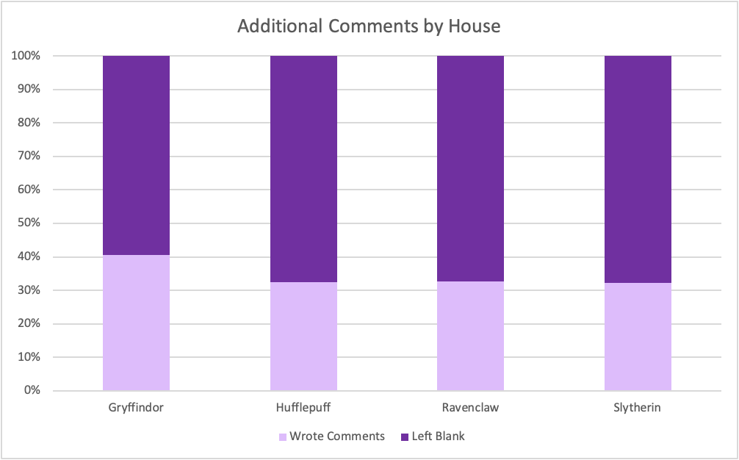
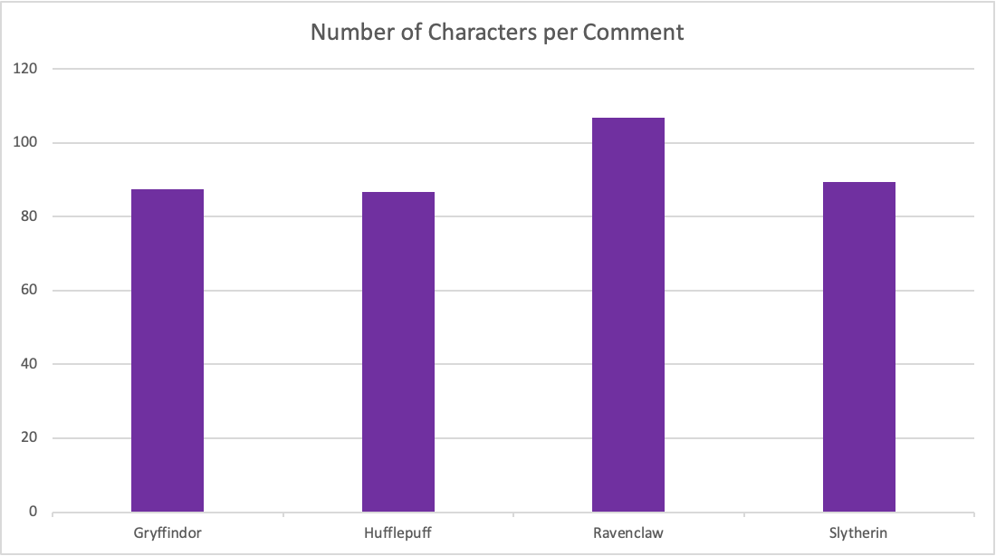
Unintended Conclusions: Comments
Gryffindors most likely to have additional comments… but when Ravenclaws leave comments they write a LOT
Notes:
(w?)
Continuing on with unintended conclusions, we looked into the comments left in the “do you have any comments” section.
The chart to the left is the percent of respondents from each house who left any kind of additional comment in our section, while the right is the average number of characters per comments left.
So we can see from this that gryffindors are more likely to be outspoken and have things to say, but when ravenclaws DO have something to say, they’re rather…….. Verbose… about it.

Slide 24
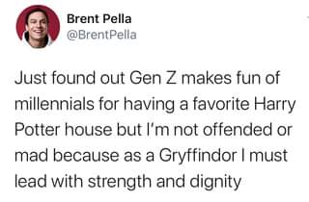
Unintended Conclusions: Types of comments
Critical: having questions about our survey methodology
Elaborative: elaborating on either their house characteristics or another field that was multiple choice
Encouraging: “Very interested in your results from this survey!”
Insightful: adding insight
JKR: “F**k J. K. Rowling and her anti-Semitic, transphobic, fat-phobic, and generally awful viewpoints.”
No: “No”
Prediction: “I think a lot of librarians will be Ravenclaws.”
Rude: “This is a ridiculous exercise without any possible value to a real profession”
Notes:
R
Together, Winnie and I went through and decided what each comment is and how to tag it so that it would decrease the amount of bias (or in Randa's case, anger at the rude comments). We used 8 different tags and some comments go more than one tag.
The tags were:
Critical: not necessarily negative, not necessarily positive. More along the lines of constructive criticism
Elaborative: elaborating upon or clarifying some point that they said elsewhere. Sometimes saying they fit in more than one house, sometimes saying that they were about to graduate from their MLIS but didn’t yet technically have it
Encouraging: pretty self explanatory. We got some “this is fun!” and “can’t wait to see the results!”
Insightful: we only had one of these and it was about food and didn’t really fit anywhere else
JKR: comments about JKR as a person. Some were critical, saying they thought we shouldn’t be doing this kind of research which publicizes her work since she’s so terrible, and others like this one, which are critical of her but not of the survey or of us.
No: people who commented to say they didn’t have any further questions or comments instead of leaving it blank
Prediction: some comments shared how they suspected the results would pan out, saying that they suspected a lot of ravenclaws or hufflepuffs, or some particularly funny ones mentioning about how they thought administration was almost certainly all slytherins
Rude: some rude comments, which we thought were funny if only because why would you fill out an entire survey just to write several paragraphs about how you thought it wasn’t worth your time to fill out the survey? It’s worth noting that people, overall, were very supportive and encouraging.
Also, to note, these comments on this slide are actual comments we got.

Slide 25
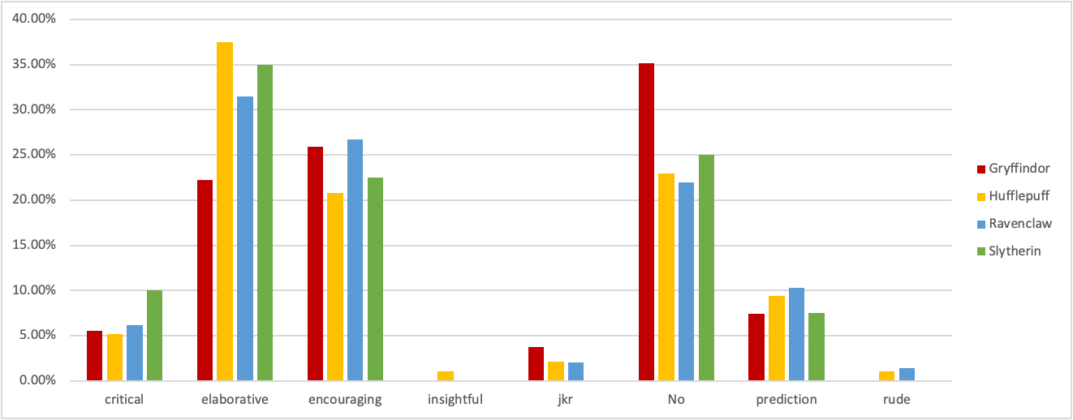
Unintended Conclusions: Types of comments
Gryffindors don’t like to leave fields blank
Slytherins are critical but not mean
Gryffindors openly hate JKR
Hufflepuffs and Ravenclaws were the only houses to be rude
Hufflepuffs are most elaborative and least encouraging
Ravenclaws were most encouraging and predictive and least (by a hair) likely to say “No”
Notes:
W
This is a graph of the types of comments left by house. Like all the others, this graph is also done by house, so all the red Gryffindor bars here add up to 100 percent.
I think this was actually my favorite graph for hilarious takeaways, which you can see written here:
Gryffindors much more likely than any other house to say “no” instead of leaving the field blank since it wasn’t required, and also the only house that said “no” more than actually elaborating upon their answers
Slytherins are openly the most critical but not mean or rude about it, and also the only house that didn’t have any JKR comments (again, also the house with the fewest respondents)
Hufflepuffs and ravenclaws were the only houses to be rude
And I personally was surprised that hufflepuffs were the least encouraging house while ravenclaws were the most encouraging, because “encouraging” is a trait that seems like it would be very hufflepuffian trait.

Slide 26
Unintended Consequences
Getting called a TERF
JKR Sucks
HP World is V. problematic.
Lack of diversity
Sexism
Cultural appropriation
Just Why?
SNAPE
Love the art not the artist
Hogwarts sorting system is FLAWED
(but also)
recognizing the importance of
work or discovery
, racist, sexist, bigoted in more ways than could possibly be described in a single sentence, and otherwise generally terrible
Image source: twitter.com/aaricasm
Notes:
R
We got called names just by association. Through the creation of a survey exploring these ideas, people in the profession felt like we were promoting the works especially in light of JKR's transphobic statements. There were also comments about how we shouldn't be using HP at all or shouldn't be utilizing the works in anyway due to their problematic nature.
JKR Sucks. She constantly makes transphobic comments and writes transphobic essays AND THEN DOUBLES DOWN ON THEM when her fans call her out. She writes under a pseudonym that has extremely disturbing LGBTQ+ connections to conversion therapy.
The HP World is problematic AF. JUST TO MENTION A FEW THINGS.
-There’s a lack of diversity when it comes to basically every factor: racial, cultural, gender, and even sexual preferences. Then a whole lot of tokenization for the little diversity that does exist.
-It’s nice to have a strong female character in the spotlight but Hermione also has huge “I'm not like the other girls” vibes, which is also inherently sexist.
-The American magic system in Fantastic Beasts and Where to Find Them is appropriative of native and indigenous beliefs
-There’s a whole lot of gross tidbits hidden in Pottermore that everyone pretends doesn’t exist
-Snape’s redemption arc is terrible and the concept of not only excusing but praising someone’s abusive actions, regardless of motivation, is nauseating. He is also literally just a horrible human, being un-necessarily cruel. He's also rocking that SUPER INCEL attitude.
Can we still love HP and not JKR? We say yes. Is it possible to separate the work from the author? Yes. We do this all the time with other authors, artists, historical figures and scientific discoveries. We take it and evolve it and it’s in that evolution that the people intentionally marginalized by terrible creators/discoverers/whatever can reclaim some of that power.
HP Lovecraft was a racist jerk but now there’s a whole series on HBO called Lovecraft Country. (The series is about a young black man who travels across the segregated 1950s United States in search of his missing father, learning of dark secrets plaguing a town on which famous horror writer H. P. Lovecraft supposedly based the location of many of his fictional tales.)
Orson Scott Card- homophobic still cited as a SCIFI literary influencer.
However, it’s also dependent upon each reader. We can’t speak for everyone and there are people who cannot read the stories without them being ruined by JKR. They are allowed to feel that way and we just have to support their decisions.
Although what we can say is that if you were to erase all of the contributions to society made by terrible people, there would be very little left.
Honestly, we could do a separate paper just on the responses and reactions that we gathered from this survey.
Hogwarts Houses system itself is flawed. There’s a ton of fan lore about sorting based on what you need to succeed, what you value, where you are asked to be placed, even that the sorting hat itself is biased, etc. Harry Potter tells his son, Albus Severus, “The Sorting Hat takes your choice into account,” Also, you sort when you are 11? We are not the same people (hopefully) we were when we were 11. Dumbledore even makes a comment to Snape about how he thinks they sort too early. This comment was made after Snape said he wasn't a coward (thus implying that he couldn't possibly be a true Slytherin because Slytherins are cowardly?)

Slide 27
What does it mean to say “virtue-based”?
We all have a little bit of every virtue, and we decide their value based on what is important to us.
“The association between House and personality seems not to be driven by the particular House one is sorted into, but which particular House one desires to be sorted into.”
Ergo… virtues are virtues because we say they are, and we can be whoever we want to be, so really this is a study on who librarians aspire to be and how we see ourselves, not who we already are.
Jakob, L., Garcia-Garzon, E., Jarke, H., & Dablander, F. (2019). The Science Behind the Magic? The Relation of the Harry Potter “Sorting Hat Quiz” to Personality and Human Values. Collabra: Psychology, 5(1), 31. DOI: http://doi.org/10.1525/collabra.240
Image source: tiktok user gorilla_grip_co0chie
Notes:
W
Part of the title of this presentation is “A Study of Virtue-Based Typology…” and we haven’t explicitly said what that means yet.
“Virtue” is by definition “a trait or quality that is deemed to be… good and thus is valued…”
So within our title, we use “Virtue-Based” as an acknowledgement that everyone has a little bit of each virtue associated with each house, like loyalty, bravery, wisdom, etc, and we each place relative value on which virtues we deem most significant to us on an individual basis, so that self-sorting would indicate what your values are. This is something we (Randa and myself) just inherently believe and was therefore the way we wanted to approach this survey and results, but digging through other studies later in making this presentation, we found that it’s supported by a psychological study on the correlation between Hogwarts Houses and personality traits (yes, really) which says: “the association between House and personality seems not to be driven by the particular House one is sorted into, but which particular House one desires to be sorted into.”
This means, we decide who we want to be, and what is important to our own identities. Which then means that this survey is more about what we as a field love and value about ourselves and our profession, and not necessarily who we actually are as people.
Jakob, L., Garcia-Garzon, E., Jarke, H., & Dablander, F. (2019). The Science Behind the Magic? The Relation of the Harry Potter “Sorting Hat Quiz” to Personality and Human Values. Collabra: Psychology, 5(1), 31. DOI: http://doi.org/10.1525/collabra.240

Slide 28
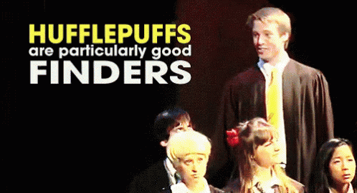
Other Lessons Learned
The world of Harry Potter is larger than what JKR could have ever imagined and is only better with FAN additions.
Source: https://paulvanderlaken.com/tag/information/
Image source: https://tenor.com/view/hufflepuff-avpm-harrypotter-gif-5041396
Notes:
R
The world of HP is bigger and more fantastic than what JKR created. The series has truly outgrown the creator. There’s HP conventions, websites, social media sites, even a running club. JKR may have started it but the fans are the ones who have taken it and run with it.
This chart on the left looks at the ACTUAL world of HP not just the sorting hat characteristics. They went through all of the text from the books and used words associated with emotion and related them to the house. This again just proves that the houses are extremely one dimension.
Sentiment related to houses’ informative words:
Anger, Anticipation, Disgust, Fear, Joy, Negative, Positive, Sadness, Surprise, Trust
READ SLIDE. These are the characteristics she leaves us with.
Every time JKR has added to the world, it just gets weird, gross, or depressing however, the best additions have been fan based.
The house characteristics and house personalities have seriously outgrown their author. One of the comments stated it best, “Houses are good, bad, smart, other.” What happens when you get sorted into a house that isn’t good or smart? You build upon it. Does our being sorted into Slytherin mean we are bad? While our biggest critics might agree with that, we don’t see ourselves as evil. This creates an identity crisis. What do you do when the world you love so much sorts you into bad? Enter people adding in characteristics that came OUTSIDE the world JKR created.
Canon usually refers to the source material but when something becomes so widely acknowledged by fans, it becomes fanon or head canon. “Hufflepuffs are good finders” isn’t technically canon but so many people have heard of it that’s become accepted in the community. It actually came from “A Very Potter Musical” from Team Starkid, an acting troupe that originally did parody musicals. They were making fun of Hufflepuffs but over time, it’s developed into an actual attribute.

Slide 29
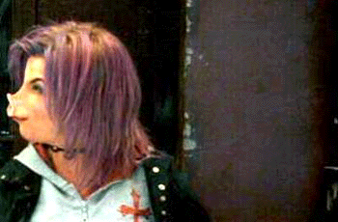
Other Lessons Learned
Themes of HP are timeless
It's hard to label people.
Photograph: Sopa/Rex/Shutterstock https://www.theguardian.com/world/2020/aug/04/thailand-protesters-openly-criticise-monarchy-harry-potter-themed-rally
Image Source: https://www.wattpad.com/391916775-sparks-hp-gif-series-nymphadora-tonks-%CF%9F-pig
Notes:
R
The themes of HP are timeless and are applicable to so many different people that it makes a lot of sense that people still love the books. The idea of rebellion and doing what is right, despite what those in charge are telling you is a huge aspect of the series and is used globally today (Thailand protestors using Harry Potter theme to openly criticize their monarchy). It fits that the fans would stand firm against JKR’s views. In a world about a boy who literally came out of a closet into a magical world where you can literally transform into ANYONE, there’s room for everyone. “Hogwarts will always be there to welcome you home”... unless you are trans? Come on.
It’s incredibly difficult to label people in the library world. THE WHOLE IRONY OF THIS PRESENTATION AND SURVEY. Our jobs, titles, even the people employed within them are so incredibly different. Yes, we may share characteristics but at the end of the day, we are a varied group. I think this is important to note because there are SO MANY librarian stereotypes. It’s easy to want to slap a label on who we are and the profession as a whole but it is difficult to define us as a whole. Even the librarian in HP is the most stereotypical and infuriating librarian you have ever seen in a book.
One of the trolls who commented on my survey post was a librarian at the Heartland Institute, an American conservative and libertarian public policy think tank. I still can’t tell if his comments were made in seriousness or sarcasm but either way, did not expect that in the library world.

Slide 30
Other Lessons Continued
Controlled Vocab = Life/Time Saver
Diversify listservs/groups
Cool to add in other personality assessment types
Follow-Up Survey
Image Source: twitter.com/utterpwnednoob
Notes:
R
What we wish we would have done differently?
Ideally controlled vocabularies would have helped out so much. Just keeping it to “public, academic, school, admin, other” we would have seen similar results as the original article? To Be Fair, Brittany O’Neil tried to warn me but I thought since there is so much variety in the fields, it would be easier to keep it this way. Also I wish we would have used all the words from various character traits to create a large word list people could pick from. It would have helped with not just coding but also with consistency.
Increased the number of participants to 5000 – this spread REALLY quickly and shockingly far. It It got posted to a LIS facebook group specific to Winnie’s alma mater, a group that has like 350 people total in it. It would have also been nice to get a good representation from each house by again, there’s issues with that.
Although the established “good number” of survey respondents varies from field to field like from psychology to neuroscience, having a small number of responses per each house made it harder to draw conclusions of houses as a whole. As an example, if we have 5000 responses and we only have one Hufflepuff, then the characteristics that the survey would say belong to hufflepuffs are probably actually just characteristics of that one person and in no way representative of hufflepuffs as a whole.
Sent it to more diverse listserves/groups. ALA Think Tank and ALAConnect have a large amount Public and academic. It would have been nice to hit more other areas too. However, it does make since, since those are our two largest make ups.
Also been neat to do a follow up survey or just also add other personality type assessments like the big 5 (which is seen as mostly credible personality analysis metric), Meyers Briggs/Horoscopes/Enneagrams (which are not seen as particularly credible)
Basically just all of these: https://openpsychometrics.org/

Slide 31
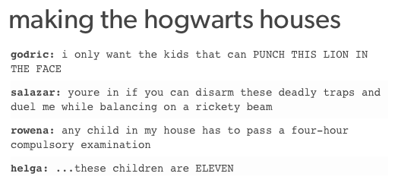
Questions?
Thank you!
Rlope12@lsu.edu
wschlin@lsu.edu
Image Source: https://me.me/i/making-the-hogwarts-houses-godric-i-only-want-the-kids-9326634

