Slide 1
Using Spreadsheets to Access Data Dynamically
Mike Waugh
Library Services Platform Administrator
LOUIS
LUC 2020
Notes:
About me and my job history – education in libraries and English – not computer science – but on-the-job picked up spreadsheets, xml processing and knowledge of catalog database structure – used APIs

Slide 2
Objectives
To show how spreadsheets can be used to do some things typically done by programming languages
To show how WEBSERVICE function in Excel can be used to pull information from the web or from webservices APIs
To show how FILTERXML can query WEBSERVICES responses using Xpath
To briefly review Xpath
To show the equivalent (and perhaps superior) functions in Google Sheets
To show common REST calls for Symphony Web Services
Show examples for searching the catalog
To point out caveats and pitfalls

Slide 3
Ode to Spreadsheets
Notes:
With apologies to Joyce Kilmer

Slide 4
I think that I shall never see

Slide 5
I think that I shall never see
A poem lovely as a spreadsheet

Slide 6
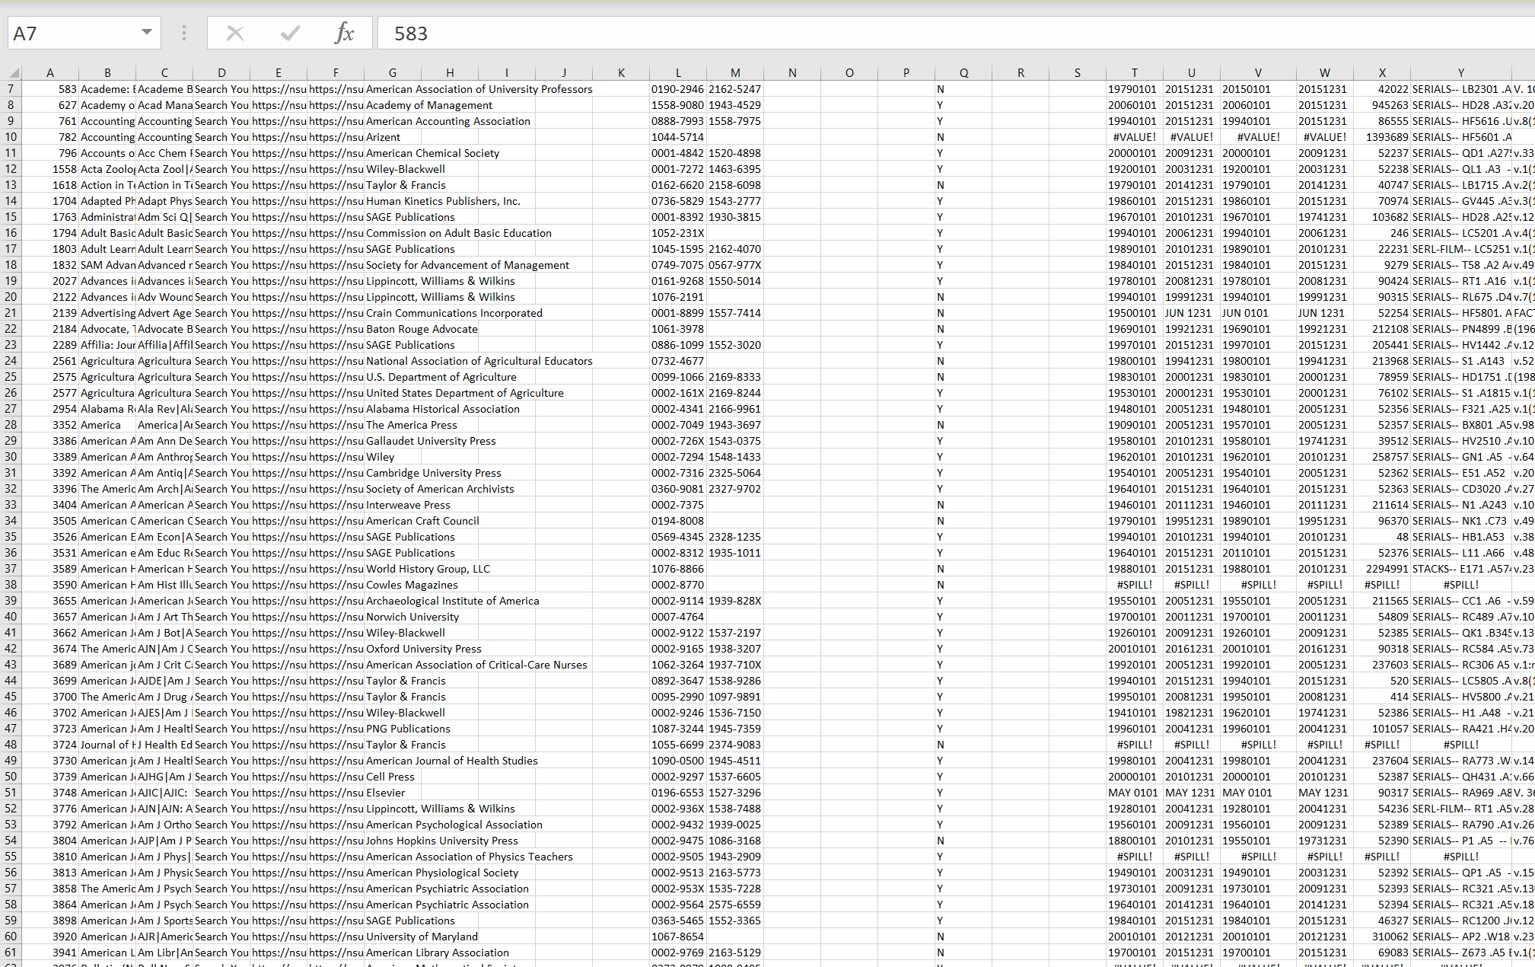
I think that I shall never see
A poem lovely as a spreadsheet
Notes:
Myers-briggs type who likes spreadsheets - or astrological sign? Hogwarts house?

Slide 7
Ode to Spreadsheets
Spreadsheet programs freely available to most
Excel
Google Sheets
Access to many functions
Many online resources on how to use functions
Can process text in addition to numbers
Results of calculations are displayed immediately
Can chain functions together to make complex calculations

Slide 8
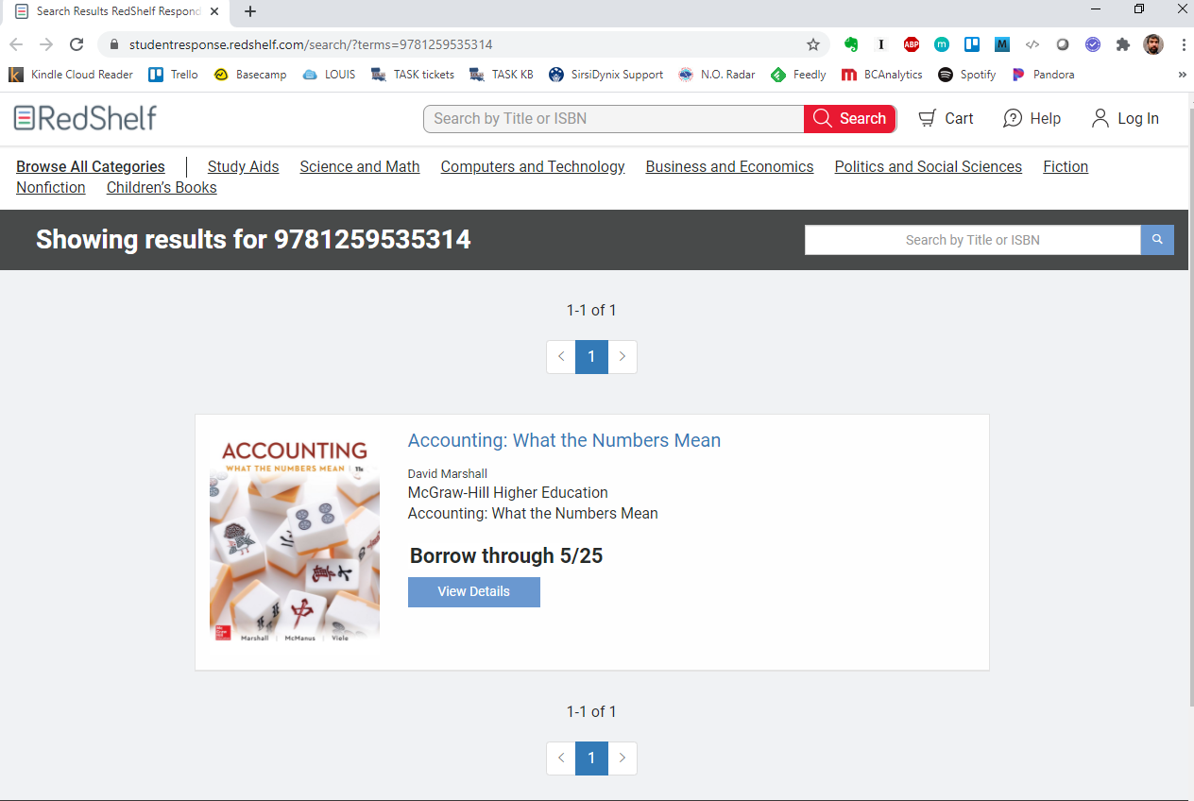

Slide 10
Notes:
What is this number? Is it the price?

Slide 11
Using Hyperlinks in Excel
Given ISBN in Cell A1: 9781259535314
=”https://studentresponse.redshelf.com/search/?terms=”&A1
Displays as the text
https://studentresponse.redshelf.com/search/?terms=9781259535314
=HYPERLINK(”https://studentresponse.redshelf.com/search/?terms=”&A1)
Displays as a clickable hyperlink
https://studentresponse.redshelf.com/search/?terms=9781259535314
Notes:
Let say you have a bunch of ISBNs - and you know the link to the webpage uses ISBN as a search term. You don’t want to type it out each time. You can make a list of clickable URLs that you can parse with your eyeballs

Slide 12
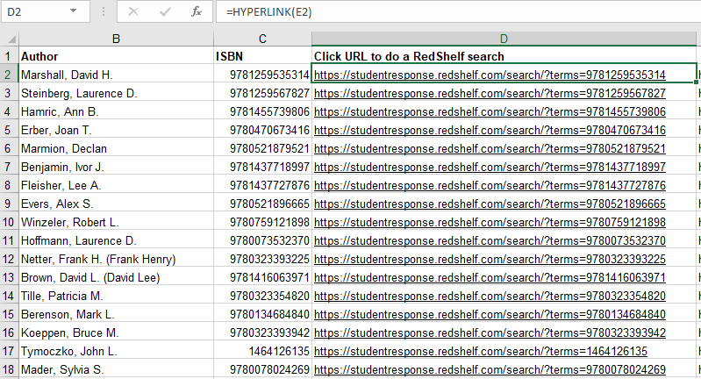
Notes:
Great for spot checking with your eyeballs. One thing I noticed

Slide 13
Notes:
Everytime it found a result - it had “Showing results for 978-blah-blah”

Slide 14
Notes:
And it would say this when not found “No results found for blah-blah-blah”

Slide 15
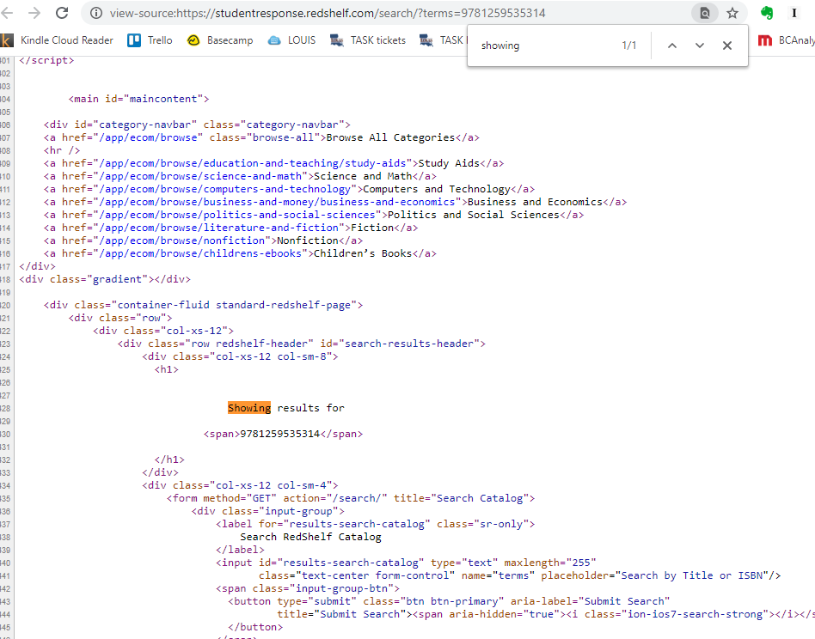
Notes:
Right-click. “Show page source”. CTRL+F - find the word “showing”. See Showing results for 978-blah-blah-blah

Slide 16
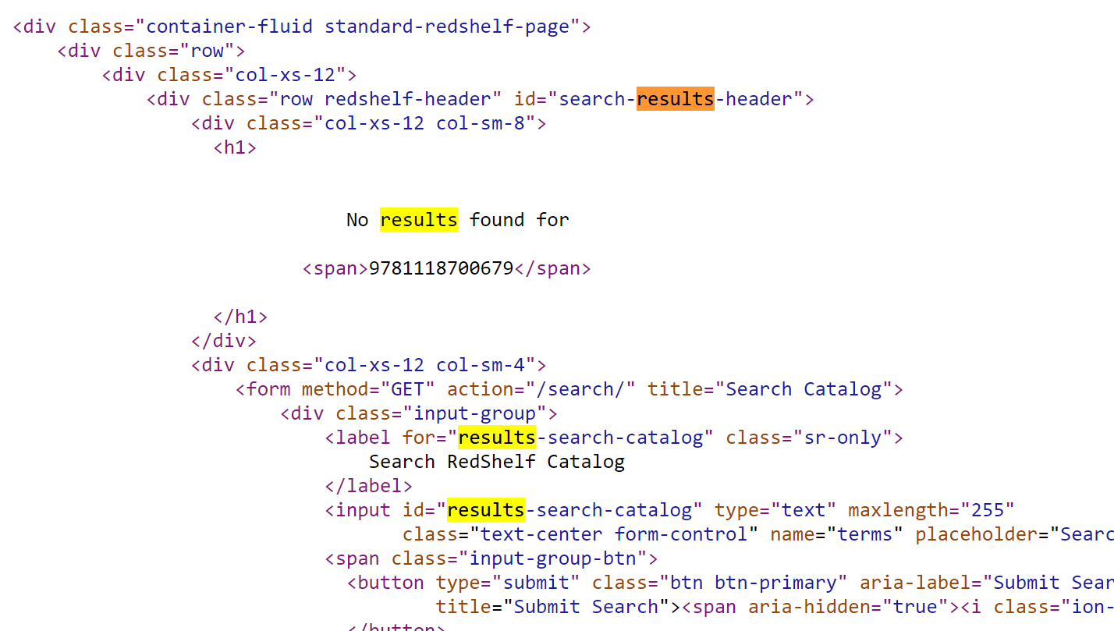
Notes:
When there’s no results - displays “No results found for - 978-blah-blah

Slide 17
Excel Functions
Two new functions added in Excel 2013 and later
WEBSERVICES
FILTERXML

Slide 18
Excel Functions
WEBSERVICES
Enter a web services URL, and return the response
FILTERXML
Parse/search an XML document using an xpath expression and return the result

Slide 20
WEBSERVICE
=WEBSERVICE(URL)
=WEBSERVICE(“http://www.google.com”)
=WEBSERVICE(“https://stockquotes.com/ticker=MSFT”)
=WEBSERVICE(“https://nsula.louislibraries.org/lans_ilsws/rest/standard/searchCatalog?clientID=DS_CLIENT&term1=1079-0713{022}”)
Notes:
I made up the stockquotes one

Slide 21
Notes:
How the response looks in Firefox

Slide 22
FILTERXML
=FILTERXML(xml, xpath expression)
=FILTERXML(A1, “//price”)
=FILTERXML(A1,”/rc/@title”)
=FILTERXML(A1,”//MarcHoldingsInfo//MarcEntryInfo/*[contains(preceding::*[2],866)]”)

Slide 23
XPath
From: https://www.w3schools.com/xml/xpath_syntax.asp
nodename Selects all nodes with the name "nodename"
/ Selects from the root node
// Selects nodes in the document from the current node that match the selection no matter where they are
. Selects the current node
.. Selects the parent of the current node
@ Selects attribute

Slide 24
XPath
bookstore Selects all nodes with the name "bookstore"
/bookstore Selects the root element bookstore
bookstore/book Selects all book elements that are children of bookstore
//book Selects all book elements no matter where they are in the document
//book[1] Selects the first of all matching book elements
bookstore//book Selects all book elements that are descendant of the bookstore element, no matter where they are under the bookstore element
//@lang Selects all attributes that are named lang

Slide 25
Notes:
How the response looks in Firefox

Slide 26
Results of Function
<?xml version="1.0" encoding="UTF-8" standalone="yes"?>
<SearchCatalogResponse xmlns="http://schemas.sirsidynix.com/symws/standard">
<queryID>20-47</queryID>
<totalHits>1</totalHits>
<firstHitDisplayed>1</firstHitDisplayed>
<lastHitDisplayed>1</lastHitDisplayed>
<HitlistTitleInfo>
<titleID>308679</titleID>
<materialType>CR</materialType>
<title>AACN clinical issues</title>
<author>American Association of Critical-Care Nurses.</author>
<yearOfPublication>1995</yearOfPublication>
<copiesOnOrder>0</copiesOnOrder>
<ISBN></ISBN>
<SICI></SICI>
<UPC></UPC>
<OCLCControlNumber>31275033</OCLCControlNumber>
<documentNumber>1</documentNumber>
<callNumber>RT120 .I5 A334</callNumber>
</HitlistTitleInfo>
</SearchCatalogResponse>

Slide 27
Results of Function
<?xml version="1.0" encoding="UTF-8" standalone="yes"?>
<SearchCatalogResponse xmlns="http://schemas.sirsidynix.com/symws/standard">
<queryID>20-47</queryID>
<totalHits>1</totalHits>
<firstHitDisplayed>1</firstHitDisplayed>
<lastHitDisplayed>1</lastHitDisplayed>
<HitlistTitleInfo>
<titleID>308679</titleID>
<materialType>CR</materialType>
<title>AACN clinical issues</title>
<author>American Association of Critical-Care Nurses.</author>
<yearOfPublication>1995</yearOfPublication>
<copiesOnOrder>0</copiesOnOrder>
<ISBN></ISBN>
<SICI></SICI>
<UPC></UPC>
<OCLCControlNumber>31275033</OCLCControlNumber>
<documentNumber>1</documentNumber>
<callNumber>RT120 .I5 A334</callNumber>
</HitlistTitleInfo>
</SearchCatalogResponse>

Slide 28
Given the results of WEBSERVICES function, find certain elements
Xpath for a call number when there is only one call number
//callNumber
/SearchCatalogResponse/HitlistTitleInfo/callNumber
=FILTERXML(A1, “//callNumber”)
Result is RT120 .I5 A334
=FILTERXML(A1,”//titleID”)
308679
=FILTERXML(A1,”//yearofPublication”)
1995

Slide 29
WEBSERVICE Errors
If arguments are unable to return the data, WEBSERVICE returns a #VALUE! error.
If arguments result in a string that is not valid or that contains more than the allowable cell limit of 32767 characters, WEBSERVICE returns a #VALUE! error.
If url is a string that contains more than the 2048 characters that are allowed for a GET request, WEBSERVICE returns a #VALUE! error.
Watch out for responses that might yield more than one result

Slide 30
Notes:
Remember this example. Right-click. “Show page source”. CTRL+F - find the word “showing”. See Showing results for 978-blah-blah-blah

Slide 31
Google Sheets
IMPORTXML
Can handle longer responses than Excel
=IMPORTXML(URL, Xpath query)
=IMPORTXML(A1, "//div[@id='search-results-header']/div/h1")
Showing results for 9781479893409

Slide 32
Symphony Web Services
REST
No prior state assumed by server for each request
Not necessary to use tokens or caches
Most of the requests look like URLs
They are URIs (Uniform Resource Identifiers)
But the responses are not necessarily HTML
The responses can be XML (or JSON or others)

Slide 33
Symphony Web Services
To do a keyword search on the string “9780061252662”
https://bpcc.louislibraries.org/labp_ilsws/rest/standard/SearchCatalog?clientID=DS_CLIENT&term1=9780061252662
Base URL >> https://bpcc.louislibraries.org/labp_ilsws
Web Services endpoint (REST or SOAP) >> /rest
Web Services service >> /standard/
Web Services operation >> SearchCatalog?
Client >> clientID=DS_CLIENT
Web Services parameters >> &term1=9780061252662

Slide 34
Symphony Web Services
Base URL
https://{SiteNickname}.louislibraries.org/{SiteCode}_ilsws
https://bpcc.louislibraries.org/labp_ilsws
https://brcc.louislibraries.org/labr_ilsws
https://cltcc.louislibraries.org/lacl_ilsws
https://delta.louislibraries.org/ladc_ilsws
https://fletcher.louislibraries.org/lafl_ilsws
https://{SiteNickname}.test.louislibraries.org/{SiteCode}test_ilsws
https://bpcc.test.louislibraries.org/labptest_ilsws
https://brcc.test.louislibraries.org/labrtest_ilsws

Slide 35
Symphony Web Services
Version request
A good way to test your base URL and connection
https://{SiteNickname}.louislibraries.org/{SiteCode}_ilsws/rest/standard/version
https://bpcc.louislibraries.org/labp_ilsws/rest/standard/version

Slide 36
<VersionResponse xmlns="http://schemas.sirsidynix.com/symws/standard">
<version>
<product>SYMPHONY</product>
<version>3.7.0.0.GA</version>
</version>
<version>
<product>SYM-WS</product>
<version>v5_0_201262115</version>
</version>
</VersionResponse>

Slide 37
Symphony Web Services
searchCatalog
https://bpcc.louislibraries.org/labp_ilsws/rest/standard/searchCatalog?clientID=DS_CLIENT&term1=9780061252662
Parameters
term: the search term
Number the term for REST (term1=louisiana)
searchType: specify the search policy type
If not specified, it defaults to “GENERAL”
Number the term for REST (searchType1=author)
Use syntax for GENERAL keyword search
Can use curly brackets for searching indexed fields
{022}
{856}
{au}

Slide 38
Symphony Web Services
Filters
libraryFilter: get results from a particular library
&libraryFilter=ECAT
homelocationFilter: get results from a particular home location
&homelocationFilter=STACKS
languageFilter
formatFilter
pubyearFilter
itemtypeFilter
itemcat1Filter
&itemcat1Filter=LOUIS
itemcat2Filter

Slide 39
Symphony Web Services
lookupTitleInfo: get more detailed information given a particular titleID or itemID
https://nsula.louislibraries.org/lans_ilsws/rest/standard/lookupTitleInfo?clientID=DS_CLIENT&titleID=308679&includeMarcHoldings=true&marcEntryFilter=ALL
Parameters
titleID: the titleID, aka the catalog key, aka catkey
itemID: the itemID, aka the barcode
Either titleID or itemID are required

Slide 40
Symphony Web Services
lookupTitleInfo:
Parameters, continued
includeAvailabilityInfo (true/false)
includeAvailabilityInfo=true
includeItemInfo (true/false)
includeOrderInfo (true/false)
includeMarcHoldings (true/false)
includeItemCategory (true/false)
includeShadowed (none/only/both)

Slide 41
Example: Search catalog for ISBN
Where A2 is an ISBN
=”https://lsue.louislibraries.org/lale_ilsws/rest/standard/searchCatalog?clientID=DS_CLIENT&term1=”&A2

Slide 42
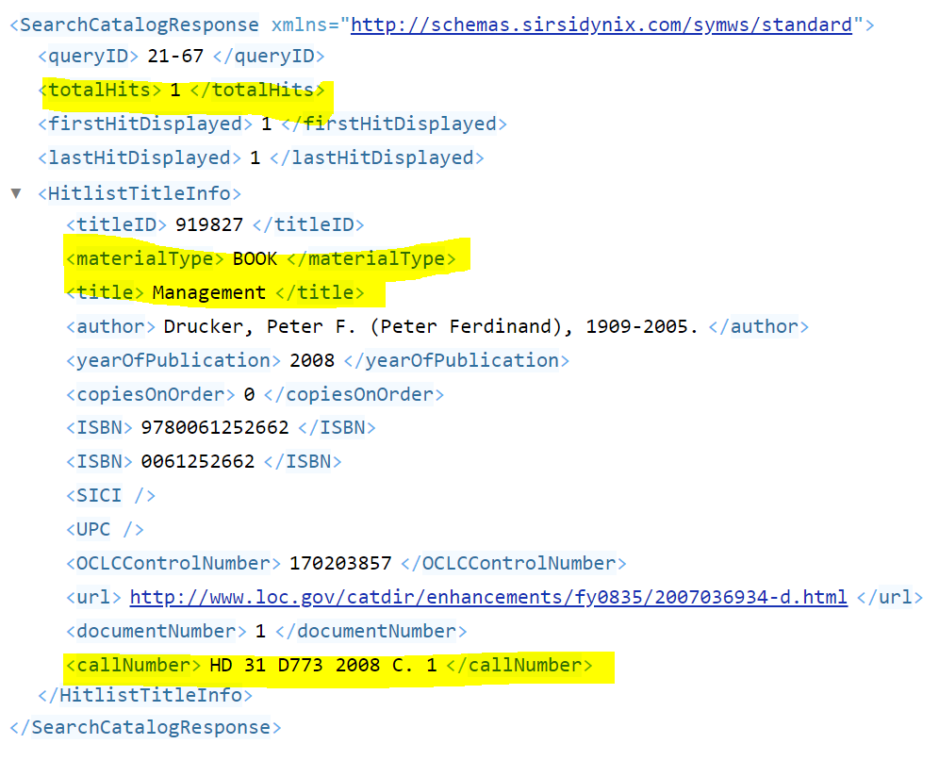

Slide 43
Example: Search catalog for ISBN
=FILTERXML(B2,”//totalHits”)
Equals 0 for no hits, 1 or more for matches
=FILTERXML(B2,”//HitlistTitleInfo/materialType”)
BOOK
=FILTERXML(B2,”//HitlistTitleInfo/callNumber”)
HD 31 D773 2008
=FILTERXML(B2,”//HitListTitleInfo/title”)
Management

Slide 44
Example: Search by ISSN, get Marc Holdings Text
Where A2 is the ISSN
https://nsula.louislibraries.org/lans_ilsws/rest/standard/searchCatalog?clientID=DS_CLIENT&term1=1079-0713{022}
=”https://nsula.louislibraries.org/lans_ilsws/rest/standard/searchCatalog?clientID=DS_CLIENT&term1=”&A2&”{022}”
searchCatalog won’t output Marc Holdings, but lookupTitleInfo will, if it has the titleID
=FILTERXML(B2,”//HitlistTitleInfo/titleID”)
Output: 308679

Slide 45
Example: Search by ISSN, get Marc Holdings Text
Where C2 contains the FILTERXML function that’s outputting titleID
=”https://lans.sirsi.net/lans_ilsws/rest/standard/lookupTitleInfo?clientID=DS_CLIENT&titleID=”&C2&”&includeMarcHoldings=true&marcEntryFilter=ALL”

Slide 46
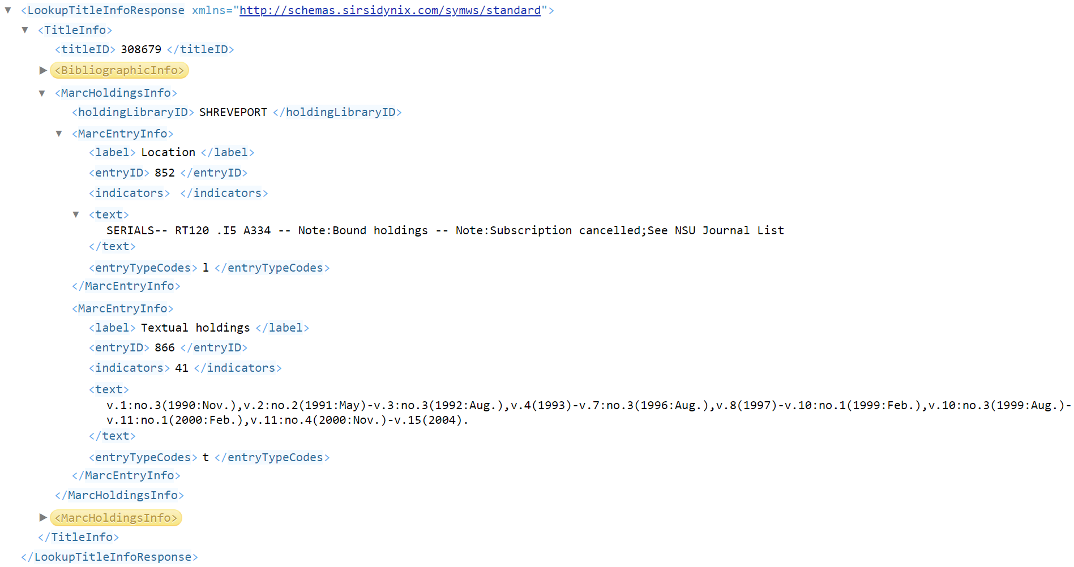

Slide 47
Example: Search by ISSN, get Marc Holdings Text
Where C2 contains the FILTERXML function that’s outputting titleID
=”https://lans.sirsi.net/lans_ilsws/rest/standard/lookupTitleInfo?clientID=DS_CLIENT&titleID=”&C2&”&includeMarcHoldings=true&marcEntryFilter=ALL”
=FILTERMXML(D2,”//MarcHoldingsInfo//MarcEntryInfo/*[contains(preceding::*[2],866)]”)
Output the node within MarcHoldingsInfo/MarcEntryInfo where the node that precedes it by two nodes contains the text “866”
Output: v.1:no.3(1990:Nov.),v.2:no.2(1991:May)-v.3:no.3(1992:Aug.),v.4(1993)-v.7:no.3(1996:Aug.),v.8(1997)-v.10:no.1(1999:Feb.),v.10:no.3(1999:Aug.)-v.11:no.1(2000:Feb.),v.11:no.4(2000:Nov.)-v.15(2004).

Slide 48
Caveats and warnings
Too many simultaneous web service calls
Slow on your spreadsheet
Might be throttled by the service provider (looks like malicious attack)
100? 1000? 10000?
Any automation should be tested
Do not share any Web Services information outside of your organization or LOUIS
Proprietary information
Security risk
Documentation on Symphony Web Services can be found on SirsiDynix Support Center. Search for Symphony Web Services SDK

Slide 49
Caveats and warnings
Works best if results are limited to one per cell
Excel has limitations on function length and response length
Due to response times, simply opening a spreadsheet with many active webservices functions will be slow to open or even crash the application
Copy column, and paste “value”
Removes the WEBSERVICE function and replaces it with the results
Functions might be processed out of order

Slide 50
Bonus example: Text processing
v.1:no.3(1990:Nov.),v.2:no.2(1991:May)-v.3:no.3(1992:Aug.),v.4(1993)-v.7:no.3(1996:Aug.),v.8(1997)-v.10:no.1(1999:Feb.),v.10:no.3(1999:Aug.)-v.11:no.1(2000:Feb.),v.11:no.4(2000:Nov.)-v.15(2004).
To find the first 4 characters (like a year) that occur after the first parentheses
MID(Text,Number of spaces from beginning of text to start,number of characters to output)
=MID(A2,FIND(“(“,A2)+1,4)
Output: 1990
To find the 4 characters that occur right before the last parentheses
=MID(A2,FIND("@",SUBSTITUTE(A2,"(","@",LEN(A2)-LEN(SUBSTITUTE(A2,"(",""))),1)+1,4)

