Slide 1
The Library Catalog Meets the IR: Integrating Institutional Repository Materials into EBSCO Zachary Stein, Head of Special Collections, University of Louisiana at Lafayette Sheryl Curry, Assistant Dean of Technical Services, University of Louisiana at Lafayette Scott Jordan, Digitization Archivist, University of Louisiana at Lafayette
October 8, 2020

Slide 2
Development of Institutional Repository
Home Page of UL Lafayette Institutional Repository: ir.louisiana.edu

Slide 3
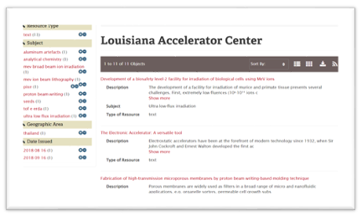
Investigation of IR Integration
• Discovery
• Demos and Discussions
• IR Growth Continues
• SD Enterprise Portfolio
• SD Archival Data Load

Slide 4
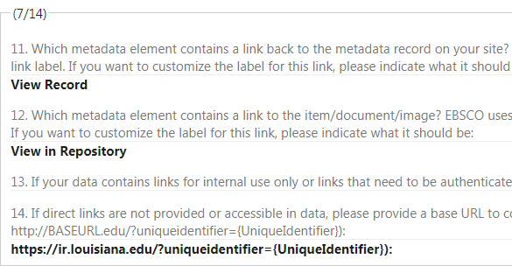
Implementation
5/15/2019: Questionnaire Submitted
6/3/2019: Call with EBSCO
7/17/2019: WebEx Presentation on IR Services
11/12/2019: Received Quote and POF for Service
3/23/2020: Implementation Began
4/27/2020: EDS IR Live
EDS – IR Database Questionnaire: https://connect.ebsco.com/s/article/EBSCO-Discovery-Service-EDS-Institutional-Repository-Database-Questionnaire?language=en_US

Slide 5
Islandora Metadata
Input metadata based on MODS schema (i.e. syntax, vocabulary, descriptive language)
Title, Creator, Subject(s), Type of Resource, Genre, etc.
A separate Dublin Core record auto-generated
Includes the object’s PID
Standard metadata language used in OAI harvesting
Metadata captured via online input form during ingest process and can be edited
Each content model (e.g. PDF, Video, Audio) determines which metadata elements are appended to digital object
Fundamental building-blocks for how systems communicate with each other to harvest records

Slide 6
Sample MODS Form
How metadata is captured.
These elements and values will eventually translate into shared harvested metadata on discovery platforms.

Slide 7
Metadata Display
How the record appears to users in the IR

Slide 8
Sample MODS in XML
Machine-readable and
Human-readable

Slide 9
Sample DC Record
Information mapped from MODS record.
First <dc.identifier> taken from PID of digital object

Slide 10
OAI Overview
IR integration into EDS involves Open Archives Initiative Protocol for Metadata Harvesting (OAI-PMH)
Low-barrier mechanism for data interoperability between repositories (in this case, the IR and EDS)
As a data provider, IR exposes structured metadata
EBSCO, as the service provider, harvests metadata through OAI-PMH requests via software/programming
Open Archives Initiative Protocol for Metadata Harvesting. URL: https://www.openarchives.org/pmh/. Accessed 2020-09-25.

Slide 11
OAI Configuration
Admin | Islandora Utility Modules | Islandora OAI
Repository Name
Path to the Repository:
https://ir.louisiana.edu/oai2
Repository Unique ID
Select an OAI request handler and configuration

Slide 12
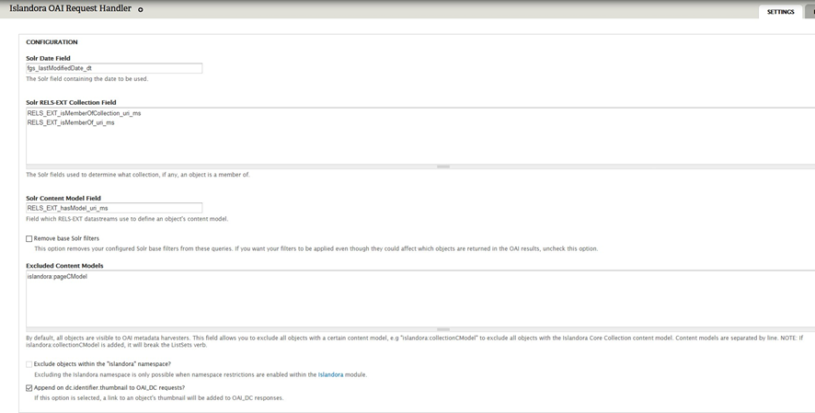
OAI Request Handler Options
Excude content models
Append <dc.identifier.thumbnail> to objects for OAI_DC requests
Metadata Format (e.g. MODS, OAI_DC)
Transformations (supplied, custom-built, or none) – basically XSLT that determines how data is interpreted and processed by harvester

Slide 13
OAI Harvest Example (good)
Identifier in record header matches <dc.identifier> with object PID, which appears before any other <dc.identifier>
All else looks clean and accurate
But still some odd mappings: (e.g. MODS <genre> = <dc.type>; author = <dc.contributor>

Slide 14
OAI Harvest Example (bad)
Identifier in record header does not match any of the <dc.identifier> fields
Hardly anything looks accurate
Lots of odd DC namespace references instead of object metadata

Slide 15
Main Hurdle
IR is structured by schools, colleges, departments, and research centers
Each a collection folder with restricted user permissions
Not content objects or archival collections; no harvesting
Test harvest request in URL to check metadata consistency and correct number of records:
https://ir.louisiana.edu/oai2/?verb=ListRecords&metadataPrefix=oai_dc
Apparently, it seemed okay, but ...
Not able to exclude collection folders without breaking the parent-object relationships
Need “sets” or <setSpec> values (i.e. parent IDs) for the harvester to locate the content objects in the IR and harvest the object metadata
Installed separate OAI request handler excluding sets
Service provider performed work-around

Slide 16
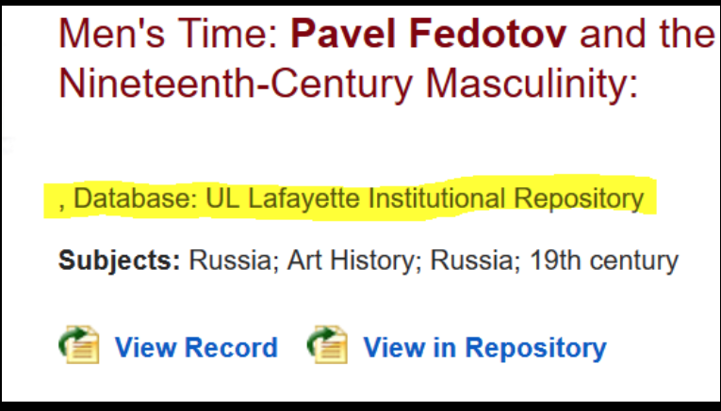
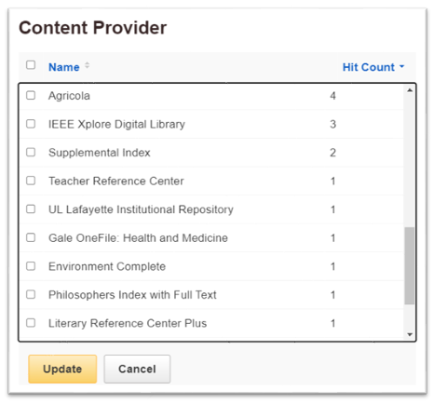
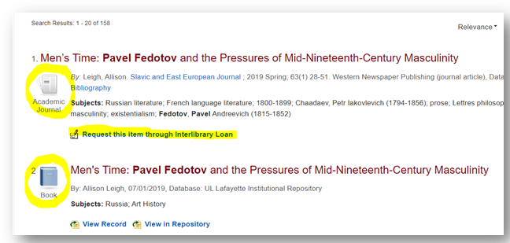
Challenges and Issues
EDS Search Results
• Dead links, unexpected punctuation
• Interlibrary Loan Links
• Appearance of Entry
• Content Provider position

Slide 17
Resolutions
Conference Call between Special Collections, DiscoveryGarden, and EBSCO
Collection objects appearing properly after adjustments
Harvesting takes 24-28 hours

Slide 18
Plans and Lessons Learned
Further promotion of IR
Providing UL Lafayette students, faculty, and staff with more resources for finding scholarship
Hope to integrate IR into Library Catalog
Lesson learned: Metadata configuration needs to be consistent

Slide 19
Questions
Zachary Stein, Head of Special Collections
Email: zachary.stein@louisiana.edu
Phone: 337-482-6427
Sheryl Curry, Assistant Dean of Technical Services
Email: sheryl.curry@louisiana.edu
Phone: 337-482-5704
Scott Jordan, Digitization Archivist
Email: scott.jordan@louisiana.edu
Phone: 337-482-5702

Slide 20
Screenshot of IR Object in EDS

