Slide 1
BRIDGING THE DIGITAL LITERACY DIVIDE IN LOUISIANA - NORTHSTAR
Notes:
Now that you understand the importance of digital literacy, I'm going to go into some detail about how Northstar can help us address the problem and how it works.

Slide 2
Agenda
Introduction to Northstar
Teaching & Learning Resources
Assessments
Student Management
Notes:
Here is our agenda for the rest of the session. I'll talk a little bit about what is means to be a Northstar testing center, then we will go over the Teaching and Learning Resources, Assessments, and Student Management.

Slide 3
Digital Literacy Cooperative
Teaching & Learning Resources
Assessments
Student/Learner Management
AKA
Testing Center
Notes:
When I was preparing the slides for this presentation, I had trouble connecting the title Testing Center with how Northstar actually works. I settled on Digital Literacy Cooperative to help to describe all the resources that are available. LOUIS and the Board of Regents pays a fee to be a member of the cooperative and then we can extend access to all of the cooperative's resources to you.
So what are those resources? There are three basic components:
1. Teaching and learning resources.
2. Assessments
3. Student/Learner Management
These three components don't necessarily build on each other. You can pick and choose what you want to use.
Content is continuously being refreshed and added.
In order to access everything that I'm going to go through, you need to be signed up as a "Northstar Testing Center" or in my terminology a member of the Northstar Digital Literacy Cooperative. :-)
To be a member means that someone, somewhere on your campus will administer the site for your campus. That could be the Information Literacy Liaison, it could the continuing education department, it could an actual testing center, or even the department in charge of orientation if they want to incorporate digital literacy into the orientation instruction for new students.
It's helpful though not to think of a testing center as a physical location, rather think of it as a resource center.

Slide 4
Northstar Testing Center
Teaching & Learning Resources
Two Components
Northstar Online Learning
Student
Testing Center
Curriculum
Notes:
Let's first talk about the Teaching and Learning resources of which there are two pieces.
1. Northstar Online Learning which itself has both student facing and testing center only components
2. and the Northstar Curriculum

Slide 5
Northstar Testing Center
Teaching & Learning Resources
Northstar Online Learning
1 - Northstar Online Learning
For Students/Learners
Customized, self-directed online instruction and practice resources
For Testing Center
Ability to track your learners' progress.
Notes:
Northstar Online Learning is really the student facing, learning component of Northstar.
So a student gets an account through their testing center. They log in and see the digital literacy skills. They can click on any of those skills to go get instruction and practice before taking an assessment.
They do not need to do the practice in order to take the assessment.
The Testing Center can track student progress. I'll show you what each of these things looks like.

Slide 6
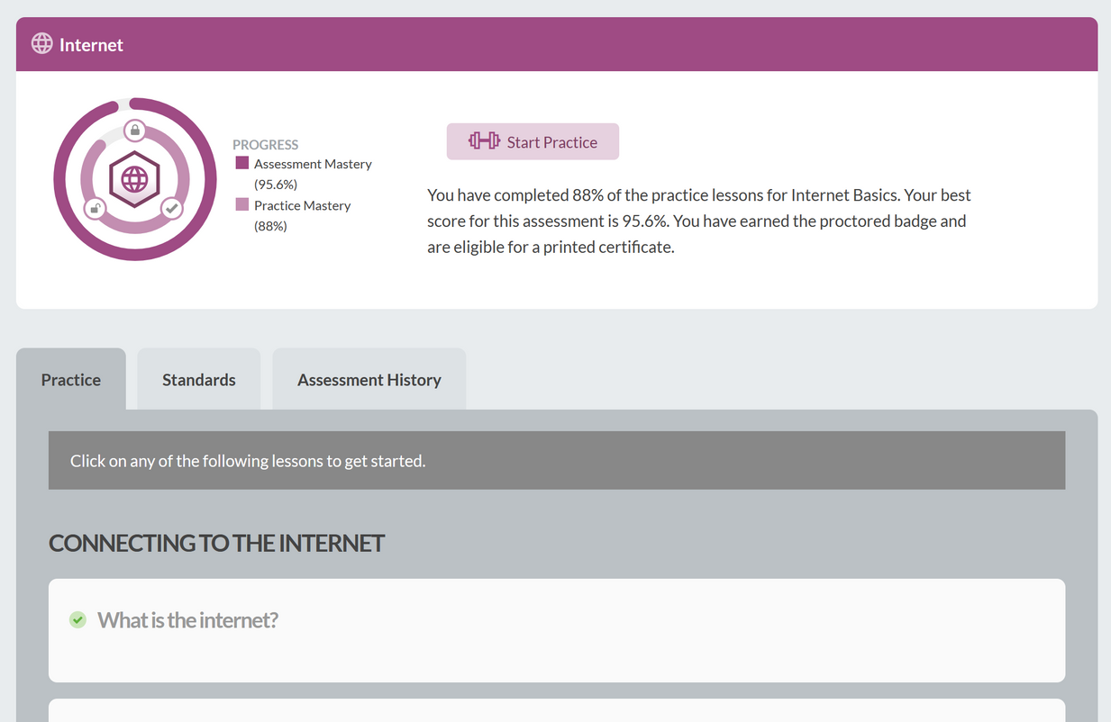
Northstar Testing Center
Teaching & Learning Resources
Students/
Learners
Notes:
This student has clicked on the Internet Digital Literacy Skill. They can decided to complete all the practice lessons, which is indicated by the inner circle. They can also see that they passed this assessment with a score of 95%.

Slide 7
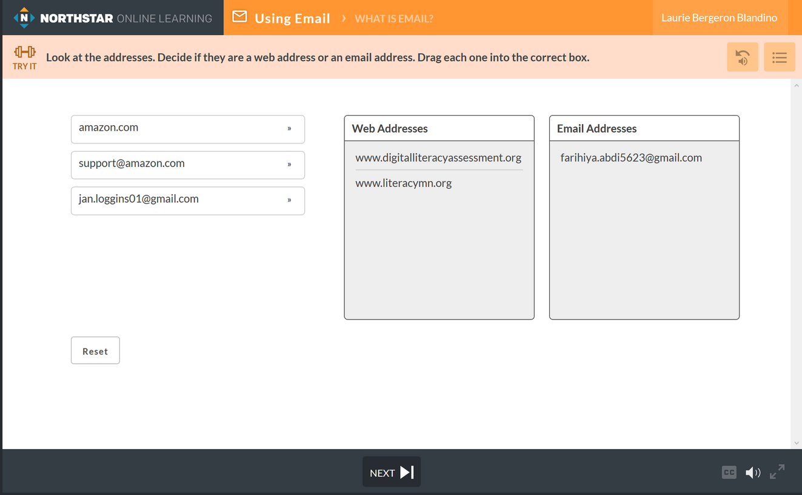
Northstar Testing Center
Susan Smith
Teaching & Learning Resources
Students/
Learners
Notes:
Each lesson has short (approx one minute) videos walking through and illustrating the concepts. The videos are followed by practice which often emulates the real thing.
In this example you can see the student needed to drag and drop the items into the correct categories.

Slide 8
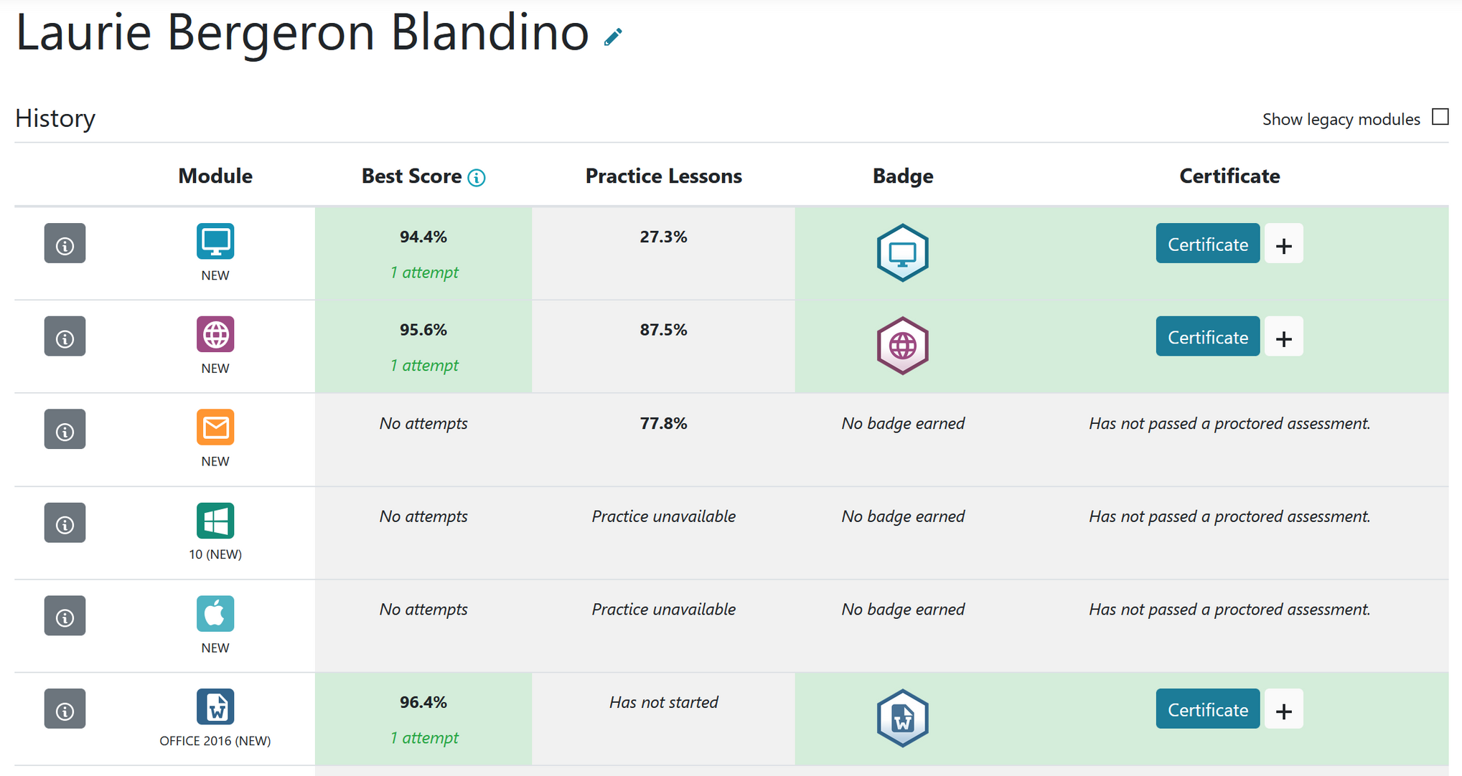
Testing Center - Learner Progress
Susan Smith
Notes:
Testing Centers can see detailed information about a learner's progress.
You can see how many times they've taken a test, whether they've attempted practice. Whether they've claimed the badge or earned the certificate. This detailed information would be useful to a teacher who incorporated Northstar into their class.

Slide 9
Northstar Testing Center
Teaching & Learning Resources
Testing Center
2 - Curriculum
Lesson Plans
Lessons
Aligned with Standards
Vocabulary
Concepts
Handouts
Assignments
In class exercises
Notes:
The second component of the Teaching and Learning resources is the Northstar Curriculum. The curriculum corresponds directly with the digital literacy standards.
The curriculum are comprehensive and contain everything an instructor would need to teach a skill including:
lesson plans and lessons with handouts and assignments.

Slide 10
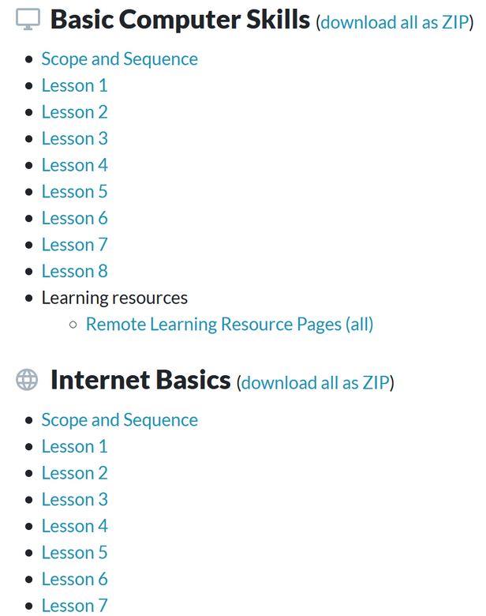
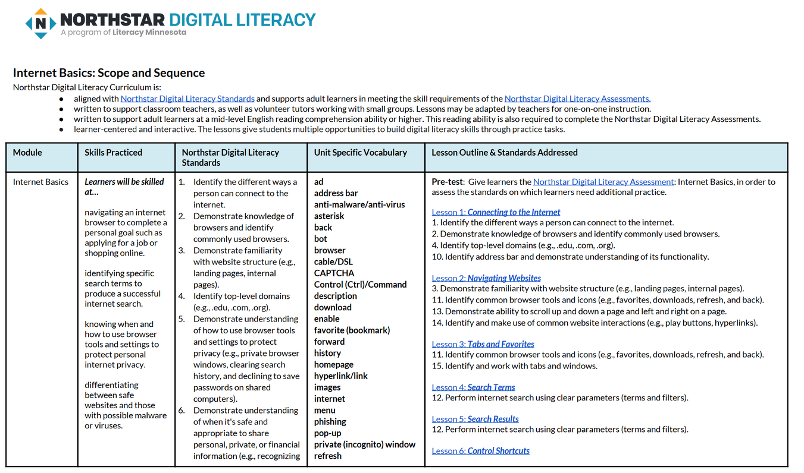
Northstar Testing Center
Notes:
This is an example of a lesson plan.

Slide 11
Northstar Testing Center
Assessments
Cover basic computer and digital literacy skills
Certificate
Digital Badge
Notes:
Now we are going to talk about the second major component of Northstar. The assessments.
Assessments are open and and can be taken by anyone. However in order for a student to get access to the practice lessons, track their progress, get a certificate and digital badge, they need to have their own student account, which is only available through a testing center.
Assessments align with the digital literacy standards, and are supported by the lessons available through Northstar Online Learning.

Slide 12
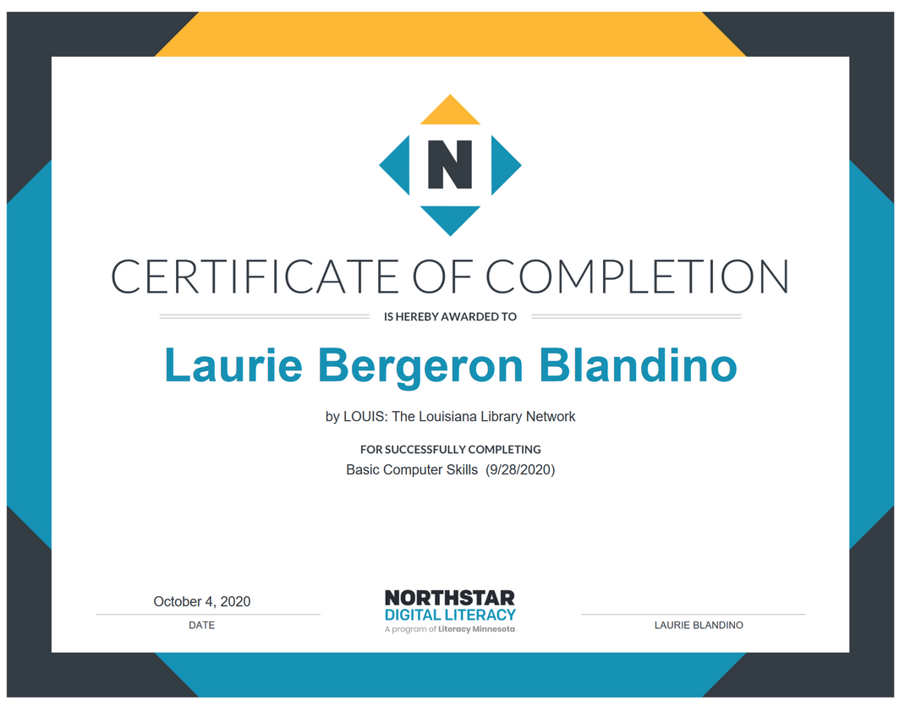
Northstar Testing Center
Assessments
Susan Smith
Notes:
Proctors can print or download and email a certificate to a student after they have successfully passed an assessment with a score of 85% or higher.

Slide 13
Essential Computer and Digital Literacy Skills Covered in Assessments
Essential Computer Skills
Basic Computer
Internet basics
Using Email
Windows 10
Mac OS
Essential Software
Microsoft Word
Excel
PowerPoint
Using Technology in Daily Life
Social Media,
Information Literacy
Career Search Skills
Your Digital Footprint
Notes:
These are the digital literacy skills covered in the lessons and assessment. You saw these in Teri's presentation, but I just thought it might be helpful to see them again to be reminded of all of the content that is covered in the student practice, curriculum, and assessments.

Slide 14
Northstar Testing Center
Assessments
Testing Center
Testing Center Roles
Administrator
add proctors, add students, run reports
Proctors
give in person and remote assessments
teach from or access curriculum
track student/learner progress
print/download certificate
Notes:
There are two basic roles the testing center uses to operate.
1. Admin - they can add proctors, students, and run reports. There are between 1 - 3 admins per site.
2. Proctors - They give the assessments for credit. Proctors have to take a short course to qualify. It takes about 20 minutes to complete.
Proctoring of assessments can be done remotely and many students can take the assessment at once. So if an instructor incorporate Northstar in their class, they could proctor the assessment for their students.
Proctors have access to the curriculum and can track learner progress.
They also print or download the certificate for the learner.
You can be both an admin and a proctor in a testing center.

Slide 15
Northstar Testing Center
Assessments
Student/learner
Student/learner
take assessment
practice skills
receive certificate
receive digital badge
track own progress
Notes:
Students, through their account can take proctored assessments and track their own progress. They can download their digital badge for all assessments they have passed.

Slide 16
Northstar Testing Center
Student Management
Enroll Students/learners
Track progress
Run reports
Notes:
So we've covered Teaching and learning resources and assessments. Now we'll talk about student management.
Admins and proctors can enroll new students.
There are some nice dashboards and detailed reports available to admins and proctors. These are useful for instructors to track student progress. They can also be used to determine the effectiveness of Northstar.

Slide 17
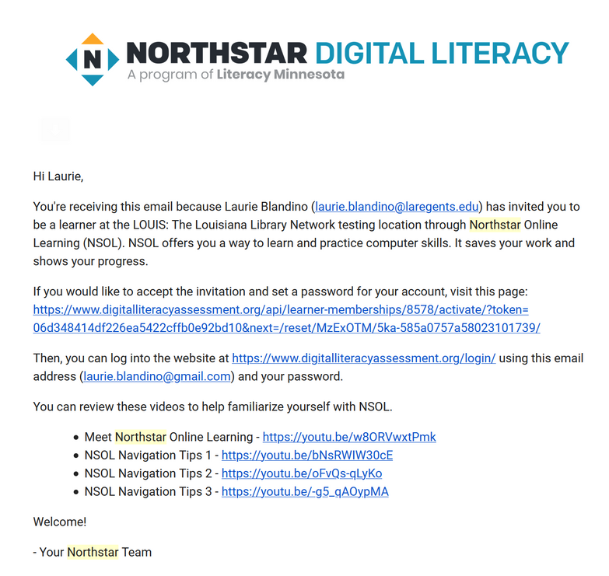
Northstar Testing Center
Student Management
Enroll Student/learner
Notes:
You just need a name and email address to enroll someone. They will immediately receive an email invitation to access their new Northstar Online Learning account.

Slide 18
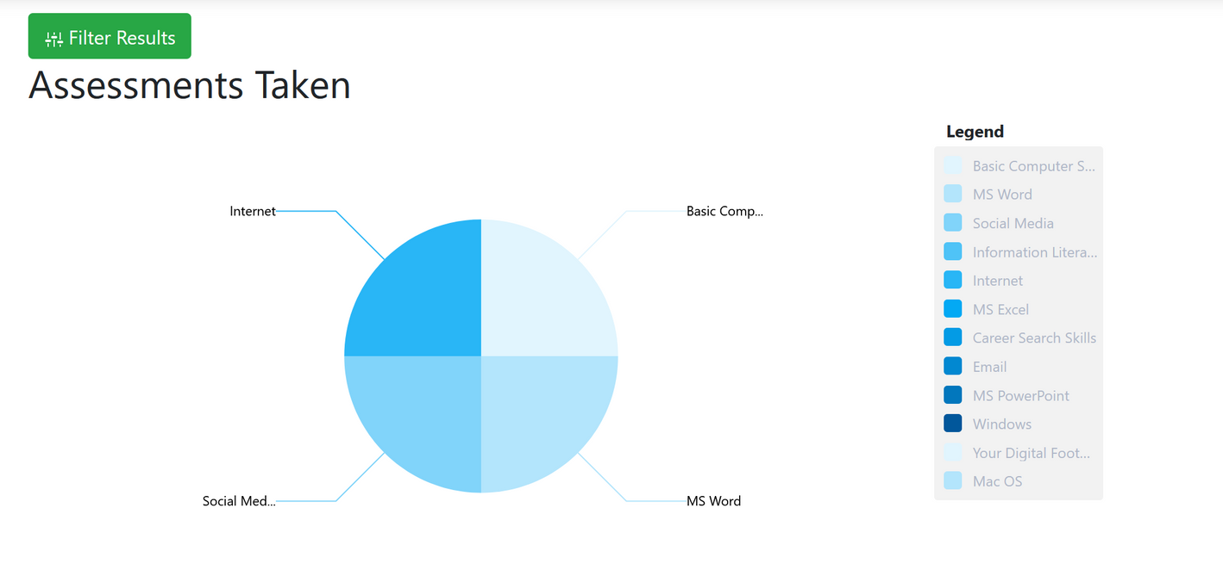
Northstar Testing Center
Student Management
Dashboard
Notes:
Dashboards

Slide 19
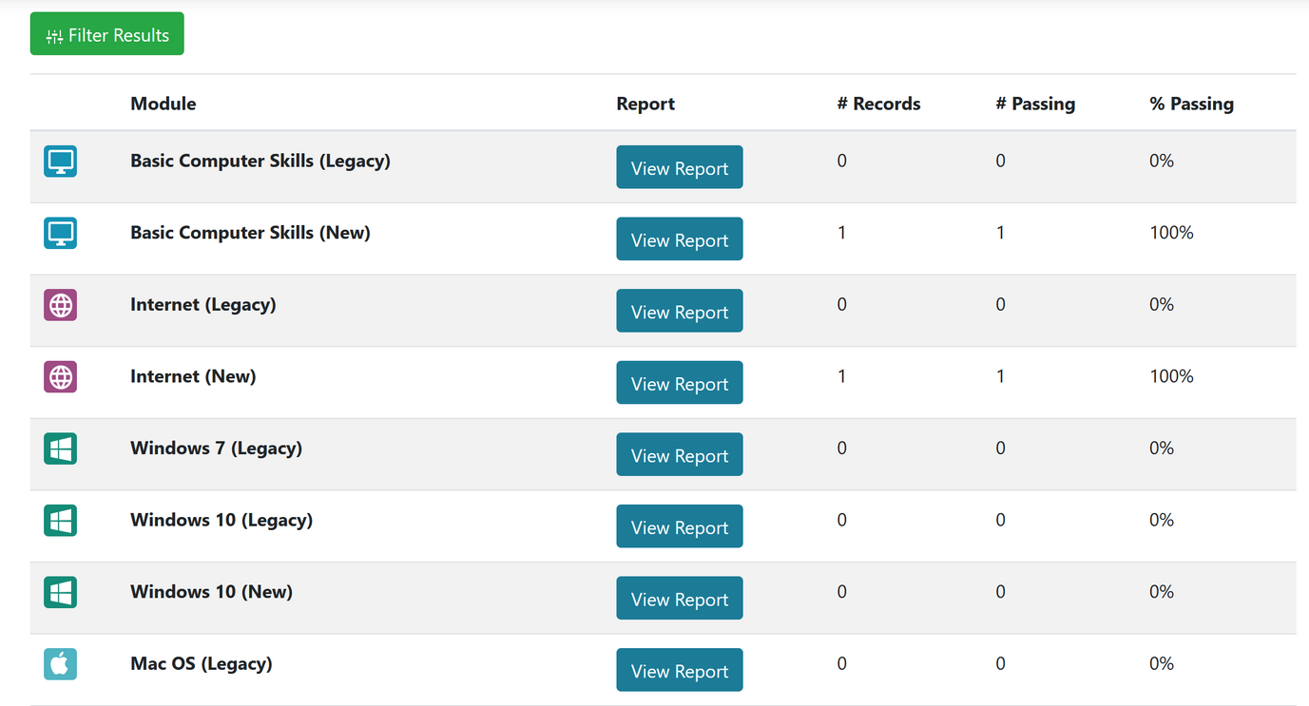
Northstar Testing Center
Student Management
Detailed Reports
Notes:
Detailed Reports

Slide 20
Northstar Testing Center
Resources
https://louislibraries.org/services/training/digital_literacy
Digital Literacy Introduction & Standards Training Sessions
Northstar Digital Literacy: Getting to know Northstar
How to Use Northstar: Proctoring, Assessments, Q & A
Northstar Training Manual
Northstar Quick Start Guide
Notes:
On our website we have recordings of all of the training sessions that Northstar has done for us so far. They go into all of this in much greater detail.
You can also access the Northstar Training Manual and Quick start guide for more information.

