Slide 1
Rose is a Rose is a Rose
Creating Name Authorities for the Library of Congress
Janelle Zetty, Head of Cataloging
University of Louisiana at Lafayette
Notes:
Today I’m presenting Rose is a Rose is a Rose. This presentation will cover our library's experiences with becoming a NACO member and creating and updating authority records in OCLC.

Slide 2
What is NACO?
Name Authority Cooperative Program
Notes:
NACO stands for the Name Authority Cooperative Program. It is part of the Library of Congress Program for Cooperative Cataloging, otherwise known as the PCC. NACO began in 1977 as a joint project between the Library of Congress and the GPO to use and maintain a joint authority file, which would reduce the cost of authority work, which is the most expensive part of cataloging. NACO Participants contribute new name authority records and update existing records in the name authority file. As of March 2019, there were 633 NACO institution members.

Slide 3
Who can join NACO?
Notes:
Any institution may join NACO--academic, public, and special libraries of any size, as well as vendors. NACO is an institutional commitment. Several people at your institution must attend training to ensure continued participation in NACO because if someone retires or moves on to another job, institutional knowledge is lost. There is no cost involved to join, only an initial investment of time for staff training. The PCC expects institutions to have access to the RDA Toolkit and membership to either OCLC or SkyRiver. As of January 2020, there is a temporary moratorium on accepting new members into the NACO Program because the PCC Secretariat is revising training documents and resources in preparation for anticipated changes in RDA. New institutions cannot submit applications until the suspension is lifted. However, existing funnel projects may add new members.

Slide 4
Why should you join NACO?
Images from www.canva.com
Notes:
You should join NACO because it reduces the cost of cataloging by increasing the number of authority records that can be used with little or no local editing. Cataloging is labor-intensive: shared efforts make it less so. Secondly, it improves cataloging skills. Finally, on a local scale, it benefits other Louisiana libraries. Many libraries in the state do not have in-house catalogers. When a library creates new Louisiana name authority headings, they are improving library catalogs throughout the state. Current NACO members in Louisiana: are Tulane University, Louisiana State University, and the University of Louisiana at Lafayette.

Slide 5
Notes:
The following is an example of the impact of NACO participation on a state level. In 2009, two Idaho librarians published a study that considered the number of Idaho-related corporate records generated by a group of Idaho libraries that became NACO certified in 2005. The study questioned whether their NACO certification had a positive effect on creating authority records for Idaho corporations. It revealed that from 2005 to 2007, the total number of Idaho corporate name authority records in the Library of Congress Name Authority File increased by approximately 12 percent. The pre-existing body of records dated back to 1977, showing a notable increase in two years versus forty years of legacy authority record creation.

Slide 6
Application process
Notes:
An applicant must fill out a form and choose a primary contact/site coordinator and membership level. The membership levels are a small institution, with a goal of 100 records annually, a large institution with a goal of 200 records annually, or a funnel member, which does not have a set number of records defined annually. A NACO funnel project is a group of libraries that have joined together. NACO funnels can be based on a subject area, location, or membership in a consortium. A funnel is a good alternative for a library that expects to contribute less than 100 records annually. After the form is completed, it is submitted through the PCC New Institution Membership online application.

Slide 7
MARC Organization Code
Notes:
In addition to applying, an institution must obtain a MARC Organization Code. The MARC Organization Code is your library’s symbol, and it is added to the 040 field of new and updated name authority records. It is not the same as an OCLC symbol. You can check the MARC Code List for Organizations on the Library of Congress website to verify if your institution has an organization code. If you do not have a MARC Organization Code, you can apply once your NACO application has been approved.

Slide 8
Notes:
This is the MARC Code List for Organizations on the Library of Congress website. Our MARC Organization code is LLafS, which is different from our OCLC symbol, which is LWA.

Slide 9
OCLC Authorization
Notes:
Institutions must also apply for a OCLC NACO Regular authorization. Each OCLC authorization that an institution intends to use for NACO work must be upgraded to "NACO Regular" status. After being accepted into NACO, the site coordinator must notify OCLC to confirm the new NACO institution's PCC approval before OCLC will issue NACO authorizations. You may use the OCLC Access & Authorization online form to apply or contact OCLC.

Slide 10
NACO Training
5 days of training
2 hours each session
7 sessions
Spread out over 5 weeks
Notes:
Once the membership application is approved, the PCC Secretariat will contact the new participant to schedule the training. The PCC Secretariat chooses the dates of the training according to the trainer's availability, and the training may be conducted online rather than in-person. Training modules are freely available to anyone to use at any time on the Library of Congress website. You can take a look at the training materials to get an idea of the course scope and familiarize yourself with the structure of authority headings.

Slide 11
Review period
About 100 records needed for independence
Notes:
Once an institution completes training, they are assigned a NACO reviewer. The NACO reviewer is an experienced NACO member who volunteers to review the records and provide feedback. The site coordinator first looks over the records before sending them to the NACO reviewer. The ballpark goal for independence is 100 records. The ultimate goal is independence within the one-year probationary period. If an institution's low production becomes a cause for concern, the institution may be invited to join a funnel project.

Slide 12
New RDA Authority MARC Fields
Notes:
Several new fields were added to MARC authorities as a result of the transition to RDA. As of now, NACO policy defines all of these fields as optional. The new fields help to define what RDA considers information in support of identification.

Slide 13
Notes:
Here is an example of an AACR2 format name authority heading. It’s pretty sparse. It lists the name heading and the source cited in the 670, but that’s it. There’s no personal information about John Williamson Smith to differentiate him from other John Smiths.

Slide 14
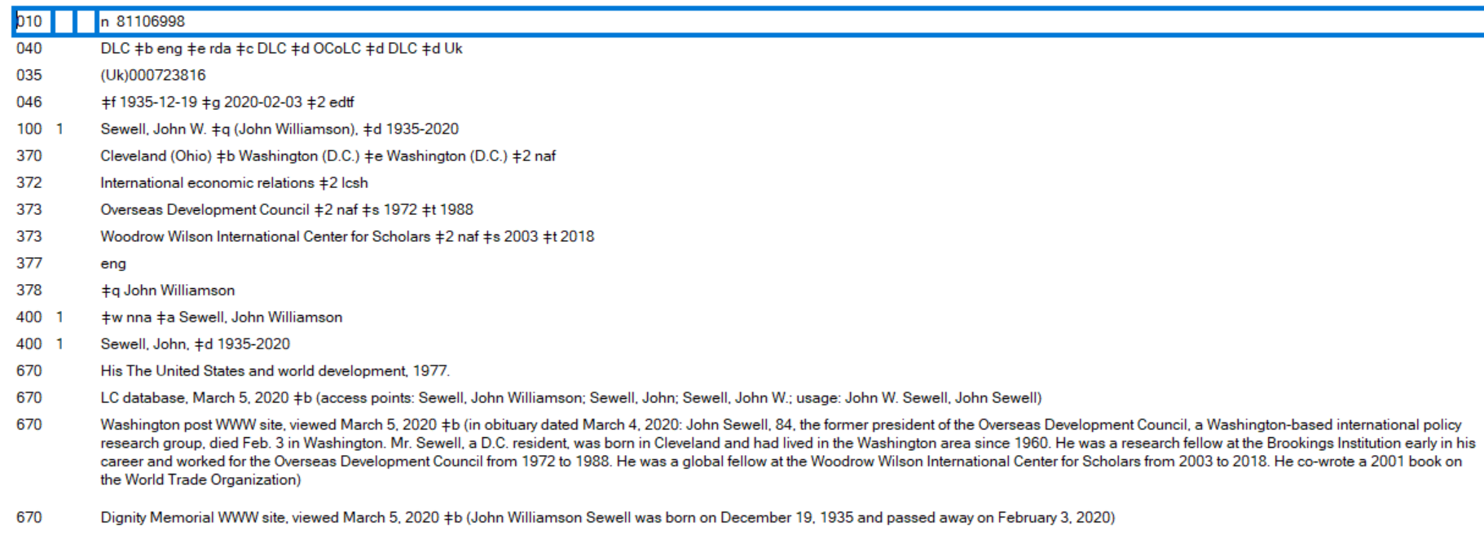
Notes:
This is an RDA version of a name authority heading, which includes the new optional fields. You can see there is a lot more biographical information about this person. So, if you are making an original catalog record for an item authored by John Williamson Sewell, you can tell at a glance whether this is the correct name authority heading to use. If you are cataloging a book about economics, then this would probably be the right name authority heading because this man was involved in economics. If you’re cataloging a book about tennis, for example, then this obviously would not be the name authority record you would use.

Slide 15
046 Special Coded Dates
Example: year of birth, 1978-04-26
Notes:
I’m going to briefly go over some of the new RDA fields. First is the 046, Special Coded Dates. It’s used for birth and death dates, date of founding of a business or the formation of a band. Dates are supplied using the pattern year, month, day.

Slide 16
368 Other Attributes of Person or Corporate Body
Notes:
Next is the 368. It contains other attributes of a person or corporate body. Some examples for a person are a Saint or a Princess. Some examples for a corporate body are a Musical group or Television stations. The Library of Congress subject headings are used for this field and other fields that follow.

Slide 17
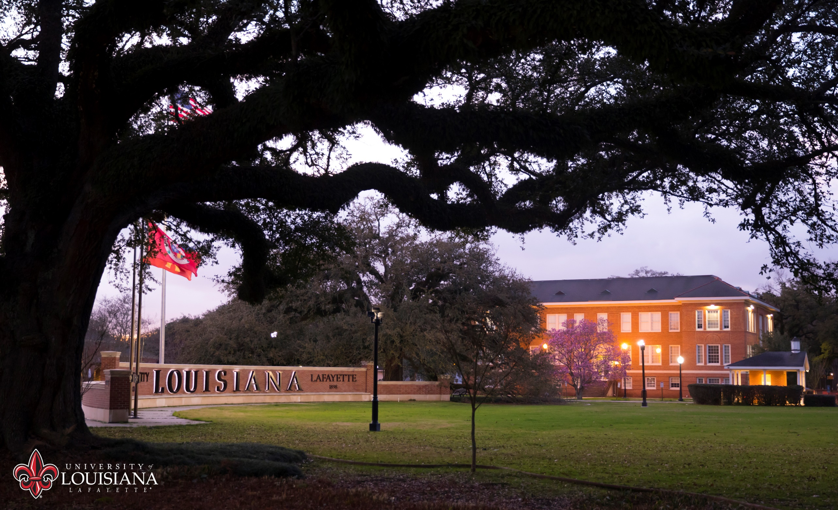
370 Associated Place
Notes:
The 370 contains a person’s place of birth and death, a place of residence or a location of a company.

Slide 18
372 Field of Activity
Notes:
The 372 contains the field of activity. It’s a person’s field of endeavor, area of expertise; or a corporate body’s field of activity. Some examples for a person are Banking or Acrobatics. An example for a corporation is Security, International.

Slide 19
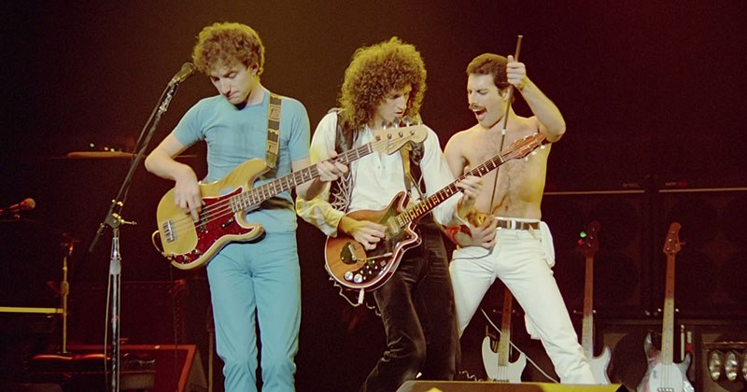
373 Associated Group
Notes:
The 373 contains an associated group. It is information about a group or institution that is associated with the entity in the 1XX field. An example is the record for Freddie Mercury. Freddie Mercury is in the 100 field, and Queen (Musical group) is in the 373 field.

Slide 20
374 Occupation
Notes:
The 374 contains information about a person’s profession or occupation in which a person works or has worked. Some examples are Judges or Elementary school teachers.

Slide 21
375 Gender
Gender is not a Core attribute for persons in RDA.
Examples: Male, Female, Transgender
Notes:
The 375 field is for gender. If you choose to record it, you should provide information on how the person self-identifies. It would be best if you did not assume gender identity based on pictures or names.

Slide 22
377 Associated Language
Notes:
The 377 contains codes for languages. It Includes the language a person uses when writing for publication, broadcasting, etc. or a language a corporate body uses in its communications Examples: eng (English) or spa (Spanish).

Slide 23
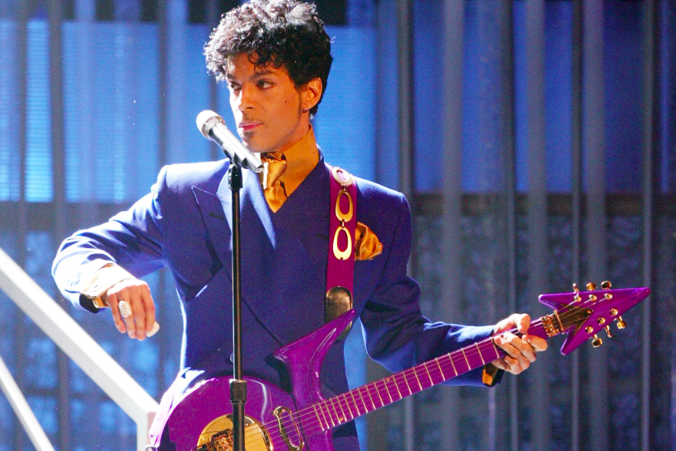
400/410 See from tracing
Notes:
The 400/410 are see from tracings. They are used in an established heading to trace a see from reference. Examples are IBM (for International Business Machines Corporation) and the Artist Formerly Known as Prince (for Prince).

Slide 24
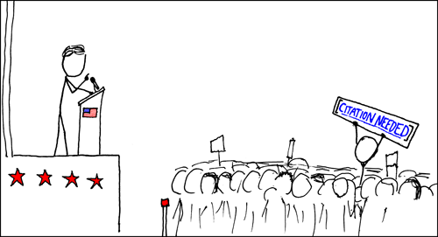
670 Source data
https://xkcd.com/285/
Notes:
Last is the 670 field. The 670 field is like the works cited page in a research paper. Any information in a name authority record should be cited in a 670 field.

Slide 25
670 Source data example
100 King, Stephen, 1947-
670 The official Stephen King web presence, viewed Oct. 26, 2001: The man (Stephen Edwin King; b. Portland, Maine, 1947) http://www.stephenking.com
Notes:
Here is an example of a 670 field in name authority record. Stephen King’s birth year is in the 100 field, therefore, it is cited in a 670.

Slide 26
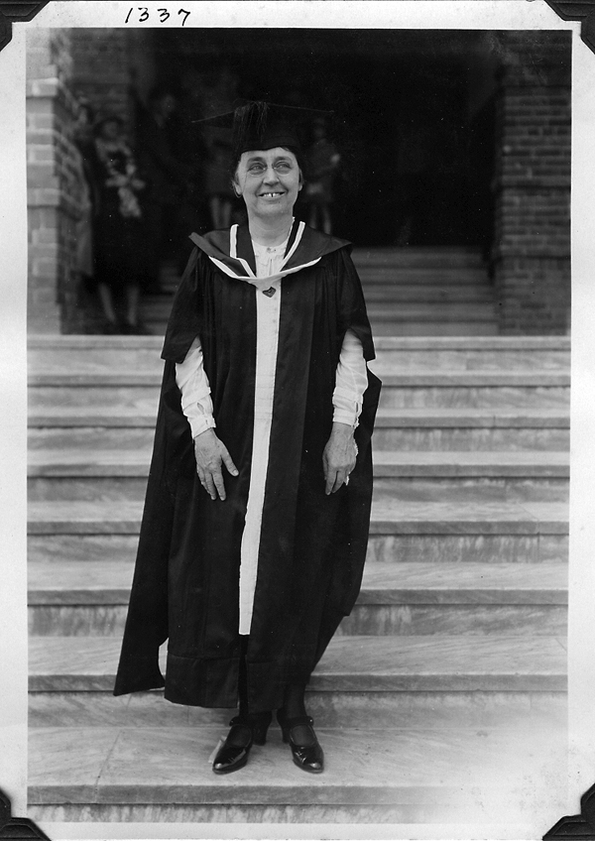
Edith Garland Dupré
Notes:
So, how do we put all of this information together? Here is Dupré library’s namesake, Edith Garland Dupré. She was among the first eight faculty members at the Southwestern Louisiana Industrial Institute, now the University of Louisiana at Lafayette. She was also head of the English Department and oversaw the operation and development of the library. Ms. Dupré is an important figure in the history of the University of Louisiana at Lafayette and the city of Lafayette. However, she did not have a name authority.

Slide 27
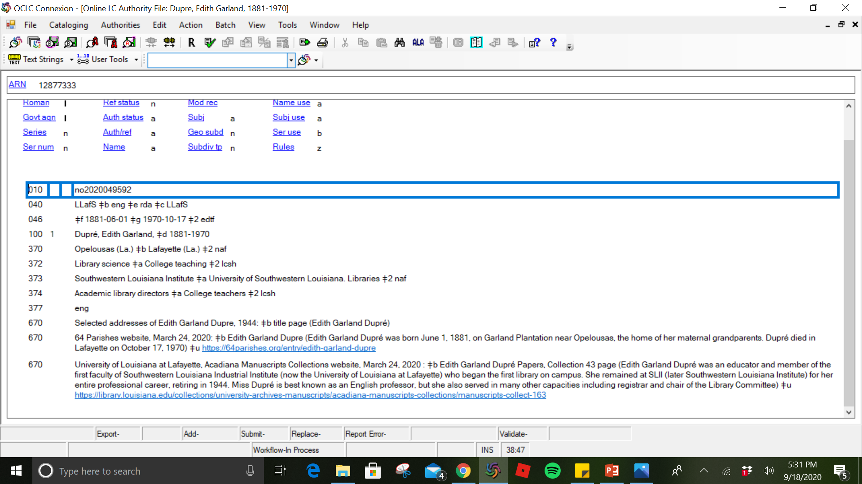
Notes:
Here is the name authority I created for Edith Garland Dupré. You can see our MARC Organization code in the 040 field. The 046 lists her birth and death dates. The 370 lists her birth place as Opelousas, Louisiana, and her place of death as Lafayette, Louisiana. The naf at the end of the field means that these cities are established name authorities. Her field of activity is listed in the 372 as library science and college teaching. Both of these are Library of Congress Subject Headings, as seen with the notation lcsh. The 373 is the associated group. She worked for the university and the university library, so both of those headings are included. The 374 is her occupation, and she was both a library director and a college teacher. The 377, language, is English because this is the language she used when writing for publication. The first 670 cites the book for which I was establishing the name heading, and the following 670s cite the biographical information in the record.

Slide 28
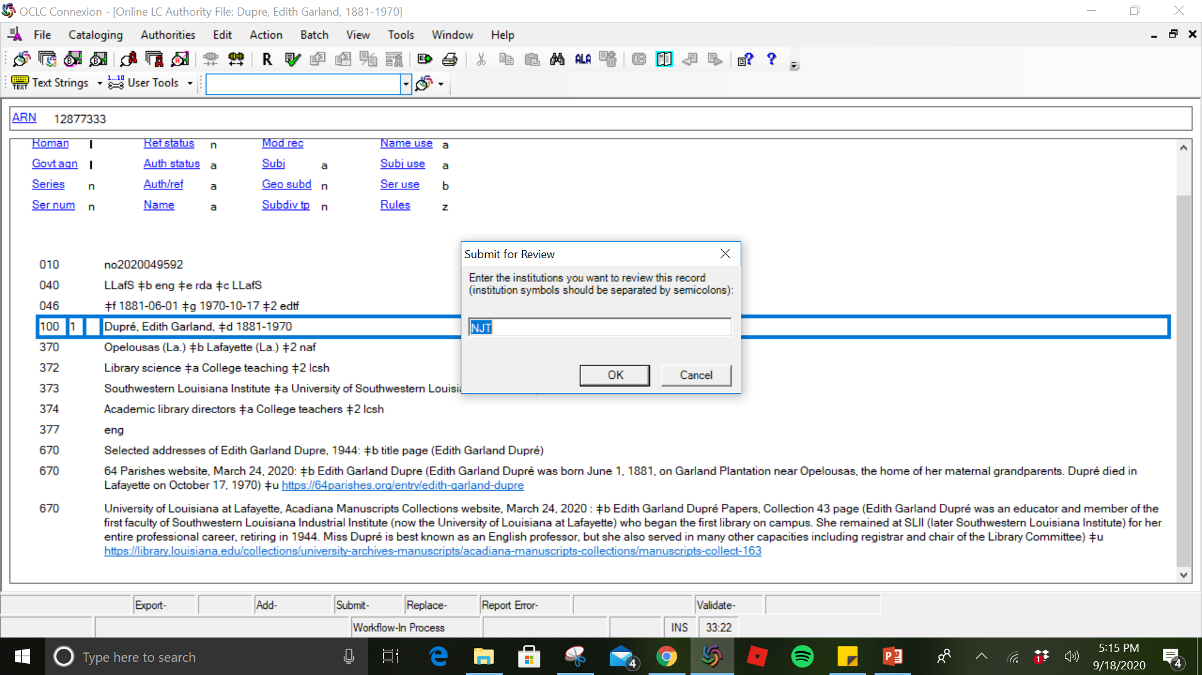
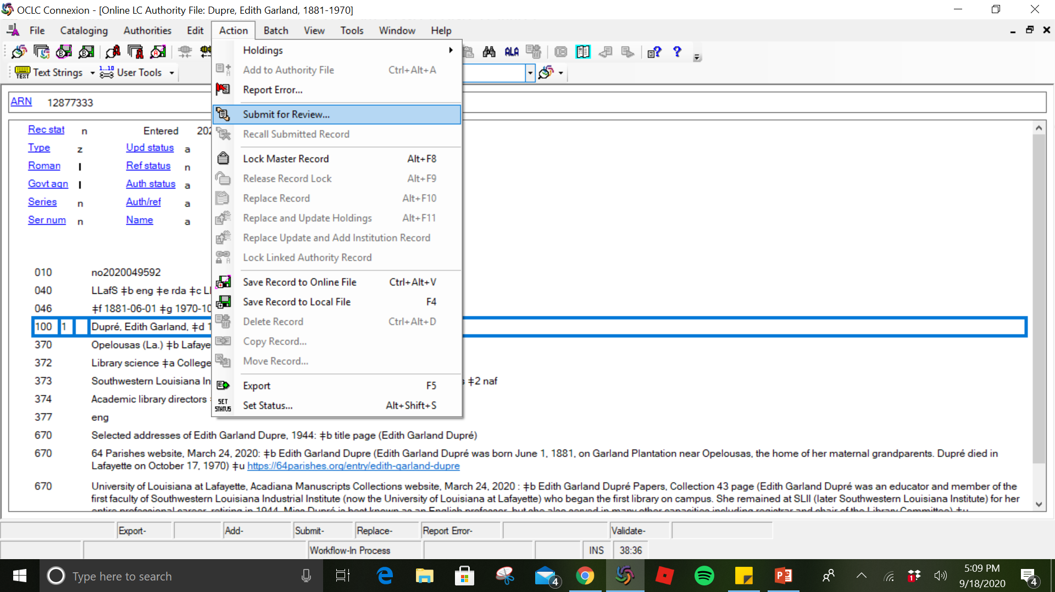
Notes:
After completing a name authority record, it is submitted for review through OCLC. The OCLC symbol for the NACO reviewer is included. Our reviewer is from The College of New Jersey, so his OCLC symbol is NJT. I email the reviewer to notify him that records are ready for review. The reviewer contacts us for any changes and approves headings, then we add them or replace them in the authority file.

Slide 29
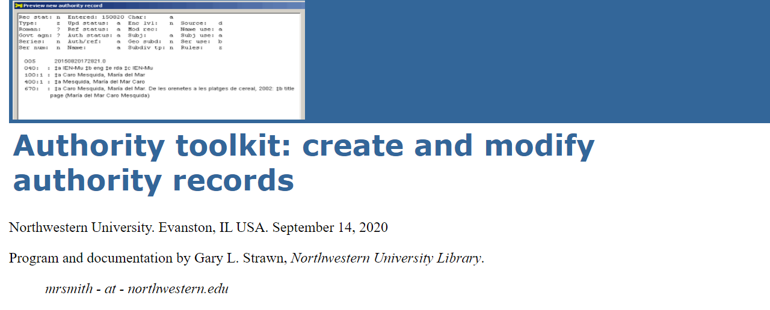
bit.ly/StrawnTool
Notes:
For assistance with name authority creation, I suggest using Gary Strawn’s authority toolkit. The toolkit installs a macro in OCLC Connexion that creates an authority record from an access field in a bibliographic record and then helps you enhance the authority record. More information is available at the link seen here.

Slide 30
How to find unauthorized names to contribute?
Notes:
How can you find name authority headings to contribute? You can look at certain areas of your collection, such as state government publications, self-published materials, materials of local interest, materials published by smaller presses, oral histories, genealogical materials, institutional archives, rare materials, and intuitional works such as theses, dissertations, and professors’ publications. Libraries in NACO decide which areas of their collection will require name authority records. For example, a local author who has only a vanity press publication in your file may not need a national-level authority record. Or maybe that person is the one you need to make sure gets into the name authority file. It’s up to your institution to decide on these policies.

Slide 31
Notes:
One trick I use to find headings is searching for the term “Unauthorized” in Workflows. I do a keyword index search under the author, and narrow the search to Dupré Library’s Louisiana Room. The Louisiana Room contains the library’s collection of materials related to the University and Louisiana. Here is a list of titles that this search returned. I’m going to pick the title ‘Bout It, ‘Bout It, to look at in-depth.

Slide 32
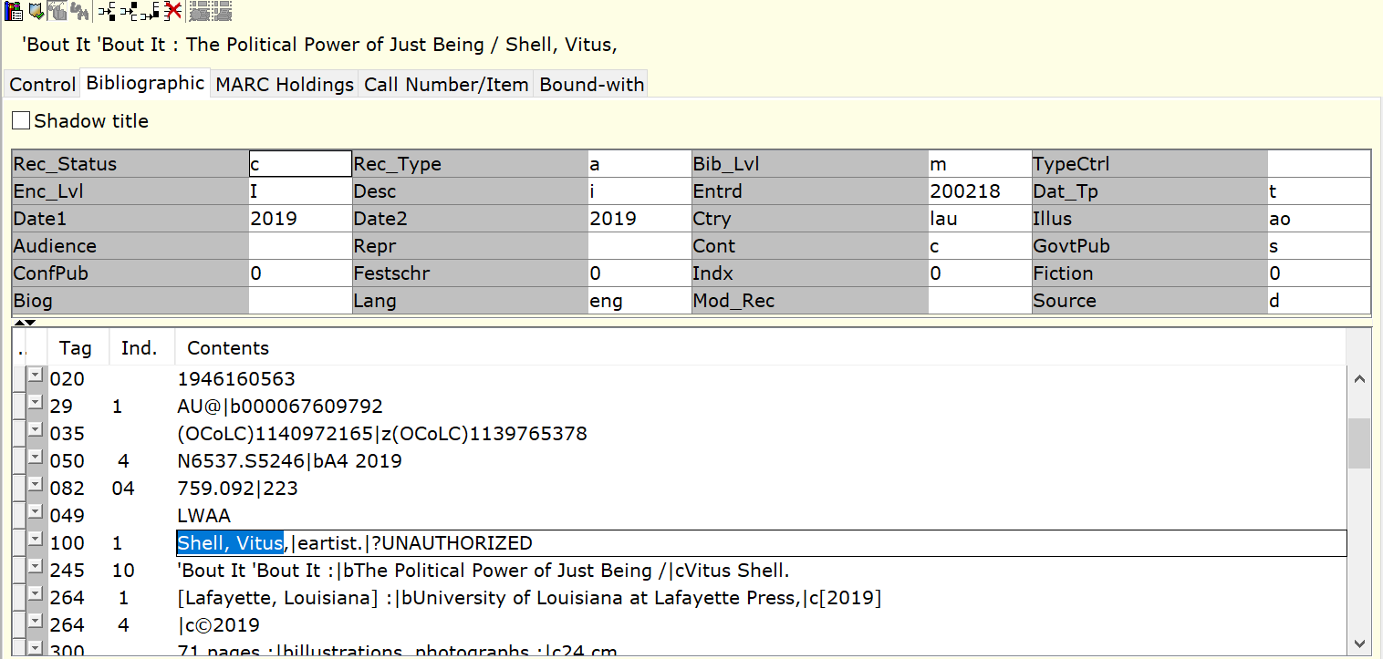
Notes:
In this record, the author, Vitus Shell is unauthorized. There is no authority heading for him in our catalog. Before I go any further, I log into OCLC Connexion and search for his name and variations of his name in the Library of Congress name authority file. His name does not come up, so I’ll create a name authority heading for him. During my research, I find the title Bring that beat back by Vitus R. Shell from the University of Mississippi listed in Worldcat. The name heading in this OCLC record is Shell, Vitus, 1978-. Is this the same person? It would be useful to have an established heading for his name to bring all of his works together.

Slide 33
Linked Data and BIBFRAME
Notes:
How will authority work benefit us on a larger scale? Library data is encased in a data format that is not easily understood or easily deployed by non-library professionals. BIBFRAME is a linked data project that seeks to lower barriers to accessing library data. Library bibliographic data is built upon a solid infrastructure of authoritative names and subjects. It is reliable, consistent, and “clean,” thanks to its use of regulated standards. With BIBFRAME and linked data, the library community has an opportunity to make its controlled and well-crafted bibliographic data available to a global audience. Wider accessibility of a library’s data makes the library’s resources and holdings known and available to “outsiders.” If one of those outsiders, for example, is Google, then exposing library data in this way can translate into more relevant search results for users and more patrons utilizing library collections.

Slide 34
Authority Functionality in SirsiDynix Enterprise
Notes:
According to the SirsiDynix Support website, authority cross-references are not found in Enterprise. When a library user searches Enterprise by an invalid form of an authority heading, they are not directed to the heading's current valid form. The library user gets a message that their search term was not found. This occurs because authority records in the ILS are not harvested by Enterprise to be indexed. Only headings in bibliographic records are harvested. This issue is in SirsiDynix's tracking system to be addressed and is not currently on the enhancement roadmap.

Slide 35
Notes:
Here is an example of how authorities worked in e-library, the previous online public access catalog. As you can see, cross references for authority headings are listed for the user on the right of the screen.

Slide 36
Authority control integration in
the Enterprise discovery
Platform
Notes:
So, what can you do about authority functionality in Enterprise? One option is to do a custom configuration involving custom reports, manual updates, and 30+ custom MARC maps and search fields. Rosemary Groenwald and Joel Hahn came up with this solution and gave a presentation at COSUGI in 2019. If you are interested in learning more, the presentation is available on the SirsiDynix Support website.

Slide 37
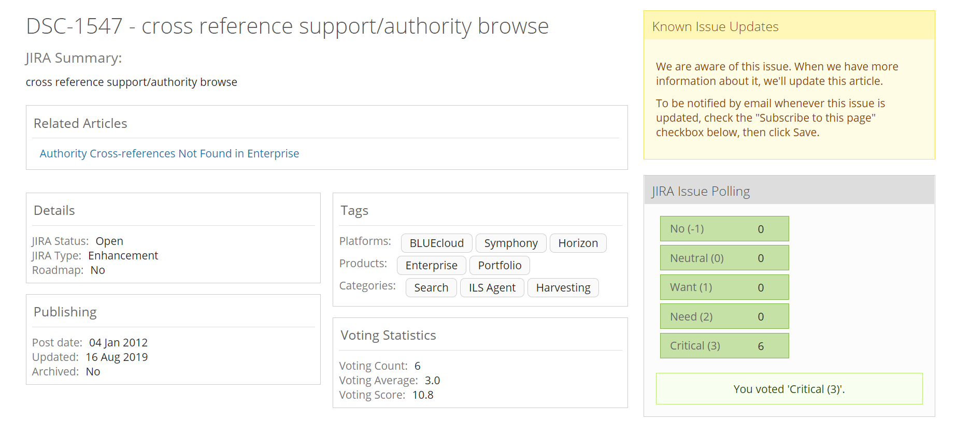
Notes:
Another solution is to participate in enhancement voting. Enhancement voting is open to anyone with a SirsiDynix Support Center account. This is the enhancement request for the cross/reference support/authority browse issue. There is a poll on the right-hand side where you can vote on how urgently this improvement is needed with the categories Not needed, Neutral, Want, Need, or Critical. Customer Forum Moderators review these votes and submit to SirsiDynix their top five enhancement requests for the modules they represent. In 2020, SirsiDynix accepted requests for Horizon, Symphony, Enterprise, BLUEcloud Analytics, BLUEcloud Staff clients, BLUEcloud Mobile, BLUEcloud Central, eResource Central, MobileStaff, and Web Services.

Slide 38
Experiences and Takeaways
Notes:
Finally, here are some of our experiences and takeaways from participating in NACO. Our library applied for NACO certification and received training in 2017; however, our contributions were sporadic. It wasn’t until the coronavirus quarantine that we had time to work on this project in earnest. In my opinion, this is a good work from home project. This project would also be useful for institutions that don’t have a large book budget and don’t have many new materials coming in to catalog. If you decide to become a NACO library, I suggest keeping statistics on the number of records you create and including them with your annual reports. You can retrieve these statistics through OCLC. I also suggest creating a template in Connexion with commonly used fields to streamline workflow. I recommend checking in with staff regularly and having them save records to the Connexion online save file for the site coordinator to check over. Communication and attention to detail are essential with this task as the site coordinator must verify the records before sending them to the NACO reviewer.

Slide 39
Thank You
Notes:
Thank you! Questions?

Slide 40
References
Folkner, C. A., & Glackin, B. C. (2009). Idaho Participation in NACO: The Effect on Idaho Corporate Name Authority Control. Library Resources & Technical Services, 53(3), 197-207. doi:10.5860/lrts.53n3.197
Groenwald, R., & Hahn, J. (2019). Authority control integration in the Enterprise discovery platform [PPT].
Jones, J. L. (2015, April 16). Many Hands Make Light Work: Name Authority Cooperative Program (NACO) Training at University of Kentucky Libraries [PDF]. Lexington: University of Kentucky Libraries.
Library of Congress Cooperative Programs Section & Associates. (2010, April). NACO Training for OCLC Libraries Trainer's Manual [PDF]. Washington, DC: Library of Congress.
Library of Congress Policy, Training, and Cooperative Programs Division. (2012, August). DESCRIPTIVE CATALOGING MANUAL Z1: NAME AND SERIES AUTHORITY RECORDS [PDF]. Washington, DC: Library of Congress.
Library of Congress Policy, Training, and Cooperative Programs Division. (2019). Library of Congress BIBFRAME Manual [PDF]. Washington, DC: Library of Congress.
Library of Congress Program for Cooperative Cataloging Standing Committee on Training. (2020). NACO Participants' Manual [PDF]. Washington, DC: Library of Congress.
Library of Congress Program for Cooperative Cataloging. (2019). PCC Statistics FY19 midyear [XLSX]. Washington, DC: Library of Congress.
Library of Congress Program for Cooperative Cataloging. (2020). Five-day NACO Training Outline. Retrieved October 02, 2020, from https://www.loc.gov/aba/pcc/naco/outline.html
Library of Congress Program for Cooperative Cataloging. (2020). Frequently Asked Questions about Funnel Projects. Retrieved October 02, 2020, from https://www.loc.gov/aba/pcc/naco/funnelfaq.html

Slide 41
Library of Congress Program for Cooperative Cataloging. (2020). Frequently Asked Questions about Joining the NACO Program. Retrieved October 02, 2020, from https://www.loc.gov/aba/pcc/naco/nacoprogfaq.html
Library of Congress Program for Cooperative Cataloging. (2020, August 5). Frequently Asked Questions on creating Personal Name Authority Records (NARs) for NACO. Retrieved October 02, 2020, from https://www.loc.gov/aba/pcc/naco/personnamefaq.html
Library of Congress. (2020, March). NACO Training. Retrieved October 02, 2020, from https://www.loc.gov/catworkshop/courses/naco-RDA/index.html
SirsiDynix. (2012, January 4). DSC-1547 - cross reference support/authority browse. Retrieved October 02, 2020, from https://support.sirsidynix.com/issue/dsc-1547
SirsiDynix. (2014, May 28). Authority Cross-references Not Found in Enterprise. Retrieved October 02, 2020, from https://support.sirsidynix.com/kb/161553
Wells, K. L. (2003). On Good Authority: NACO Participation at the University of Southern Mississippi. The Southeastern Librarian, 51(3).
Wilson, M. (2016, April 22). Edith Garland Dupré. Retrieved October 02, 2020, from https://64parishes.org/entry/edith-garland-dupre

