Slide 1
How did COVID-19 impact use of library resources?
David Comeaux, Systems & Discovery Librarian Megan Lounsberry, E-Resources Librarian Jacob Fontenot, Head of Interlibrary Loan
Thursday, october 8

Slide 2
Overview
In this presentation, we’ll compare statistics from the time when the COVID-19 pandemic forced libraries to close to a similar time frame last year to explore the potential impact of the pandemic on the use of library resources.
This research grew out of my wondering whether fewer or more patrons would be visiting the library web site and using our search systems during the COVID-induced closures. I started looking at the Google Analytics data from lib.lsu.edu in the weeks after our closure.
Then in early April, I was contacted by a colleague, a librarian at Valparaiso University, who told me that she was considering a more formal analysis of this question, and asked if I was interested in participating. I said sure, and that I had been exploring the issue some already.

Slide 3
Context
That led to a research project that also included a librarian from Northeastern Illinois University.
In addition to web and discovery statistics, we decided to include ILL data, which helps indicate demand for library resources, and patron-initiated contact with library staff. That led me to include Jacob and Megan in this project.
I’ll focus mostly on LSU’s results, but will show a comparison of stats from all three universities.

Slide 4
Outline
Research Methods
Website and EBSCO stats
LibAnswers, LibChat
Re-introduction of LibChat
Impact of LibChat
ILL

Slide 5
Methods
To determine the impact of the COVID-19 closure, we compared usage statistics from a COVID-affected timeframe in 2020 to the same time frame in 2019.
These will be called the COVID 2019 and COVID 2020 timeframes.
Because there could be other factors influencing use, we also pulled data from control timeframes to compare earlier in the spring semesters.
These will be called the Control 2019 and Control 2020 timeframes.

Slide 6
Methods
We wanted the same number of days in the two COVID timeframes and the two control timeframes, and account for holidays and breaks (so that both periods were comparable) I ended up with these dates:
2019 Control Period: 2019-01-14 to 2019-03-08 (8 weeks M-F)
2020 Control Period: 2020-01-13 to 2020-03-06 (8 weeks M-F)
2019 COVID Period: 2019-03-18 to 2019-04-27 (6 weeks M-F)
2020 COVID Period: 2020-03-23 to 2020-05-02(6 weeks M-F)

Slide 7
Website Statistics
Web site usage hit its peak in 2012, and has declined since.
The largest drop, from 2015 to 2016, was mostly due to a redesign. Prior to that redesign, the library’s subject guides were all hosted on the library site. Those accounted for a lot of page views.
Aside from that event, the decline has been fairly steady.
Year | Total Site Pageviews | Home Page Pageviews
2011 | 1,994,624 | 621,870
2012 | 2,541,309 | 892,244
2013 | 2,292,290 | 768,613
2014 | 2,182,798 | 629,731
2015 | 1,387,719 | 555,386
2016 | 964,425 | 568,940
2017 | 917,950 | 537,320
2018 | 867,969 | 499,938
2019 | 844,767 | 453,903

Slide 8
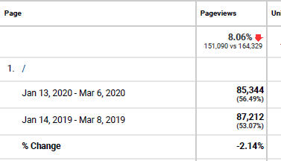
Website Statistics
Control Timeframe

Slide 9
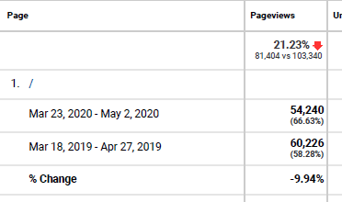
Website Statistics
Covid Timeframe

Slide 10
Discovery Statistics
Google Analytics - 2014 to 2019
Year | Total Pageviews | Detail Page
2014 | 976,764 | 143,165
2015 | 1,215,479 | 340,626
2016 | 1,685,866 | 483,656
2017 | 1,778,656 | 437,872
2018 | 2,340,817 | 430,327
2019 | 2,181,228 | 393,730

Slide 11
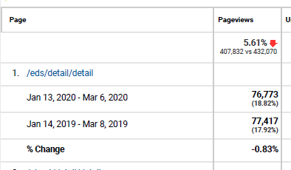
Discovery Statistics
Control Timeframe

Slide 12
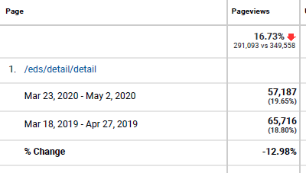
Discovery Statistics
Covid Timeframe

Slide 13
EBSCO Statistics
Since I could only download monthly numbers, for this chart I used January and February for the Control March and April for the COVID timeframe.
While both search and total item requests rose in the 2020 covid period compared to 2019, the rise was considerably less than the rise during the control period; hence use seems to have been down during the covid closure.
COUNTER 5 2017-2020
EBSCO Statistics
 | Control (Jan-Feb) |  | Covid-19 (Mar-Apr)
 | Searches | Requests | Searches | Requests
2017 | 170471 | 60894 | 245809 | 91050
2018 | 175130 | 56945 | 256800 | 83851
2019 | 188191 | 59892 | 216691 | 78617
2020 | 219994 | 81804 | 232852 | 85837
 | 116.90% | 136.59% | 107.46% | 109.18%

Slide 14
LibGuides Statistics
So what were our patrons looking for?
Apparently, LibGuides and especially LibAnswers!
In a moment, I’ll hand the reins over to Megan to explore the LibAnswers statistic in depth.
Control Period
Covid Period
Databases A-Z- views | 27,977 | 26,037 | -7% ▼ | 20,893 | 19,624 | -6% ▼
LibGuides views | 127,191 | 123,783 | -3% ▼ | 12,163 | 18,925 | 56% ▲
Ask a Librarian tickets | 35 | 88 | 151% ▲ | 17 | 108 | 535% ▲

Slide 15
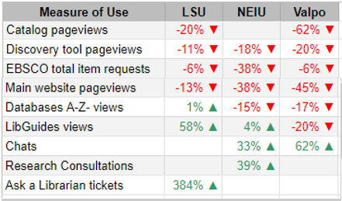
Three Institutions: Net Pandemic Change in Resource Use
Summary comparison of LSU’s stats with two other universities

Slide 16
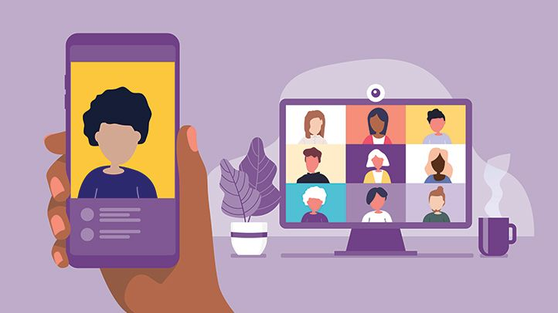
Online Communication
How did the COVID-19 pandemic impact use of LSU Library’s online communication channels?
LibAnswers
LibChat
Notes:
Hi everyone. As mentioned, I’m Megan Lounsberry, Electronic Resources Librarian, at LSU Library. For my portion of this presentation, I will examine how our online communication tools were impacted by the pandemic, specifically our ticketing system called LibAnswers and our virtual chat service called LibChat. Some questions going into this review were: was there an increase in use, and if so, what types of questions did we get?

Slide 17
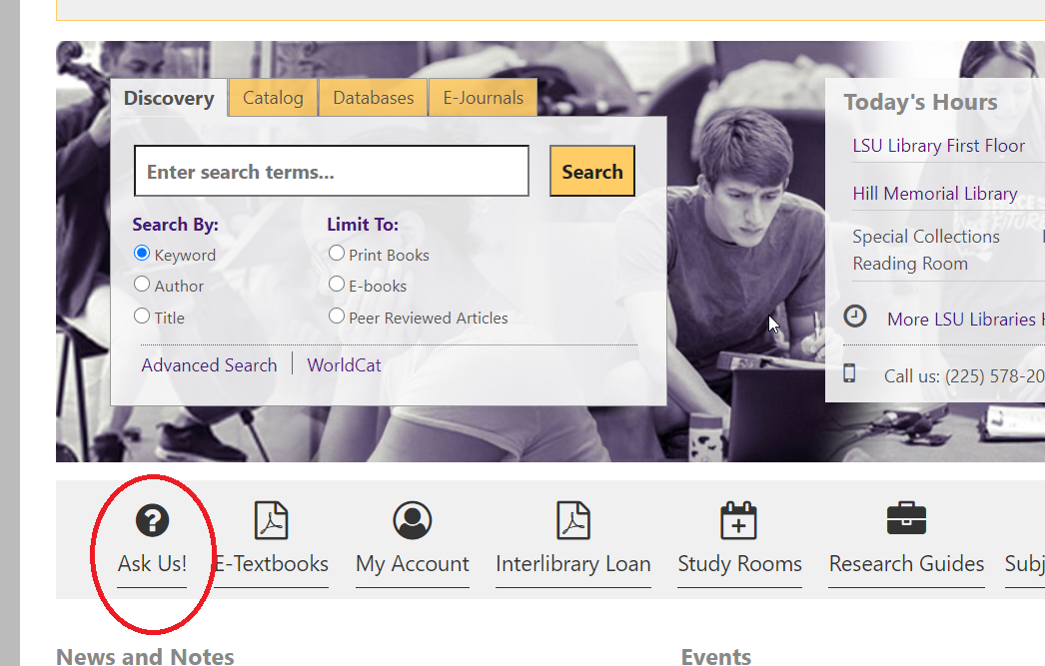
LibAnswers
LSU’s public facing ticketing system, Springshare product
Users can submit questions through the AskUs! link
Appears on homepage and at the top of Discovery results page
Notes:
So first I’m going to begin with LibAnswers, our public facing ticket system. Users can access it on our homepage through the AskUs! icon. It also appears in the menu at the top of each Discovery results page.

Slide 18
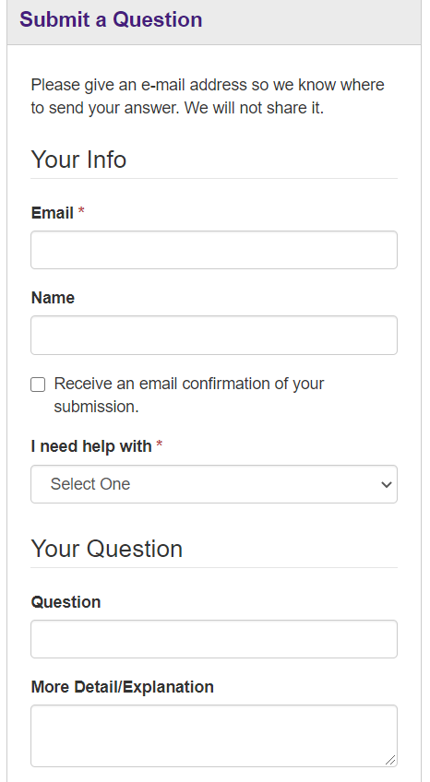
LibAnswers
Several help topics for users to choose from
Research help, ILL, circulation, accessibility needs, and e-resource access issues
E-resource related help topics relatively new
Database or full-text PDF access – added July 2019
Accessing ScienceDirect content – added October 2019
Rationale: To put troubleshooters in direct contact with users in order to resolve issues more quickly and easily
Notes:
Once users click on the icon, they are taken to a page where they can choose to submit a question that will go to the LibAnswers dashboard in Springshare. The form shown in the slide provides lots of help topics for users to choose from, topics like research help, ILL and circ related questions, accessibility needs and e-resource access issues. It’s important to note that the two e-resources related questions, which are called database or full-text PDF access and accessing ScienceDirect content were added in July and October of 2019. Prior to adding the e-resource help topics, access issues were most often reported to RIS who then submitted a ticket on behalf of the user. The rationale for adding the new help topics was to put users in direct contact with troubleshooters, and more specifically, the ScienceDirect topic was created as a way to continue spreading the word about our cancelation of Elsevier journals.

Slide 19
LibAnswers 2019 Snapshot
Period examined: 3/16/19 to 9/18/19
154 total tickets
Database/full-text PDF access: 56
No response: 50
Other: 20
Research: 14
Discovery/Catalog Issues: 5
Interlibrary Loan: 4
Overdue items/fines: 3
Accessing ScienceDirect: 2
Notes:
To get a comparison of how COVID affected LibAnswers in 2020, the timeframe I looked at for 2019 is March 16th to September 18th. In this time period, 154 total tickets were handled by library staff.
Before digging into the numbers, though, a few caveats. Reviewing data related to e-resources took some tweaking because of the no response category. No response means the user did not select a help topic. This field was changed to a required field in July 2019 when the database/full text topic was added. To get a more accurate count of tickets related to e-resource access, I reviewed the “no response” tickets for this time period to identify and relabel e-resource related tickets, so the number currently listed for No Response in the graph is what was leftover once the e-resource related issues were identified and relabeled. That makes database/full-text access the highest number of tickets received for the time period examined.

Slide 20
LibAnswers 2020 Snapshot
Period examined: 3/16/20 to 9/18/20
501 total tickets
Database/full-text PDF access: 224
Other: 96
Research: 53
Accessing ScienceDirect: 43
No response: 31
Discovery/Catalog Issues: 19
Overdue items/fines: 18
Interlibrary Loan: 17
Notes:
So here’s what I found for 2020. In the same time period as the year before, there was a large increase in the number of database/full text tickets. The total jumped from 56 in 2019 to 224 in 2020. Also, as you can see the No Response category has shown up again even though it shouldn’t because help topics are a required field. The reason it showed up for 2020, is because we turned on LibChat after the COVID closure (more on that soon), so chats that were turned into tickets didn’t get marked with the appropriate help topic. Like the 2019 data I went through and pulled out the e-resources related tickets to get an accurate count.

Slide 21
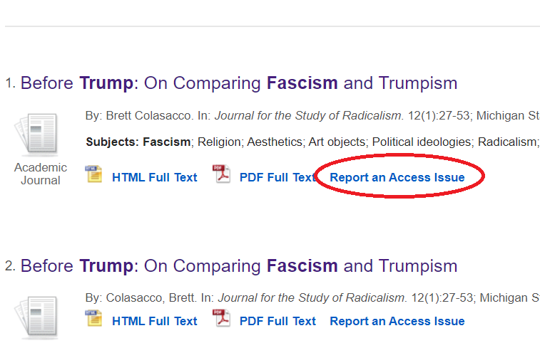
LibAnswers – Database/Full-text PDF Access
225% increase from 2019 to 2020!
Most frequently asked questions received by troubleshooters
Can I get access to this ScienceDirect article? (citation listed)
Do we have access to this article/Can you get me access to this article? (specific citation listed)
We should have to this content, but I’m unable to access it. Can you help?
Notes:
So why such a large increase? One possibility is that in January of this year, I added a “Report an Access Issue” link to the Discovery interface. The link takes users to the AskUs! page where they can report the problem either through the question form or our chat service.
A closer look at this help topic can reveal exactly what users are asking. Disclaimer: this info was not gathered in any sort of scientific way. We don’t yet have all the tags that categorize the different types of questions fully in place, which is a work in progress. I consulted with Jeremy Fontenot, our Electronic Access Specialist and main troubleshooter, to find out what questions he handles most.
ScienceDirect questions are answered with a link to our Elsevier page that describes LSU’s decision to cut titles from its subscription as well as an offer to place an ILL request.
For specific citations, troubleshooters send the article or offer to place an ILL request. These types of questions hint at the user either being unable to navigate our systems or they found it more convenient to ask us to find it for them.
And for the 3rd most FAQ, according to Jeremy, a lot of this question can be attributed to user error. Either they didn’t look at the coverage dates or there’s some other reason they couldn’t access the content. Perhaps they need to register a free account with the vendor.
Overall, while more in depth research is needed, this data seems to suggest that users will engage with the libraries through online channels, particularly when it comes to accessing electronic resources.

Slide 22
LibChat
Background
Accessed using same AskUs! icon as LibAnswers
Chat in use until mid-2019
Staffed by research librarians only
Low usage and other priorities put an end to its use
In response to the pandemic closures, the chat service reopened
Now staffed by research librarians as well as staff from Access Services and Technology Initiatives
Notes:
The other virtual communication tool I examined was a our libchat service, but first some background information before jumping into the data. In 2019, the decision was made to turn off the chat function on our website, low usage being a big reason. Also, at the time, only research librarians were staffing the chat, and many of them were strapped for time due to other responsibilities surrounding instruction.
The chat service was turned back on in June of this year. The service is staffed by research librarians as well as staff from Access Services and Collection Services. Each person is scheduled for 2 hour shifts twice a week. Because there are no stats for parts of 2019 and 2020, to get comparable data for LibChat, I looked at 2018.

Slide 23
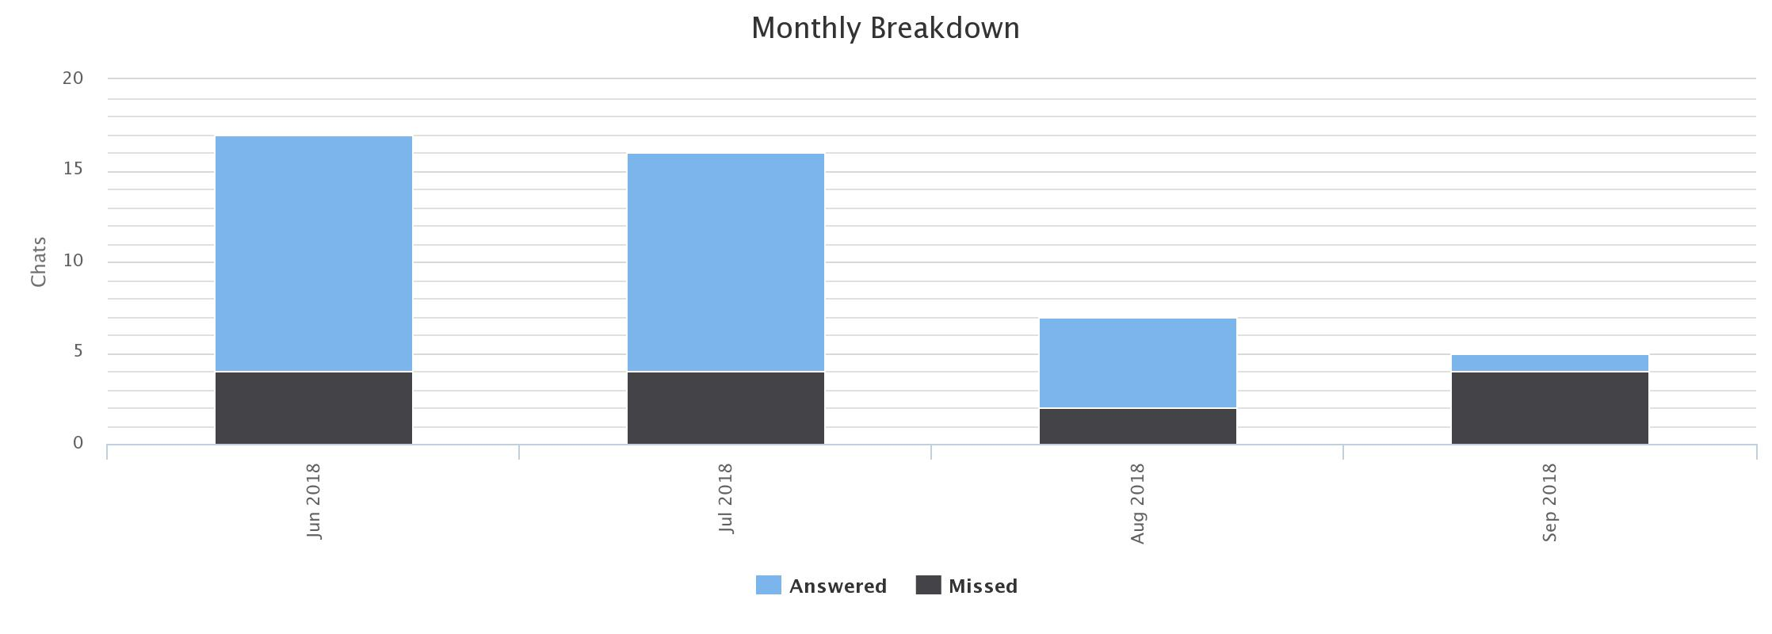
LibChat – 2018 Snapshot
Period examined: 6/1/18-9/18/18
45 total chats in 2018
Highest number of questions answered pertained to general information requests
Gen info – 42%
Research – 39%
E-resource access – 20%
Notes:
The timeframe for LibChat data is June 1st through September 18th for both 2018 and 2020. The library received 45 total chats for 2018. Digging deeper, I wanted to know the types of questions users ask via chat, so I reviewed the chat transcripts and assigned each chat topic to one of three categories: general info, research, and e-resource access. The questions most frequently asked fell into the general info category at 42%, research in second at 39%, and last, e-resource related questions at 20%.

Slide 24
LibChat – 2020 Snapshot
Period examined: 6/1/20-9/18/20
152 total chats since June 2020
Most questions pertain to e-resource access or general info
E-resource access – 35%
Gen info – 33%
Research – 28%
Notes:
So in 2020, chat questions increased to a total of 152. E-resource access questions rose to the top spot for most frequently asked questions. As a reminder, the report an access issue link takes users to the AskUs! page where they can report the issue either through the question form or the chat box, so the uptick seen here is most likely due to that link.

Slide 25
Online Communication Takeaways
An increase in the use of both LibAnswers and LibChat
E-resource access is the primary reason for seeking help through online channels
As online learning increases, e-resource access and the ability to troubleshoot in a timely and effective manner is imperative
Staffing and training guidelines are a must
Further research should be conducted into how virtual correspondence with libraries can be leveraged to serve or facilitate distance/online learning
Notes:
In conclusion, this data suggests that users are taking advantage of online channels to communicate and seek help from the library; however, with variables like the addition of a “report an access issue link,” it’s difficult to determine if the increases are entirely due to the pandemic. One takeaway that seems indisputable, though, is that users are willing to report an access issue in real time. Given the messy and complicated nature of e-resource access, it seems logical to reorient our virtual communication services to a model more focused on helping users get access to e-resources, especially during this ongoing pandemic. And finally, reviewing this data got me wondering about users and how they perceive the library and its e-resource environment. We get lots of “do we have this kind of questions?”, so I wonder, are students interested in learning to use our systems? If so, to what degree? From the user perspective, how much burden should be put on them to learn numerous and complicated information retrieval systems? Will opinions vary according to user status, age, gender, subject area, etc? How can that data then be used to design a virtual help service, which could be embedded into online courses? Or even aimed at specific user groups?
So these are just a few questions that arose for me while looking at the data, and I intend to conduct more research into this going forward.

Slide 26
Some Key ILL Terms
Borrowing
Local patron requests non-local material. ILL requests it from another library.
Document Delivery
Local patron requests local material. ILL scans it or supplies from electronic holdings.
Lending
Other libraries request local material. We supply it from our collection.
Notes:
Borrowing – We don’t have it. (Traditional ILL, our core service)
Document Delivery – We DO have it, we scan it for you.
Lending – We lend it to another library. Focus is demand for our services. Including lending because even though it isn’t *local* demand, the amount of lending gives us some insight into what’s happening at other libraries.

Slide 27
Borrowing and Document Delivery – one patron portal - ILLiad
Borrowing and Document Delivery have a single request portal, the patron’s ILL account.
To report all local patron ILL requests, combine Borrowing and Document Delivery.
Notes:
On some of these charts you’ll see that I’ve combined the numbers for Borrowing and Document Delivery. That’s all of these requests are from local patrons, placed through the same interlibrary loan web portal. If we’re tracking local patron use of our ILL services, combining Borrowing and Doc Del .

Slide 28
LSU ILL Reopening Timeline
March 17th – Closure. Borrowing articles & chapters. Lending digital articles & chapters.
May 4th – Document Delivery resumes.
Lending article and book chapter scans resumes.
June 10th – Borrowing of print resumes! Library is open for patron pickup.
July 5^{th -} Lending print books resumes.
Notes:
We filled lending requests for*electronic* materials, uninterrupted. No change because of Covid. We kept “Copies” in the Policies Directory set to 4 days, but only filled requests for electronic materials. We cancelled requests for materials we held in print because the library was closed. When we partially re-opened the library for staff on May 4th, we were able to resume scanning for local patrons and for other libraries. We changed “Copies” from 4 days to 8 days in the Policies Directory around May 6th, because we were weren’t sure we would be able to scan them quickly enough.

Slide 29
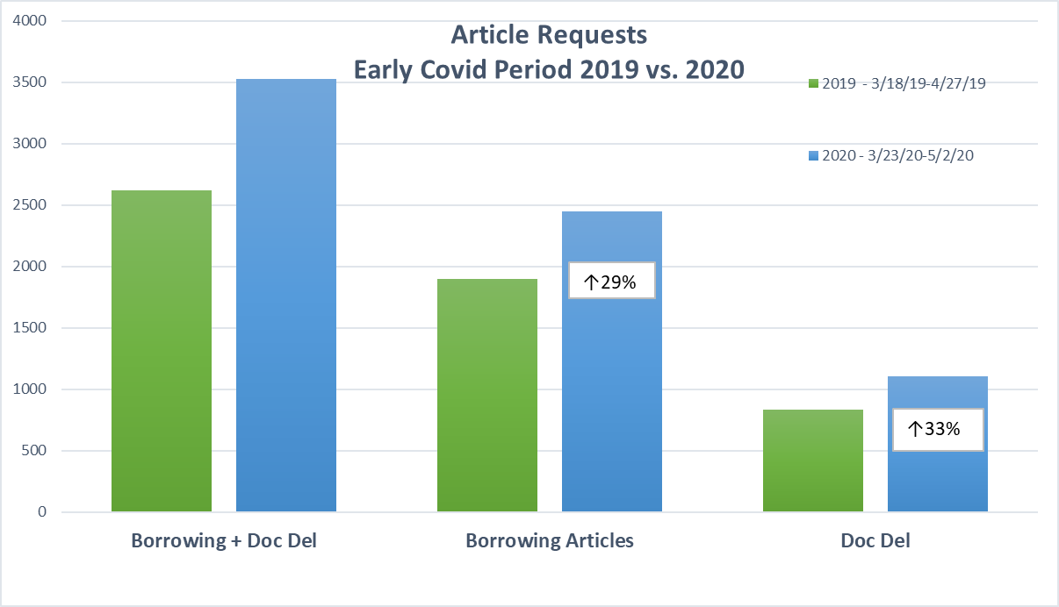
Early Covid: Articles
↑35%
Notes:
Roughly 6 weeks of data from early Covid, while library is fully closed. Digital only.
KEY POINT: Requests ONLY, this doesn’t mean we filled the request.
Why did Borrowing requests increase dramatically during early week of Covid?

Slide 30
Borrowing & Doc Del: Covid versus Control
-
Received vs. Filled = Demand vs. Service Rendered
Notes:
These are requests from local patrons. They may not distinguish between what we have (Document Delivery) and what we don’t have (Borrowing).

Slide 31
LSU and other schools
Notes:
Quick story. On 5/4 we *briefly* turned on our RapidILL service to lend print material. We turned it on for about 24 hours and received 94 requests! We filled 8 and asked RapidILL to turn it off and cancelled the rest. We didn’t have nearly enough time, staff, or equipment to meet that demand. And there was clearly an enormous pent up demand for print.

Slide 32
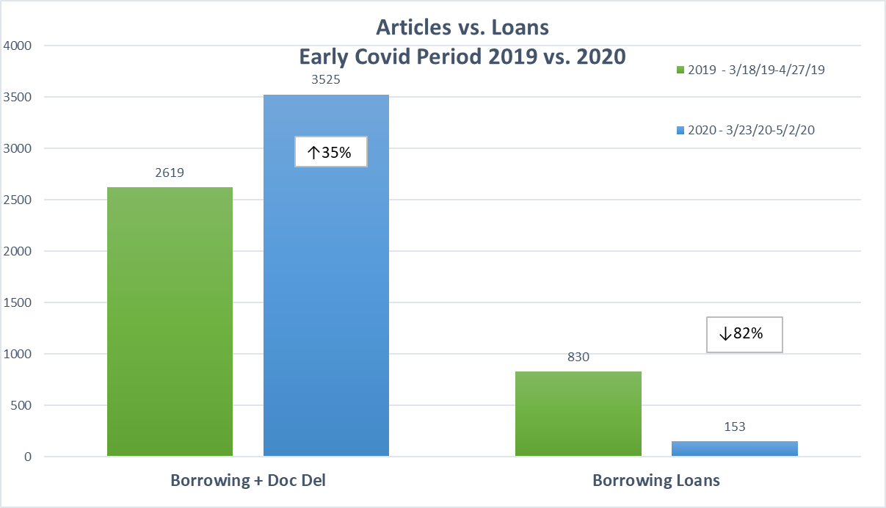
Early Covid: Loans
Notes:
Roughly 6 weeks of data from early Covid, while library is fully closed. Digital only.
KEY POINT: Requests ONLY, this doesn’t mean we filled the request.

Slide 33
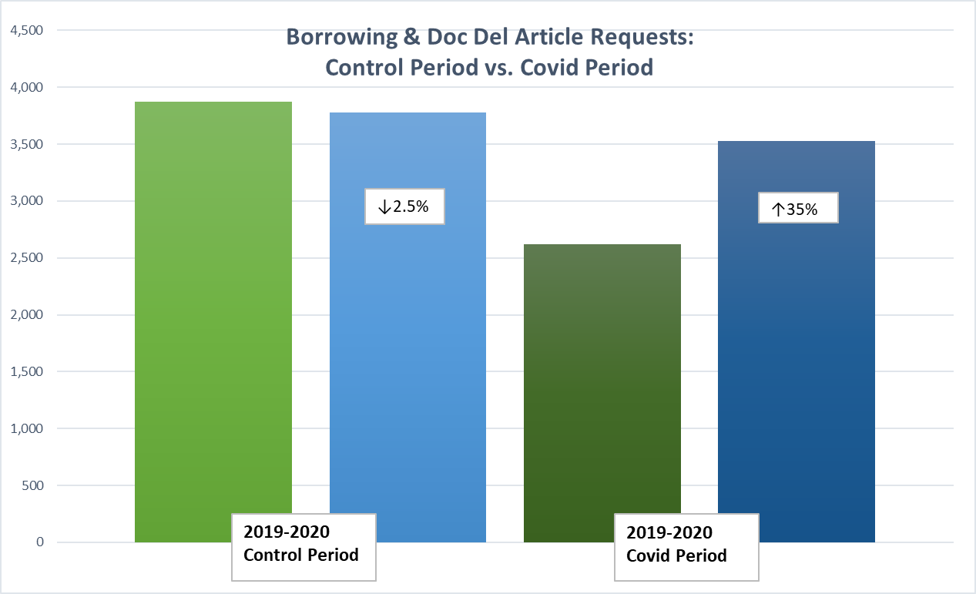
Control Period
Article Requests Received: Borrowing and Lending
- Received vs. Filled = Demand vs. Service Rendered

Slide 34
Pent up Demand: RapidILL
RapidILL
A network of libraries that agree to 24 around turnaround for ILL requests. Faster than OCLC.
Each library is a member of one or more “pods” of RapidILL libraries
Load Balancing – Distributes requests across available lenders
LSU’s experience:
Turned on Lending to RapidILL libraries from our Print collection
All Rapid Member libraries that LSU shared a relationship with were able to request through the RapidILL system. Those who turned Rapid Lending off would not receive requests
Notes:
Quick story. On 5/4 we *briefly* turned on our RapidILL service to lend print material. We turned it on for about 24 hours and received 94 requests! We filled 8 and asked RapidILL to turn it off and cancelled the rest. We didn’t have nearly enough time, staff, or equipment to meet that demand. And there was clearly an enormous pent up demand for print.

Slide 35
Demand for ILL Services: A RapidILL Example
“Interlibrary Loan requests (borrowing/document delivery and lending) rose considerably during the closure. One factor in the borrowing/document delivery increase was that document delivery was opened up to undergraduates during the COVID 2020 timeframe; this service was not available to that patron group during the control timeframes and the COVID 2019 timeframe.”
“Downloads through EBSCO, typically LSU’s busiest platform, increased in both the control timeframe (37%) and COVID timeframe (30%), resulting in a baseline-factored decrease of 6%. ProQuest use was less straightforward to interpret. There was a stunning decrease in use (52%) between the 2019 and 2020 COVID timeframes. However, the 2019 numbers were dramatically impacted by unusually high usage of the New York Times and Wall Street Journal in April. Those two resources accounted for 4,120 downloads out of 5,330 that month, skewing the 2019 COVID timeframe numbers significantly upward. In April 2020, those resources accounted for only 306 downloads. “

Slide 36
Questions?
David Comeaux, davidcomeaux@lsu.edu
Megan Lounsberry, mlouns1@lsu.edu Jacob Fontenot, jacobfontenot@lsu.edu

