Slide 1
LOUIS System Administrator Meeting
January 13, 2022

Slide 2
Agenda
12:30 pm - 12:40 pm. Welcome
Housekeeping, new sys admins, announcements
12:40 - 1:50 pm: LSP Assessment results
Overview
Next actions
Discussion/Breakout groups
1:50 pm - 2:00 pm. Break.
2:00 pm - 2:20 pm Search box options - accessible and responsive (Elizabeth)
2:20 pm - 2:30 pm - Upgrades and updates - (Marcy)
2:30 - 3:00 pm - Sys Admin Advanced training certification course (Mike)
3:00 pm to 3:30 pm - Open discussion
Notes:
Housekeeping. Meeting will be recorded. We’ll make an article in the TASK portal that will have the recording and relevant links and slide decks, and sent out on the listserv. We will take a break shortly before 2 pm - we won’t be serving food.

Slide 3
Quick Updates
COSUGI 2022 to be virtual
Conference proposals due January 14, 2022 (Tomorrow!)
LOUIS might pay for 2 attendees (Sys Admin and backup) from each institution
LOUIS will register as a group; don’t register yourself
Look for announcement

Slide 4
Reminder: Symphony Reports Ask-Me-Anything
Wednesday, January 19 at 1:00 pm
Using Sliding Date Range Gadget in Circulation and Notice Reports
Bring questions
Symphony Reports
Notices
Bibloads
BLUEcloud Analytics
Real world examples

Slide 5
Survey Comments
“The top areas of concern for SirsiDynix Symphony, when looking at survey ratings and number of comments, were in the areas of:
Course Reserves and Bookings
Reporting
Integration with Institutional Business Systems
Discovery
Electronic Resource Management

Slide 6
Survey Comments: Course Reserves and Bookings
Reserves are hard to configure in Workflows
... I find it very hard to configure.
I use reserves to bypass circ rules.
Reserves module not good for electronic reserves.
The reserves module is currently outdated. With electronic reserves being common place, the systems currently in place focus on print reserves and their public displays do not display all the fields needed for items with URLs.
More and more, reserves include e-books, but the WF reserve module is not good at accommodating e-books. For example, links don’t show properly (known bug). SD should put more effort into making the reserves module as useful as possible for both staff and students.

Slide 7
Survey Comments: Course Reserves and Bookings
Enterprise display of reserves is not good for end-user
My problem isn’t so much with the WF side but with Enterprise. The user-end of the reserves system is rather ugly and unless one knows how to code with HTML or CSS, it will not get any prettier.
Also I think the interface for Reserves is particularly clunky.
It can be tricky to search for books on reserve by course or instructor in the OPAC. Usually that’s what the person knows, rather than the name of the book.
Booking is hard to configure
We currently don’t use these platforms for booking rooms – we use a SpringShare product. The Rooms booking on SIRSI was hard to figure out and very clunky.
The Booking module in WF is clunky and not really useful for booking rooms (or other items). It is only really useful for recording items-in-transit.

Slide 8
Survey Comments: Reporting
Reports are not intuitive or easy to learn.
I would like to have a reporting/analytics product that would be easy to learn, able to combine many different categories of data and make presentable charts and tables without having to export anything to Excel.
Reports are one of SIRSI Dynix’s major drawbacks. They are not intuitive to create, they often take too long to run, and the output is not often what was wanted. This is an area that is more important than it has been historically to gauge/prove usage. Creating new SIRSI Dynix reports without a detailed step by step guide are frustrating and often feel like an exercise in futility. I took a Blue Cloud training, but I don’t feel like that improved the situation much.
I still mostly work with Reports in WorkFlows rather than BCA. It’s pretty clunky and not intuitive.
BCA offers these features but I need a more user-friendly interface that does not take a massive amount of time to learn.

Slide 9
Survey Comments: Reporting
Reports are not flexible or customizable
I would like to see more flexibility to build my own reports. Even in BlueCloud, it looks as if you are stuck with the same options.
The drawback of WorkFlows reports is the output. Delimited output is not always exactly as needed.
Reports need to be easier to customize and edit without having to create the whole report again just to change the date. Reporting should be interactive, so that datasets can be adjusted without rebuilding the report.

Slide 10
Survey Comments: Integration with Institutional Business Systems
Integration with campus systems, bills and user records
It would be helpful to have a method of transferring bills to our campus business office without having to “zero-out” patron accounts in WF; and to see when those bills have been paid.
I have looked at the documentation on Sirsi-Dynix website for how to integrate WF with Banner or any other accounting system and there…simply isn’t any. Which is disturbing because I know we run a fines report to the Bursar’s office but I don’t know how it works, and apparently nobody else does either.
Integration with campus financial system
We must keep track of our expenditures in Banner, but that doesn’t transfer back and forth with WF which has its own tracking. It would be helpful if the two systems communicated at least for the sake of verification.
As far as I know there is no integration with campus funds; it all has to be put in manually

Slide 11
Survey Comments: Discovery
Enterprise customization
Customization is labor intensive. Other features are barely adequate. We are always finding bugs. Sorry to not be specific enough, but this application needs to be replaced.
I would like to see more Enterprise customization done without relying on widgets, javascript, and css. When will SD ever fix the issue with EDS filters being lost?
We use the tabbed display for our Enterprise/EDS instance. It is a truly hideous way of organizing information. We have looked into getting the Bento Box display but haven’t had enough time to commit to it. When we had EDS only the elements for the catalog locations would not display correctly. 90% of the time I wish we could go back to EDS-only and abandon Enterprise completely.

Slide 12
Survey Comments: Discovery
Enterprise is missing advanced search features (browse search, Boolean)
Standard “Advanced Search” for library catalog needs to include ability to search more than one field simultaneously (for example, both author and title). Browse Search also should be a standard component. Ability to qualify keyword searches in catalog by MARC field tags works sensibly in WorkFlows but should also be available in “standard” OPAC.
Enterprise doesn’t allow for Boolean Operators, doesn’t use controlled vocabulary accurately, and doesn’t filter by date accurately.

Slide 13
SirsiDynix Response
Course Reserves
LOUIS libraries have a concern about Enterprise lacking functionality to displays URLs that may be added to Course Reserves records properly. SirsiDynix hopes to provide updates to support these URLs in Enterprise 5.2.1 in the first half of 2022. The tracking number for this update is DSC-7922.
SirsiDynix recommends that LOUIS libraries review one of our newer products, BLUEcloud Course Lists, to handle portions of electronic reserves needs. BC Course Lists also allows direct integration with Course Management systems such as Canvas or Moodle, which several libraries mentioned as a concern. LOUIS has access to BC Course Lists as part of your subscription to CloudSource OA.

Slide 14
SirsiDynix Response
Some libraries mentioned wanting improved (or new) ways to manage bookings and calendars. SirsiDynix does have a new product called Community Engagement Platform (CEP) that LOUIS may wish to consider. We can set up a presentation as desired. CEP also handles sophisticated, yet easy to manage, marketing automation that some member libraries may wish to consider to enhance communication with students, faculty, alumni, and other end users..

Slide 15
SirsiDynix Response
Discovery
Numerous updates to search result relevancy in Enterprise version 5.1.
Search relevancy for exact titles improved: single word searches will yield single word titles at top of the list
Improved parent child searching (e.g., library + item type, material type, etc.)
Thesaurus and stop word support
Additional search relevancy and result ordering in first half of 2022
Consideration of publication date in display order
As per LOUIS contract, SD Consulting will delivery new options to support brows and Boolean searching in early 2022.

Slide 16
SirsiDynix Response
Reporting
LOUIS may wish to consider Data Control as a basic reporting tool for more sites. Templates can be established to ease use of Data Control for basic reporting. There are also many additional control structures available in Symphony 3.7.1.

Slide 17
SirsiDynix Response
Several libraries would like additional automation for student/faculty patron loads as well as for bill transfers. This is another area in which the LOUIS consulting hours could be put to good use.
LOUIS/SirsiDynix consulting could review the different file transfer needs and develop a plan for automating them or improving existing automation. In some cases, there may be opportunity to use Symphony Web Services, for example to automate a workflow between a student being added via Consideration: this is an area where LOUIS team, Library Team, and Libraries’ IT teams often need to collaborate.

Slide 18
SirsiDynix Response
SirsiDynix could provide customized training to the LOUIS team or to LOUIS member library staff who create reports. This training could focus on creation of reports and dossiers that are designed to meet LOUIS library needs out of the box, with a goal of reducing the need for LOUIS member library staff to have to use basic Analytics tools extensively.
SirsiDynix could create base reports and dossiers more directly for the LOUIS team and libraries.
SirsiDynix and LOUIS could review existing reports to simplify them or to provide basis choices such as type of material or patron that report consumers could make.
We could also collaborate on means to load non-Symphony data into BC Analytics if LOUIS member libraries would like to have a more holistic reporting platform. Examples might include electronic database Counter statistics, other information from campus departments, etc.

Slide 19
SirsiDynix Response
“FRBR-ish”
There were concerns about presentation of “grouped” materials (for example, different editions of the same title, or potentially different formats of the same title) being referred to as “FRBR-ish”. This naming convention reflects that SirsiDynix is not currently making major changes to bibliographic structures.
Our Dataload team can provide a service that will process LOUIS titles to create index keys that denote “matching” titles. LOUIS and individual libraries would work with out team to refine the criteria for matching.
• Our consulting team can implement grouped displays in Enterprise that will take advantage of the index key, but that can also create “super” matching if metadata other than that of the LOUIS member’s library ILS has been loaded into Enterprise.
Notes:
One comment about FRBR - “FRBRish Result Grouping is available for Enterprise 5.0.1. The best they can do is “ish?”

Slide 20
SirsiDynix Response
A new discovery platform beyond Enterprise
Multi-tenant architecture
We will capitalize on our work on CloudSource OA (native support for Boolean, improved search relevancy, etc.)
We will explore additional metadata options
We may be able to provide additional options for centralizing and improving common metadata sets
Customization will continue to be supported
SirsiDynix will also look for means to reduce need for common types of customization by providing more out of the box config options

Slide 21
SirsiDynix Response
Electronic Resource Management (ERM) Tools
How many LOUIS sites currently use an ERM?
Are sites using SirsiDynix BLUEcloud ERM (Coral-based) or Standalone Coral with EBSCO Holdings IQ integration?
Are sites using the SirsiDynix ERM/EBSCO/Acquisition’s integrations provided by SirsiDynix Consulting?
Are sites taking advantage of COUNTER stats via an ERM or directly from vendors? Could these be loaded into BC Analytics for ease of access?
Would sites be interested in SirsiDynix reviewing Folio ERM for potential support?

Slide 22
LSP Assessment Recommendations
1. LOUIS will provide training as well as templates for creating and customizing search boxes.

Slide 23
LSP Assessment Recommendations
1. LOUIS will provide training as well as templates for creating and customizing search boxes.
2. LOUIS will develop ongoing training focused on reporting using the new Data Control application and BC Analytics. Some features identified as areas of concern are not widely used by LOUIS members, and satisfaction could be improved via training.

Slide 24
LSP Assessment Recommendations
1. LOUIS will provide training as well as templates for creating and customizing search boxes.
2. LOUIS will develop ongoing training focused on reporting using the new Data Control application and BC Analytics. Some features identified as areas of concern are not widely used by LOUIS members, and satisfaction could be improved via training.
3. LOUIS can provide training for batch editing bibliographic data through Symphony reports, Item Group editor, Data Control, BLUEcloud Cataloging, and MarcEdit. Some of this training can be provided through the Advanced System Administrator certification program.

Slide 25
LSP Assessment Recommendations
4. LOUIS will implement the improved search and browse functionality within SirsiDynix Enterprise by early 2022 and continue to assess its effectiveness.

Slide 26
LSP Assessment Recommendations
4. LOUIS will implement the improved search and browse functionality within SirsiDynix Enterprise by early 2022 and continue to assess its effectiveness.
5. LOUIS will help sites assess their business processes with regards to billing and user record management and install integrations to transfer and sync user and bill records with institutional business systems where possible.

Slide 27
LSP Assessment Recommendations
4. LOUIS will implement the improved search and browse functionality within SirsiDynix Enterprise by early 2022 and continue to assess its effectiveness.
5. LOUIS will help sites assess their business processes with regards to billing and user record management and install integrations to transfer and sync user and bill records with institutional business systems where possible.
6. LOUIS will pilot BLUEcloud Course Lists and assess its ability to provide course reserve functionality and provide integration with campus learning management systems.

Slide 28
LSP Assessment Recommendations
7. LOUIS will arrange EBSCO training to address concerns with customization and Full Text Finder.

Slide 29
LSP Assessment Recommendations
7. LOUIS will arrange EBSCO training to address concerns with customization and Full Text Finder.
8. LOUIS will explore the ability to add additional Symphony patron functions to EDS beyond the current integration that allows users to place holds, pay fines, and reset their pin.

Slide 30
Small group discussion
Discussion questions:
What do you think of the recommendations?
Are any of the proposed actions more important than the others? Are you excited about any of them?
Are there any responses that have been left out? Is there something that LOUIS could do that was not listed?
Are there additional things we could ask from SirsiDynix?
Or EBSCO?
Google jamboard: https://jamboard.google.com/d/1tyrYu8mrlm6p1vfrjYY26J6EnolRX6icXM0BYyO8yjc/viewer?f=0
Notes:
Break out into small groups. We’ll share this jamboard. Then report back and discuss.

Slide 31
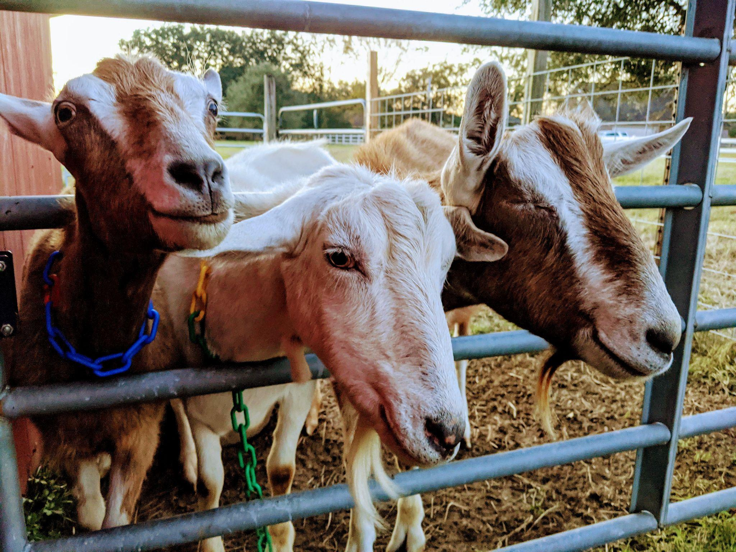
Break!

Slide 32
System Administrator Certification - Advanced
36 Certified System Administrators - Level 1 - Basic
Level 1 Basic is open to all users of Symphony
10 Level 2 - Intermediate
Level 2 Intermediate is open to all System Administrators and Backup System Administrators
Advanced - ready by end of January 2022
Level 3 Advanced will be open to all System Administrators and Backup System Administrators

Slide 33
System Administrator Certification - Advanced
Similar to Basic and Intermediate
Mentor classes
Quizzes
Some modules personalized for LOUIS
Self evaluation
Rate yourself 1-100 on each competency
Example: I can schedule a BLUEcloud Analytics report to run monthly and email me or other staff the results.
Follow up with personalized training
Capstone project
After completing quizzes and final self-evaluation

Slide 34
System Administrator Certification - Advanced
Modules
Circulation
Cataloging
SmartPort
Bibload report
Optional: Authorities
Administration
Public and staff user management
Processing long overdue materials
Optional: Z39.50
Symphony Reports
BLUEcloud Analytics
MarcEdit

Slide 35
System Administrator Certification - Advanced
Capstone project
Demonstrates proficiency with the library services platform (Symphony, Enterprise, BLUEcloud, etc.)
Provides value to the LOUIS community

Slide 36
System Administrator Certification - Advanced
Example Formats
Presentations
Learning With LOUIS
Reports Ask-Me-Anything
LUC presentation
Provide training
Article
Knowledge base article
Best practice guide
Discussion
Lead listserv discussion
Topics
Project recap
Catalog cleanup
Reclassing a collection
Best practice or how to guide
Annual reports
Inventory
Staff training materials
Notes:
Or even a whole open access textbook published on the LOUIS Pressbooks platform <grin>

Slide 37
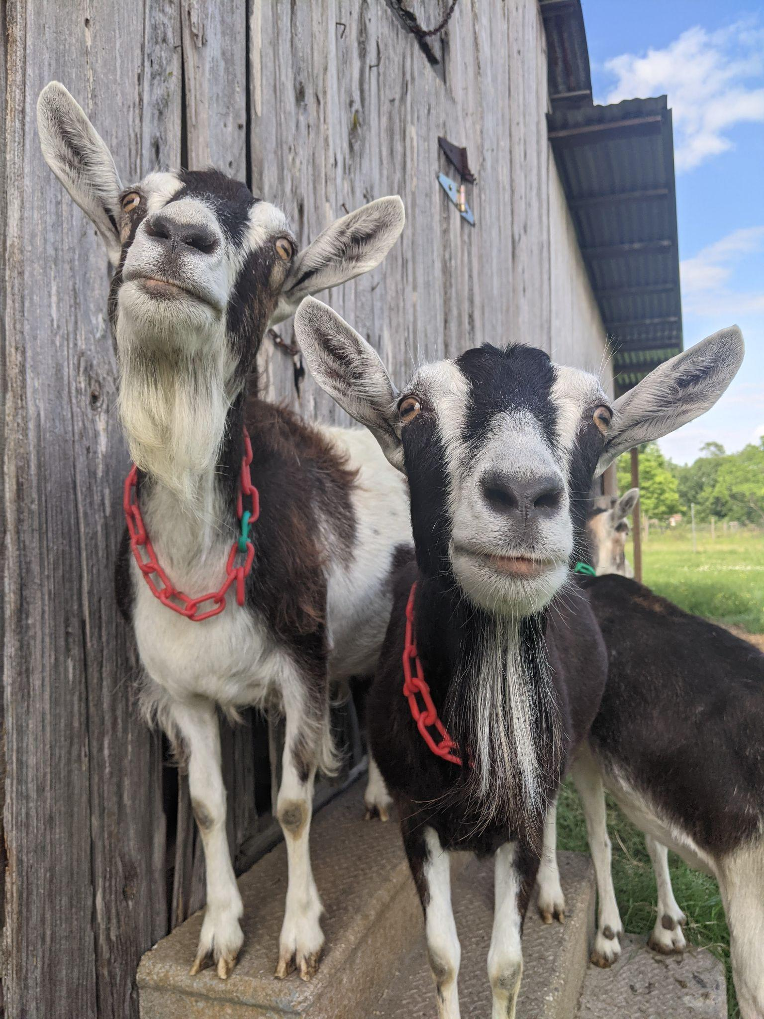
Notes:
Impatiens and Aster, looking goofy.

