Slide 1
LSP Platform
Final Year of 3-Year (Oct 21-Sept 22)
2017 Assessment-Favorable Review
2021 Assessment-Favorable Review
Notes:
Laurie

Slide 2
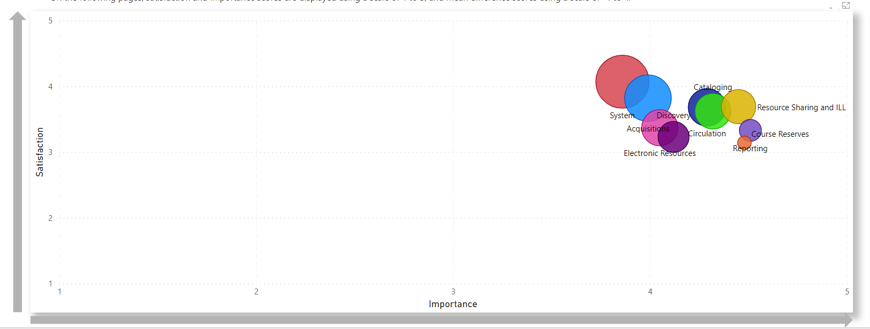
Member Satisfaction versus Importance
Notes:
Laurie

Slide 3
Process
Usage Statistics
Support & Training
Needs Assessment and Satisfaction Survey
Decision Point (Renew: 1 yr -3 yr ; RFP)
Notes:
Laurie

Slide 4
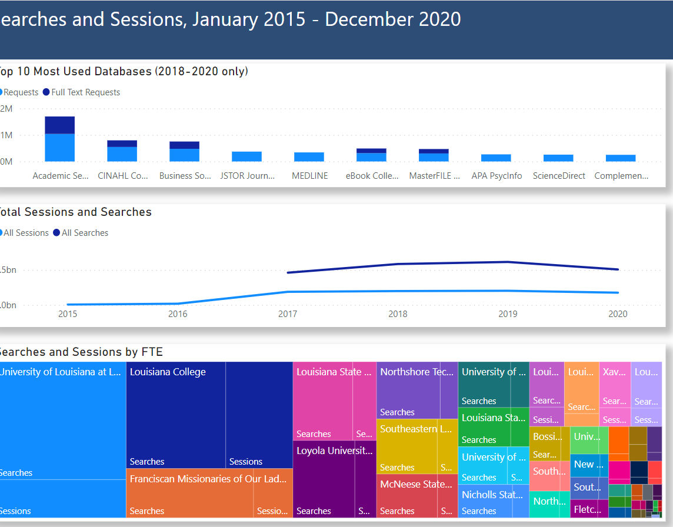
Usage Statistics System Statistics Interactive Data Dashboard
EBSCO Discovery Service, or EDS
Enterprise Discovery, a SirsiDynix product
ILLiad Transactions
ILS Transactions (Use of Modules)
Notes:
Elizabeth

Slide 5
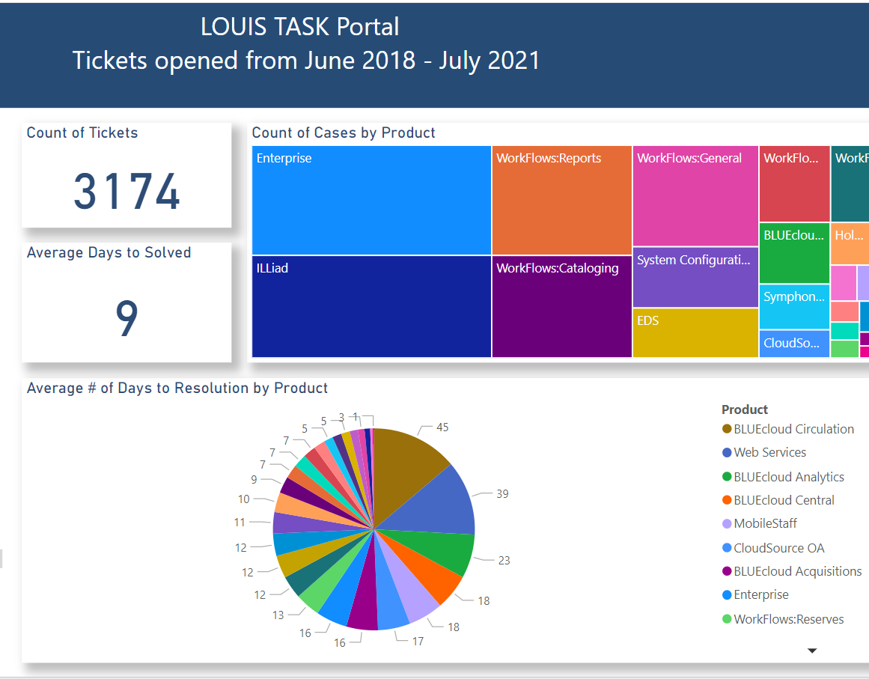
Support & Training Support Tickets Interactive Data Dashboard Mentor Training Interactive Data Dashboard
LOUIS Support via TASK Portal (and FootPrints)
SirsiDynix Tickets
EBSCO Support Tickets
ILLiad Tickets
Mentor Training Usage
Notes:
Laurie

Slide 6
Needs Assessment and Satisfaction Survey
Member Survey (150+ responses)
LOUIS Staff Survey
Notes:
Laurie

Slide 7
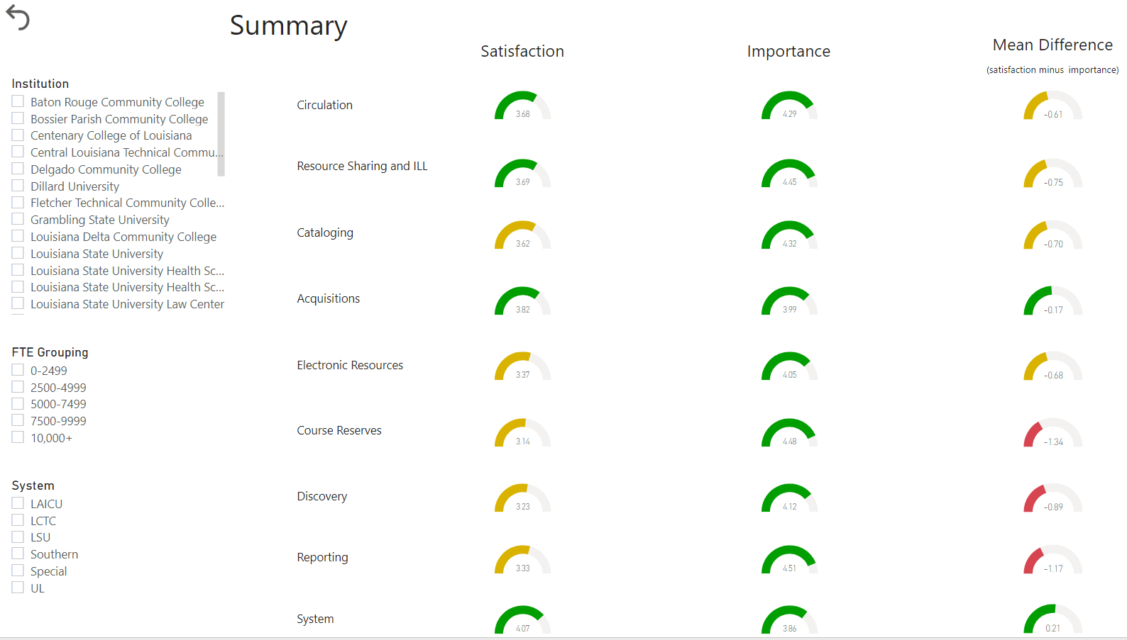
Member Survey
All LSP elements important and are also satisfied with their functionality.
Some issues with Course Reserves, Discovery, and Reporting.
Discovery improved with Enterprise, but some issues persist
Notes:
Elizabeth

Slide 8
LOUIS Staff Survey
LOUIS staff believe LOUIS member libraries are largely satisfied regarding SirsiDynix software.
Some newer components of the software have been well received, SymphonyWeb and CloudSource OA in particular.
Some staff concerns surfaced related to SirsiDynix enhancement schedules or priorities.
Regarding EBSCO EDS, there are some pain points related to the Faculty Portal and the complexity involved in full text linking services.
Notes:
Mike

